Slide 1


Solar Energetic Particles
Pertti Mäkelä
The Catholic University of America
NASA Goddard Space Flight Center

Slide 2
Solar Energetic Particles (SEPs)
Kinetic energy of SEPs range from few tens of keV/nucleon to over GeV/nucleon, so the fastest SEPs arrive at Earth in ~ 10-30 mins
Mostly protons and α-particles (~1 % heavy ions Z>2)
Particles are fully or partially ionized
Acceleration region(s) near the Sun
Durations of SEP events extend from hours to days
adapted from Mewaldt et al. 2001

Slide 3
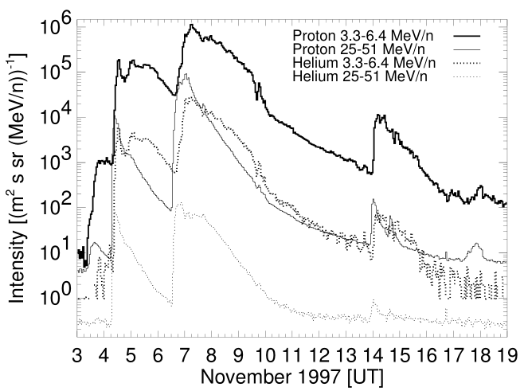
Solar Energetic Particles (SEPs)
Large event-to-event variability in intensity, elemental/isotopic composition, charge states, energy spectra…
SEP event characteristics are also energy dependent.
Differences reflect variability in source particle population, in particle acceleration mechanisms and interplanetary (IP) particle transport conditions
adapted from, Tylka et al. 2005; Desai et al. 2006a
Torsti et al.2000

Slide 4
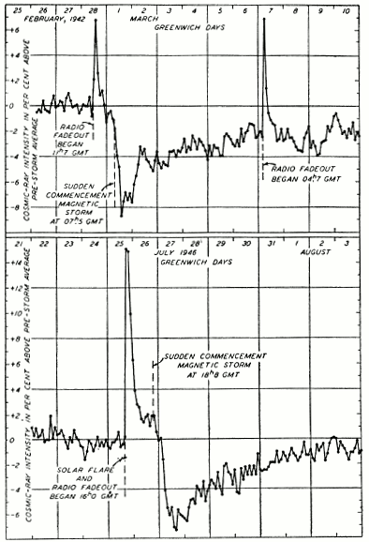
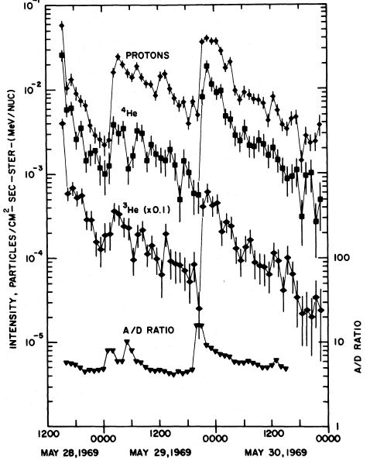
History
Scott Forbush (1946) first to report an enhancement of cosmic-ray counting rates of ionization chamber at ground (Ground Level Enhancement=GLE)
Enhancement of heavy ion SEPs (Fichtel & Guss 1961, nuclear emulsion on a sounding rocket)
Enhancement of ³He-isotope using aluminum and lead pieces of Discoverer 17 satellite flown during a flare of November 12, 1960 (Shaeffer & Zäringer 1962)
Enhancements of Fe ions (Bertsch et al. 1969, nuclear emulsion on a sounding rocket)
The source of SEP enhancements assumed to be a solar flare
Forbush 1946
Serlemitsos & Balasubrahmanyan 1975

Slide 5
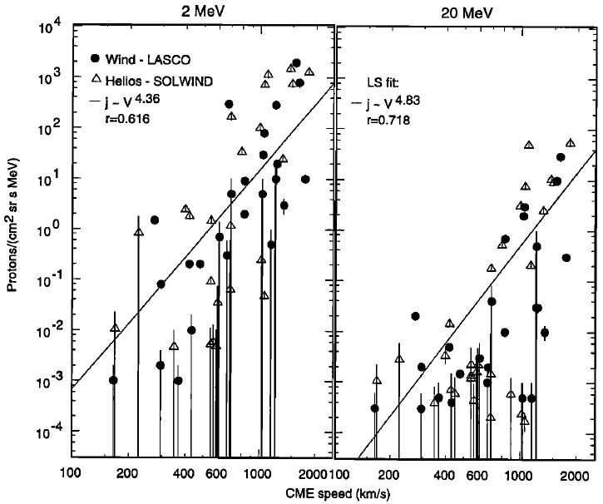
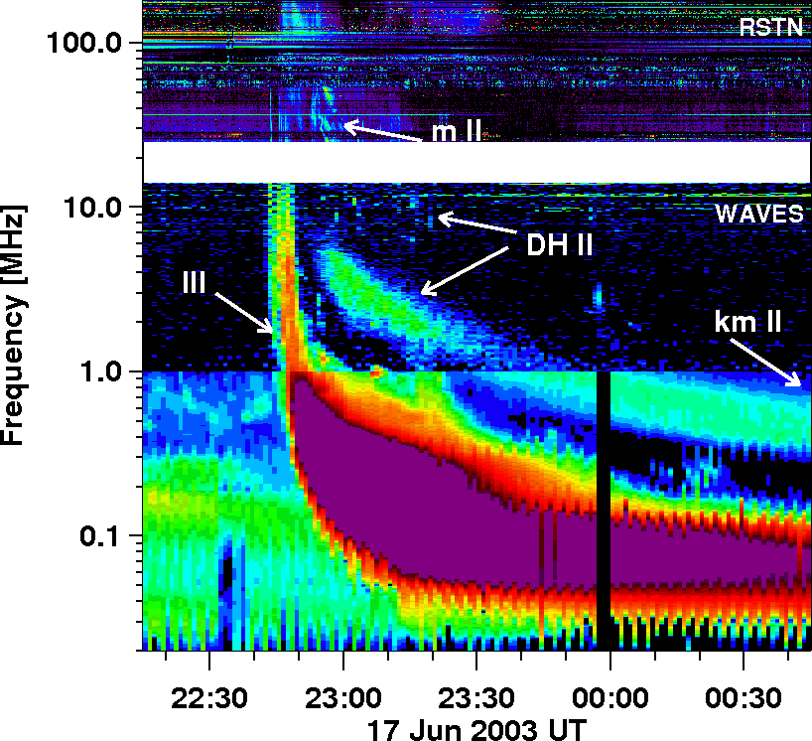
CMEs, Type IIs and SEPs
Kahler 2001
Prompt SEP events associated with coronal mass ejections (CMEs; Kahler et al. 1978)
Modest correlation between CME speed and maximum intensity of SEPs (Kahler et al. 1984)
Proton events associated with metric type II radio burst (Lin 1970)
Large SEP events associated with IP shocks (Cane et al. 1988) and with DH type IIs (Gopalswamy et al. 2002)
Fast CMEs interacting are more likely to produce an SEP event (Gopalswamy et al. 2002)
A CME-driven shock is assumed to be the source of SEPs

Slide 6
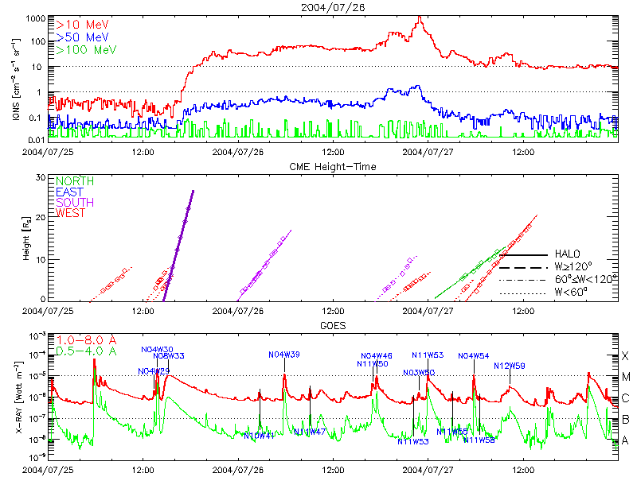
Energetic Storm Particle (ESP) Events
Energetic particle intensities increase near the vicinity of a shock (Bryant et al.,1962)
Local shock acceleration, particle trapping
ESP events can produce very high particle intensities
Time profiles vary from event to event

Slide 7
What We Measure?
Flux = the rate at which particles pass through unit area [particles/(cm² s)]
Fluence = the time integral of flux (usually over event duration), the number of particles passing through a unit area over a specified time
Differential (in energy) flux j(r,Ω,E,t) = the number of particles cm⁻² sec -1 with energy in dE about E with direction dΩ about Ω that passes through the unit area perpendicular to the direction of Ω. [particles/cm²/sec/MeV/sr]
Integral (over energy) flux j(r,Ω,t) = the number of particles cm-2 sec -1 above a threshold energy E₀ with direction dΩ about Ω that passes through the unit area perpendicular to the direction of Ω. [particles/cm²/sec/sr]

Slide 8
NOAA Major SEP Event
Definition: A major proton event starts when the first of 3 consecutive data points of the 5-minute averaged proton fluxes in the integral >10 MeV energy channel measured by the GOES spacecraft at geosynchronous orbit are greater than or equal to 10 particle flux units (pfu).
particle flux unit (pfu), 1 pfu = 1 p cm⁻² sr⁻¹ s⁻¹
Proton event time is the last time the flux was greater than or equal to 10 pfu.
This definition allows multiple proton flares and/or interplanetary shock proton increases to occur within one SESC proton event.
ftp://ftp.swpc.noaa.gov/pub/indices/SPE.txt
https://umbra.nascom.nasa.gov/SEP/
CDAW major SEP events list, where individual SEP events are resolved.
https://cdaw.gsfc.nasa.gov/CME_list/sepe/

Slide 9
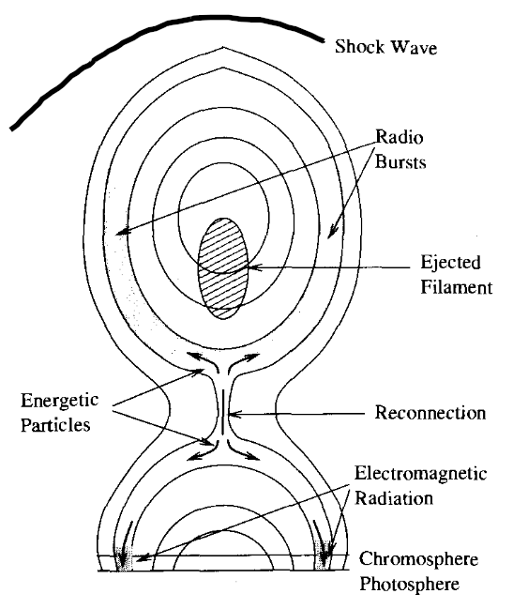
Major question in SEP research has been the relative contributions of the flare-accelerated and CME-shock accelerated particles in the observed SEP events
SEP events are mostly observed at 1 AU and particle acceleration occurs close to the Sun, so the processes particles experience during the transport to observer make it difficult to identify the acceleration source.
Flares and CMEs both are associated with large SEP events and occur concurrently.
?
IP space
CME shock acceleration
?
Energetic Particles
Type II Radio Bursts
Does CME shock accelerate flare particles? Flare occurs low in the corona: How particles escape to IP space?
Type IV
Radio Bursts
Where and when the shock forms? Is there enough time for the shock to form and accelerate particles to explained the first observed IP particles?
Flare acceleration
Adapted from Kallenrode 2004

Slide 10
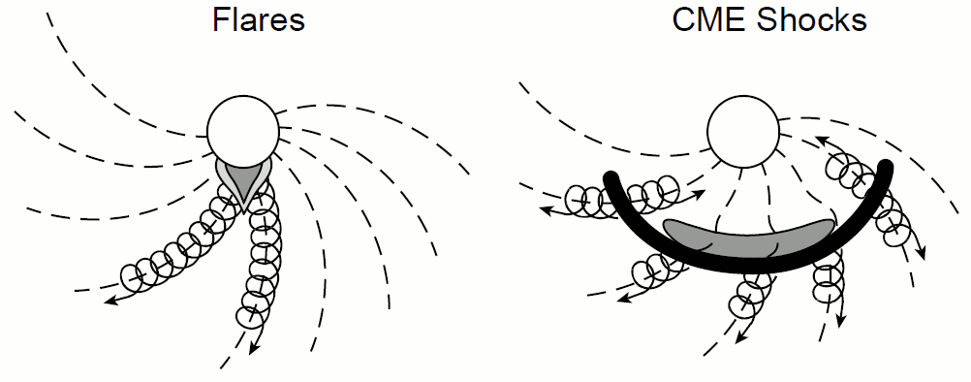
Two-Class Paradigm
Reames 1999
IMPULSIVE (flare) events:
Narrow longitudinal range
Short-duration
Low intensities (small events)
Electron rich
He³/He⁴ ~1-10
Fe/O ~1
H/He ~10
Q_{Fe} ~ +20 (Temp. ~10 MK)
Type III radio bursts
Flare heated material
GRADUAL (CME shock) events:
Wide longitudinal range
Long-duration
High intensities (large events)
Proton rich
He³/He⁴ ~10⁻⁴
Fe/O ~0.1
H/He ~100
Q_{Fe} ~ +14 (Temp. ~1-2 MK)
Type II radio bursts
Coronal or SW material
SEP events divided into impulsive and gradual events based on the duration of the associated solar flare (Cane et al. 1986) Bimodal distribution of abundances (Reames 1988) Paradigm revised: gradual events with characteristics typical of impulsive events (mixed composition)

Slide 11
Seed Particle Population
Suggested explanations for mixed composition in gradual SEP events:
shock acceleration of remnant suprathermal ions from previous impulsive SEP events or particles from associated flare (Mason et al. 1999; Tylka et al. 2005; Mewaldt et al. 2003; Tylka and Lee 2006)
Mixture of flare-accelerated particles and CME shock-accelerated particles (Cane et al. 2003, 2006)

Slide 12
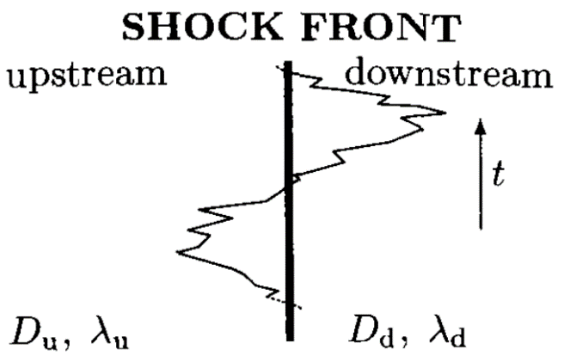
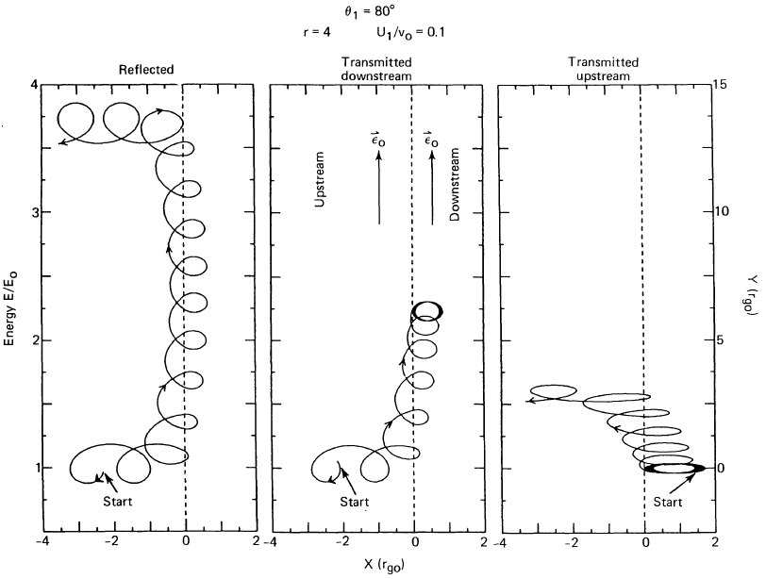
Particle Acceleration Mechanisms
Diffusive shock acceleration (DSA):
  Quasi-parallel shock (θ_{BN}≤45°)
  particles scattering between up- and downstream magnetic fluctuations (1st order Fermi acceleration)
  Slower acceleration rate
  Efficient scattering requires enhanced level of turbulence/waves
Shock drift acceleration (SDA):
  Quasi-perpendicular shock (θ_{BN}≥45°)
  Induced electric field E=-V×B at shock front
  Fast acceleration rate
  Higher maximum energy
Kallenrode 2004
θ_{BN} is the angle between the shock normal and the direction of the upstream magnetic field
Decker 1988

Slide 13
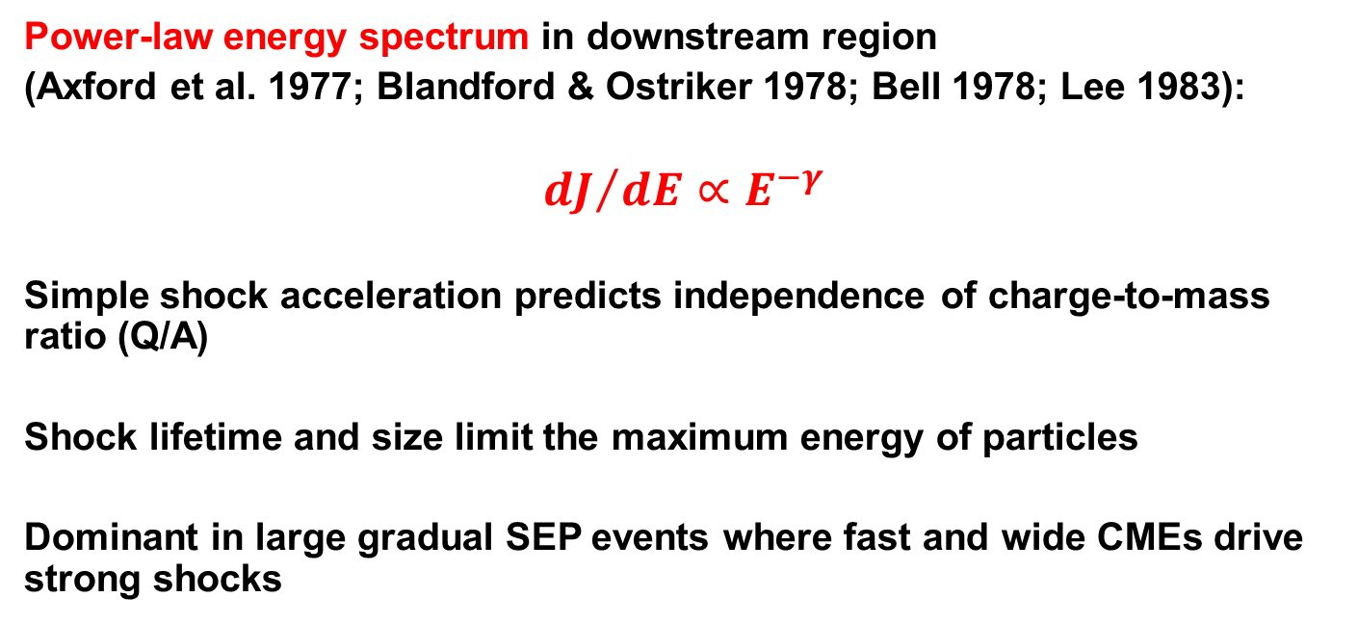
Particle Acceleration in Shocks
Power-law energy spectrum in downstream region
(Axford et al. 1977; Blandford & Ostriker 1978; Bell 1978; Lee 1983):
$${dJ}/{dE}∝E^{−γ}$$
Simple shock acceleration predicts independence of charge-to-mass ratio (Q/A)
Shock lifetime and size limit the maximum energy of particles
Dominant in large gradual SEP events where fast and wide CMEs drive strong shocks

Slide 14
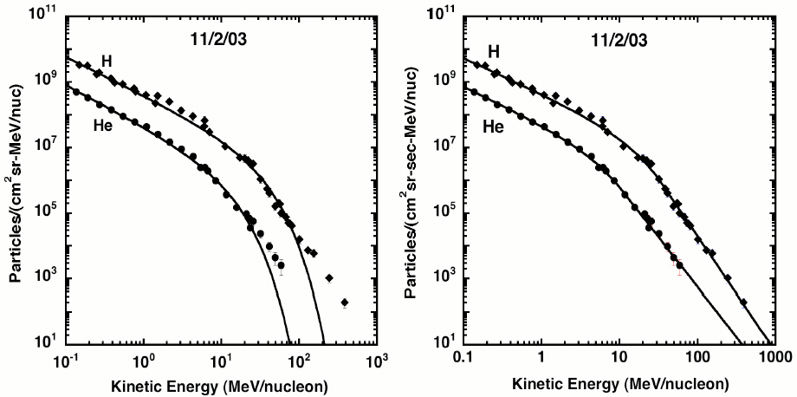
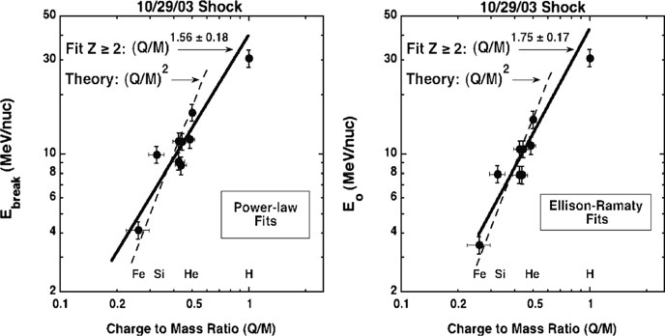
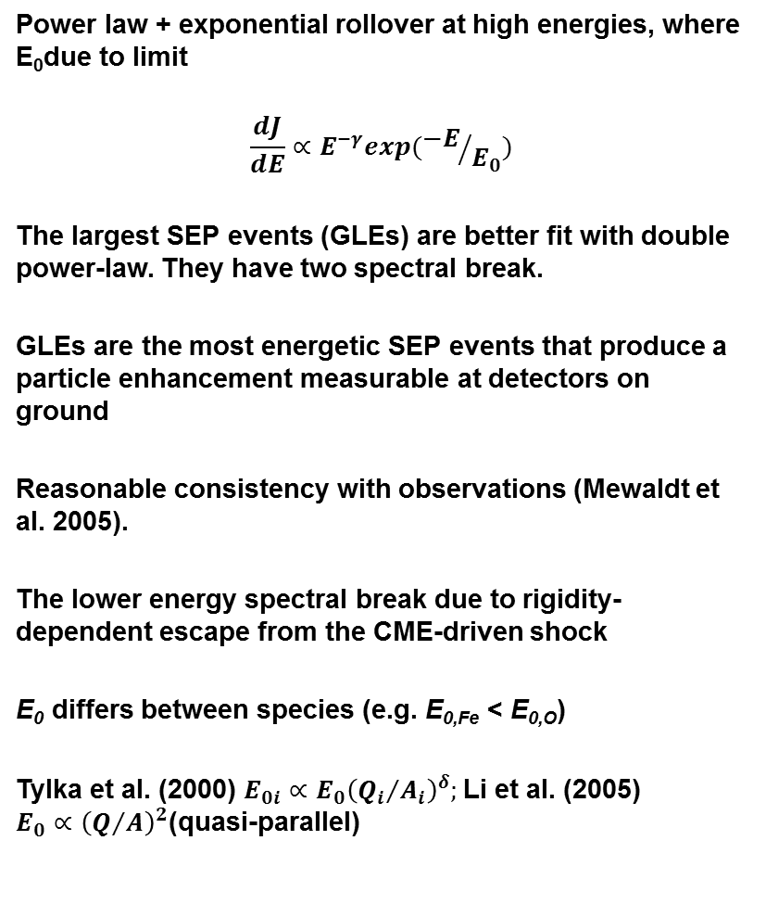
Energy Spectra in Gradual Events
Power law + exponential rollover at high energies, where E₀due to limit
$$\frac{dJ}{dE}∝E^{−γ}exp({−E}/{E_{0}})$$
The largest SEP events (GLEs) are better fit with double power-law. They have two spectral break.
GLEs are the most energetic SEP events that produce a particle enhancement measurable at detectors on ground
Reasonable consistency with observations (Mewaldt et al. 2005).
The lower energy spectral break due to rigidity-dependent escape from the CME-driven shock
E₀ differs between species (e.g. E_{0,Fe} < E_{0,O})
Tylka et al. (2000) $E_{0i}∝{E_{0}\left({Q_{i}}/{A_{i}}\right)}^{δ};$Li et al. (2005) $E_{0}∝{\left(Q/A\right)}^{2}$(quasi-parallel)
Mewaldt et al. 2005

Slide 15
Interplanetary (IP) Transport
During propagation from the source to observer particles experience:
convection with solar wind (low-energy particles)
interactions with the turbulent IP magnetic field (pitch angle scattering)
focusing in large-scale magnetic field (diverting Archimedean spiral field)
Adiabatic energy change
Transport effects change observed in-situ distributions of accelerated particles
Harder to resolve original acceleration processes

Slide 16
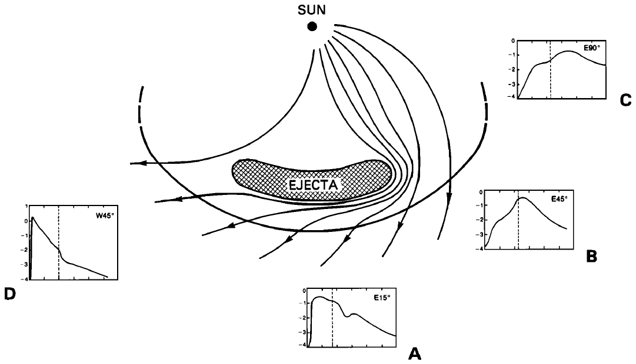
Magnetic Connection to Observer
east
west
E90°
W45°
E45°
E15°
Cane et al. 1988
SEP time profiles are organized by the longitude of the solar source: depends on where the observer’s magnetic field line connects at the shock and how the connection point moves along the shock front (IP magnetic field lines follow Parker spiral). Nominal solar wind: Earth connected to the longitude ~W60°.
Acceleration most efficient at the shock nose, decreases towards flanks.

Slide 17
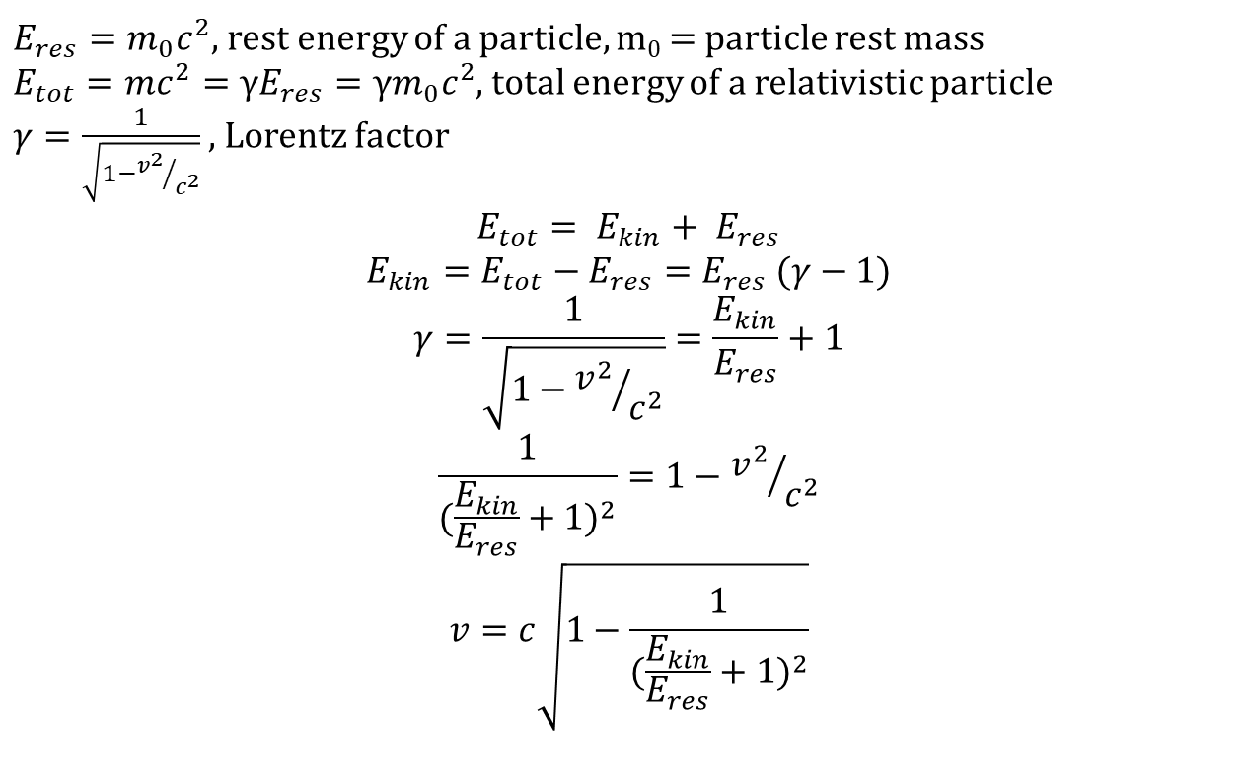
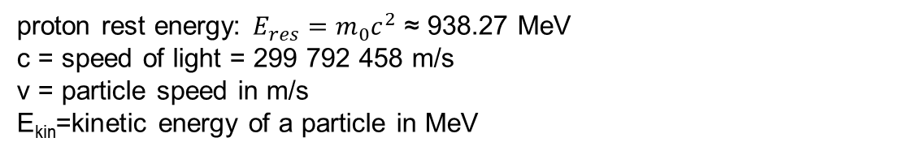
Relativistic kinetic energy E_{kin}
$E_{res}=m_{0}c^{2}$, rest energy of a particle, m₀ = particle rest mass
$E_{tot}=mc^{2}=γE_{res}=γm_{0}c^{2}$, total energy of a relativistic particle
$γ=\frac{1}{\sqrt{1−{v^{2}}/{c^{2}}}}$ , Lorentz factor
$$E_{tot}= E_{kin}+ E_{res}$$
$$E_{kin}=E_{tot}−E_{res}=E_{res} (γ−1)$$
$$γ=\frac{1}{\sqrt{1−{v^{2}}/{c^{2}}}}=\frac{E_{kin}}{E_{res}}+1$$
$$\frac{1}{{(\frac{E_{kin}}{E_{res}}+1)}^{2}}=1−{v^{2}}/{c^{2}}$$
$$v=c\sqrt{1−\frac{1}{{(\frac{E_{kin}}{E_{res}}+1)}^{2}}}$$
proton rest energy: $E_{res}=m_{0}c^{2}$ ≈ 938.27 MeV
c = speed of light = 299 792 458 m/s
v = particle speed in m/s
E_{kin}=kinetic energy of a particle in MeV

