Slide 1
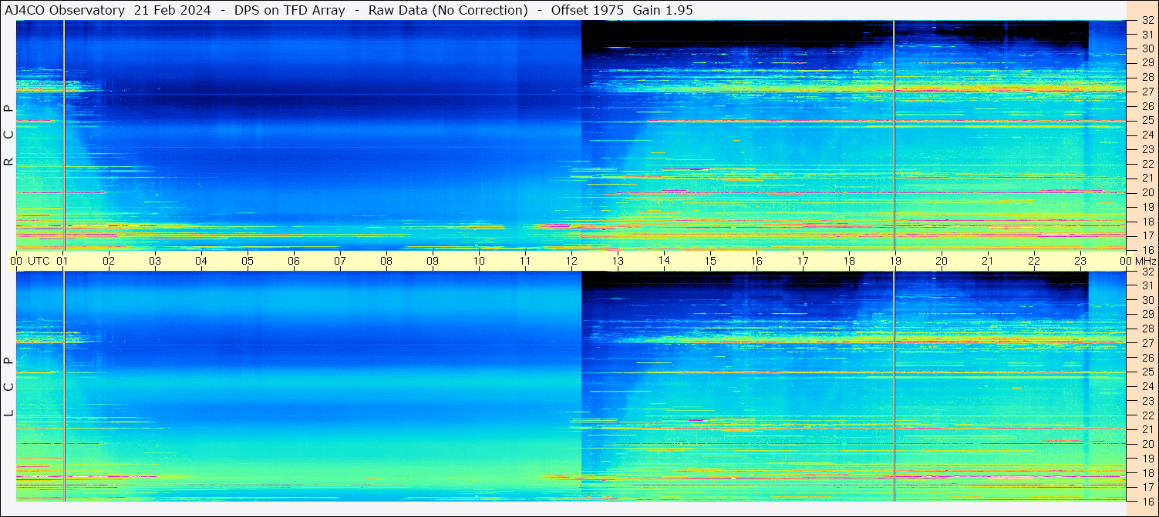
Radio Jove AJ4CO https://aj4co.org/
High Springs, Florida, operated by Dave Typinski

Slide 2
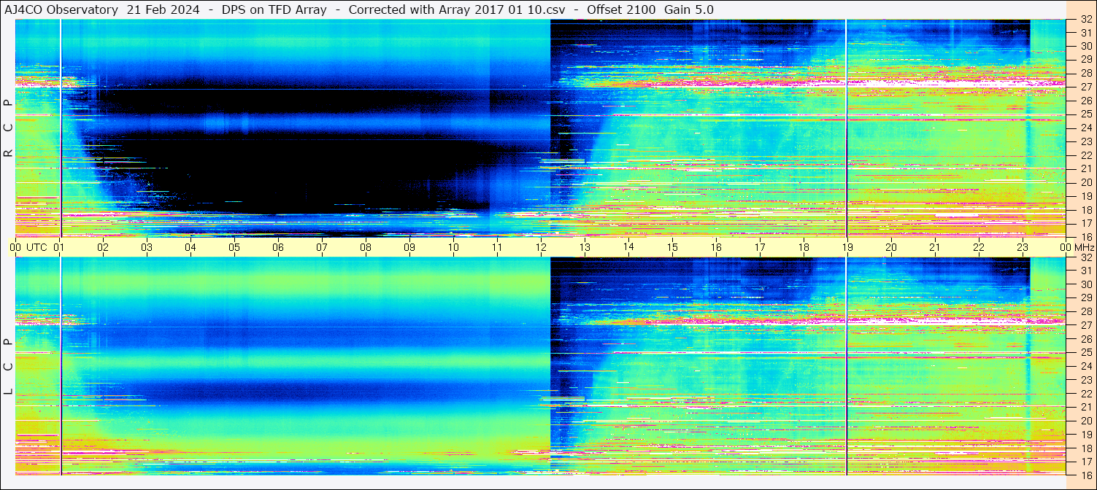

Slide 3
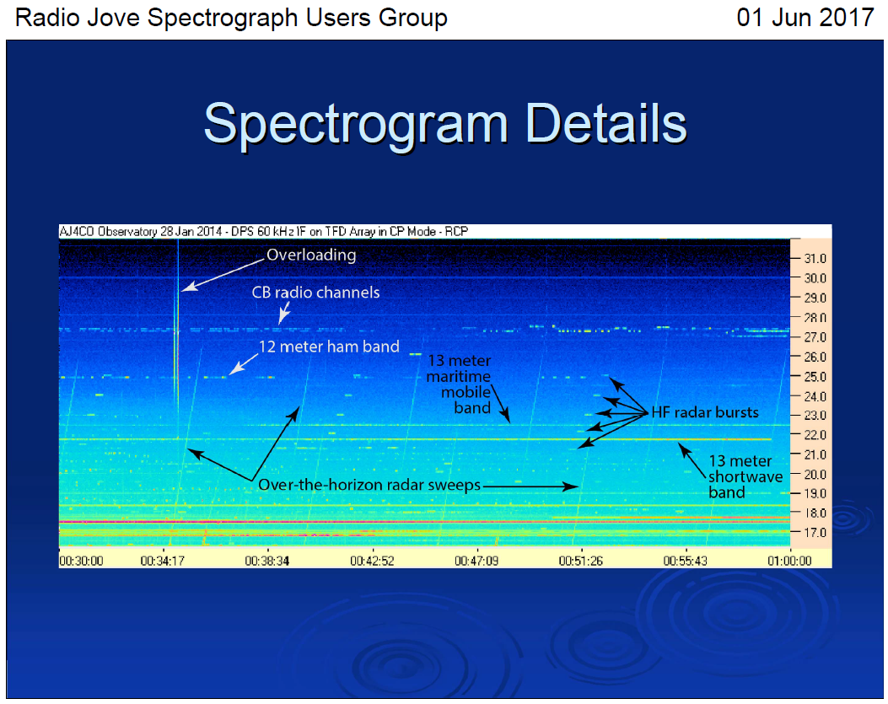
The HF Spectrogram, Typinski (2017) Slides and Notes.pdf

Slide 4
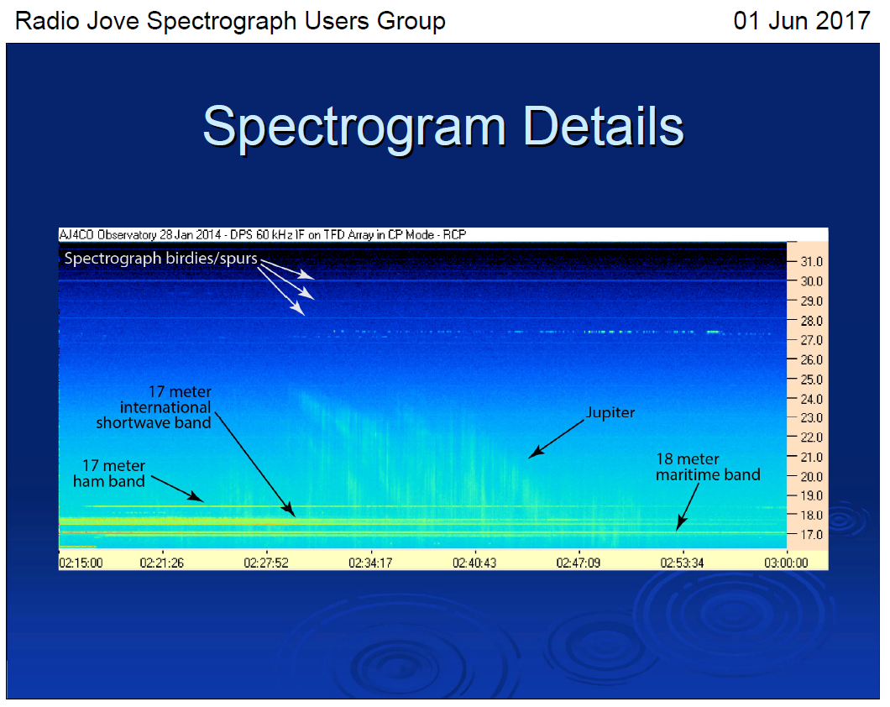
The HF Spectrogram, Typinski (2017) Slides and Notes.pdf

Slide 5
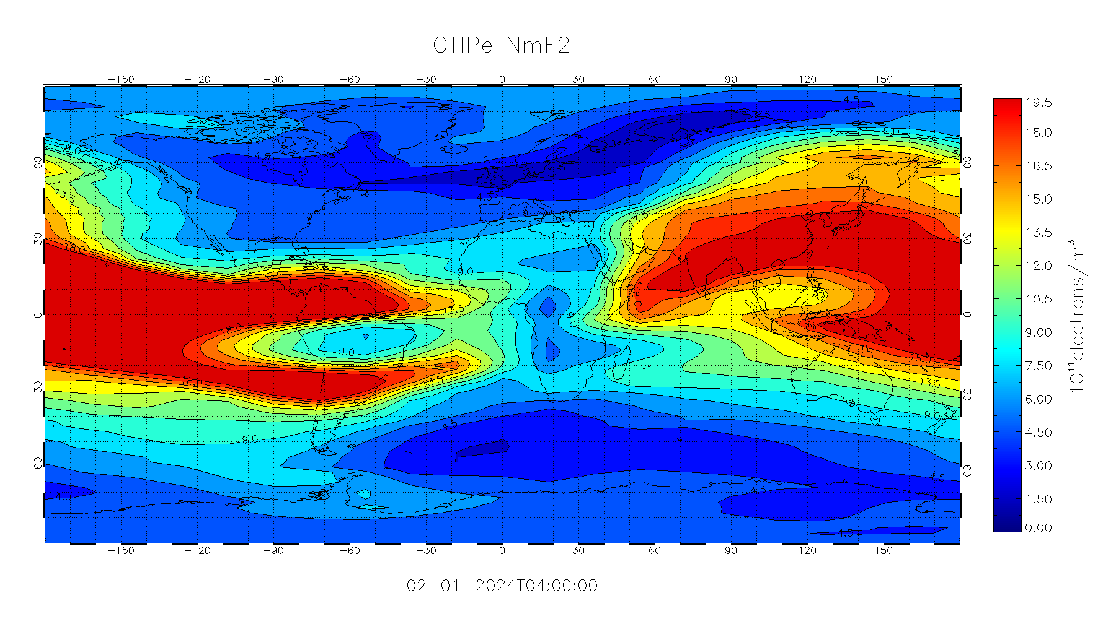
https://iswa.gsfc.nasa.gov/iswa_data_tree/model/ionosphere/CTIPe4.X/plots/
peak density of F2 layer
The Coupled Thermosphere Ionosphere Plasmasphere Electrodynamics Model (CTIPe)
Critical Frequency at vertical incidence :
NmF2=6e11 m⁻³, foF2 = 7 MHz
NmF2=4.5e11 m⁻³, foF2 = 6 MHz

Slide 6
