Slide 1



Large (Gradual) Solar Energetic Particle Events
Pertti Mäkelä^{1,2}
¹The Catholic University of America, USA
²NASA, Goddard Space Flight Center, USA
Collaborators:
Nat Gopalswamy², Seiji Yashiro^{1,2}, Hong Xie^{1,2}, Sachiko Akiyama^{1,2}, Neeharika Thakur^{1,2}
ISWI Webinar 2022

Slide 2
Solar Energetic Particles (SEPs)
Kinetic energy of SEPs range from few tens of keV/nucleon to over GeV/nucleon
The fastest SEPs arrive at Earth in ~ 10-30 mins
Mostly protons and α-particles (~1 % heavy ions Z>2)
Particles are fully or partially ionized
Acceleration region(s) near the Sun
Durations of SEP events extend from hours to days
Large event-to-event variability in intensity, elemental/isotopic composition, charge states, energy spectra…
SEP event characteristics are energy dependent
Desai & Giacalone 2016; adapted from Mewaldt+ 2001

Slide 3
Major SEP Event
NOAA Definition: A major proton event starts when the first of 3 consecutive data points of the 5-minute averaged proton fluxes in the integral >10 MeV energy channel measured by the GOES spacecraft at geosynchronous orbit are greater than or equal to 10 particle flux units (pfu, 1 pfu = 1 p cm⁻² sr⁻¹ s⁻¹ ). Event end time is the last time the flux was greater than or equal to 10 pfu.
This definition allows multiple individual proton increases to occur within one large solar proton event (SPE), because the next increase may occur before the flux has decreased below the 10 pfu limit.
https://umbra.nascom.nasa.gov/SEP/
CDAW Data Center major SEP events list, where individual SEP events are resolved.
https://cdaw.gsfc.nasa.gov/CME_list/sepe/

Slide 4
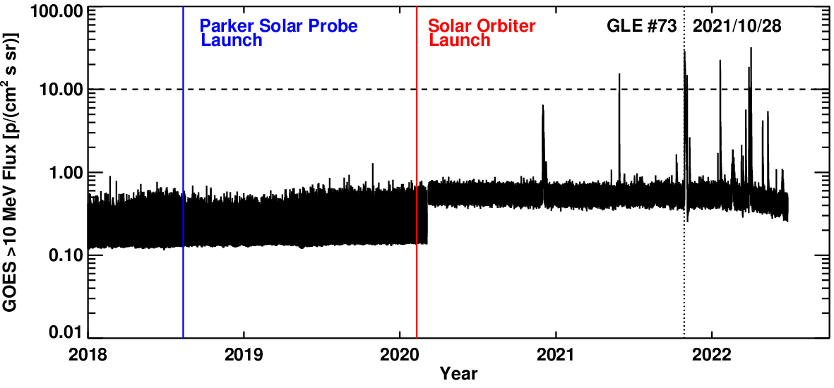
Recent Major SEP Events

Slide 5
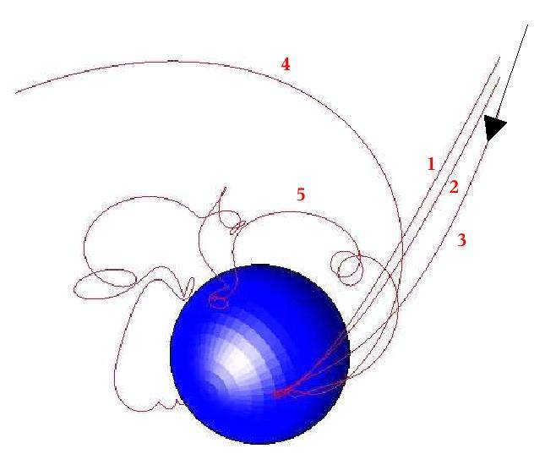
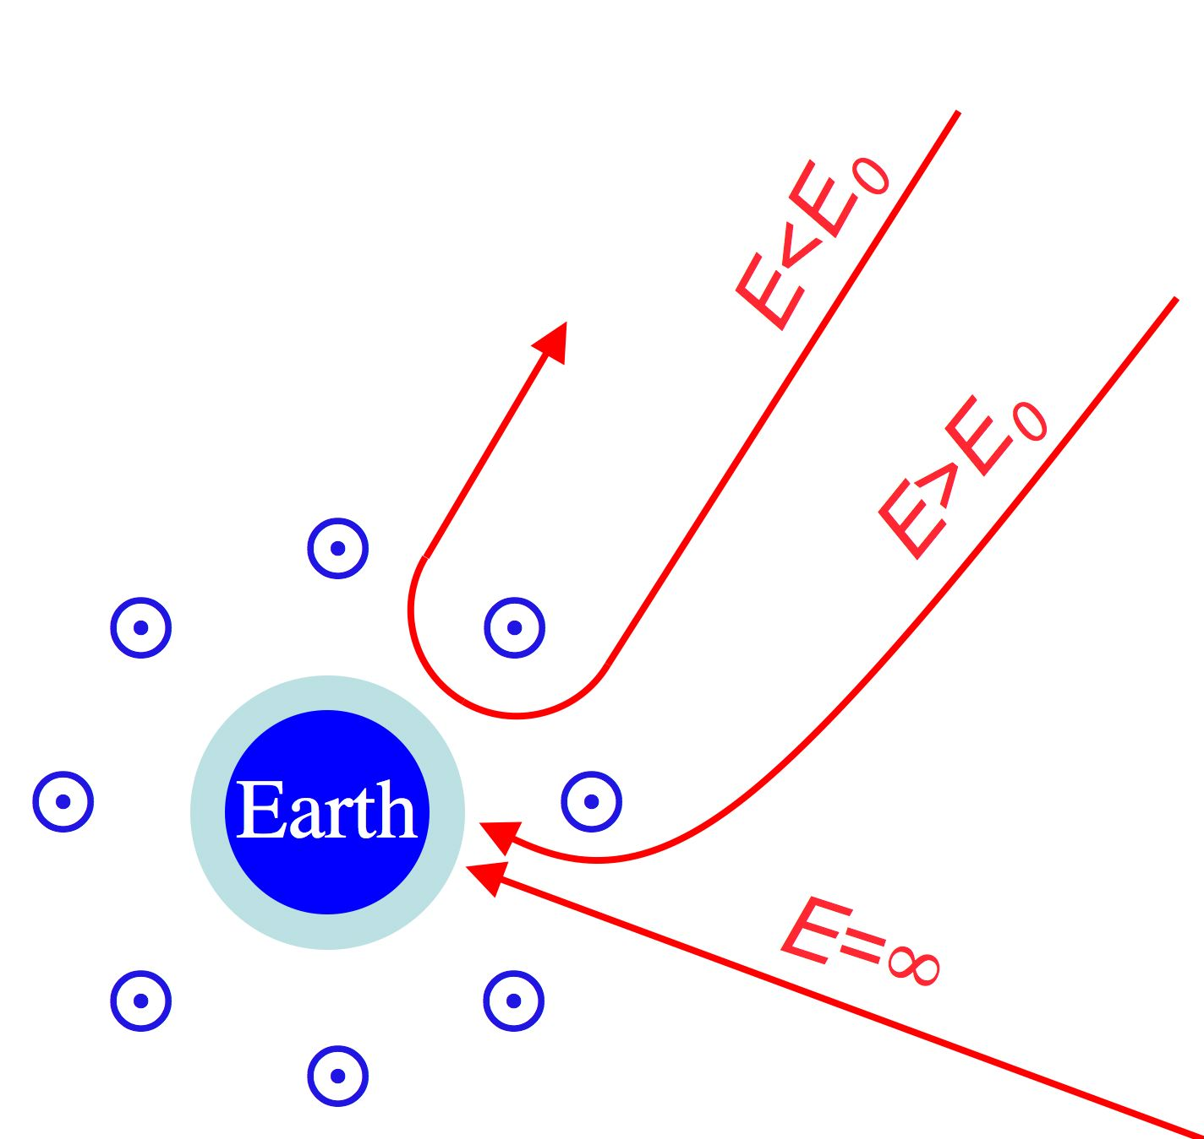
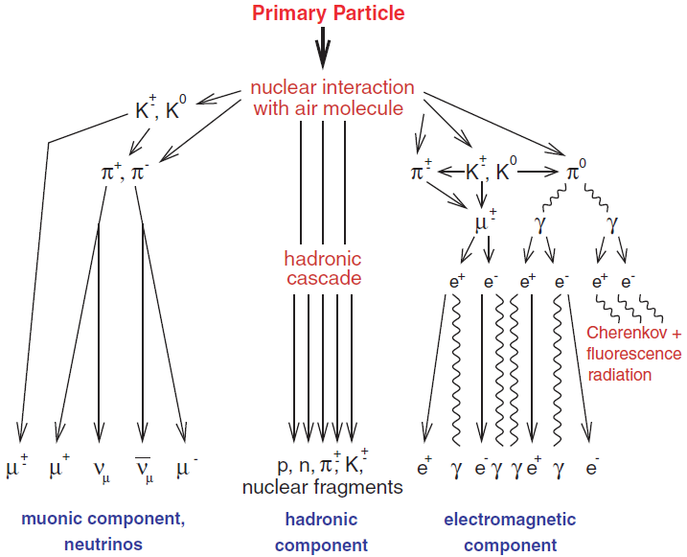
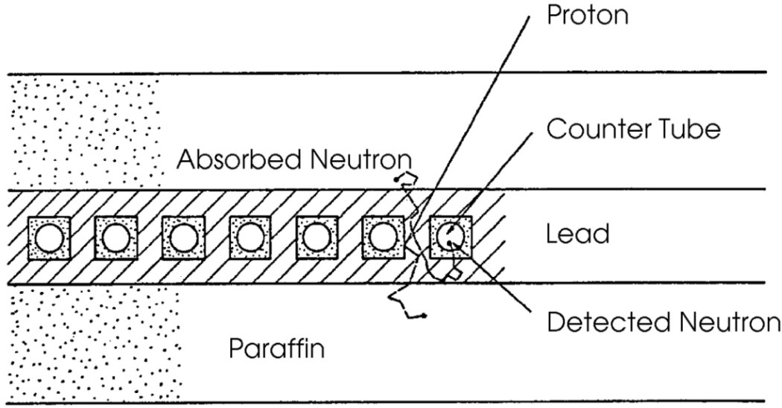
Neutron Monitors
Courtesy of https://www.nmdb.eu
Invented by John Simpson (Simpson 1958; Simpson+ 1953) Improved design of the NM64-type NM (Hatton & Carmichael, 1964)
Sensitive to particles penetrating the Earth's atmosphere with energies from about 0.5-20 GeV
(1) Primary particle penetrates Earth’s magnetosphere:
Low-energy cutoff (Rigidity R=p/q [V], momentum/charge)
Asymptotic arrival directions of the particles
(2) Primary particle interacts in the thick atmosphere:
Produce atmospheric nucleonic-muon-electromagnetic cascade
(3) The incident secondary particle flux produces low-energy neutrons in the lead. These MeV-neutrons are slowed down to thermal energies by the moderator. Neutrons (NM64 ~6% ) are finally detected by the proportional counter tubes. NM cannot directly measure the energy of the primary particle.
Haungs+ 2003
Notes:
PAMELA 2006-2016 and AMS on International Space Station, astrophysics missions with large particle detectors

Slide 6
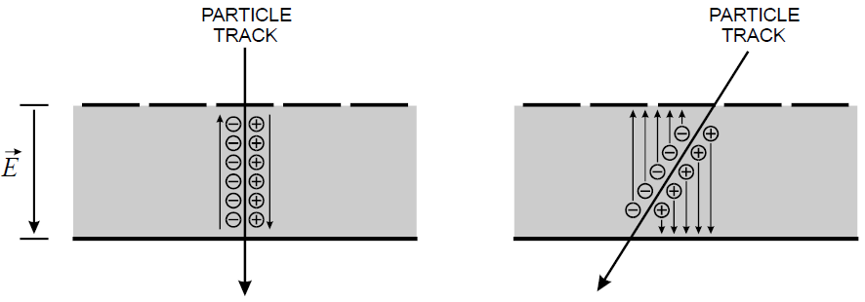
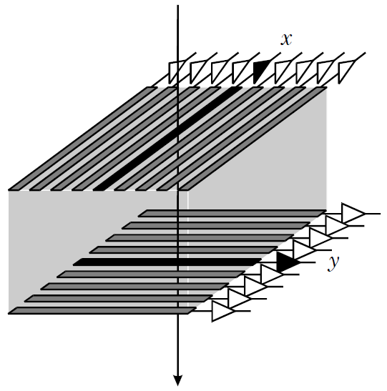
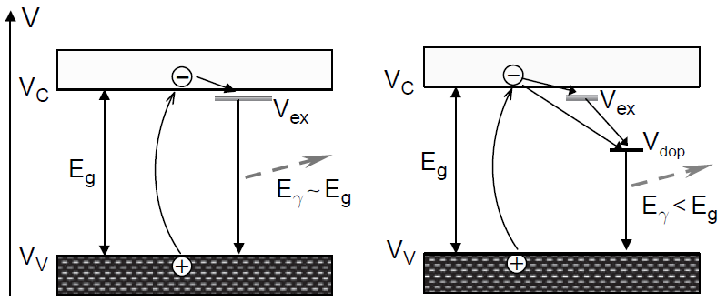
Semiconductor Detectors, Scintillators
Solid-state detectors:
Penetrating particle produces electrons (ionization) along its path in the detector layer. Number of electrons proportional to deposited energy.
Silicon or germanium
Applied electric field sweeps the cloud of electrons to be read by charge-sensitive pre-amplifier
Luminescent materials:
Absorb and re-emit particle energy in the form of (visible, UV) light (scintillate). Intensity proportional to deposited energy (≈3%).
Organic (crystalline, liquid, plastic); inorganic crystals, e.g., NaI(Tl), BGO, CsI(Tl); gases and glasses
Light detected using photomultiplier tubes or photo-diodes
Spieler 2012
Pure Doped
Grupen & Schwartz 2008

Slide 7
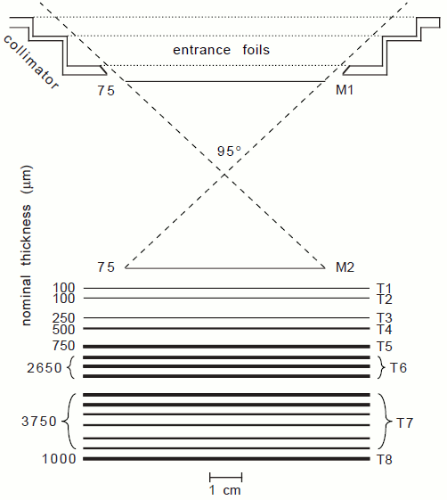
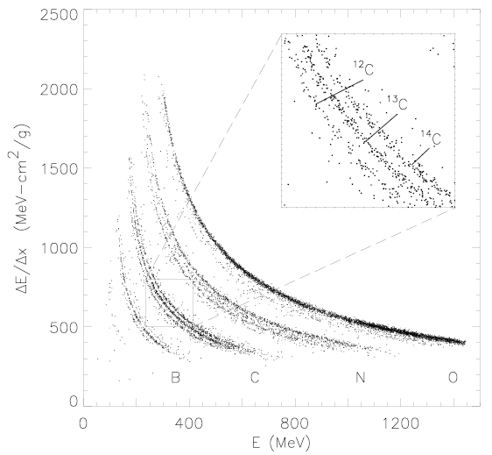
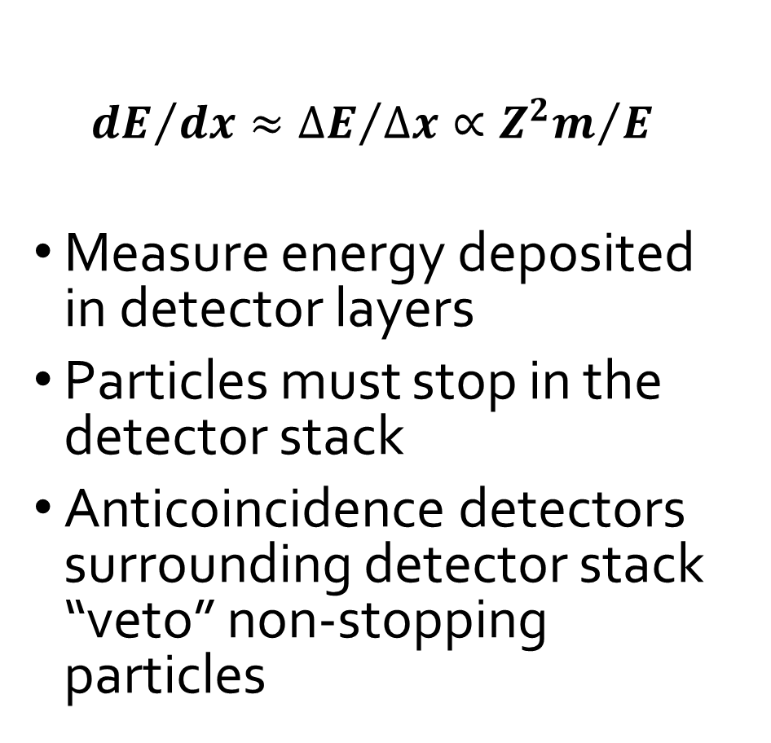
dE/dx vs E Technique
m, E
$${dE}/{dx}≈{∆E}/{∆x}∝{Z^{2}m}/E$$
Measure energy deposited in detector layers
Particles must stop in the detector stack
Anticoincidence detectors surrounding detector stack “veto” non-stopping particles
Stone+ 1998

Slide 8
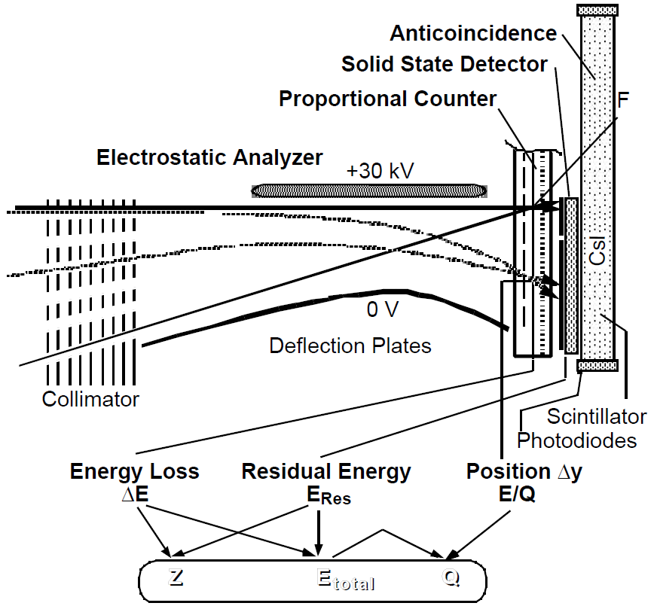
SEPICA on ACE
Solar Energetic Particle Ionic Charge Analyzer
Particle deflection (ΔY) by electrostatic analyzer E-field (voltage=U_{defl}):
ΔY=δ∙U_{defl}∙Q/E,
δ=sensor constant
Measured total energy:
E_{tot}=E_{res}+ΔE_{win}+ΔE_{PC}+ΔE_{SSD}
ΔY→Q/E
Q=(Q/E)∙E_{tot}
ΔE vs E_{tot} →Z
Möbius+ 1998

Slide 9
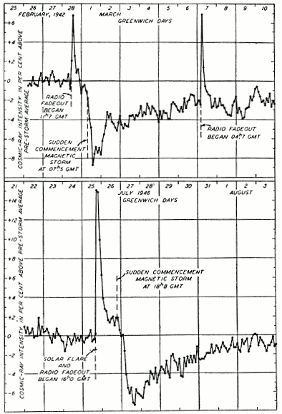
First Observation of SEP Increase
Scott Forbush (1946) first to report an enhancement of cosmic-ray counting rates of ionization chamber at ground
The source of SEP enhancements assumed to be a solar flare
The most intense SEP events can be observed by ground-based detectors such as neutron monitors (NMs) (Ground Level Enhancement=GLE; https://gle.oulu.fi)
Observations of SEP flux increases with weaker intensities can be made in space, which became possible in 1960’s when particle detectors started flew onboard sounding rockets and spacecraft
Forbush 1946

Slide 10
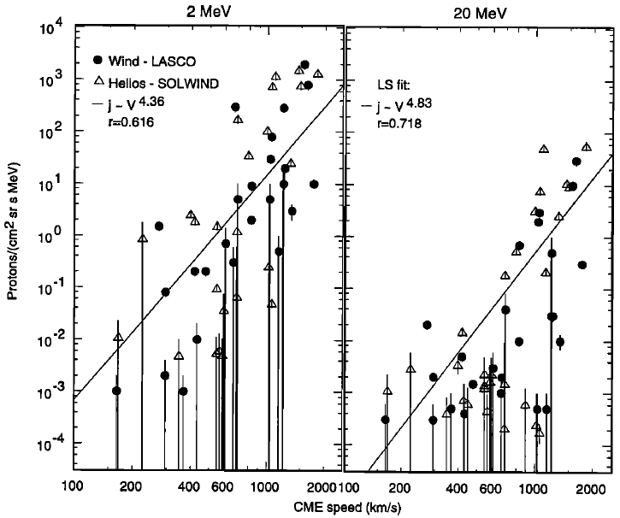
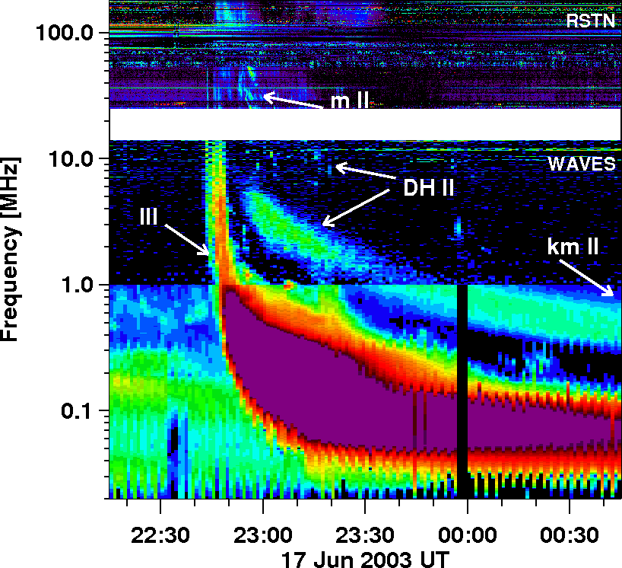
CMEs, Type IIs and SEPs
Kahler 2001
Prompt SEP events associated with coronal mass ejections (CMEs; Kahler+ 1978)
Modest correlation between CME speed and maximum intensity of SEPs (Kahler+ 1984)
Proton events associated with metric type II solar radio burst (Lin 1970)
Large SEP events associated with IP shocks (Cane+ 1988) and with DH type IIs (Gopalswamy+ 2002)
In general, fast (V≥900 km/s and wide (W≥60°) CMEs associated with SEP events. (Gopalswamy+ 2008, Kahler+ 2019)
Fast and wide CMEs without >20 MeV increase are on average narrower, less massive and less energetic than CMEs associated with SEPs (Lario+ 2020)
A CME-driven shock is assumed to be the source of large SEP events

Slide 11
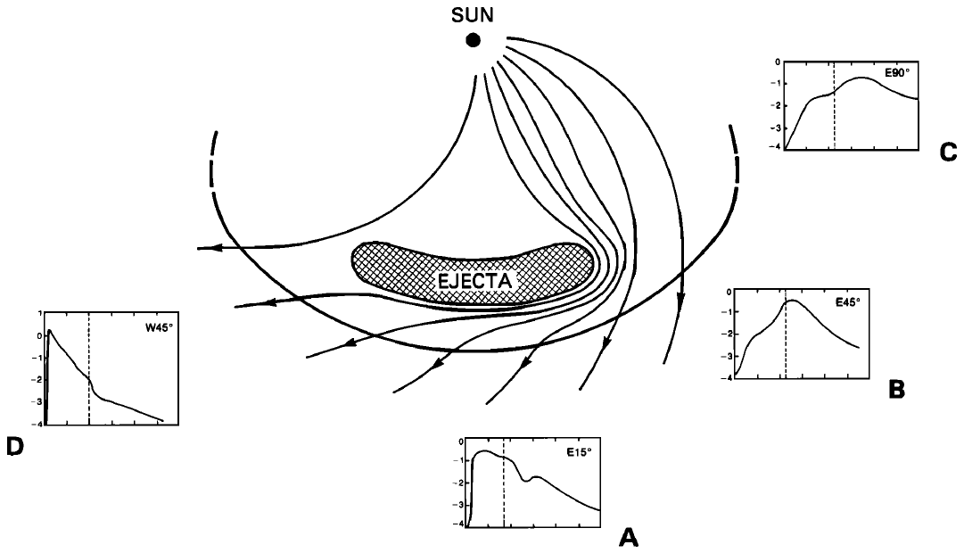
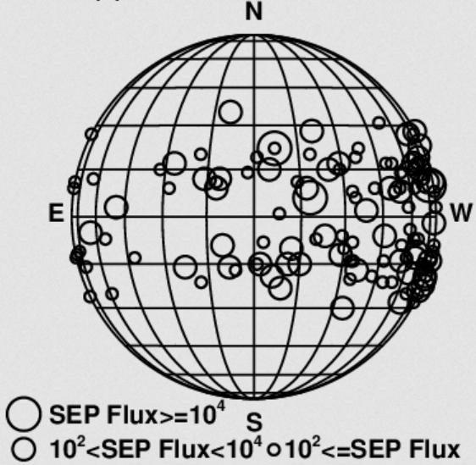
Longitudinal Magnetic Connection to Observer
Turbulence
east
west
E90°
IP magnetic field
Parker Spiral
W45°
E45°
Flare
E15°
Cane+ 1988
Lee 2005
SEP time profiles are organized by the longitude of the solar source depends on where the observer’s magnetic field line connects at the shock and how the connection point moves along the shock front (IP magnetic field lines follow Parker spiral).
Nominal solar wind speed: Earth connected to the longitude ~W60° at the Sun.
Acceleration most efficient at the shock nose, decreases towards flanks.

Slide 12
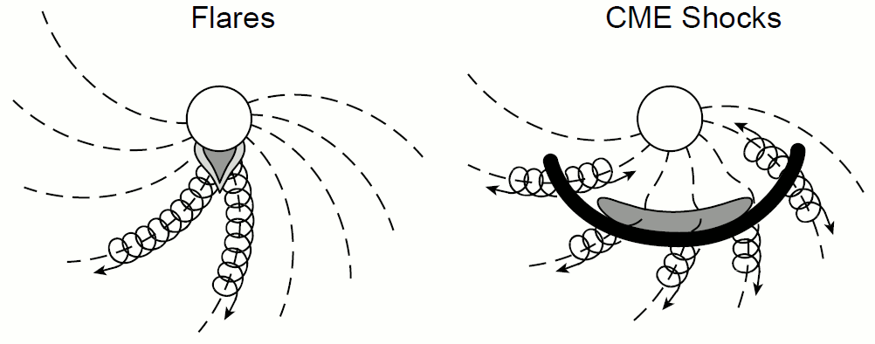
Two-Class Paradigm
Reames 1999
IMPULSIVE (flare) events:
Narrow longitudinal range
Short-duration
Low intensities (small events)
Electron rich
³He/⁴He ~1-10
Fe/O ~1
H/He ~10
Q_{Fe} ~ +20 (Temp. ~10 MK)
Type III radio bursts
Flare heated material
GRADUAL (CME shock) events:
Wide longitudinal range
Long-duration
High intensities (large events)
Proton rich
³He/⁴He ~10⁻⁴
Fe/O ~0.1
H/He ~100
Q_{Fe} ~ +14 (Temp. ~1-2 MK)
Type II radio bursts
Coronal or SW material
SEP events divided into impulsive and gradual events based on the duration of the associated solar flare (Cane+ 1986)
Bimodal distribution of abundances (Reames 1988)
Paradigm revised: gradual events may have some compositional characteristics typical of impulsive events

Slide 13
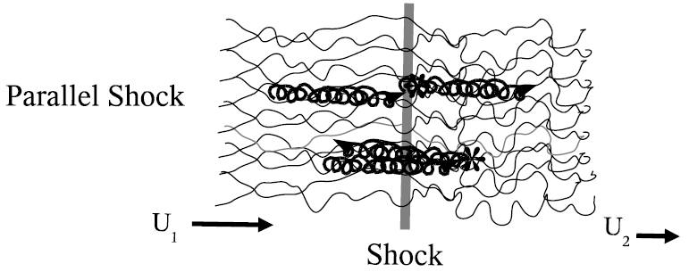
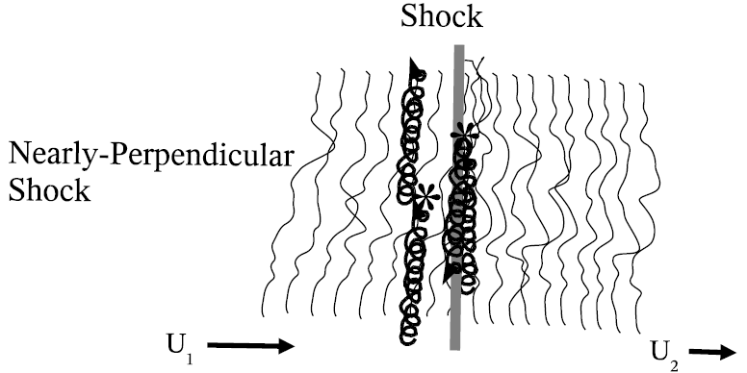
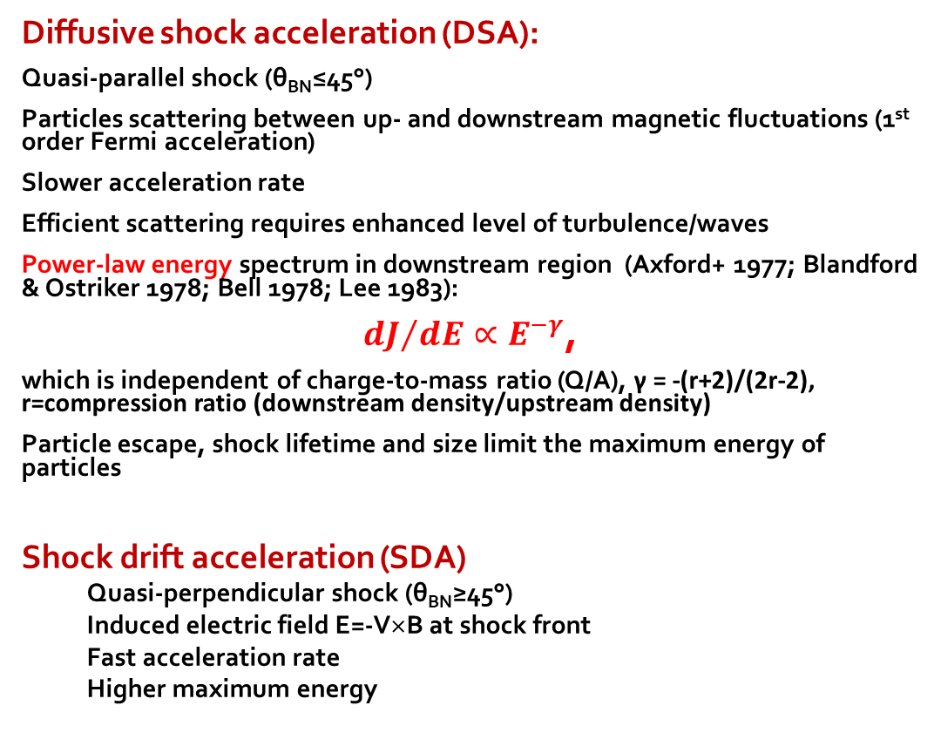
Particle Acceleration Mechanism
Diffusive shock acceleration (DSA):
Quasi-parallel shock (θ_{BN}≤45°)
Particles scattering between up- and downstream magnetic fluctuations (1st order Fermi acceleration)
Slower acceleration rate
Efficient scattering requires enhanced level of turbulence/waves
Power-law energy spectrum in downstream region (Axford+ 1977; Blandford & Ostriker 1978; Bell 1978; Lee 1983):
${dJ}/{dE}∝E^{−γ}$,
which is independent of charge-to-mass ratio (Q/A), γ = -(r+2)/(2r-2), r=compression ratio (downstream density/upstream density)
Particle escape, shock lifetime and size limit the maximum energy of particles
Shock drift acceleration (SDA):
Quasi-perpendicular shock (θ_{BN}≥45°)
Induced electric field E=-V×B at shock front
Fast acceleration rate
Higher maximum energy
Giacalone & Kóta 2006
θ_{BN} is the angle between the shock normal and the direction of the upstream magnetic field

Slide 14
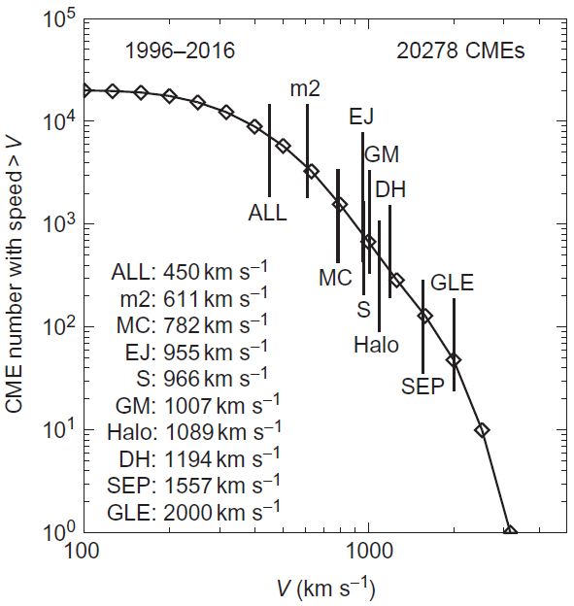
Speed Hierarchy of CME Populations
CMEs associated with regular large SEP events and GLEs have the highest average speed compared to all other CME categories, such as those associated with geomagnetic storms (GM), halo-CMEs, decameter-hectometric type II radio bursts (DH)
Gopalswamy 2018

Slide 15
Interplanetary (IP) Transport
During propagation from the source to observer particles experience:
convection with solar wind (low-energy particles)
interactions with the turbulent IP magnetic field (pitch angle scattering)
focusing in large-scale magnetic field (diverting Archimedean spiral field)
Adiabatic energy change
Transport effects change observed in-situ distributions of accelerated particles
Harder to resolve original acceleration processes

Slide 16
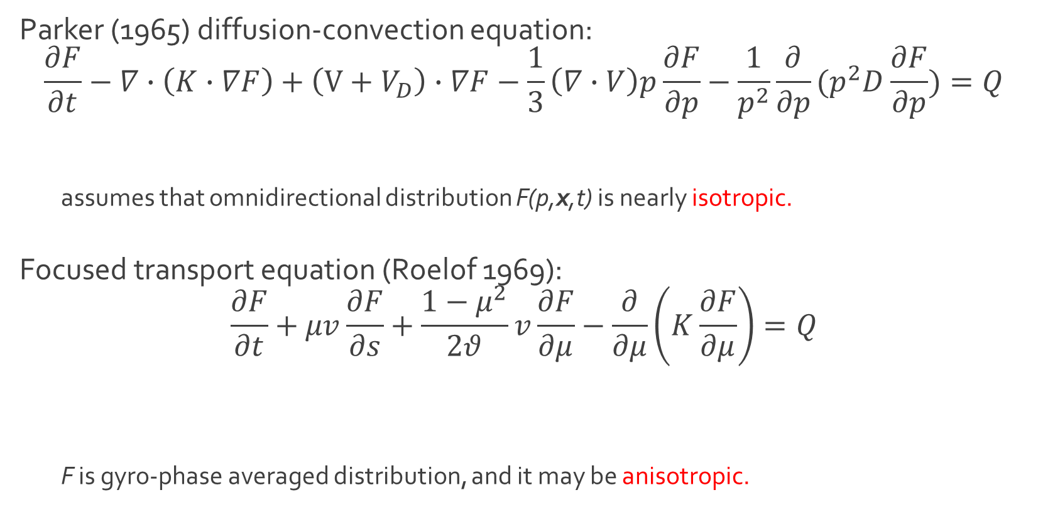
Basic Transport Equations
Parker (1965) diffusion-convection equation:
$$\frac{∂F}{∂t}−∇∙\left(K∙∇F\right)+\left(V+V_{D}\right)∙∇F−\frac{1}{3}\left(∇∙V\right)p\frac{∂F}{∂p}−\frac{1}{p^{2}}\frac{∂}{∂p}(p^{2}D\frac{∂F}{∂p})=Q$$
assumes that omnidirectional distribution F(p,x,t) is nearly isotropic.
Focused transport equation (Roelof 1969):
$$\frac{∂F}{∂t}+μv\frac{∂F}{∂s}+\frac{1−μ^{2}}{2θ}v\frac{∂F}{∂μ}−\frac{∂}{∂μ}\left(K\frac{∂F}{∂μ}\right)=Q$$
F is gyro-phase averaged distribution, and it may be anisotropic.
Spatial diffusion
Advection & Drift
Adiabatic energy change
Momentum diffusion
Source
Field parallel propagation
Focusing in diverging field
Pitch angle scattering
Source
μ = cos (θ), where θ is the angle between the direction of the magnetic field and the particle propagation direction

Slide 17
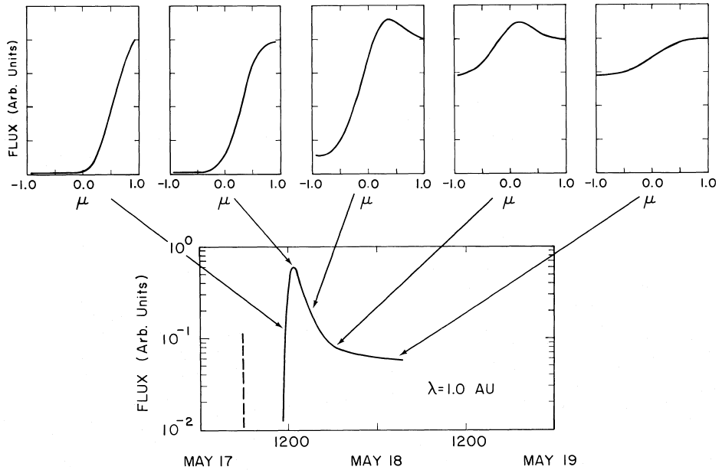
Particle Flux Anisotropy
Pitch-angle (μ) distributions provide information on IP transport of particles
Shape of the distribution depends on strength, field topology, and turbulence level of the magnetic field particles encounter
At the beginning of a SEP event particle fluxes can be anisotropic, i.e. if particle mean free path is long (scatter-free or weak scattering)
Later SEP fluxes become isotropic, because particle scatter spreads particle propagation directions
μ = cos (θ), where θ is the angle between the direction of the magnetic field and the particle propagation direction
Mason+ 1989

Slide 18
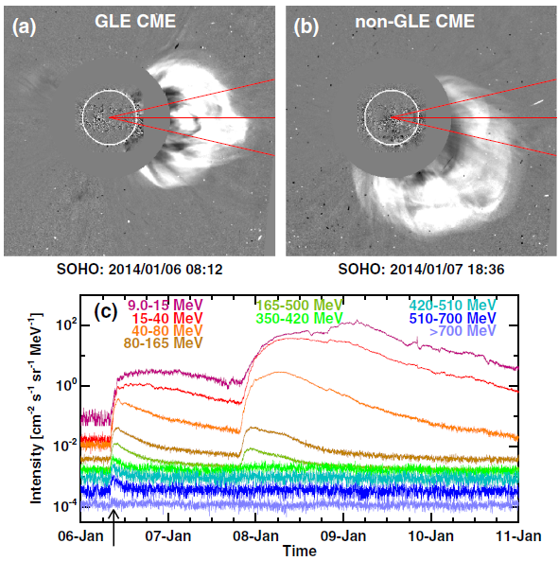
Latitudinal Connection to Observer
Gopalswamy+ 2014
If shock nose outside region ±13° from the ecliptic, highest-energy particles are not observed at Earth (Gopalswmay+ 2013)
Non-radial CME motion due to deflection by coronal holes or streamers explains historical GLE events at latitudes >30° (Gopalswamy & Mäkelä 2014)
Probability P of observing an SEP event as a function of the latitudinal separation between the location of the parent flare associated to an SEP event and the footpoint of a near-Earth detecting spacecraft is largest for separations between 4◦ and 12◦. Outside the range P ~constant (Dalla & Agueda 2010)

Slide 19
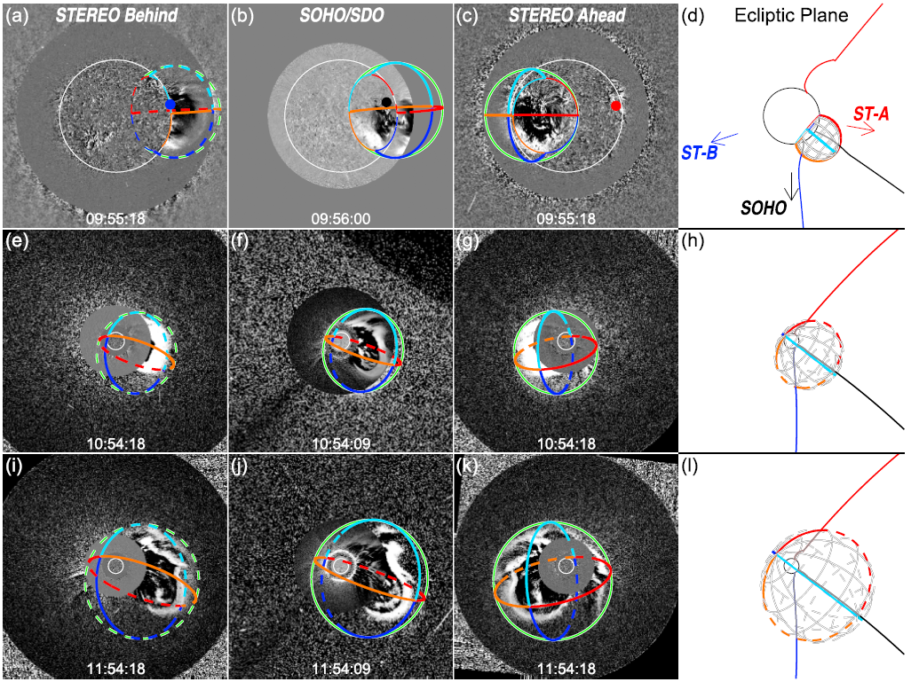
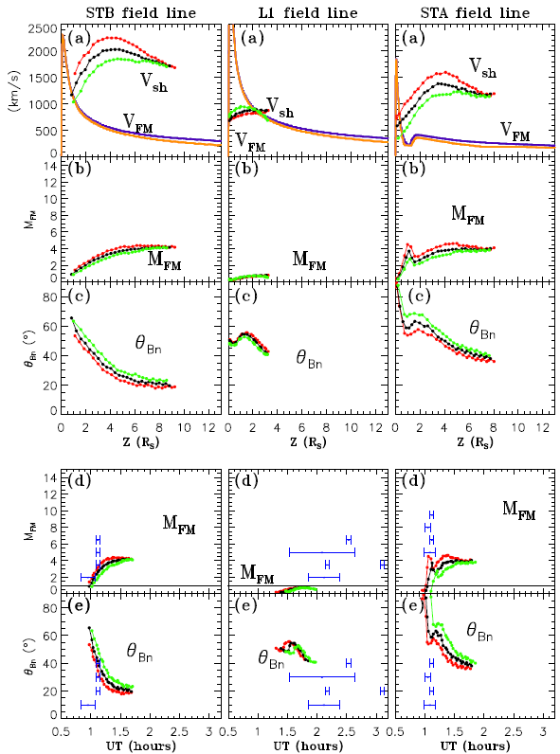
3-D Connection to Observer
2014 February 25 (Lario+ 2017, ApJ 847)
Geometrical shock fitting (Kwon+ 2014) + Magnetohydrodynamic Around a Sphere (MAS, Lionello+ 2009)
2010 August 14 (Lario+ 2017, ApJ 383)
Parker field down to 2.5 R_{SUN} + potential field source surface (PFSS) model (Schatten+ 1969) + geometrical shock fitting (Kwon+ 2014)

Slide 20
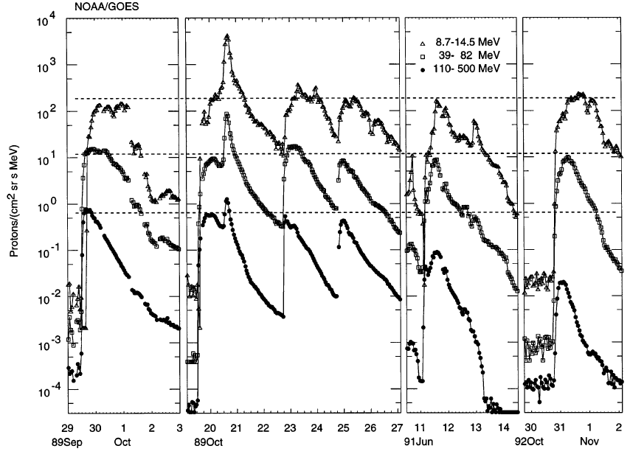
Streaming Limit
Intense SEP events have maximum-intensity plateau:
Excitation of waves by earlier high-E particles restrict later low-E particles escape from the shock (e.g. Lee 1983, Reames & Ng 1994)
Limit depends on the intensity and spectra
of the accelerated particles (Reames & Ng 2010)
Reames & Ng 1998

Slide 21
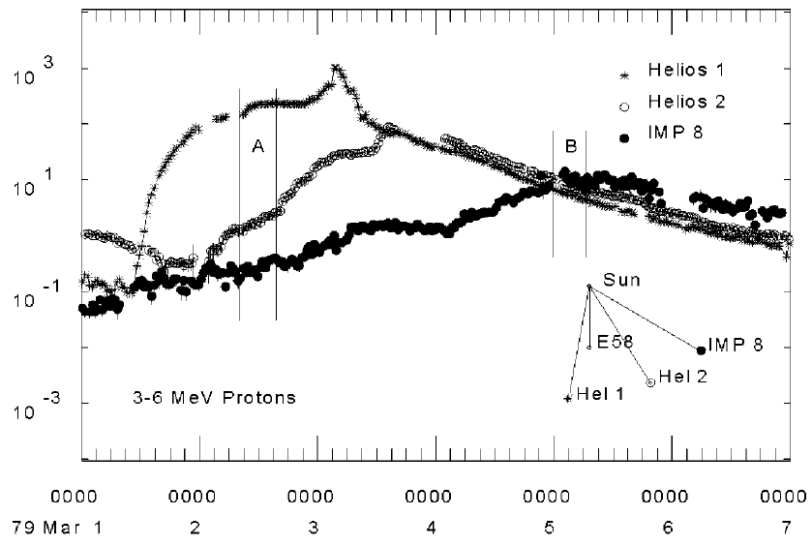
Particle Reservoir
Reames+ 1996
Widely separated spacecraft detect similar particle spectra: Seeing same large reservoir of particles trapped behind the CME shock
Region of invariant spectrum
Decrease in flux due to the expansion of the reservoir , not the commonly assumed diffusion (Reames 2017)
Notes:
Highest-E particles should escape first leading spectrum steepening, which is not observed (assumes energy dependent diffusion which is uncertain)

Slide 22
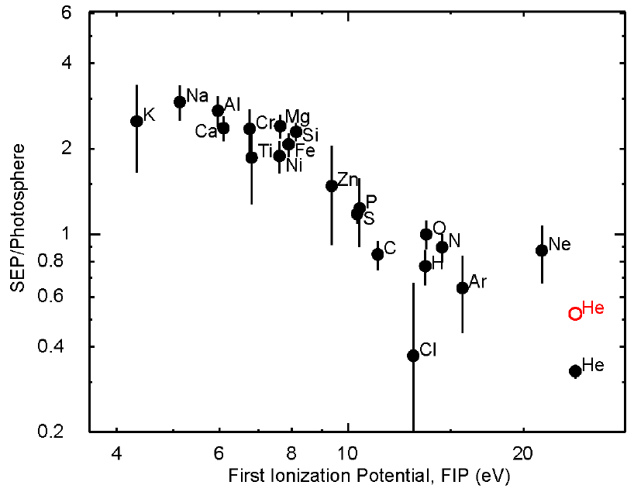
FIP Fractionation
The SEP/photospheric abundance ratios as a function of first ionization potential (FIP) change ~ 10 eV
Elements with a low FIP ionized in the chromosphere
Degree of FIP fractionation varies from event to event (Garrard & Stone 1994)
Differences in the fractionation patterns of SEPs and solar wind suggest that they are distinct samples of coronal material (Mewalt+ 2002)
Reames 1995

Slide 23
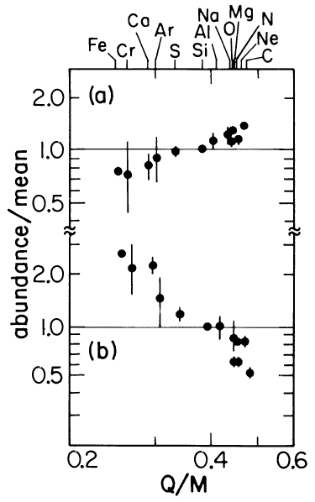
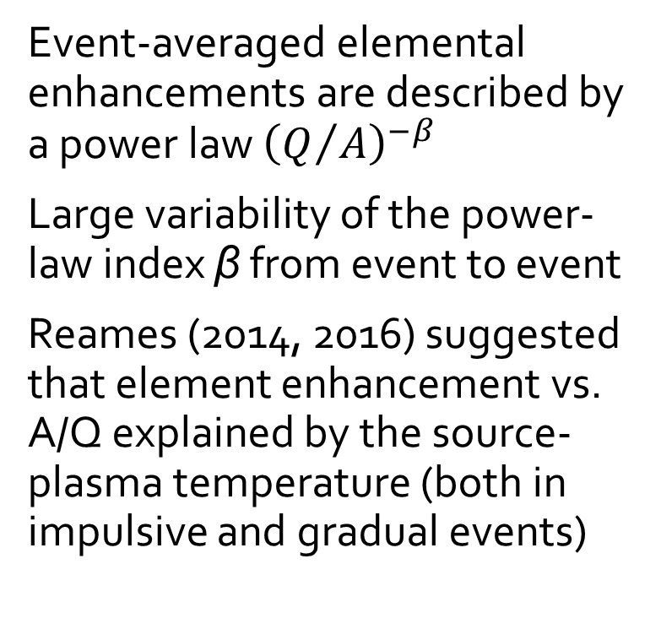
Q/A Fractionation
Event-averaged elemental enhancements are described by a power law ${\left(Q/A\right)}^{−β}$
Large variability of the power-law index β from event to event
Reames (2014, 2016) suggested that element enhancement vs. A/Q explained by the source-plasma temperature (both in impulsive and gradual events)
Breneman & Stone 1985
Notes:
pattern of enhancement vs. A/Q determine the source-plasma temperature

Slide 24
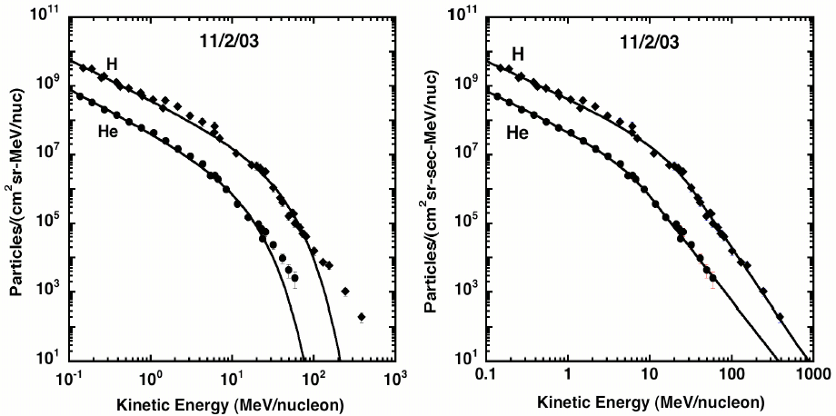
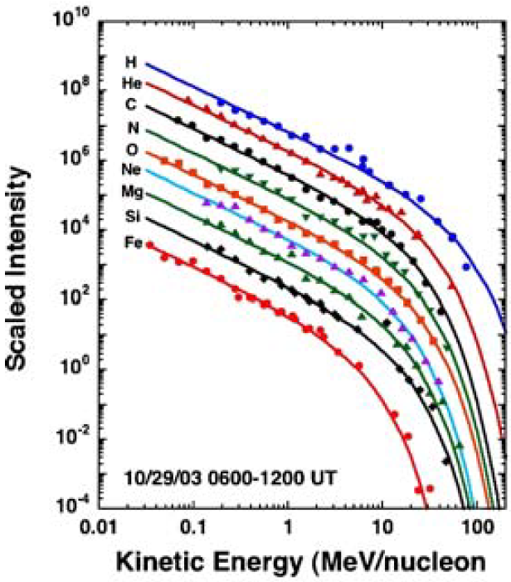
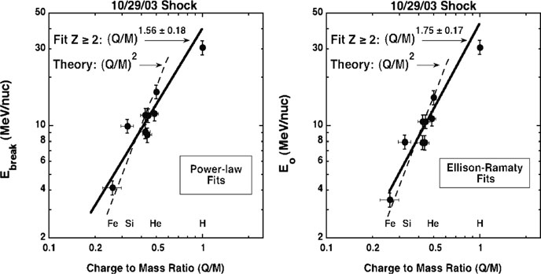
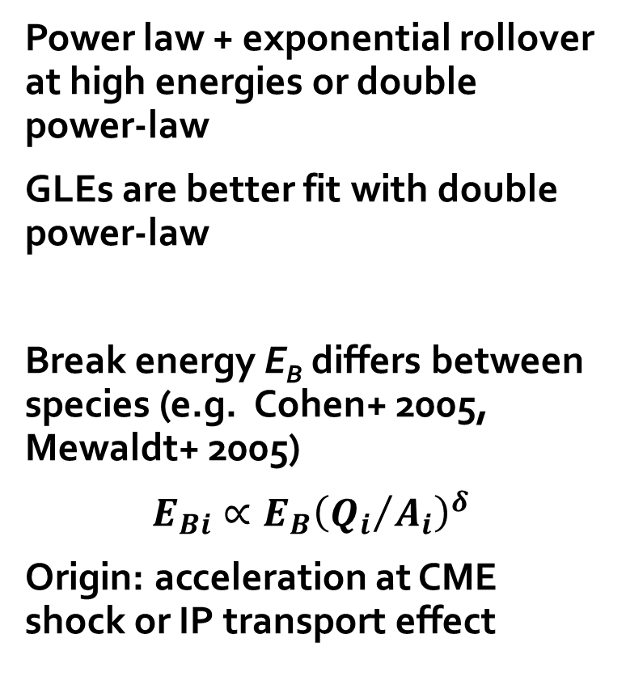
Event Integrated Energy Spectra
Power law + exponential rollover at high energies or double power-law
GLEs are better fit with double power-law
Break energy E_{B} differs between species (e.g. Cohen+ 2005, Mewaldt+ 2005)
$$E_{Bi}∝{E_{B}\left({Q_{i}}/{A_{i}}\right)}^{δ}$$
Origin: acceleration at CME shock or IP transport effect
Mewaldt+ 2005
Mewaldt 2006
Notes:
High-E rollover: finite shock size, limited acceleration time, shock geometry, and adiabatic cooling

Slide 25
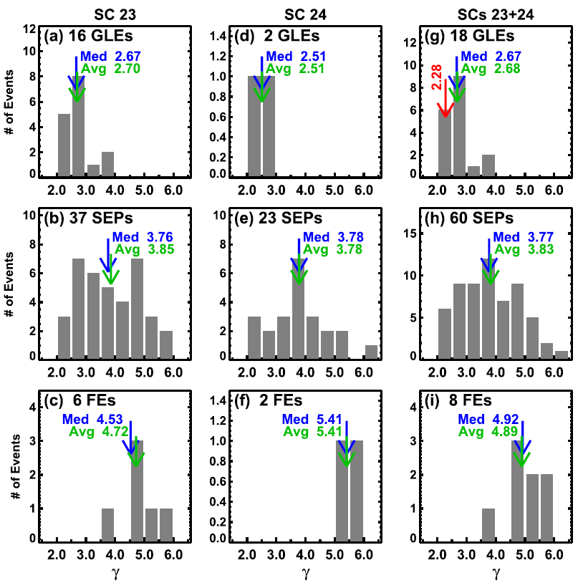
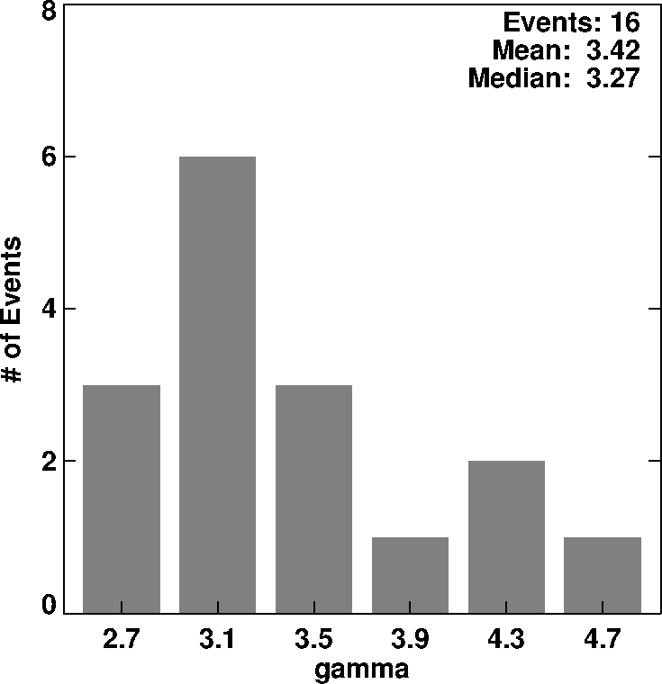
Spectral Index Hierarchy
Systematic increase in spectral index as one goes from the ground level enhancement (GLE) events to regular SEP events and to filament eruption (FE, Kahler 2000) SEP events
Fluence spectra
 | Cycle 23 | Cycle 24 | Cycles 23 and 24
FE SEP | 4.72 | 5.41 | 4.89
Regular SEP | 3.85 | 3.78 | 3.83
GLE | 2.70 | 2.51 | 2.68
Soft
Intermediate
Hard
Small SEP events
Small SEP events follow the spectral index hierarchy
Gopalswamy+ 2016, ApJ 833

Slide 26
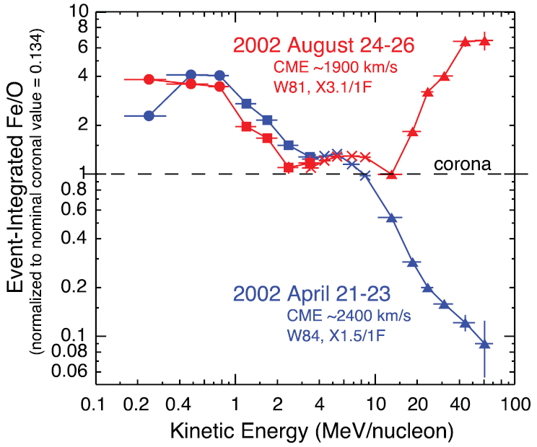
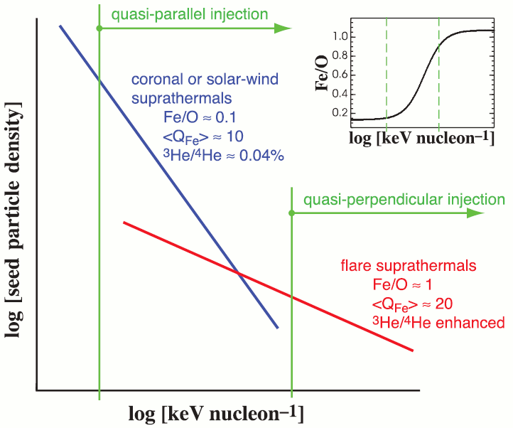
Variation of High-Energy Fe/O Ratio in Gradual Events
Two similar gradual SEP events but high-energy Fe/O varies dramatically
Variability due to shock geometry (quasi-parallel vs quasi-perpendicular) that affects the injection energy of particles. Therefore, shocks accelerated seed particle populations with differing composition: coronal and remnant suprathermals (Tylka+ 2005; Tylka & Lee 2006)
PROBLEM 1: Shock geometry unknown near the Sun
PROBLEM 2: Injection energy might not depend on shock geometry (Giacalone 2005)

Slide 27
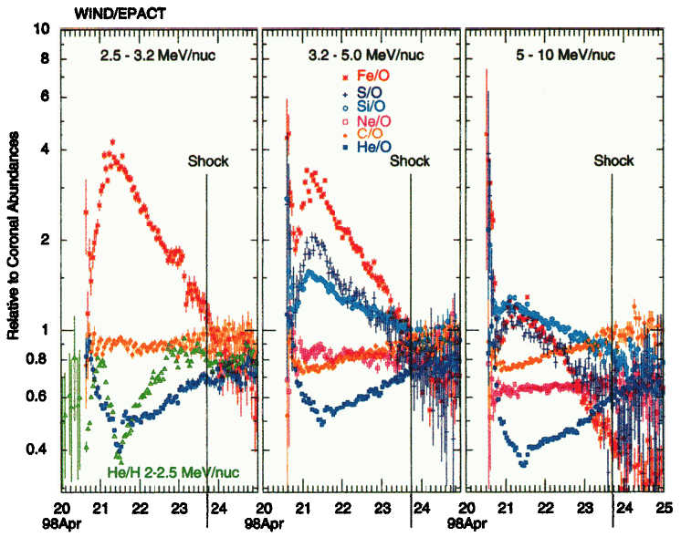
Time Variation of Elemental Ratios
Elemental ratios vary during SEP events
High Fe/O ratio at the beginning of the well-connected SEP events indicates direct flare particles (Cane+ 2003)
Variation caused by transport effects (Ng+ 1999): waves generated by escaping protons cause Fe ions to arrive before O ions. Fe higher rigidity than O, so O ions are delayed by stronger scattering
Tylka+ 2006

Slide 28
Charge States
Charge states of ions decided by a competition between recombination and ionization processes
Charge states reflect source region temperature and effects of collisional processes
Gradual events Q_{Fe} ≈ 15+ ( ~1-2 MK solar source plasma, i.e. coronal material)
Stripping of electrons in high-density regions during acceleration may change charge-state distributions (e.g. Kocharov+ 2000)

Slide 29
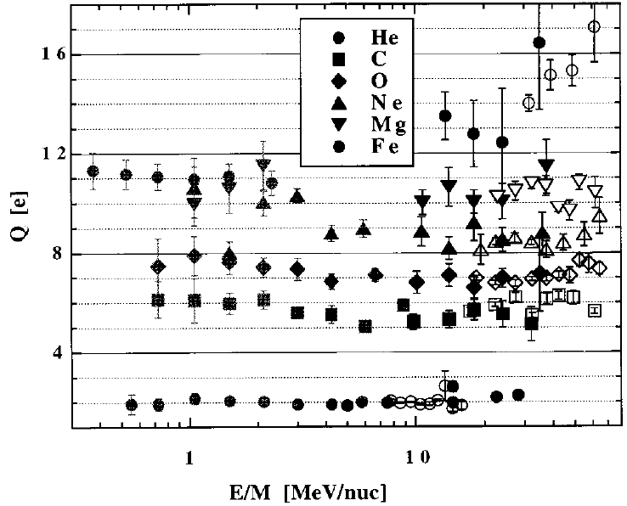
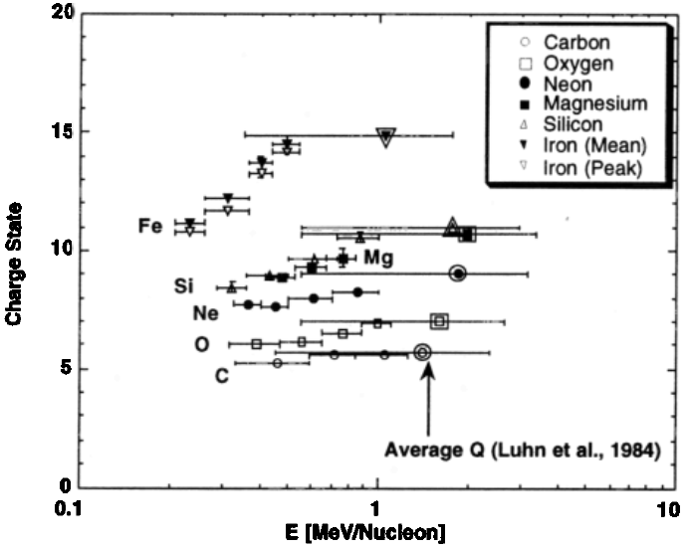
Charge States in Gradual Events
Oetliker+ 1997
Möbius+ 1999
October-November 1992 and 6 November 1997 gradual events: higher charge states as energy increases (Oetliker+ 1997; Mazur+ 1999)
No simple correspondence with source temperature possible. Possible mixture of flare and CME-shock accelerated particles.

Slide 30
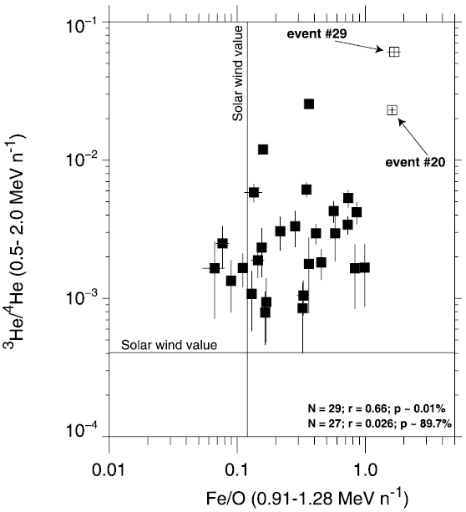
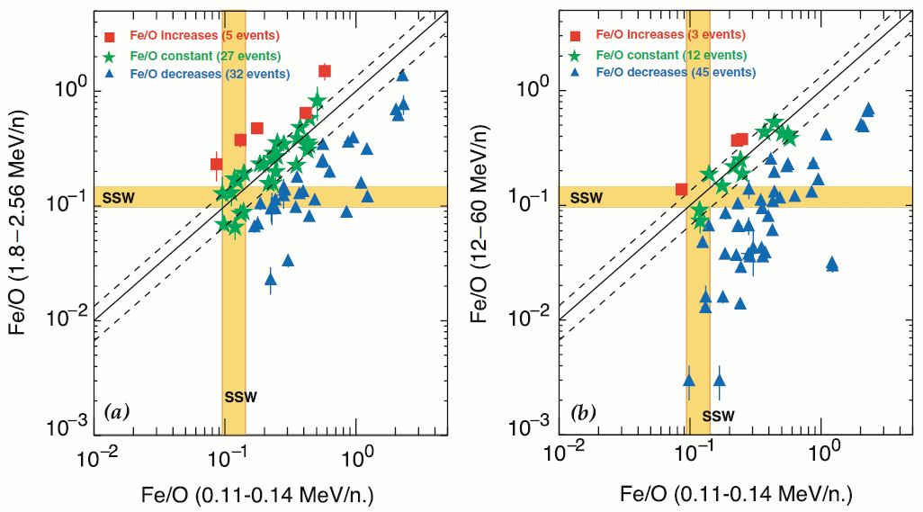
³He and Fe Enhancements in Gradual Events
Desai+ 2006
Fe/O and ³He/⁴He enhancements typical to flare-related impulsive events observed also during gradual events (e.g. Reames 1990; Mason+ 1999)
Could indicate the presence of flare-accelerated particle populations
Fe/O ratio decreases with increasing energy in most of events, show large even-to-event variation and poor correlation with ³He/⁴He ratio, event-to-event abundance variations are reasonably well ordered by M/Q, source: suprathermal material with enriched Fe and the heavier ion abundances (Desai+ 2006)
Notes:
Systematic M/Q-dependent enhancements in LSEP events are an inherent property of a highly variable suprathermal seed population, most of which is accelerated by mechanisms that produce heavy-ion abundances similar to those observed in impulsive SEP events. heavy-ion-enriched material accelerated at CME-driven shocks near the Sun by processes in which ions with higher M/Q ratios are accelerated less efficiently, thus causing the Fe/O ratios to decrease with increasing energy

Slide 31
Seed Particle Population
Suggested explanations for mixed composition in gradual SEP events:
shock acceleration of remnant suprathermal ions from previous impulsive SEP events or particles from associated flare (Mason+ 1999; Tylka+ 2005; Mewaldt+ 2003; Tylka & Lee 2006)
Mixture of flare-accelerated particles and CME shock-accelerated particles (Cane+ 2003, 2006)

Slide 32
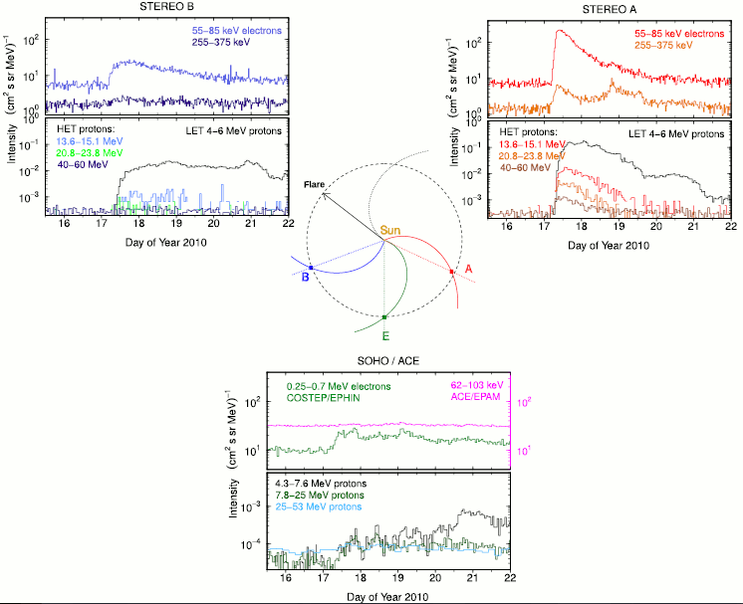
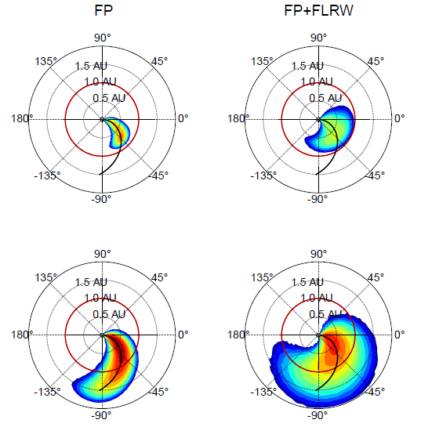
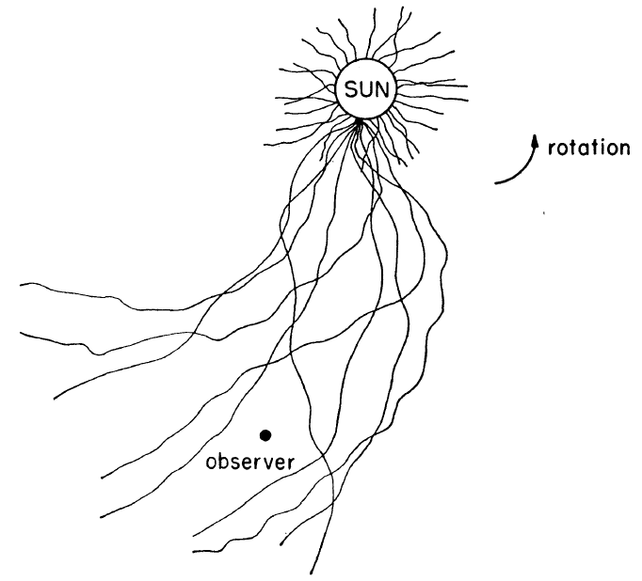
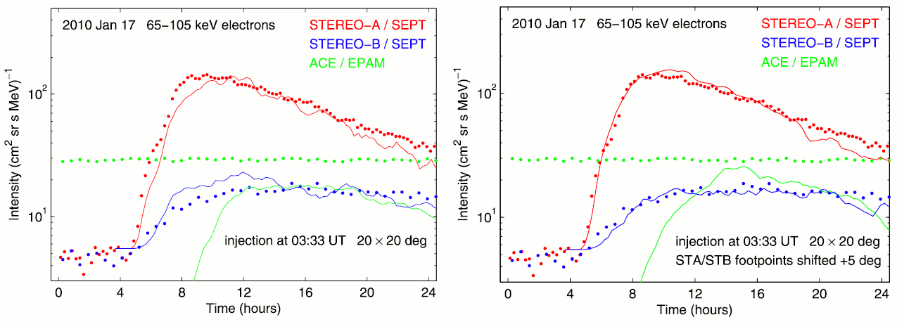
Perpendicular Diffusion
Perpendicular diffusion across magnetic field lines not well understood
Example by Dresing+ (2012)
fluctuations scatter particles from one field line to another
field line mixing
Propagation model:
Source: flare pos ± 20° in lon/lat
lateral particle transport due to perpendicular diffusion and co-rotation
FP=Diffusion FLRW=field line random walk
Laitinen+ 2016
Jokipii 1966

Slide 33
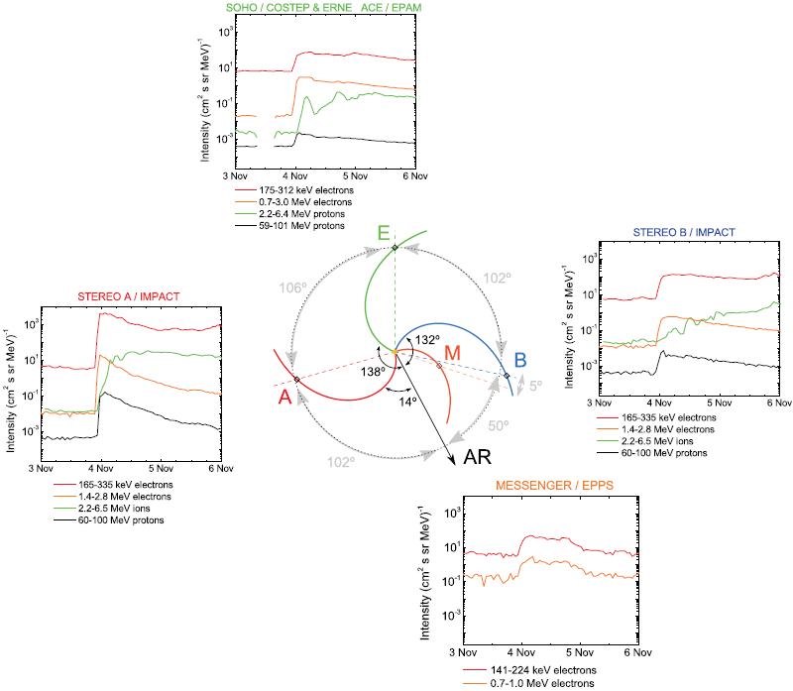

2011 November 3 Circumsolar Event
SOHO/ERNE 12.9-28.0 MeV proton intensities during far-eastern hemisphere (E120-E170) eruptions with the halo CME sky speed > 1000 km/s, no other CMEs
2 no SEP events, 4 possible circumsolar SEP events
Gómez-Herrero+ 2015
Propagation conditions for the 3 Nov 2011 CME shock must have been exceptional, because a strong shock seems to have reached the Earth’s magnetic field line.

Slide 34


Longitudinal Dependence of SEP Intensity
E >25 MeV solar proton events detected by 3 spacecraft.
σ = 43° ±13°
Cohen+ 2017 studied H, He, O, and Fe at 0.3, 1, and 10 MeV/n and found the same average σ, but distributions narrowed with increasing energy: (1) lower-E ions experience more field line co-rotation, (2) are accelerated over a larger area of the shock, or (3) are accelerated for longer times.
Richardson+ 2014

Slide 35



Intensity Prediction
Electrons 62-105 keV:
Xie+ 2019
Obs. ~25 MeV protons
Pred. 14 – 24 MeV protons
Protons 19-30 MeV:
CA=connection angle [deg]; v=shock speed [10³ km/s]; κ=flux rope (FR) aspect radio; ω_{FO}= FR face-on width [10² deg]; v²κ²ω_{FO} =proxy of CME kinetic energy
I(Φ)(MeV s cm² sr)⁻¹ ≈ 0.013 exp(0.0036V – Φ²/2σ²), σ = 43°
Richardson+ 2014, also Richardson+ 2018, Bruno & Richardson 2021

Slide 36

Preconditioning
Fast CMEs interacting are more likely to produce an SEP event (Gopalswamy+ 2002)
Twin-CME suggested for GLE events (Li+ 2012)
P: Preceding CME from the same active region ≤ 24 hours
Cycle -24 large SEP events analyzed for preconditioning
The result is consistent with Gopalswamy+ (2004) who considered cycle 23 events, but the cycle 24 distributions overlap more than cycle 23 ones
Yashiro + 2015

Slide 37
Solar Cycle Dependence
Gopalswamy+ 2022

Slide 38

Cumulative Distribution of Peak Flux
NOAA definition of a major SEP event does not separate overlapping SEP events and peak intensities include energetic storm particle (ESP) peak values.
SEP measurements are affected by magnetic connection between the observer and the particle source.
Earth’s magnetic field line connects to the western hemisphere of the solar disk.
100-year event: ~1.9 10⁵ pfu
1000-year event: ~9.3 10⁵ pfu
Updated from Gopalswamy 2018

Slide 39


Cumulative Distribution of Integral Fluence
GOES >10 MeV:
100-year event: ~4.8 10¹⁰ cm⁻²
1000-year event: ~1.3 10¹¹ cm⁻²
GOES >30 MeV:
100-year event: ~1.5 10¹⁰ cm⁻²
1000-year event: ~4.6 10¹⁰ cm⁻²
Updated from Gopalswamy 2018

Slide 40
Historical Extreme SEP Events
Historical extreme SEP events have been discovered using cosmogenic isotope proxies: ¹⁰Be and ³⁶Cl concentration in polar ice cores and ¹⁴C in tree rings (Usoskin+ 2006; Miyake+2012, Mekhaldi+ 2015).
Miyake+ (2012, 2013) discovered sudden ¹⁴C increases in Japanese cedar trees, indicating two extreme SEP events in 774-775 CE and 993-994 CE.
New one-year event in ¹⁴C of 5411/5410 BCE tree rings, a possible extreme SEP event (Miyake+ 2021)

Slide 41

Integral Fluence Spectrum Comparison
The 100-year and 1000-year data points derived using Weibull, Ellison-Ramaty (Ellison & Ramaty 1985), and Band (Band+ 1993) functions.
The 774/5 CE and 993/4 CE spectra and the February 23, 1956, (SEP56) and August 4, 1972 (SEP72) spectra (Mekhaldi+ 2015).
The spectra of the 2012 July 23 backside eruption from Gopalswamy+ (2016) .Very fast CME (Sun-to-1 au shock transit time 18.5 hr, estimated >10 MeV flux peak ∼5000 pfu at STEREO-A).

Slide 42
References
Recent review papers:
Desai, M., Giacalone, J. (2016), Large gradual solar energetic particle events, Living Reviews in Solar Physics 13:3, DOI:10.1007/s41116-016-0002-5
Cliver, E. W, Schrijver, C. J., Shibata, K., Usoskin, I. G. (2022), Extreme solar events, Living Reviews in Solar Physics 19:2, DOI:10.1007/s41116-022-00033-8
Recent books:
Reames, D. V. (2021), Solar Energetic Particles, A Modern Primer on Understanding Sources, Acceleration and Propagation, Lecture Notes in Physics 978, Springer
Simnett, G. M. (2017), Energetic Particles in the Heliosphere, Astrophysics and Space Science Library 438, Springer

Slide 43
Thank You!

