Slide 1
Solar Sources of Earth-affecting Energetic Particles
Nat Gopalswamy NASA Goddard Space Flight Center
Thanks to: H. Xie, P. Mäkelä, & S. Yashiro
11th Annual International Astrophysics Conference, March 19-23, 2012 Palm Springs, CA

Slide 2
Plan of the Talk
Introduction
SEP events of Solar Cycle 23
SEP events of Solar Cycle 24
Other indicators of space weather events: Halo CMEs, Type II radio bursts
SEP butterfly diagram
Interacting CMEs
Summary

Slide 3
Introduction
Consider large SEP events (proton intensity ≥ 10 pfu in the >10 MeV GOES energy channel)
Do not consider radiation-belt energetic particles although they are also important for space weather (Parks, Raeder)
Rise phases of cycle 23 & 24:
→ June 1996 – May 2000 [cycle 23]
Jan 2008 – December 2011 [cycle 24] to March 2012?
Phases important: Storm season
Solar rotation and solar cycle bring active regions facing Earth

Slide 4
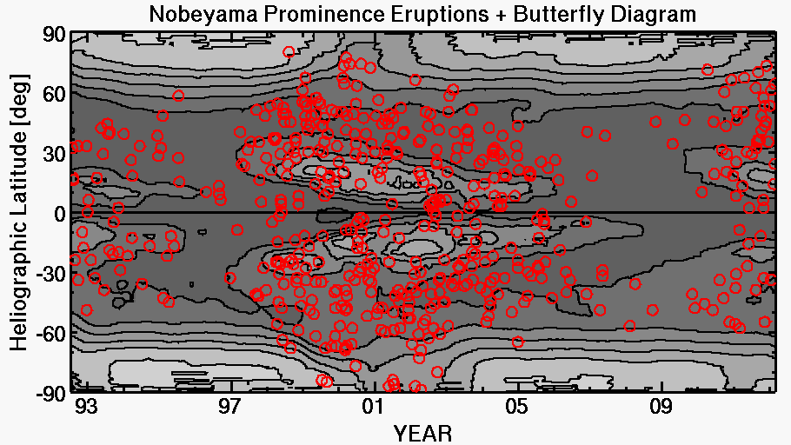
PE Locations + Butterfly Diagram
23 Maximum
24 Maximum?
22/23 Min
23/24 Min
Notes:
The intervals are times of positive offset between PE and CME (positive offset means the prominence eruptions are at a higher latitude than are the associated CMEs).
Indication of solar maximum conditions is the occurrence of prominence eruptions at latitudes higher than 60 deg. This occurred in 1999 – 2001 in the north pole and 1999.5 to 2002.5 in the south pole.
In the new cycle, the Pes have crossed the 60-deg line in the beginning of 2011 and continued during 2012. This means solar maximum conditions have arrived at the north pole. This is also indicated by the disappearance of microwave polar brightening at the north pole. Thus the PEs and CH brightness both indicate solar maximum conditions in the north pole. On the other hand, in the south pole, the PEs still have not crossed the 60 deg latitude. The coronal hole brightness is still high. Both these conditions indicate that the south polar region is still in the rise phase.

Slide 5
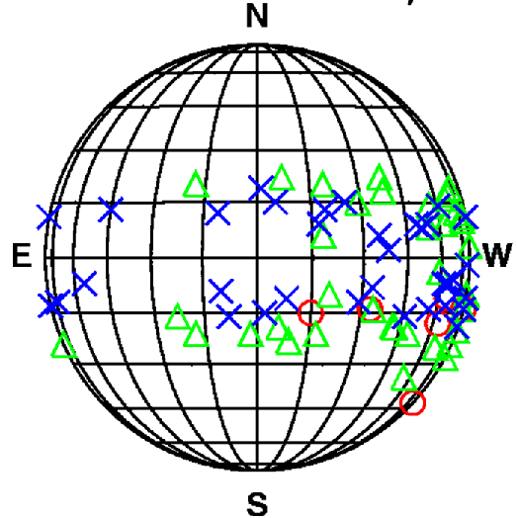
SEP-producing CMEs from the Active Region Belt
Solar Sources generally within ±30º Lat.
maximum and declining phases important
Solar sources are generally located in
the western hemisphere because
magnetic connectivity to Earth for
SEPs affecting Earth
Active regions emerge at any longitude
but those in the western hemisphere
are likely to send particles to Earth
DECL
MAX
RISE

Slide 6
Solar Sources of Earth-affecting CMEs
Geoeffective
SEP-producing
Gopalswamy, 2009

Slide 7
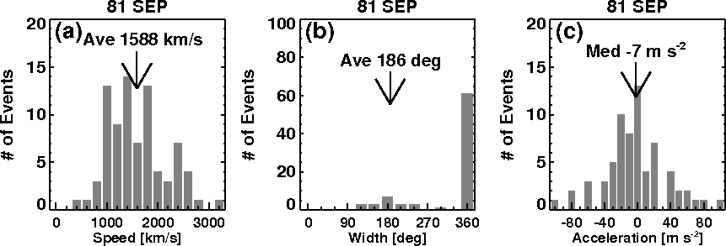
Large SEP Events of Cycle 23
61% Halos
Average speed of ordinary CMEs: 475 km/s
Fraction of halo CMEs: 3%
Acceleration ~0
SEP-producing CMEs are very energetic

Slide 8
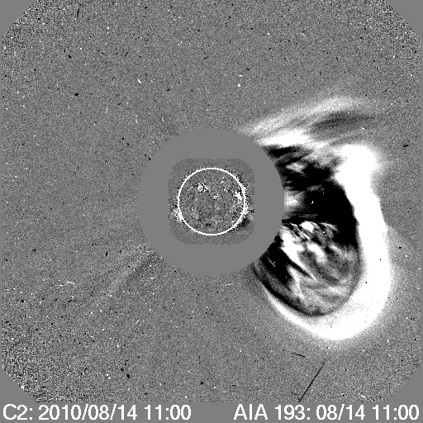
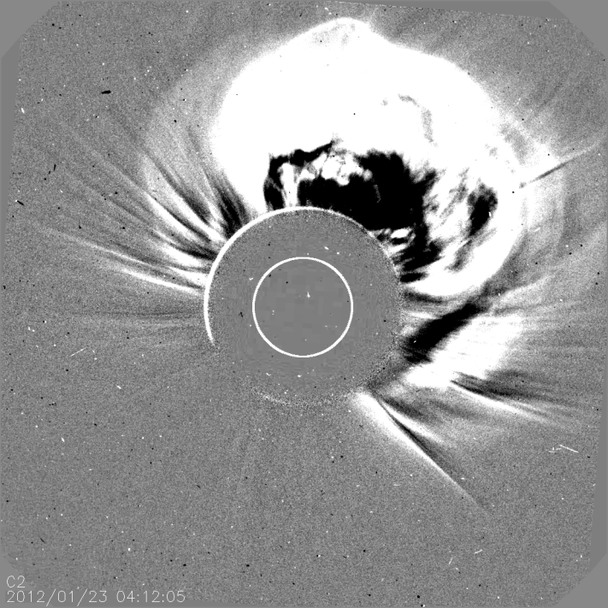
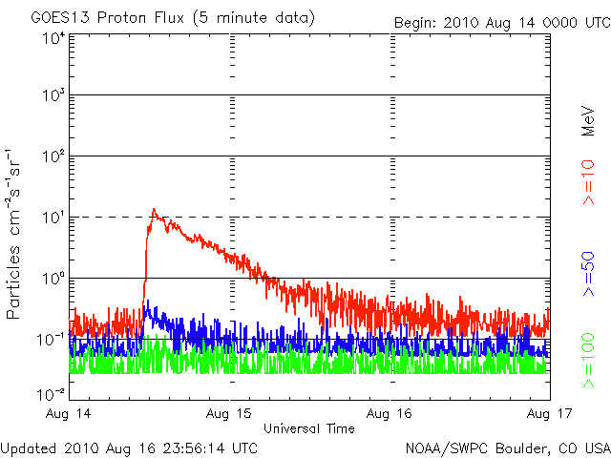
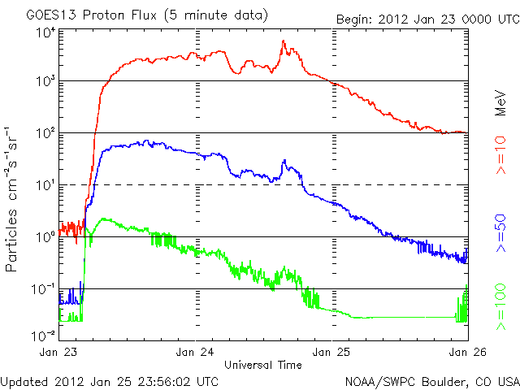
The smallest and largest events
CME at 10:12 UT V = 1205
C4.4 flare from AR 1099
N17W52
3000/6310
pfu
CME at 04:12 UT V = 2102
M8.7 flare from AR 1402
N28W36
14 pfu

Slide 9
Large SEP Events of Cycle 24
17 Events during
cycle 23
Event | Location | Intensity pfu | AR Area msh | CME Time & Speed km/s | Flare Imp. AR Number
2010/08/14 | N17W52 | 14 | 70 | 10:12 1205 H | C4.4 1099
2011/03/08 | N24W59 | 50 | 760 | 20:00) 2125 H | M3.7 1164*
2011/03/21 | N23W90b | 14 | ??? | 02:24 1341 H | backside
2011/06/07 | S21W54 | 72 | 80 | 06:49 1255 H | M2.5 1226
2011/08/04 | N16W30 | 96 | 300 | 04:12 1315 H | M9.3 1261
2011/08/09 | N17W69 | 26 | 450 | 08:12 1610 H | X6.9 1263
2011/09/23 | N11E74 | 35 | 480 | 10:48) 1905 H | X1.4 1302*
2011/11/26 | N27W49 | 80 | 10 | 07:12 783 H | C1.21353?**
2012/01/23ª | N28W36 | 3000/6310 | 370 | 04:12 2102 H | M8.7 1402
2012/01/27 | N27W71 | 800 | 270 | 18:27 2408 H | X1.7 1402
2012/03/07ª | N17E27 | 1500/6000 | 1120 | 01:36 2544 H | X5.4 1429
2012/03/13 | N19W59 | 500 | 380 | 17:36 1898 H | M7.9 1429
**Long filament, ) Previous day, ªfirst is SEP peak, second is ESP peak
Notes:
The table shows the large SEP events of cycle 24. The solar sources of the associated CMEs, peak proton flux, area of the active region, CME onset time, speed, and width and the flare size are given. The last four events are in principle in the maximum phase.

Slide 10
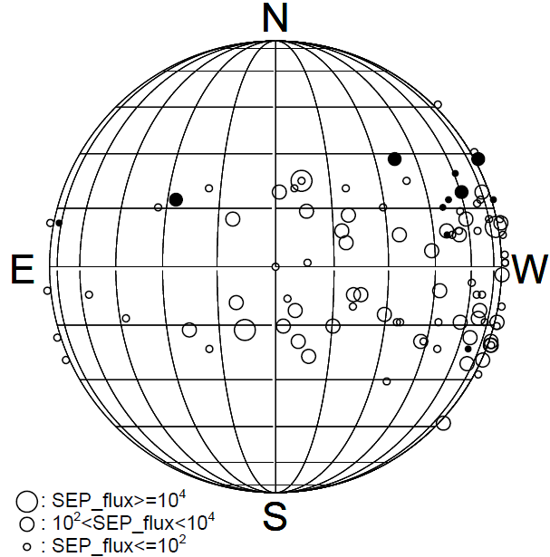
Solar Sources
Notes:
We compare the source location of cycle 24 SEPs with those of cycle 23 SEPs. The sources are within the expected range. Mostly western events. one disk center event and one event near east limb. The SEP sources appear in the northern hemisphere except one event.

Slide 11
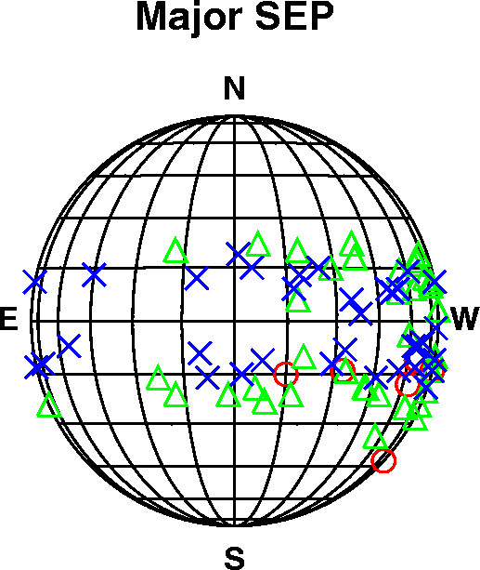
Three Phases of the Cycle
DECL
MAX
RISE

Slide 12
Three Phases of the Cycle
DECL
MAX
RISE

Slide 13
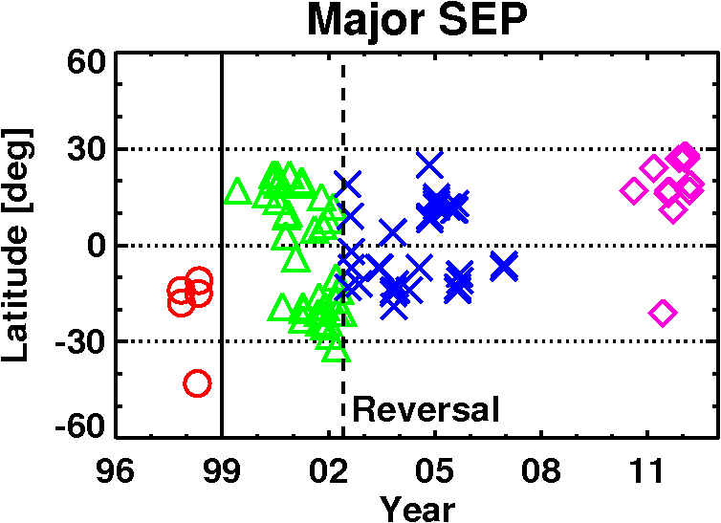
Where are the solar sources?
s
Cycle 23
2010 Aug 14
N17W52
2y
3.7y
2006 Dec 13
S05W23
1995 Oct 20
S09W55
Cycle 24
1997 Nov 04
S14W33
21/22 min only 0.5y w/o SEPs
Notes:
This diagram shows tha solar sources as a function of time. The three phases of cycle 23 are shown in different symbols. The rise phase of cycle 23 is compared with the rise phase of cycle 23. Note the north-south change in the solar sources between the two cycles. There is a long delay between the last SEP event of cycle 23 and the first SEP event of cycle 24: nearly 4 years. The corresponding delay between cycles 22 and 23 is only 2 years.

Slide 14
Reason for Asymmetry: Active regions in the North
23 Maximum
24 Maximum?
22/23 Min
23/24 Min
Notes:
The intervals are times of positive offset between PE and CME (positive offset means the prominence eruptions are at a higher latitude than are the associated CMEs). The SEP sources are located at the active region belt. There is again a north-south asymmetry in the active region belt, which seems to be responsible for the north-south asymmetry in the SEP sources. The asymmetry is reverse during cycles 23.
Indication of solar maximum conditions is the occurrence of prominence eruptions at latitudes higher than 60 deg. This occurred in 1999 – 2001 in the north pole and 1999.5 to 2002.5 in the south pole.
In the new cycle, the Pes have crossed the 60-deg line in the beginning of 2011 and continued during 2012. This means solar maximum conditions have arrived at the north pole. This is also indicated by the disappearance of microwave polar brightening at the north pole. Thus the PEs and CH brightness both indicate solar maximum conditions in the north pole. On the other hand, in the south pole, the PEs still have not crossed the 60 deg latitude. The coronal hole brightness is still high. Both these conditions indicate that the south polar region is still in the rise phase.

Slide 15
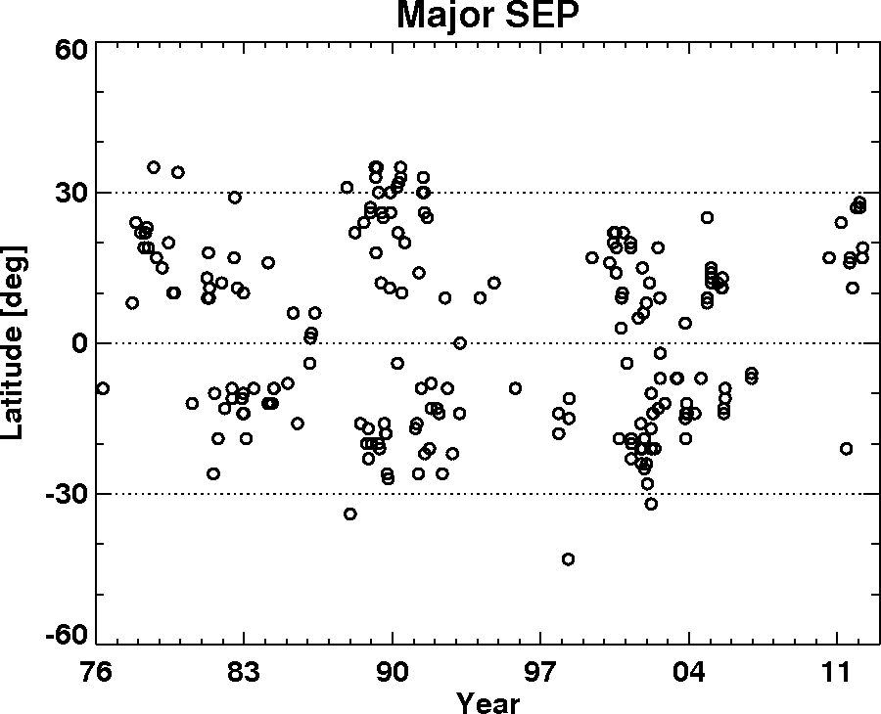
Major SEP Events: 1976 - present
s
21 Max
22 Max
23 Max
Notes:
This is the SEP butterfly diagram from 1976 to the present using GOES events compiled by NOAA. This cycle looks a lot like cycle 21 in terms of SEP sources. There is no north-south asymmetry during cycle 22. There is north-south asymmetry in cycle 23, but in the opposite sense. Cycle 22 also has >0 deg sources

Slide 16
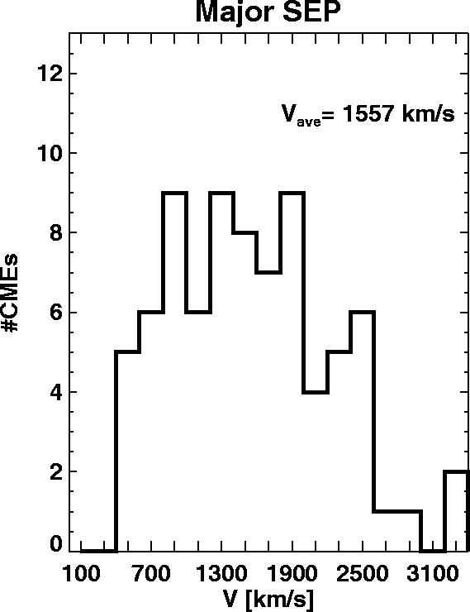
Speeds of SEP-producing CMEs
CYCLE 23
s
Cycle 24
1588 km/s
Cycle 23
(Rise)
Cycle 24 CMEs
20% faster
1423
km/s
1710
km/s
Notes:
The speeds are similar to the cycle 23 events, perhaps 20% faster. The typical error in speed measurements is 10%. All CMEs are halos, which is an indication of high kinetic energy of CMEs.

Slide 17
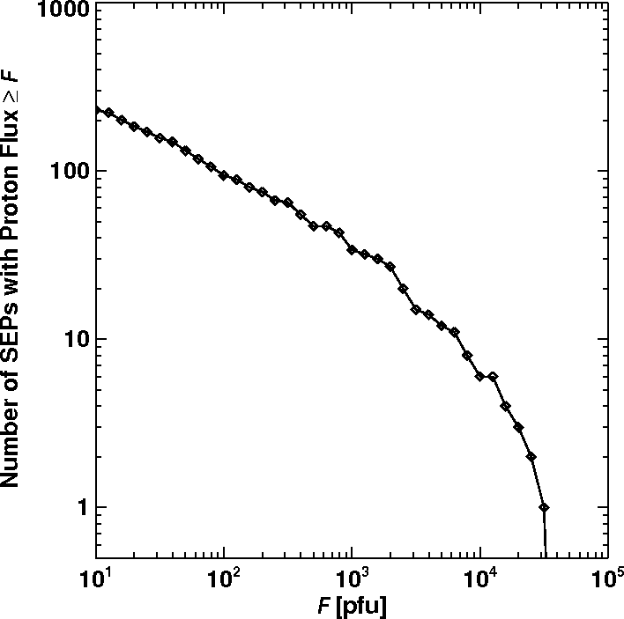
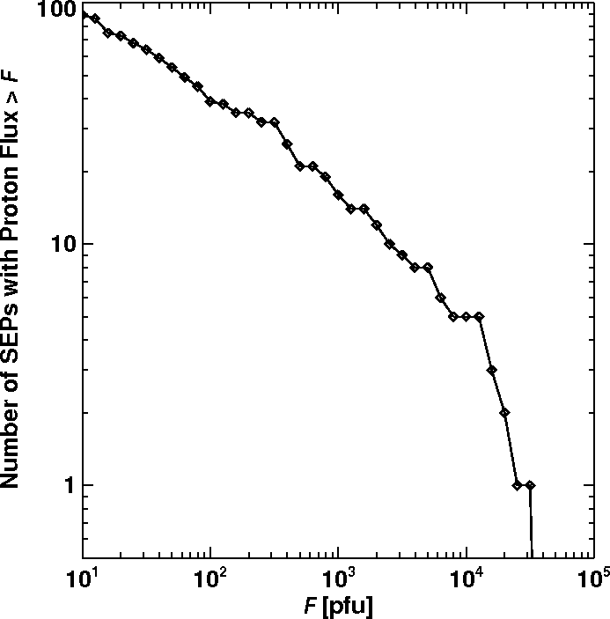
Cycle 24 Events and the Cumulative Distribution of SEP intensities
2010 & 2011 events
Jan & Mar
2012
233 large SEP events
1976 – 2012 March
Cycles 21-24
Cycle 24

Slide 18
Other Signatures of SEP events
Type II radio bursts (metric and interplanetary)
Halo CMEs
Shocks detected in situ at L1 using plasma and wave signatures

Slide 19
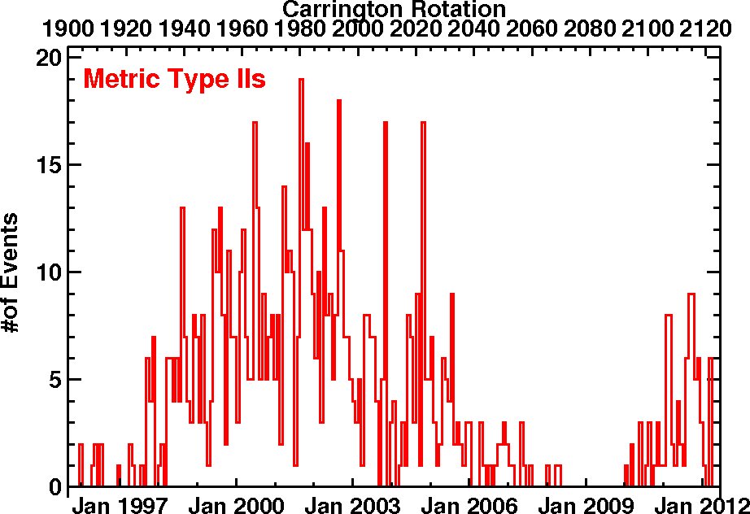
Less # of type II bursts during cycle 24
m 221
IP 101
m 91
IP 68
Notes:
# Metric and Interplanetary (IP) type II bursts summed over Carrington Rotation periods. During the cycle 23 rise phase, there were 221 m type II bursts and 101 IP type II bursts. This number is highly diminished during cycle 24. Consistent with the smaller number of SEP events during cycle 24 (17 vs. 8 or 12).

Slide 20
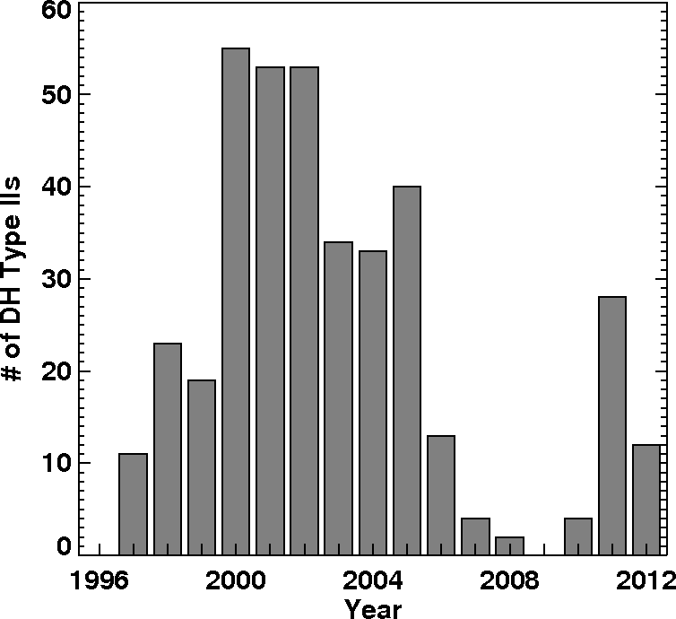
Annual #of IP Type II Bursts
* until May 31, 2000
2*
# SEP events
7
8
5
4
2
*
* Until March 22 2012
1
IP 101
IP 68

Slide 21
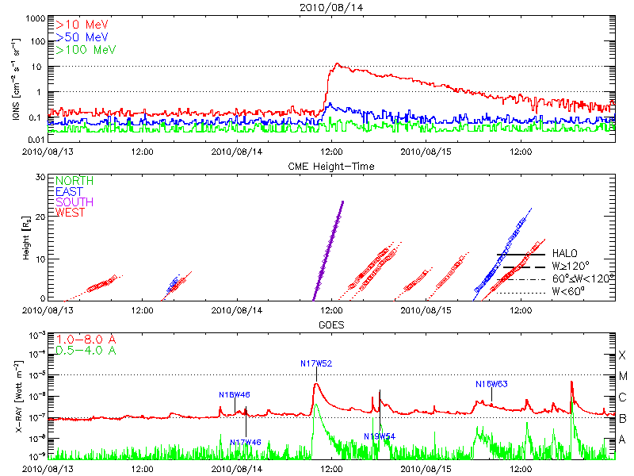
First Large SEP Event: No metric Type II
SEP onset
CME 1205 km/s
-43 m/s²

Slide 22
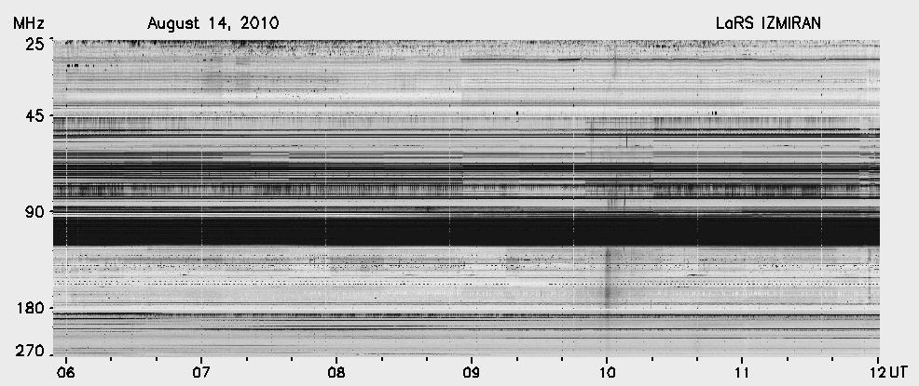
No metric Type II Burst
Type III

Slide 23
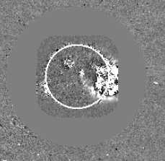
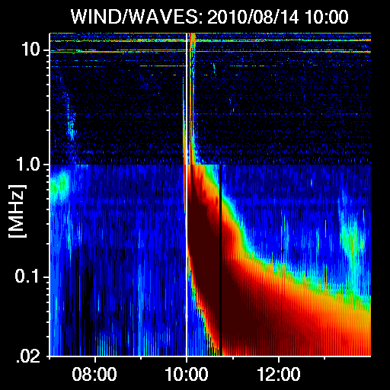
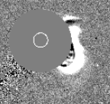
Weakest Type II & Shock
2010/08/14 10:00
Weak Type II
2010/08/14 11:0 6
Type III
Shock seems to be detaching

Slide 24
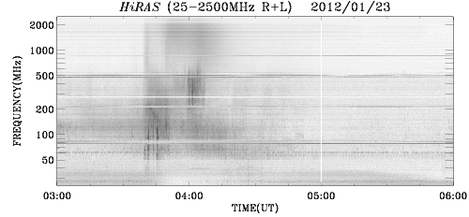
No metric type II in the 2012/01/23 Event?

Slide 25
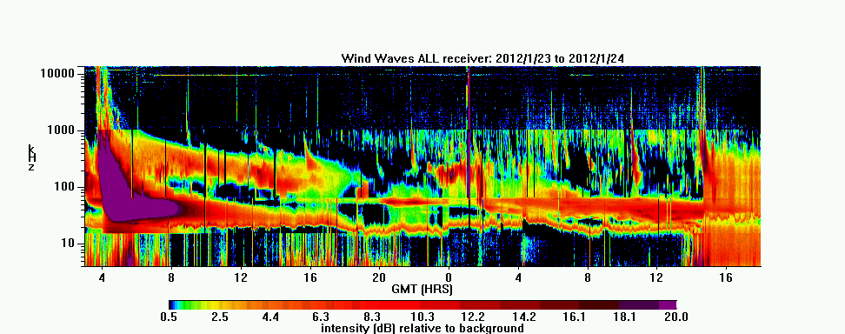
Type II Burst & Shock
36 h
SHOCK
Type II
Type III
The shock continued to produce radio emission all the way to the Wind Spacecraft

Slide 26
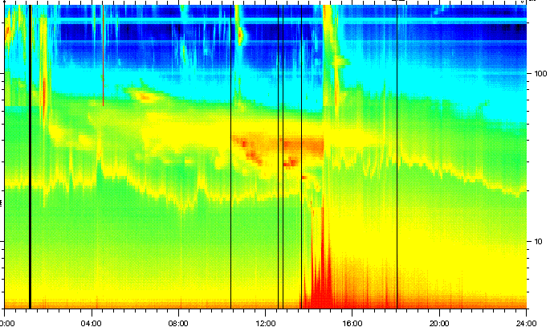
TNR Shock 2012/01/24 14:33
f2/f1 = 1.5 → n2/n1 = 2.25

Slide 27
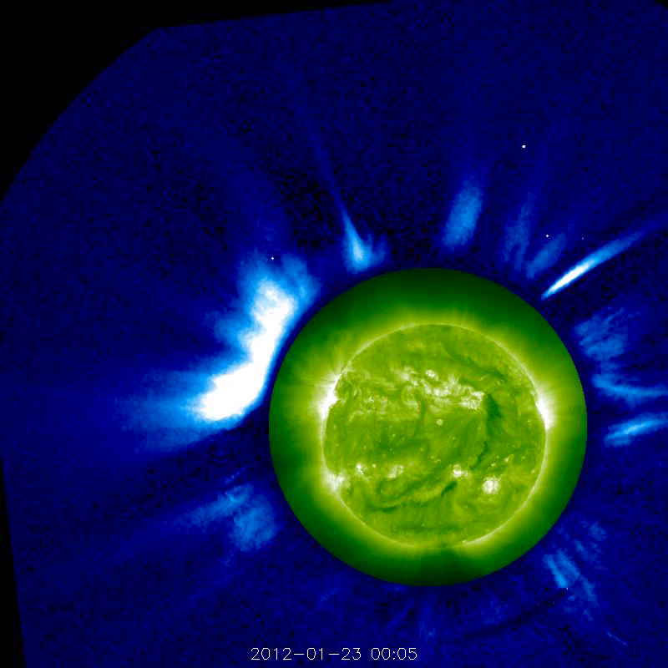
Two CMEs from the same region
Two CMEs seen distinctly in STEREO Data. COR1 + EUVI 195 A images
STEREO/Ahead – limb event

Slide 28
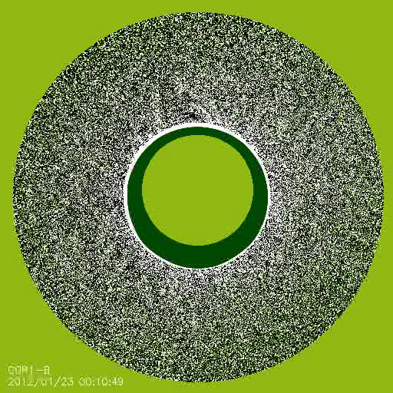
Also from STEREO/Behind
SHOCK

Slide 29
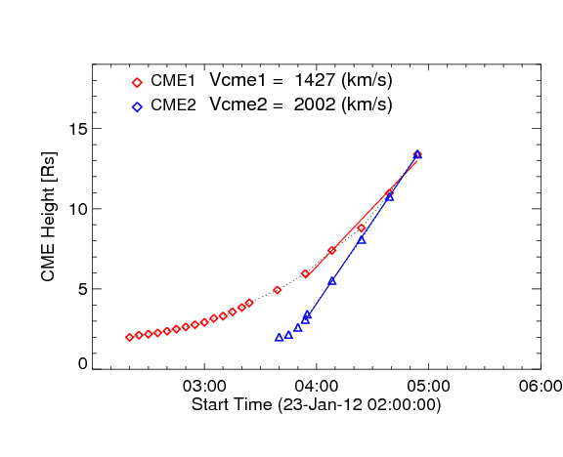
Trajectories of the two Jan 23 CMEs
CME1
CME2

Slide 30
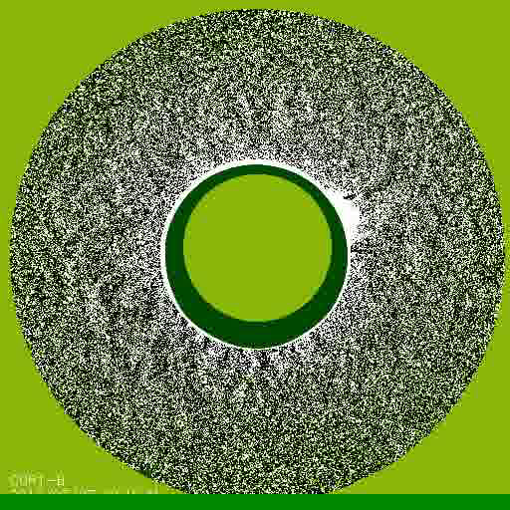
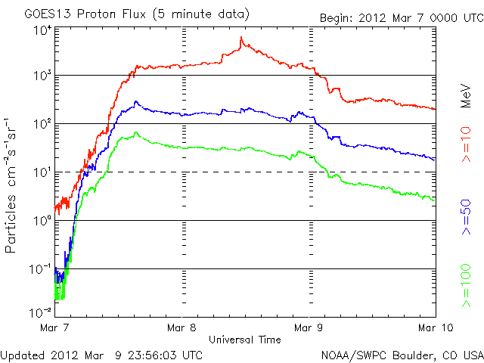
2012 March 07 SEP event: Two CMEs in Quick Succession!
SHOCK

Slide 31
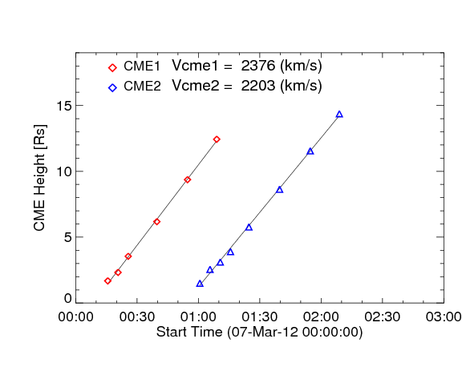
Two CMEs - same speed, <1-hr apart
CME1
CME2

Slide 32
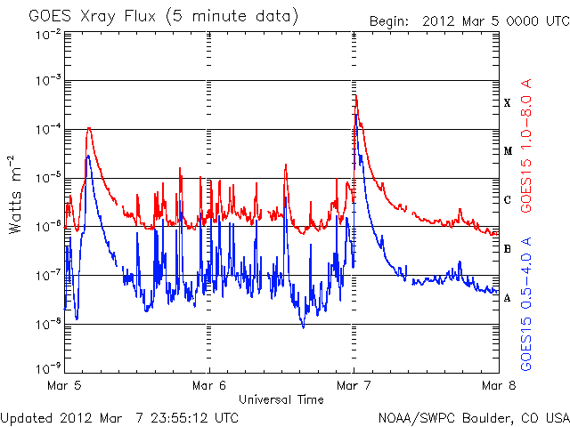
Double X-ray Flares
00:02
01:05
AR 1429

Slide 33
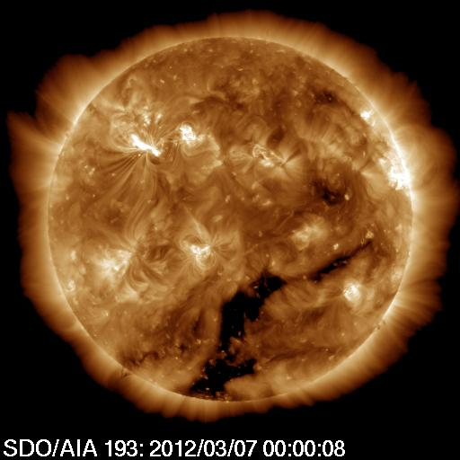
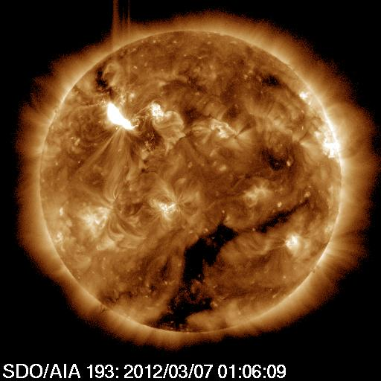
Solar Source of the Double Eruption

Slide 34
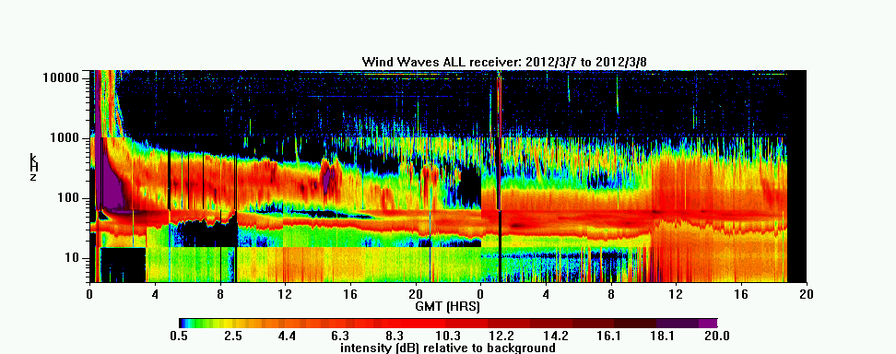
Type II Burst & Shock 2012/03/08
35 h
SHOCK

Slide 35
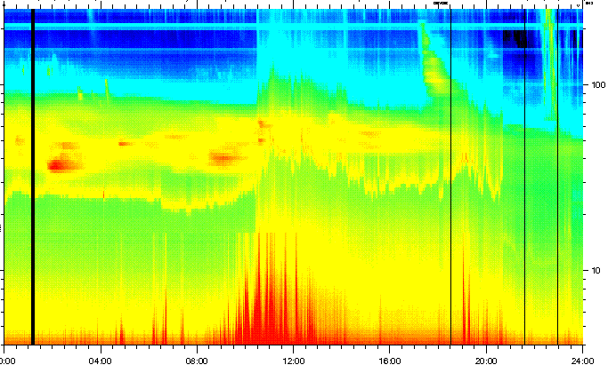
TNR Shock 20120308 10:53 UT

Slide 36
Cycles 23 & 24
*Two backside events no flare info;
** Only 13 CMEs; CME data gap for 4 SEP events
Property | Cycle 23 Rise | Cycle 24 Rise
# SEP Events | 17 (to 2000/5) | 8 [4 in 2012]
SEP intensity range | 11 – 1700 | 14 – 96 [14 – 6310]
# >100 pfu events | 7 | 0 [4]
#GLE Events | 4 | 0
AR Area Mean msh | 397 | 390
AR median msh | 290 | 370
Area Range msh | [100,900] | [10,1120]
Flare sizes | 4C, 3M, 4X* | 2C, 5M, 4X
CME Mean speed km/s | 1423** | 1710
Speed Range km/s | [750,2331] | [783,2544]
Halo Fraction | 8/13 (62%) | 12/12 (100%)
# Halo CMEs | 77 | 47 [62]
# IP Shocks (L1) | 68 | 39 [49]
# IP Type II bursts | 101 | 68
# Metric type II bursts | 221 | 91
Dst < -100 nT 23 vs. 3

Slide 37
Summary
The number of large SEP events is relatively low during the rise to the maximum of cycle 24 – similar to shock activity
CME, flare, active region properties are similar to those of cycle 23
Longest interval between cycle 23 and 24 SEP events (~4 years)
Geomagnetic activity is even more subdued
The two largest events involve interacting CMEs

