Slide 1
ENLIL Modeling for the 12-03-07 interaction event: Effect of Interacting CMEs on SEP Intensity
NASA/GSFC
H. Xie, N. Gopalswamy, P. Makela, S. Yashiro

Slide 2
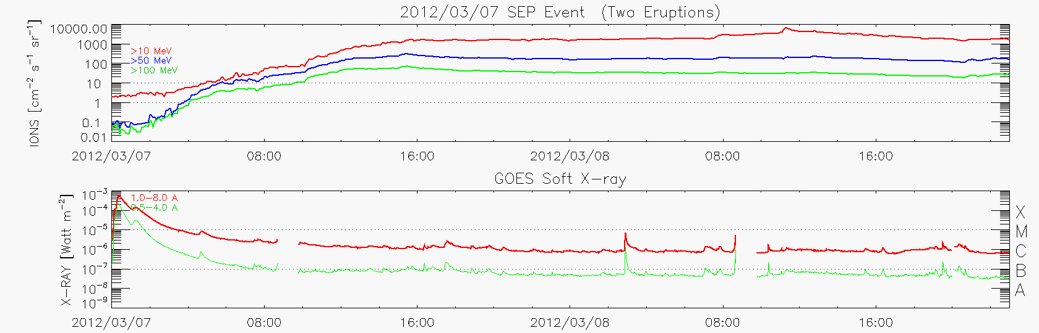
2012 March 07 SEP event: Two CMEs in Quick Succession
SEP onset
SEP peak
SHOCK
1500/6000 (SEP/EPS peak)
00:02/pk: 00:24/X5.4
01:05/pk:01:14/X1.1
AR 1429/N18E31

Slide 3
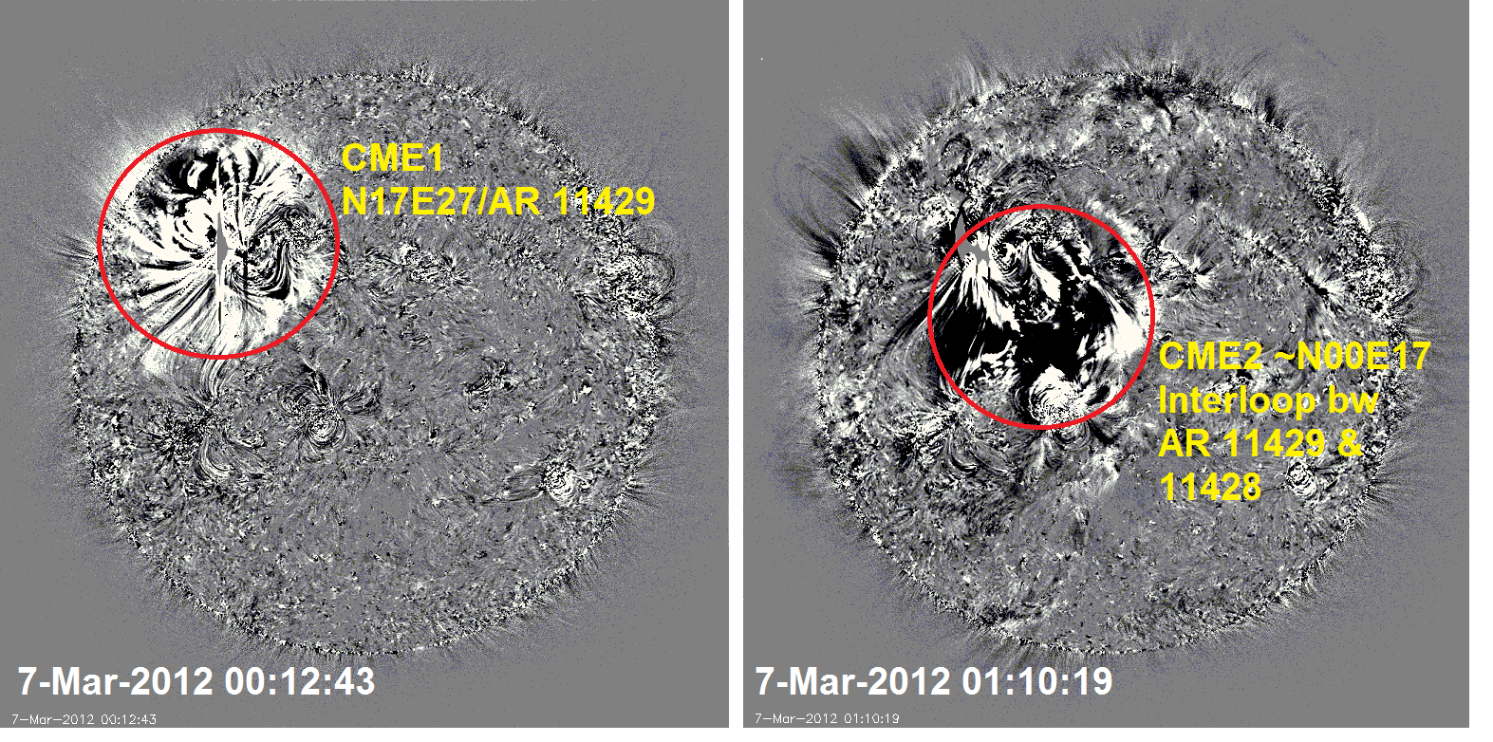
Two eruptions are seen distinctly in SDO AIA/193A movie:
CME1 : N17E27 AR11429
CME2: N00E17 inter-loop btw two ARs
with time interval of ~ 1 hour.

Slide 4
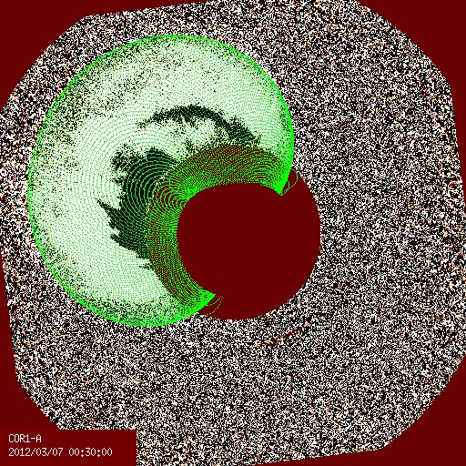
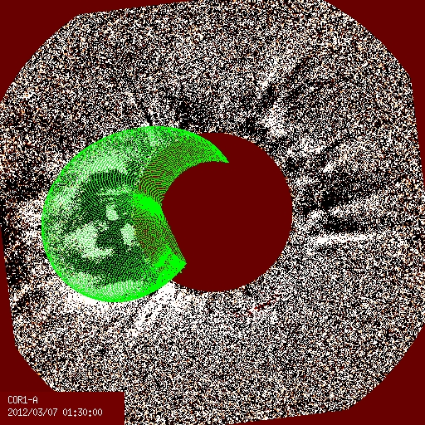
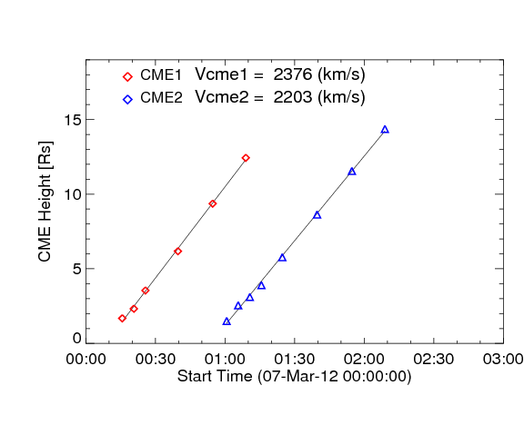
Flux-rope
fitting
CME1 :
N27E27 2376 km/s
CME2:
N00E17 2203 km/s
CME1
CME2
Two CMEs - similar speed, <1-hr (10Rs) apart

Slide 5
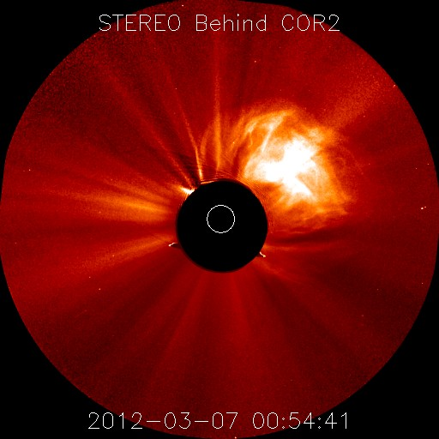
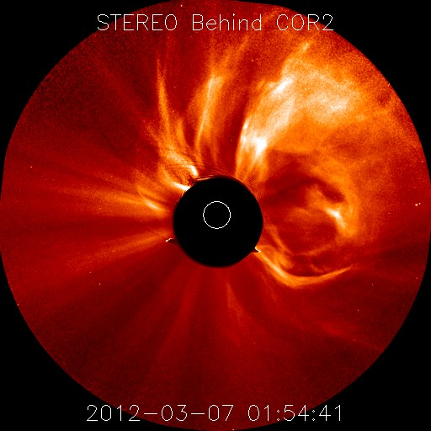
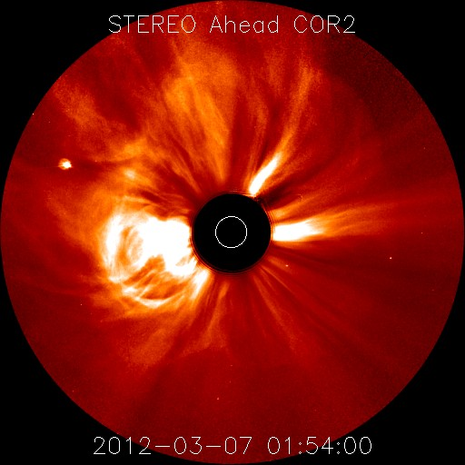
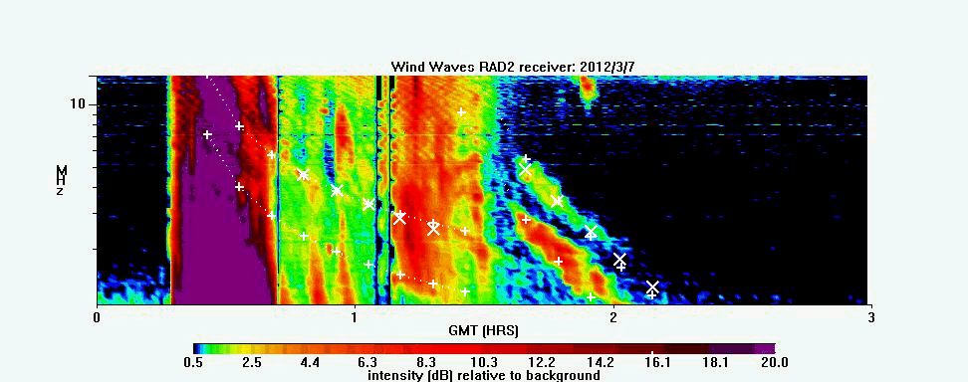
CME1
CME2
CME2
TII_CME2
TII_CME1

Slide 6
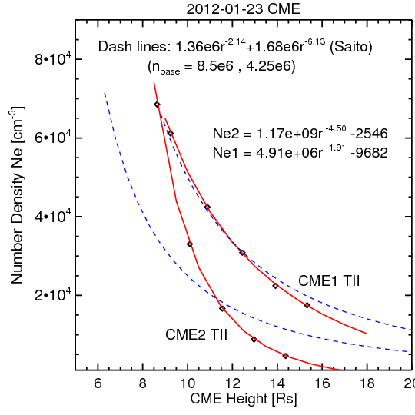
Ne vs. CME heights
Diamonds:
Density derived from
TII frequency (ne = (f/9.)^2)
Solid lines:
curves fitted from data points
Dash lines:
Saito density model (1973) with:
N_{base} = 8.5x10⁸ & 4.25x10⁸ cm⁻³

Slide 7
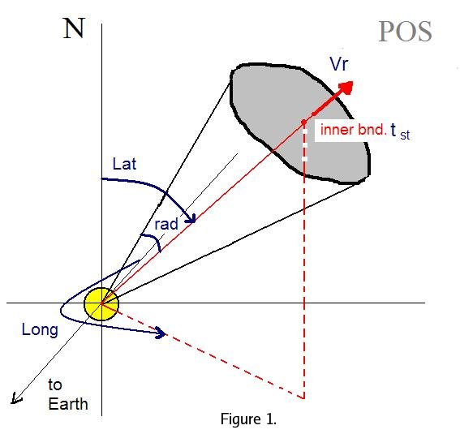
WSA_Cone_ENLIL Model
Hybrid Model combining the 3D MHD simulation with observation-based inputs.
Simulation domain: 21.5 R_{s} ~ 2 AU
Set up background solar wind
based on WSA or MAS models.
2) Insert a plasma cloud at 21.5 R_{s} based on CME parameters:
time, location, size and speed.

Slide 8
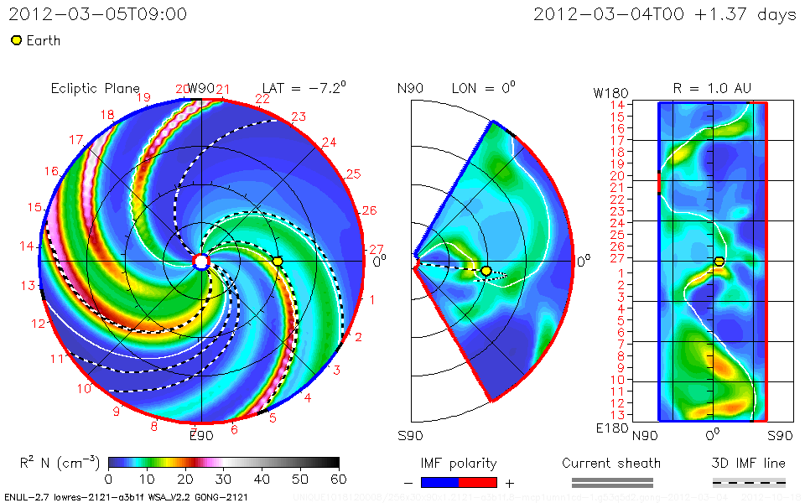
WSA_Cone_ENLIL Simulation: 2012-03-07

Slide 9
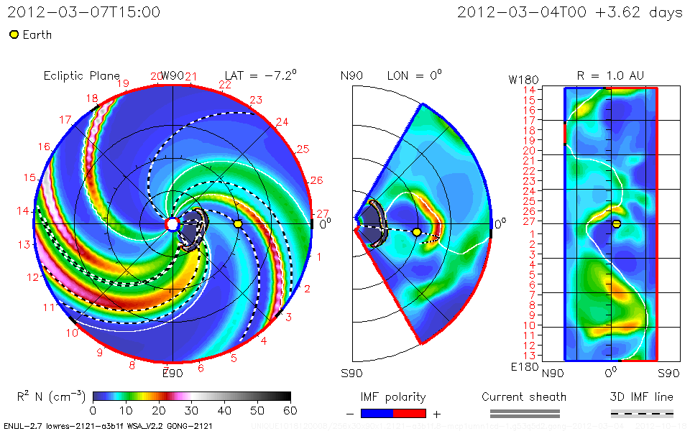
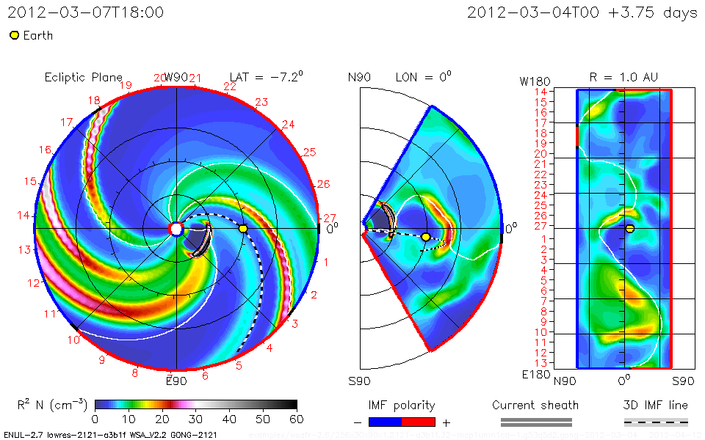
2D Density Contour
(Top ) Run1: two CMEs.
CME1: 2349 km/s, 40 deg, (17,-27) at 01:55 UT
CME2: 2203 km/s, 50 deg,
(0, 17) at 02:40 UT
Lateral Shock formation (at west well-connected field line) : ~03/07 15:00 UT
CME2
CME1
Hong_Xie_101812_SH_1
(Bottom) Run2:
Only CME1 was launched with :
2349 km/s, 40 deg, (17,-27) at 01:55 UT
No lateral Shock (at west well-connected field line) was formed
CME1
Hong_Xie_041212_SH_2

Slide 10
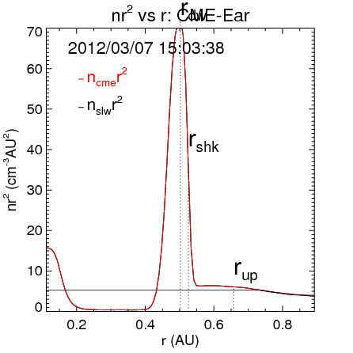
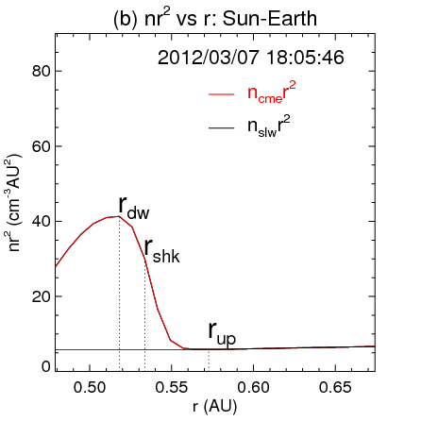
Enhanced shock intensity caused by two-CME interaction
Run2
Run1
1-D slice cut along the Sun-Ear line:
Normalized density (nr²) vs. distance (r)

Slide 11
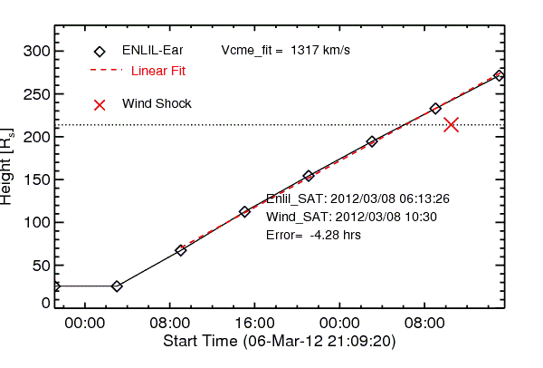
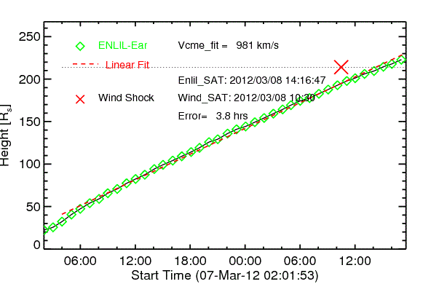
Larger shock speed caused by two-CME interaction
Run1
Run2
Time-distance profile from the simulation along the Sun-Ear line (height vs. time).
Run1: Vsk = 1317 km/s
Run2: Vsk = 981 km/s

Slide 12
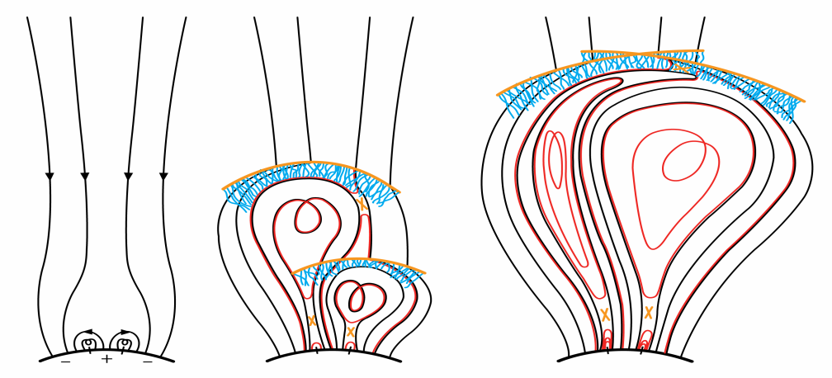
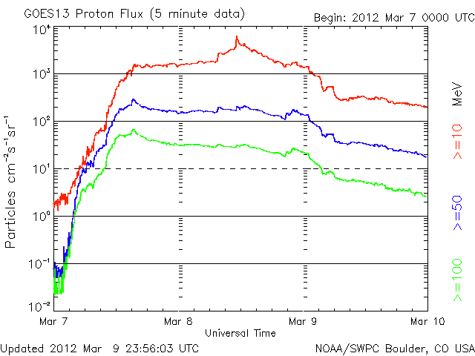
Discussion
Role of two-CME interaction:
Perpendicular Shock
Higher shock speed
Enhanced shock intensity
Role of the preceding CME:
seed particles
enhanced turbulence

Slide 13
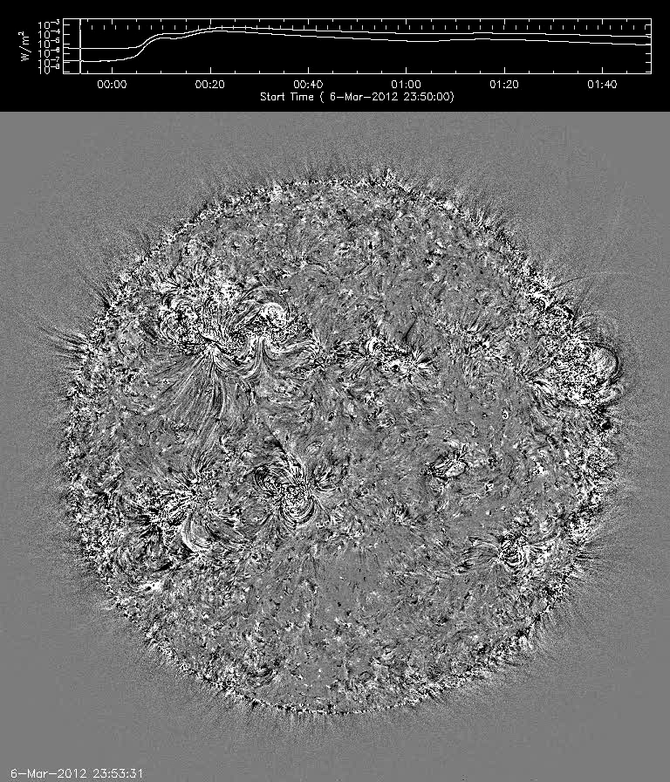
Movie of AIA/193A
Movie URL

Slide 14
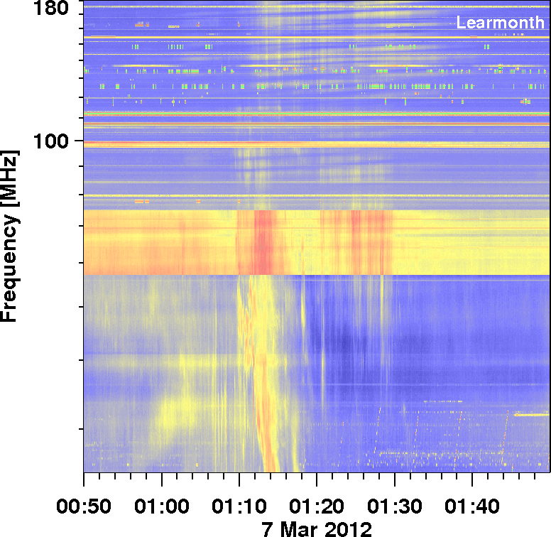
Metric type II in the 2012/03/07 Event
NOAA-Events-list
EVENT ID:
20120307_0109
from 01:09 – 01:29 LEA CRSP 025-180 II/2 1329

Slide 15
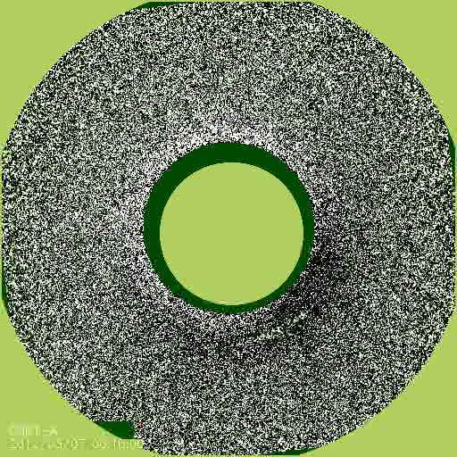
2012 March 07 SEP event: Two CMEs in Quick Succession!
SHOCK

Slide 16
Two CMEs - same speed, <1-hr apart
CME1
CME2

Slide 17
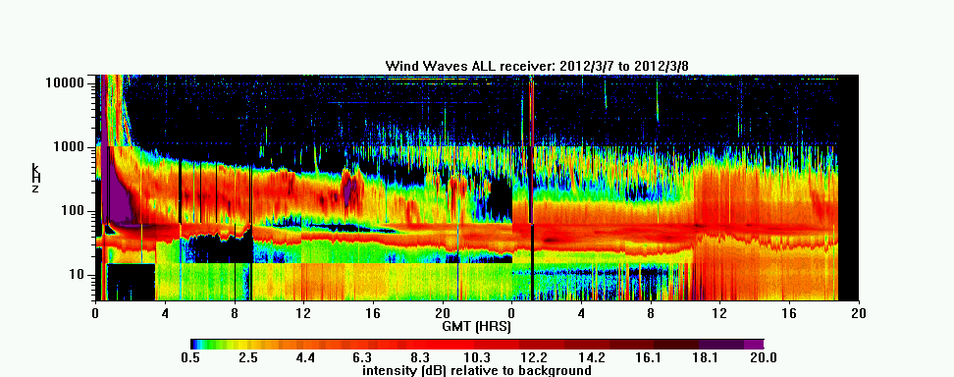
Type II Burst & Shock 2012/03/08
35 h
SHOCK

Slide 18
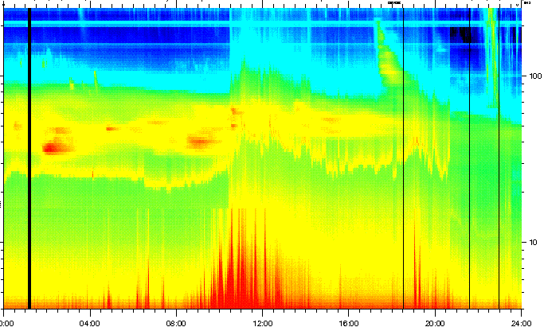
TNR Shock 20120308 10:53 UT

Slide 19
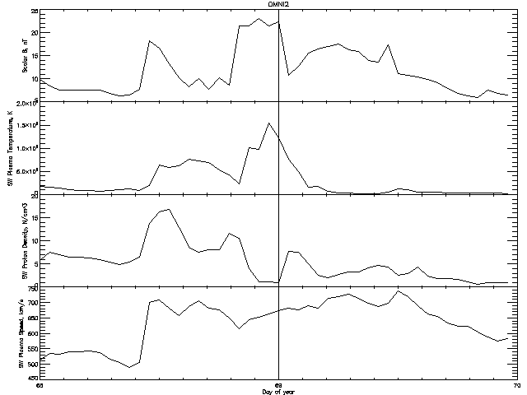
Omni data from 20120308 to 20120309
SHOCK

Slide 20
Summary
The two largest events in cycle 24 involve interacting CMEs.
The preceding CME may enhance the turbulence upstream the second shock and increase the acceleration efficiency
of the particles at the second shock.

Slide 21
Solar Cycle 24 SEP events
CMEdate Time Vcme SEP-Int Flare_pk Loc Size
2010/08/14 09:38:00 1056 14 10:05 N12W56 C4.4/1093
2011/03/07 19:43:00 2175 50 20:12 N24W59 M3.7/1164
2011/03/21 02:00:00 1594 14 ----- N24W129 backside
2011/06/07 06:16:00 1289 72 06:41 S21W54 M2.5/1226
2011/08/04 03:41:00 2198 96 03:57 N16W38 M9.3/1261
2011/08/09 07:48:00 1732 26 08:05 N17W69 X6.9/1263
2011/09/22 10:00:00 1901 35 11:01 N09E89 X1.4/1302
2011/11/26 06:09:00 977 80 07:10 N08W49 C1.2/1353
2012/01/23 02:30:00 1997 3000 03:59 N28W36 M8.7/1261
2012/01/27 17:37:00 2350 800 18:36 N33W85 X1.7/1263
2012/03/07 00:02:00 2709 1500 00:24 N17E27 X5.4/1261 2012/03/13 17:12:41 1881 500 17:41 N19W59 M7.9/1263
2012/05/17 01:25:30 1673 255 01:47 N11W76 M5.1/1476

