Slide 1
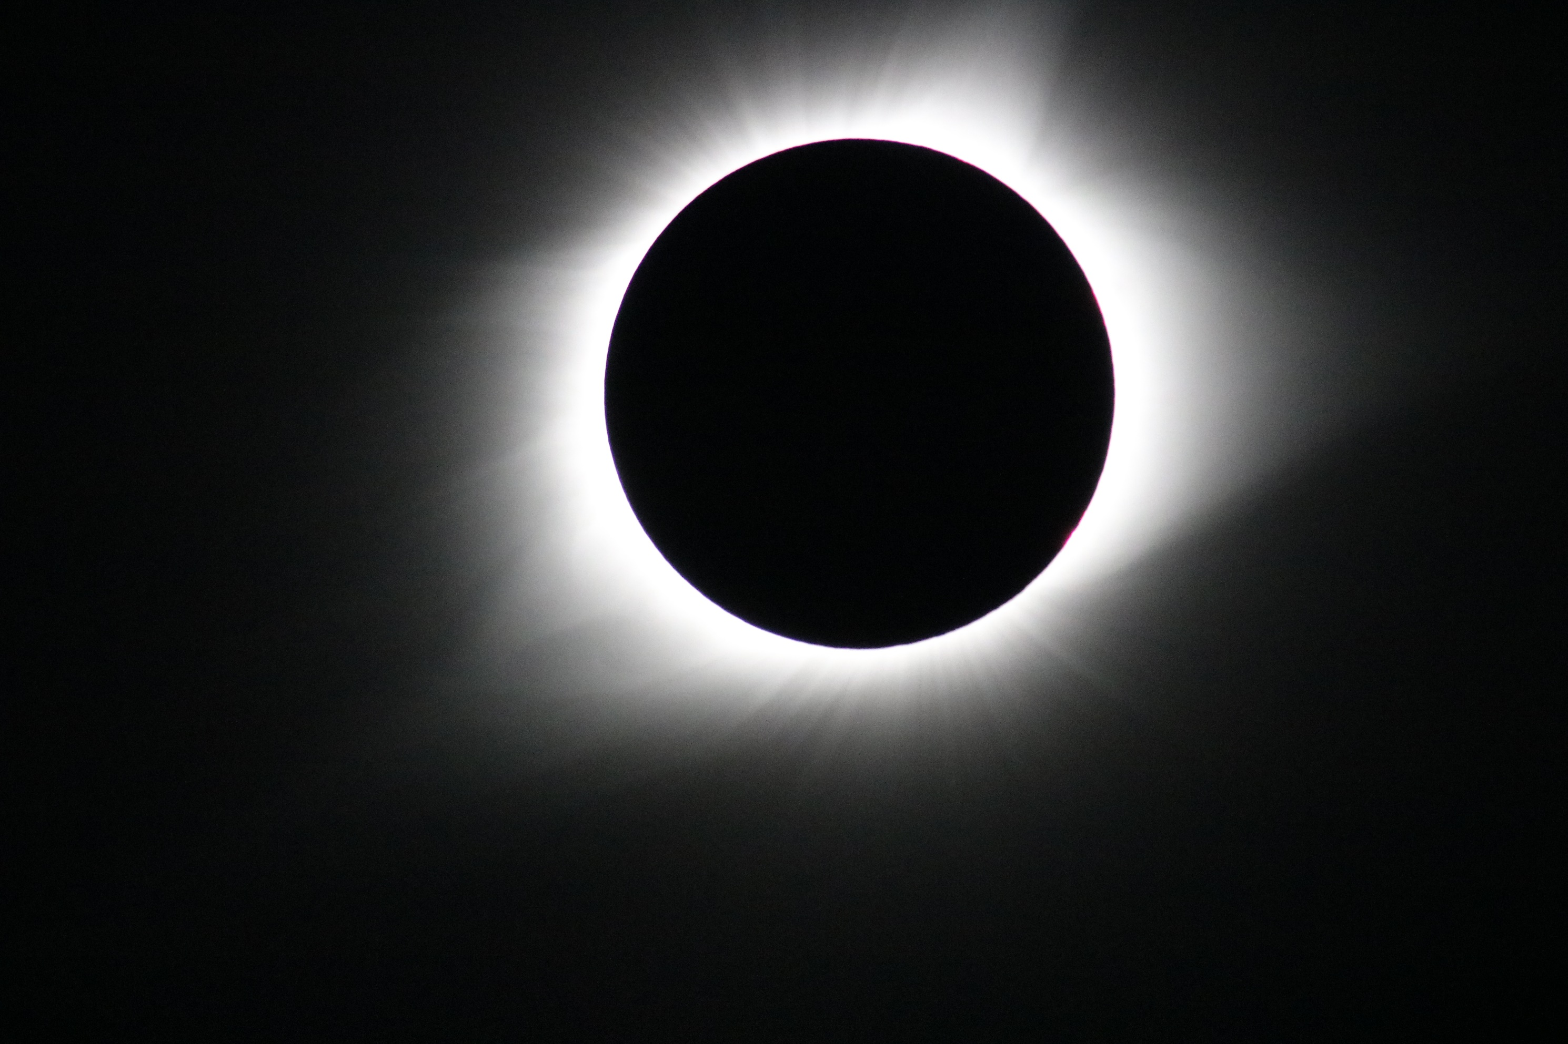


Initial
Scientific Results
from the 2017 August 21 Total Solar Eclipse
Nat Gopalswamy &
the GSFC Eclipse Team
2017 Nov 17 Director’s Seminar

Slide 2
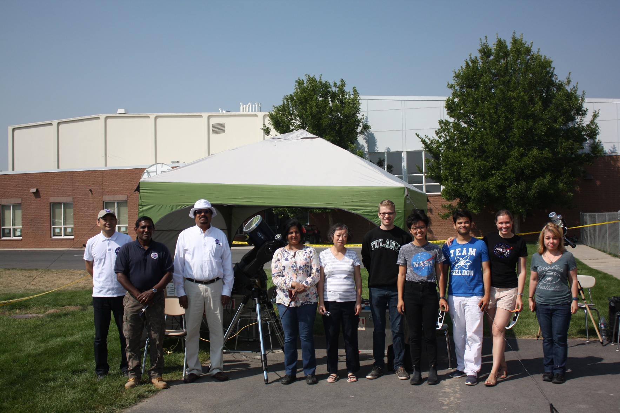
The GSFC Eclipse Team

Slide 3
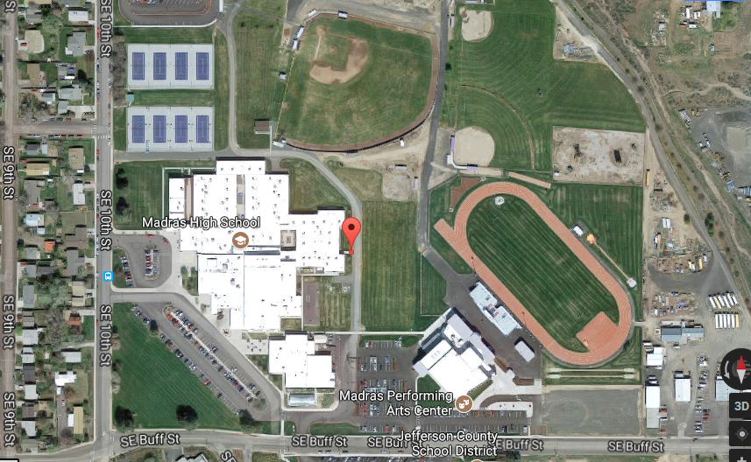

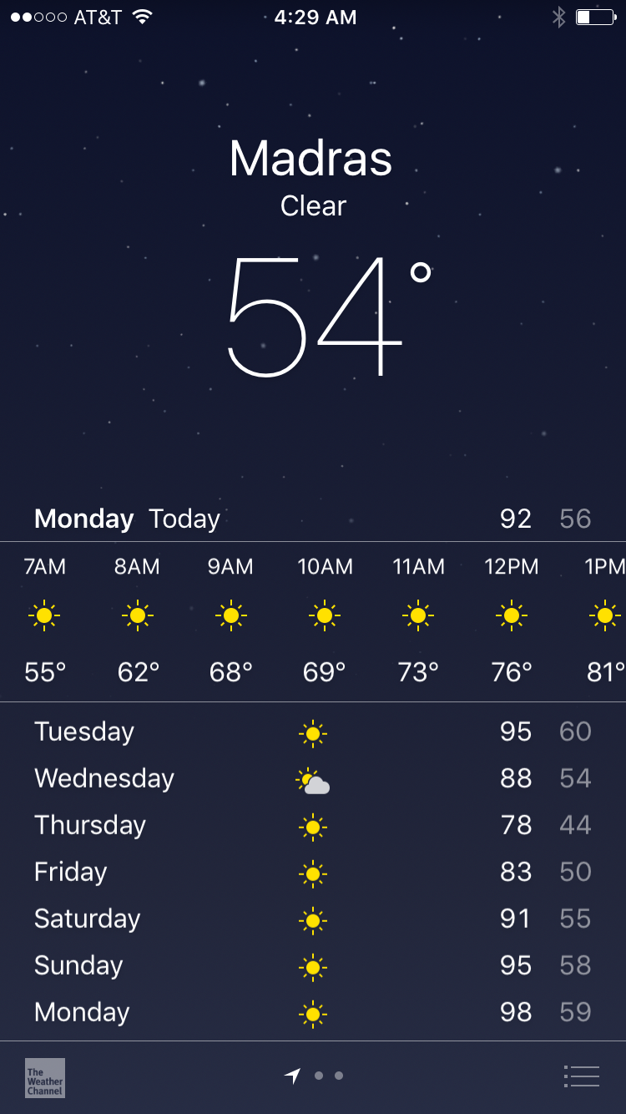
Madras High School
Madras, OR
44°37'48.9"N,121°07'18.4"W
F6.3
F10

Slide 4
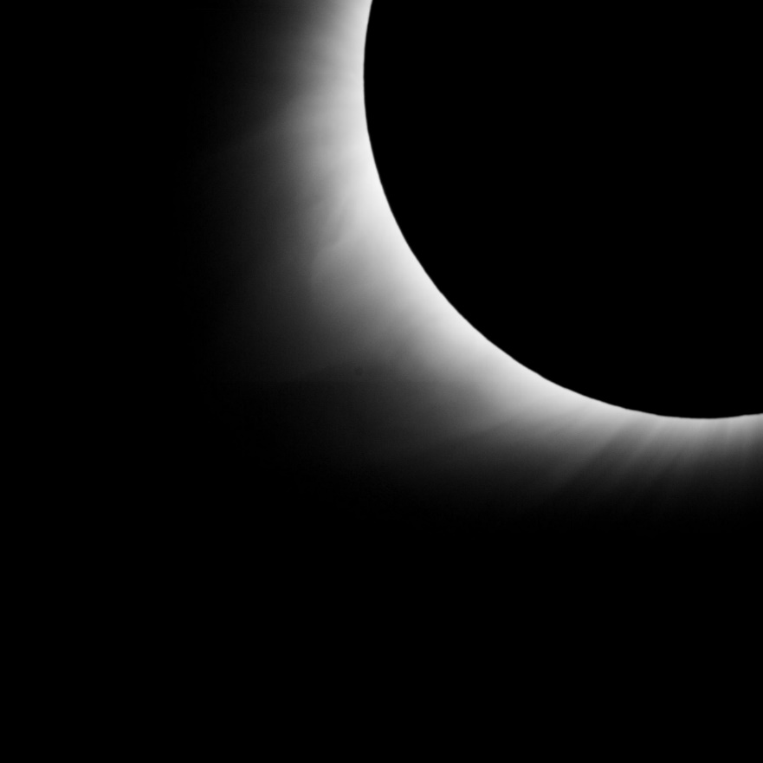

F10 Schmidt-Cassegrain
Limited FOV
2k x 2k CCD high-speed camera
Pointing at the Southeast quadrant (streamer)
800 images taken to examine streamer changes.

Slide 5
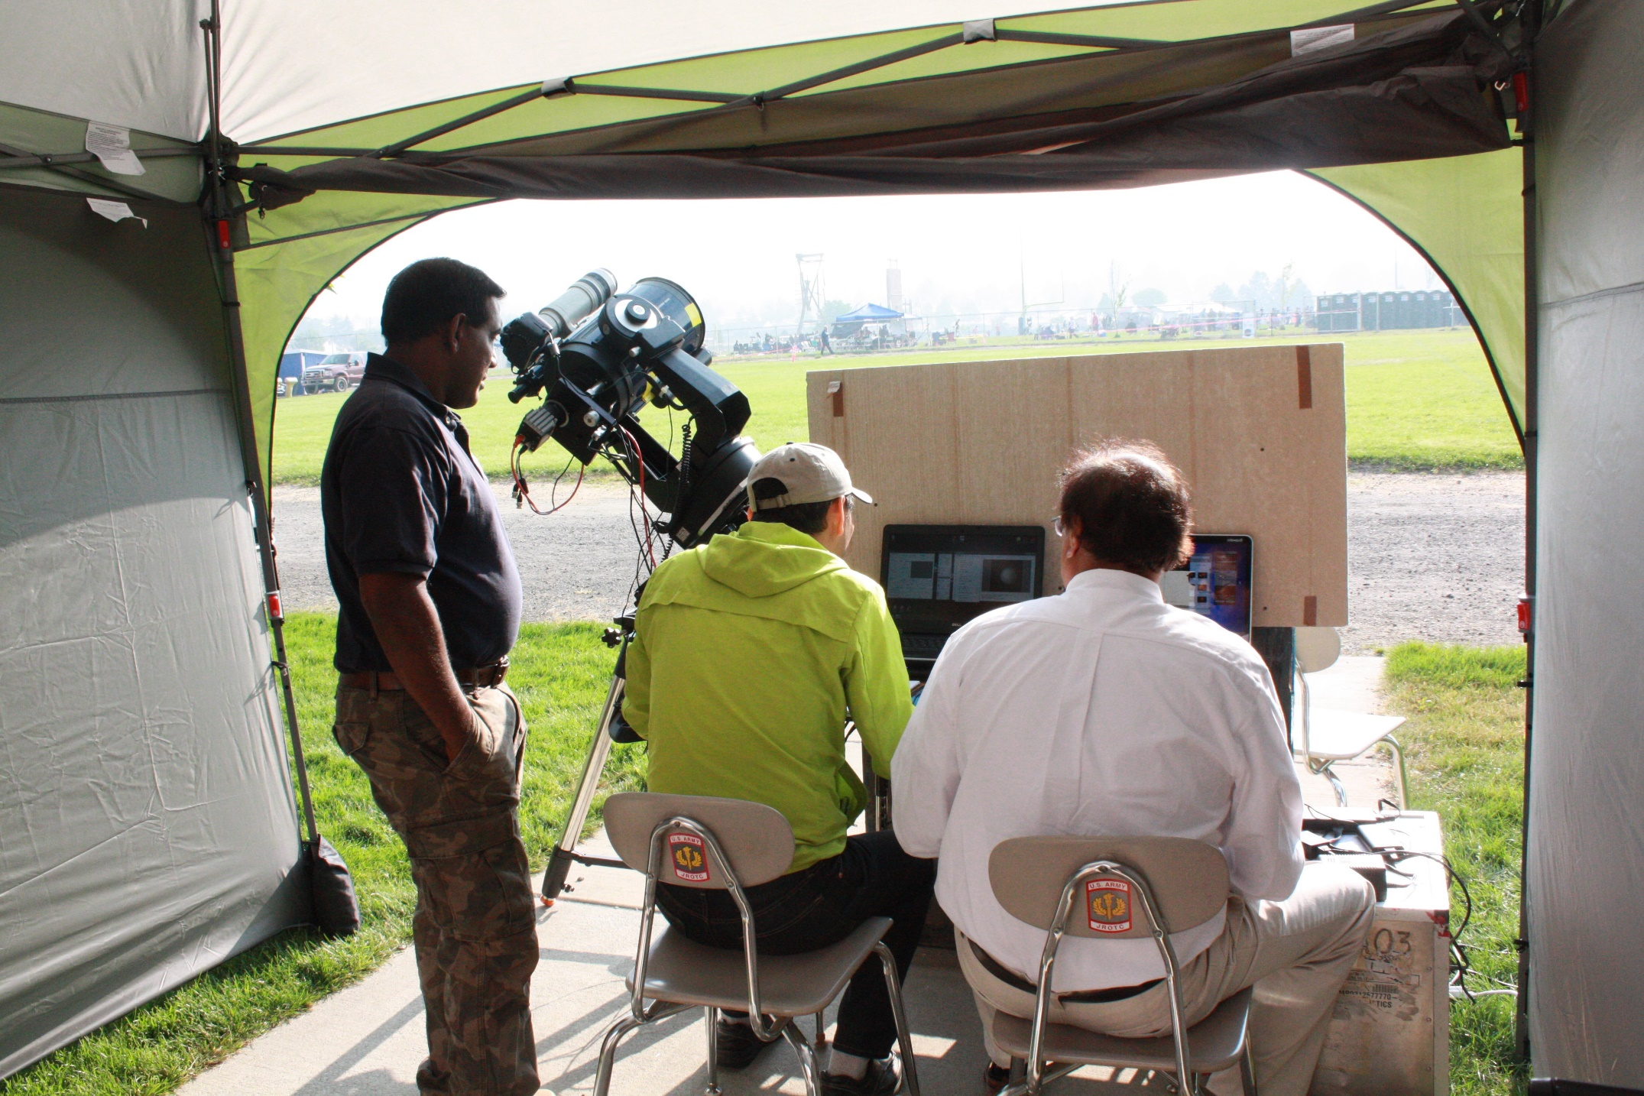
2.6 Rs
1.8 Rs
FOV
F6.3 Schmidt-Cassegrain (FR f6.3)
Canon w/ 800 mm zoom
2k x 2k pcam [4D Technology]
Pixel resolution: 3”.6/pixel
FOV 2.6 Rs – 1.8 Rs
50 images in four filters
Total and Polarized brightness

Slide 6
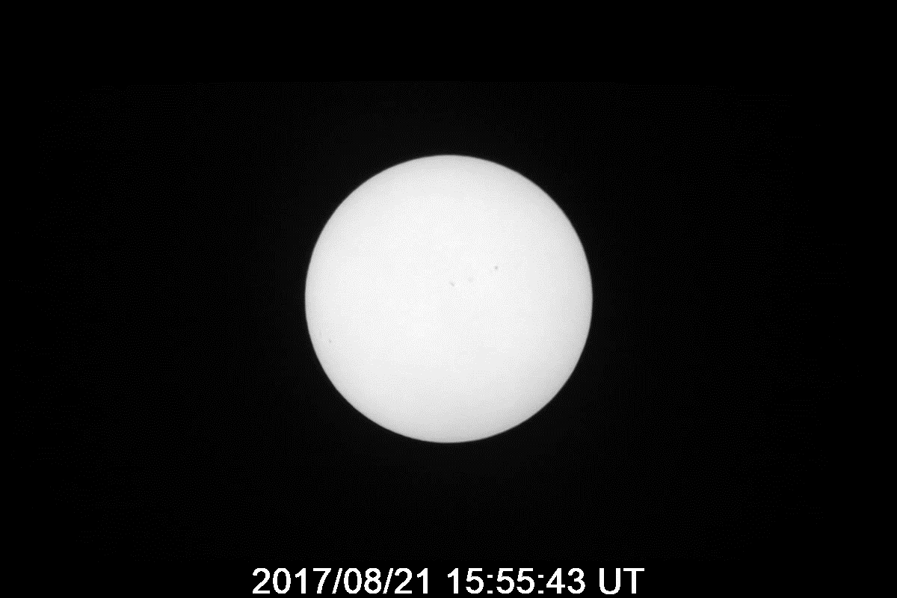
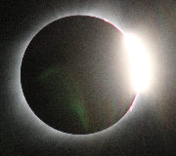
Canon Camera
4k x 3K pixels
800 mm zoom
5 s cadence
auto exposure
25 images during totality

Slide 7
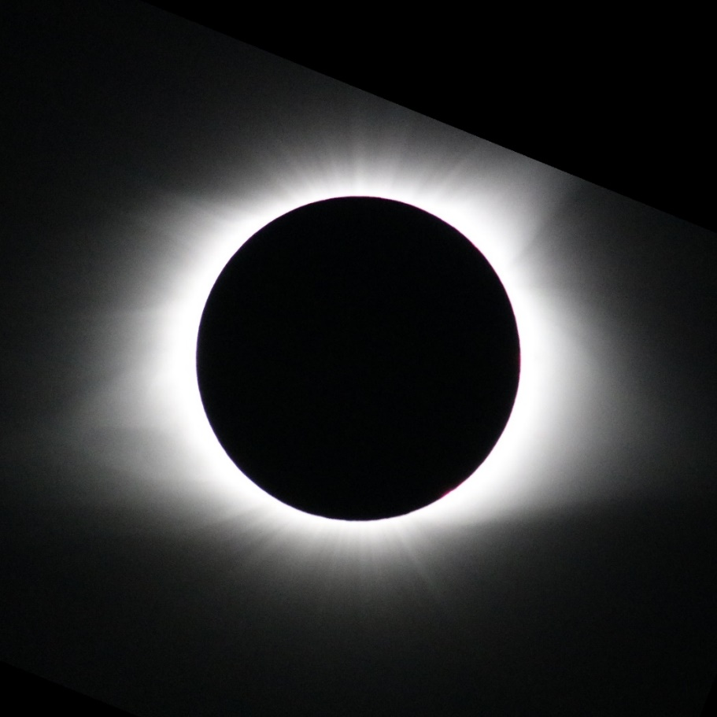
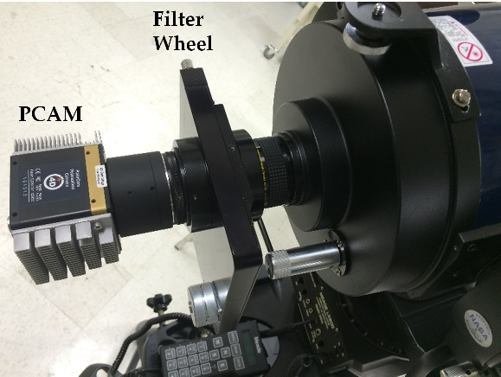
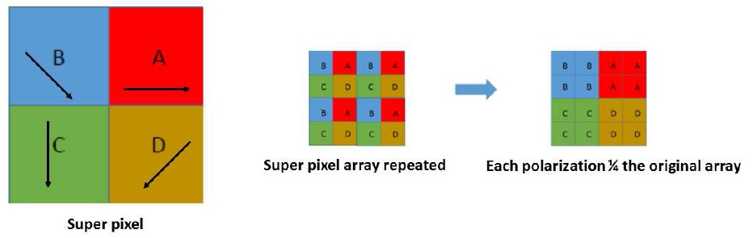
Objectives of the Expedition
1. To demonstrate the capability of a polarization camera
2. To determine the physical conditions (temperature, flow speed) in the inner corona
White-light Image: Cannon SLR
To study the physical state of the corona we need the K-corona brightness (= polarized brightness up to ~5 Rs)
The polarization camera separates the polarized K-corona from the unpolarized F-corona and gives us both total and polarized brightness
Traditionally, a polarizer wheel is used take images at three polarization angles sequentially and combine them
We used a polarization camera (PCAM) that eliminates the polarization wheel mechanism
The PCAM uses a polarization mask attached to the face of the CCD with different micro polarizers above each CCD pixel
Combining 4 neighboring pixels yields total and polarized brightness
2017 August 21
Total brightness: F and K coronas
K corona due to electrons
F corona due to dust particles

Slide 8
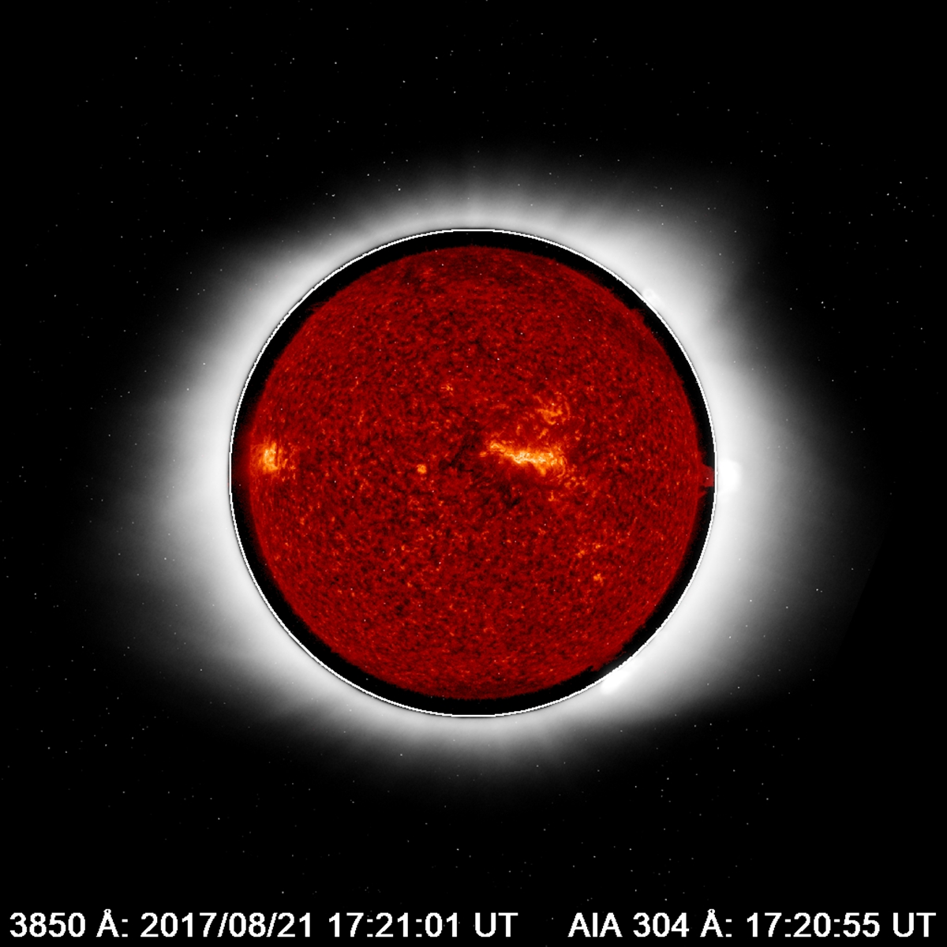
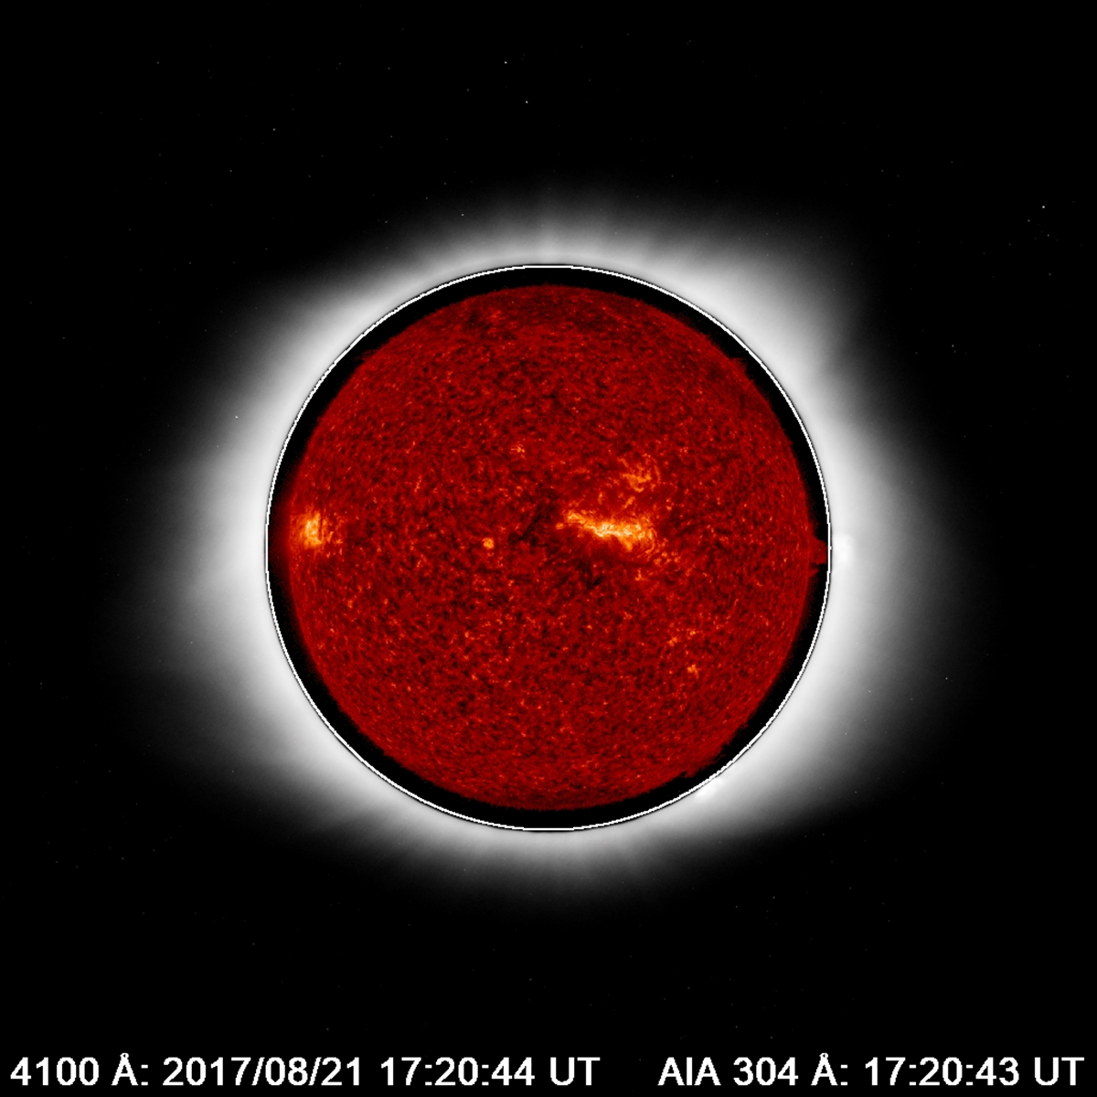
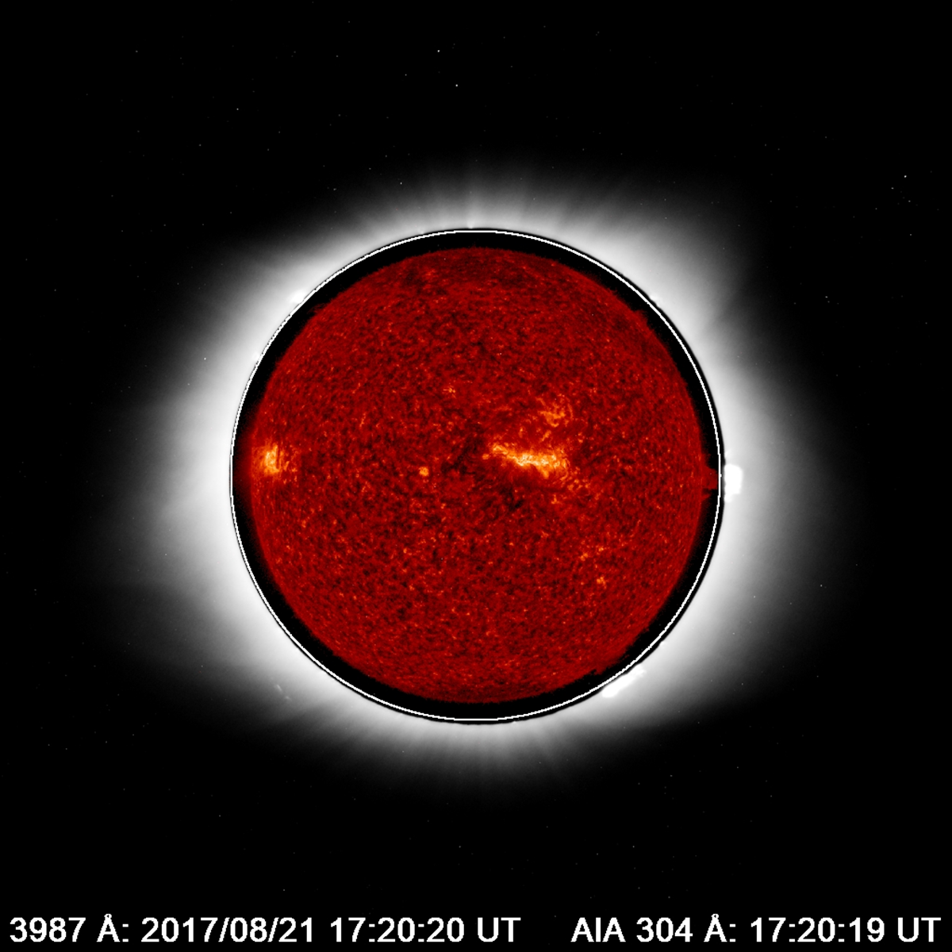
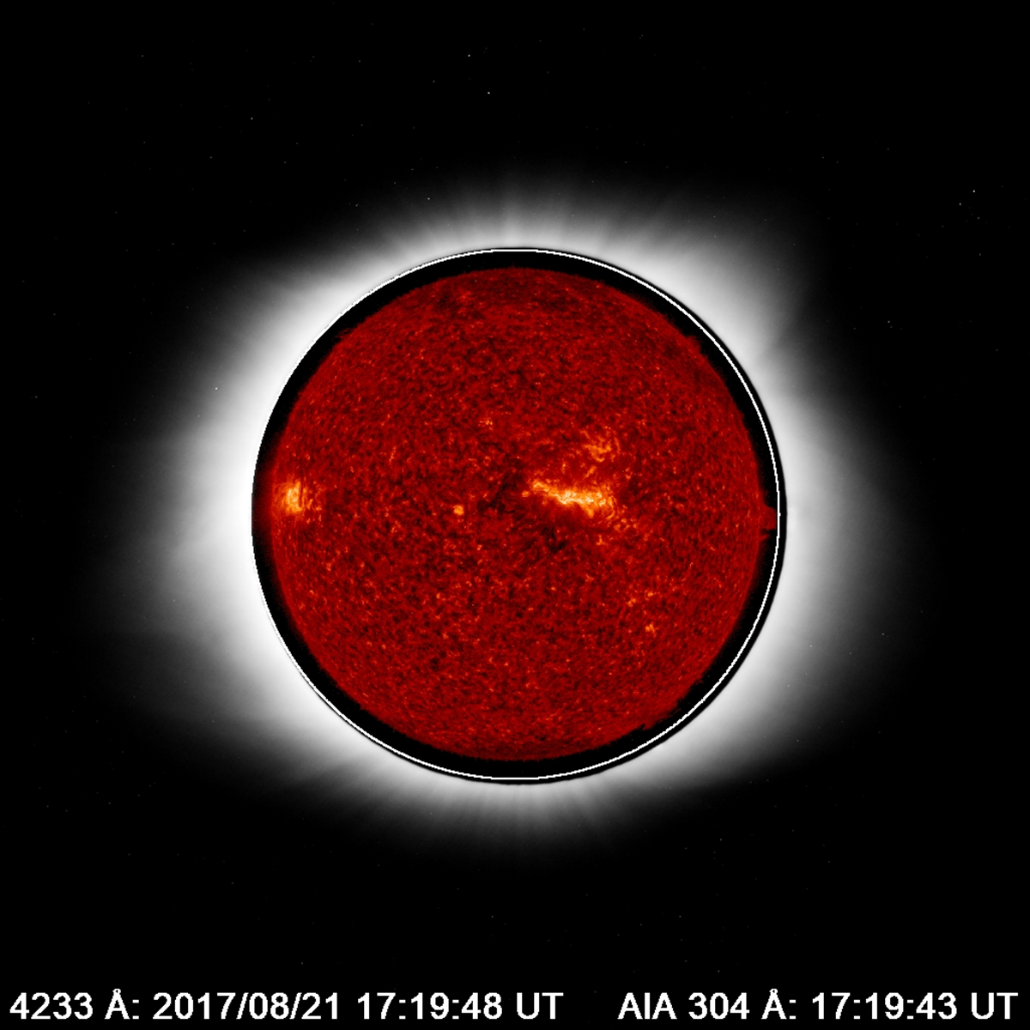
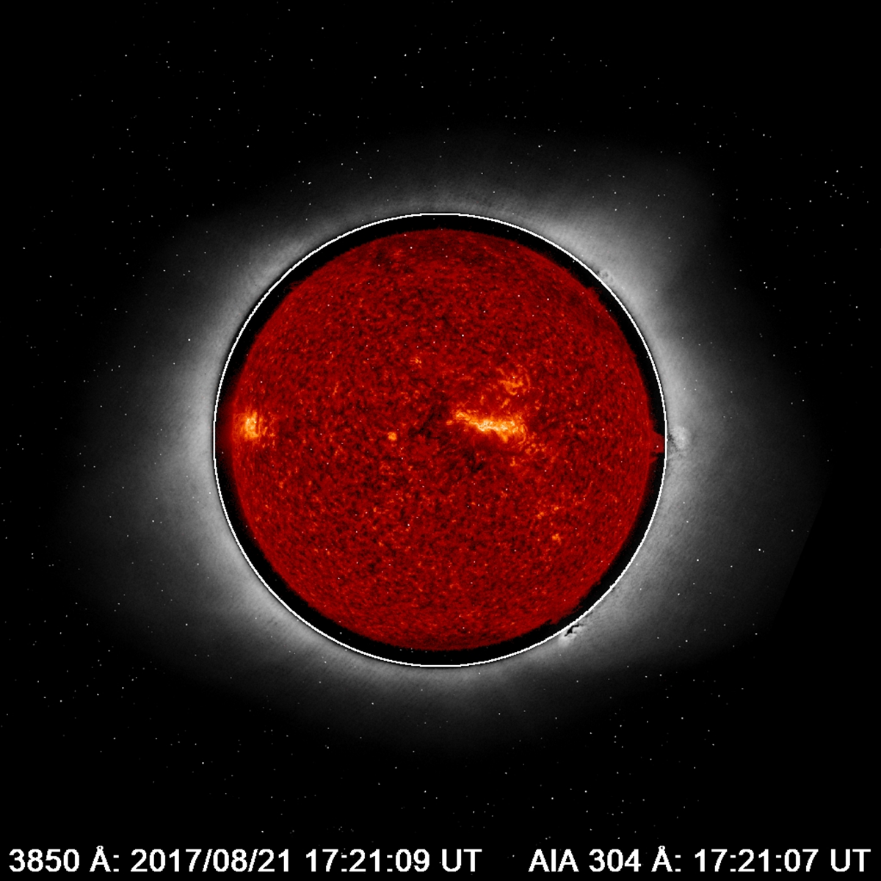
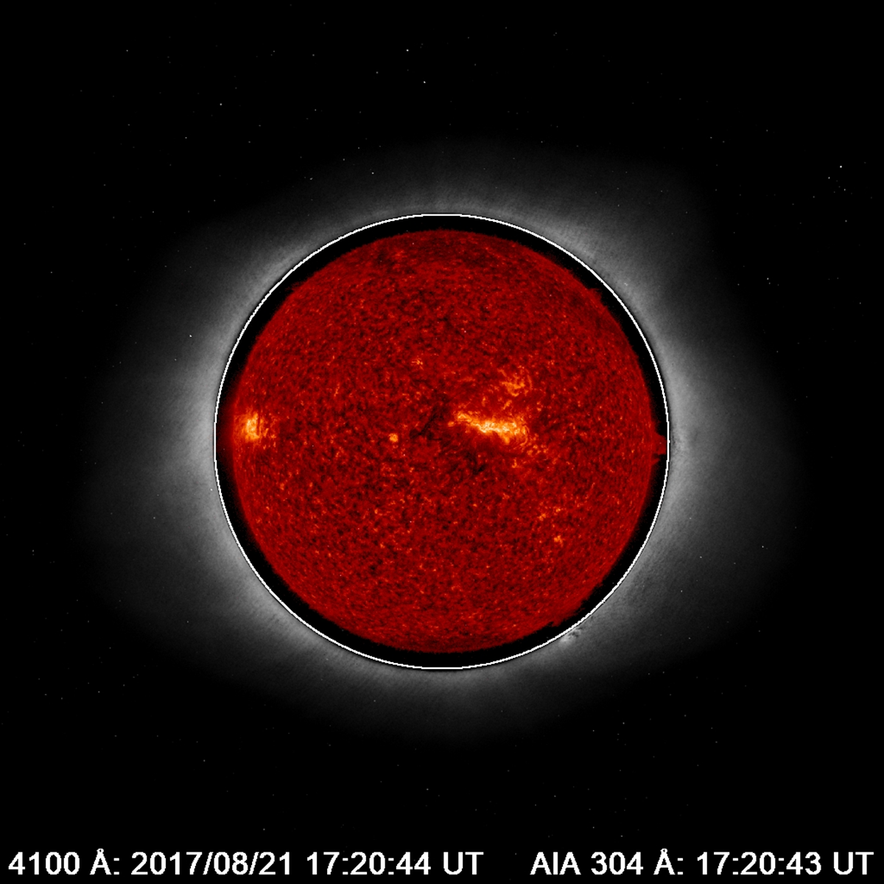
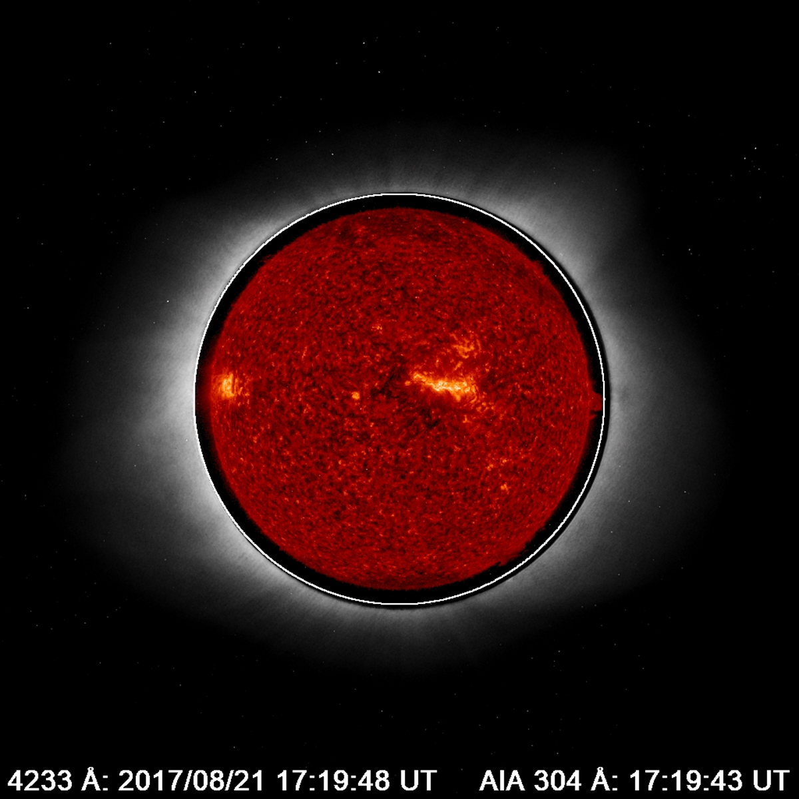
Total
Polarized
Total and polarized images obtained at each of the four wavelengths
About 10-12 images obtained in each wavelength within the 2 min totality
SDO/AIA 304 Å images superposed

Slide 9
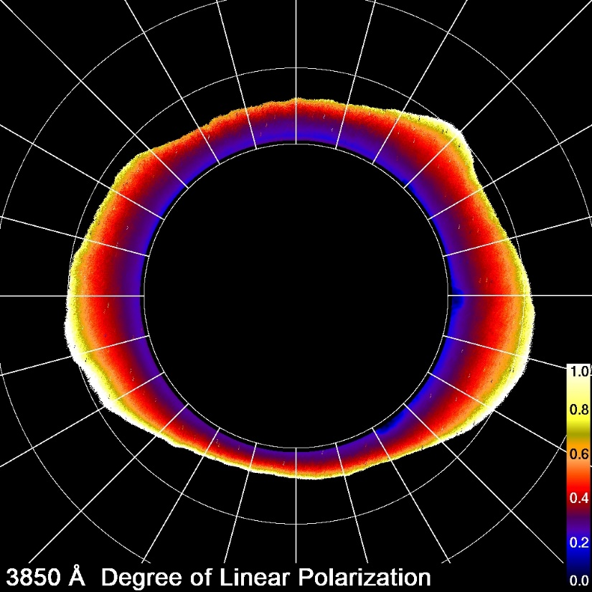
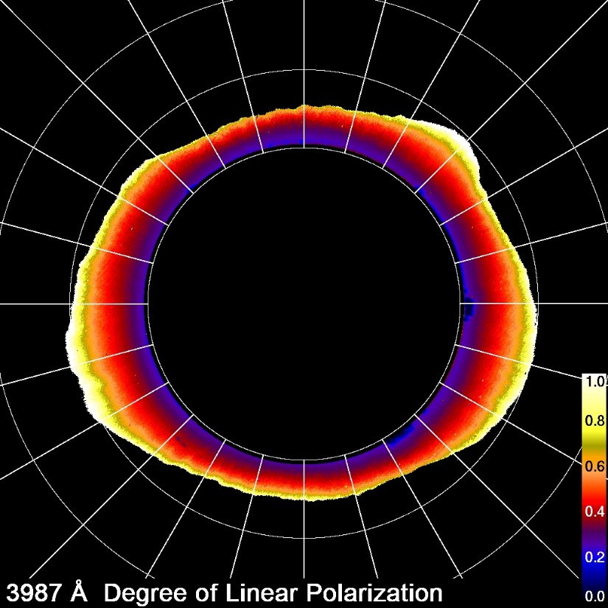
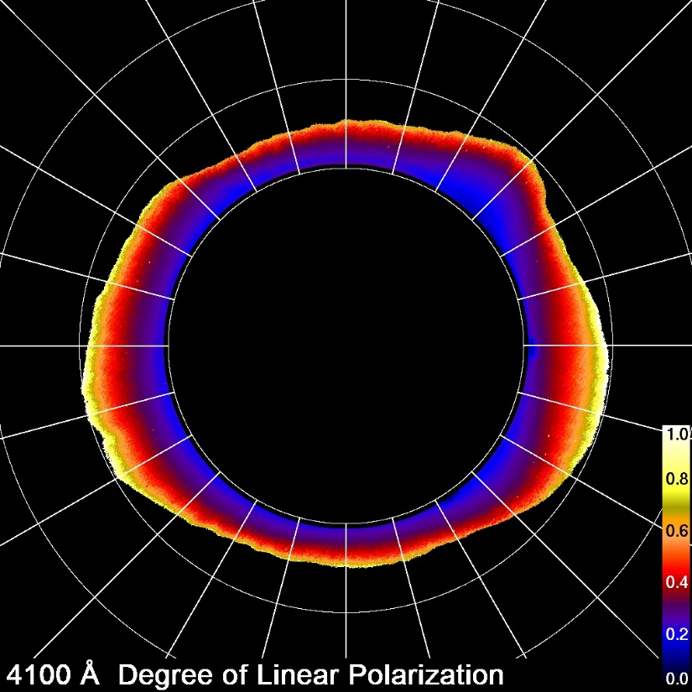
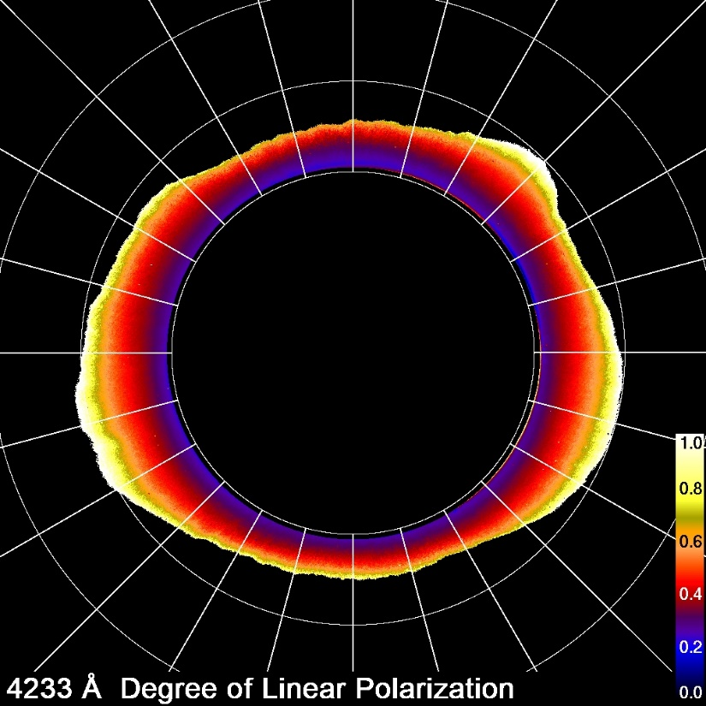
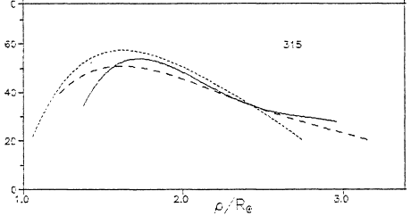
RESULTS: Degree of Polarization
Observed range: 20-60%
Increases with distance from the Sun
Consistent with past eclipse data
(e.g. Badalyan et al. 1993)
60
Badalyan et al. 1993
Degree of Polarization
40
20
0
Feb 16, 1980 eclipse
1
2
3
Distance (r/R☉)

Slide 10
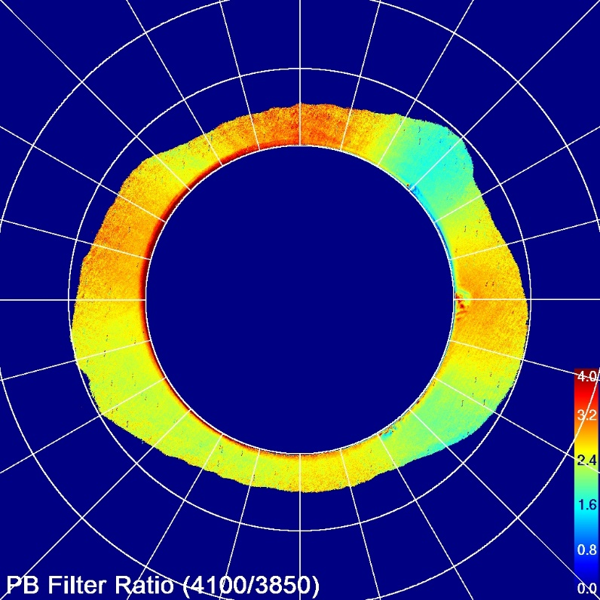
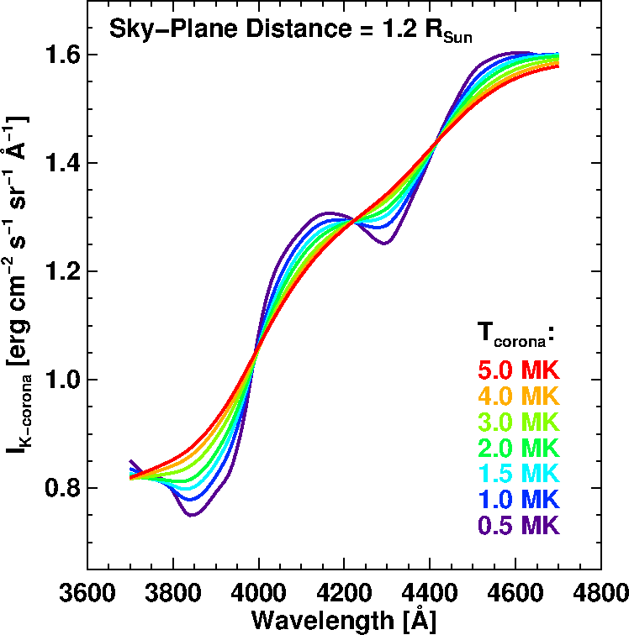
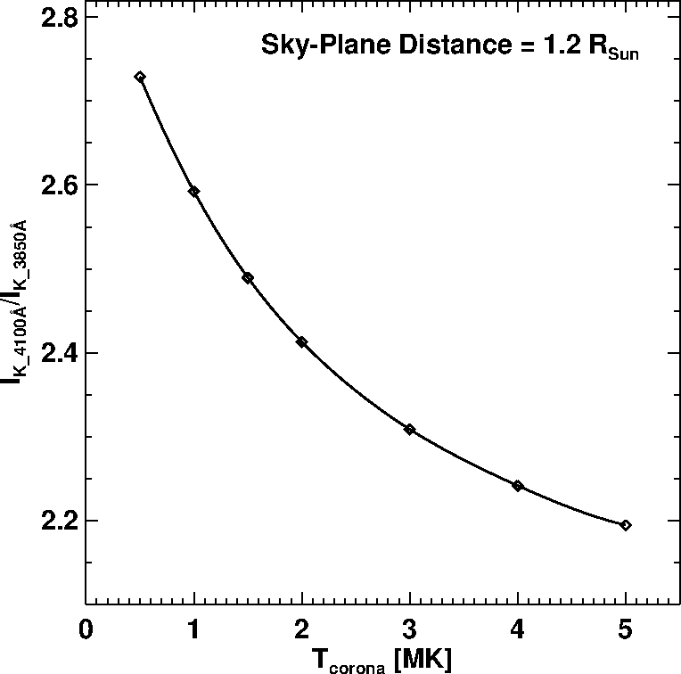
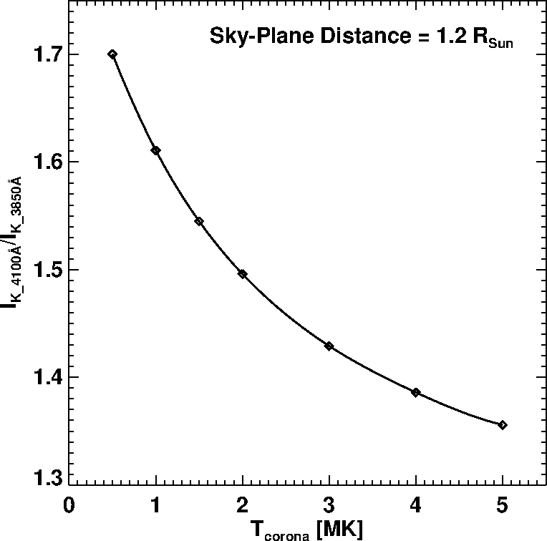
2017 Aug 21 Eclipse
RESULTS
Ratio of polarized brightness at 4100 and 3850 Å
This is a T-sensitive ratio
The ratio is different in the coronal holes (high – low T) and streamer (low – high T)
Indicates different coronal structures have different temperatures
Need to repeat the Thomson scattering calculation relaxing the spherical symmetry assumption (streamer as enhancement and coronal hole as depression in density)
4100
Theoretical ratio
Corrected for filter
profile
3850
K-Corona Spectrum obtained from Thomson-scattering calculation using photospheric spectrum and a spherically symmetric corona

Slide 11
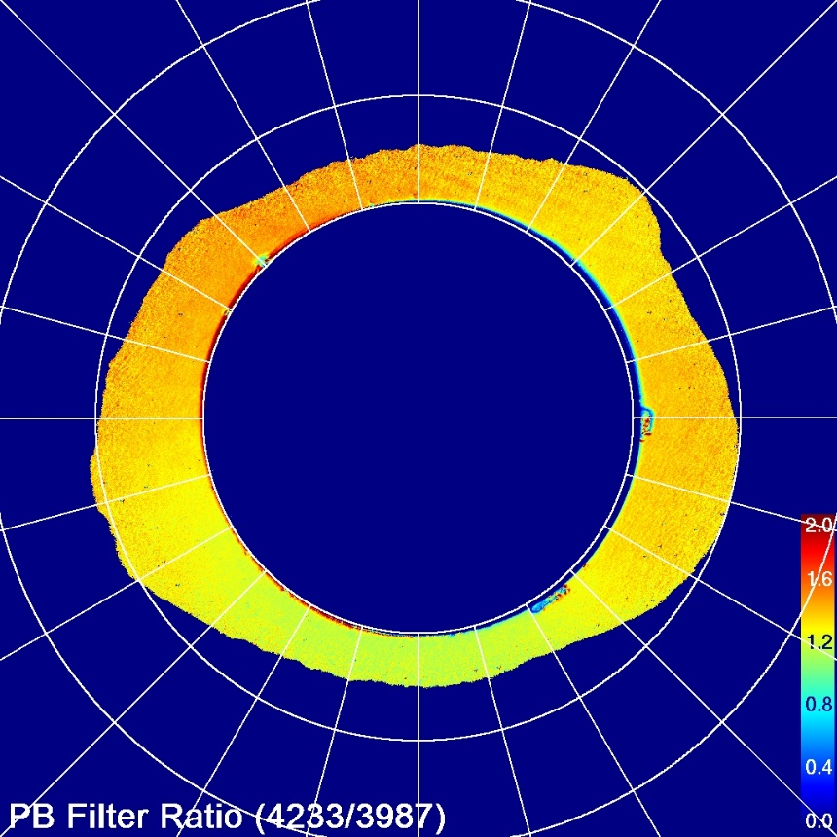
2017 Aug 21 Eclipse
RESULTS
2017 Aug 21 Eclipse
Ratio of polarized brightness at 4233 and 3987 Å
This is a T-insensitive ratio
The ratio is the same at various temperatures, as expected from theory
However, when flow is introduced, the K-coronal spectrum will redshift and the ratio will change
Close to the Sun, the solar wind flow is expected in the coronal hole regions
This is being investigated
4233
3987
The 4233/3987 ratio is approximately uniform
K-Corona Spectrum obtained from Thomson-scattering calculation using photospheric spectrum and a spherically symmetric corona

Slide 12
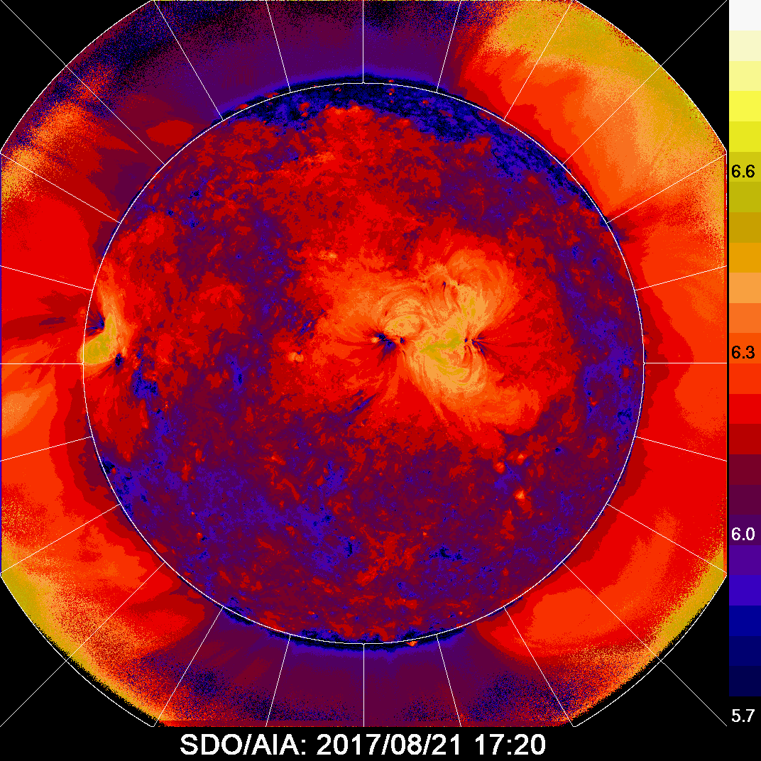
2017 August 21 Eclipse- SDO/AIA Comparison
315
315
Using Aschwanden et al. 2012 method
Low T at coronal hole (PA = 0)
High temperature in the streamer (PA=315)

Slide 13
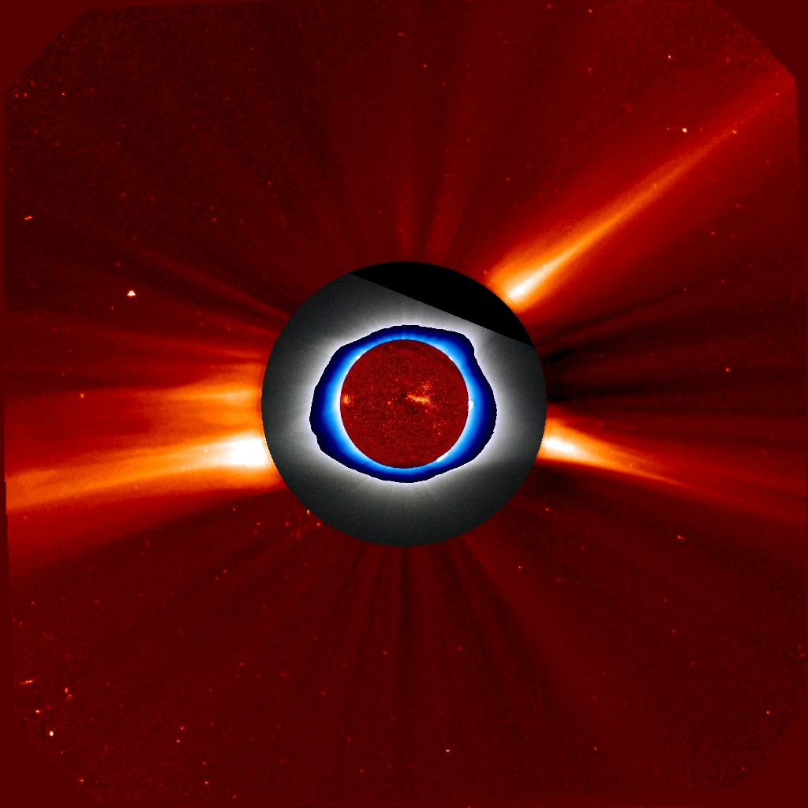
SOHO- Canon-Polcam-SDO Composite
Plumes and streamers
tracked from the surface to LASCO FOV
Density from SOHO/LASCO pB image taken at 08:54 UT
The Pseudo streamer at PA=315 is very dense (> factor of 10 compared to nearby quiet corona)
SDO
Pol Camera
LASCO/C2
Cannon-SLR

Slide 14
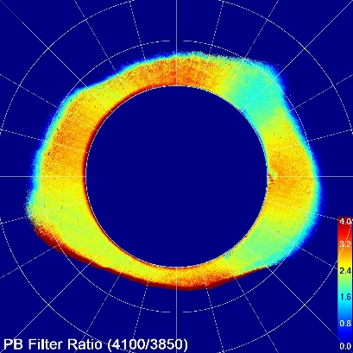
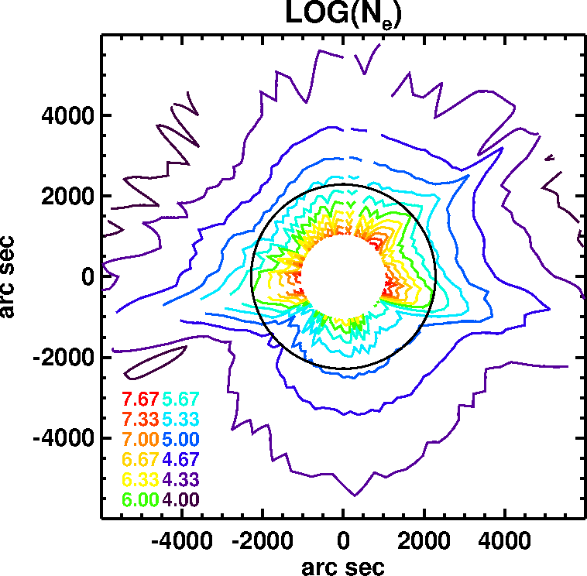
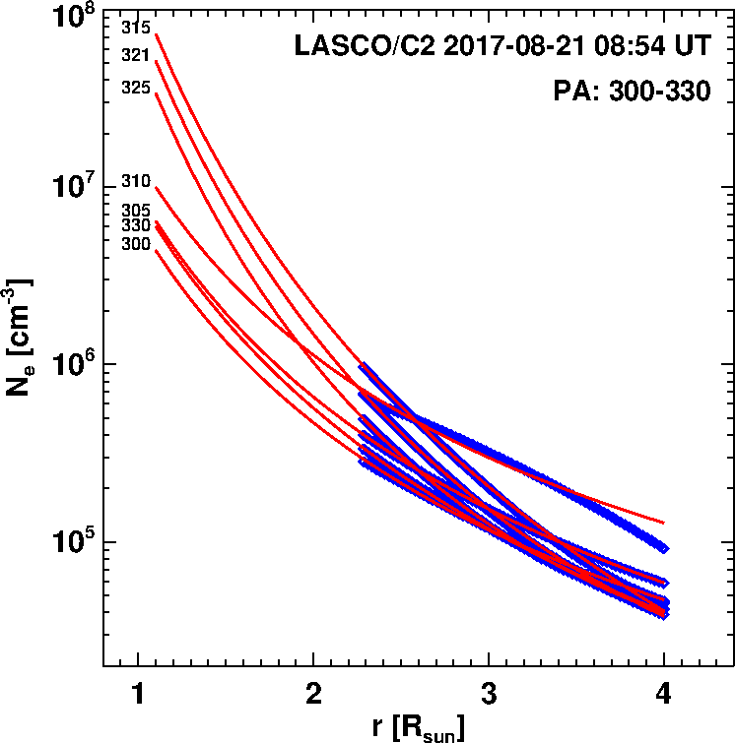
LASCO/C2 PB
08:54 UT
SOHO data indicate that the streamer density at PA=315 is more than a factor of 10 higher.
N (r,ф) = N(r)[1+ αcos (ф+ϴ)]
Extrapolation of the fits: ar⁻²+br⁻⁴+cr⁻⁶
from pB
Data (LASCO/C2)

Slide 15
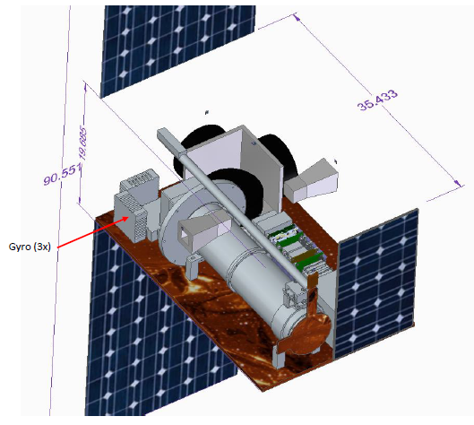

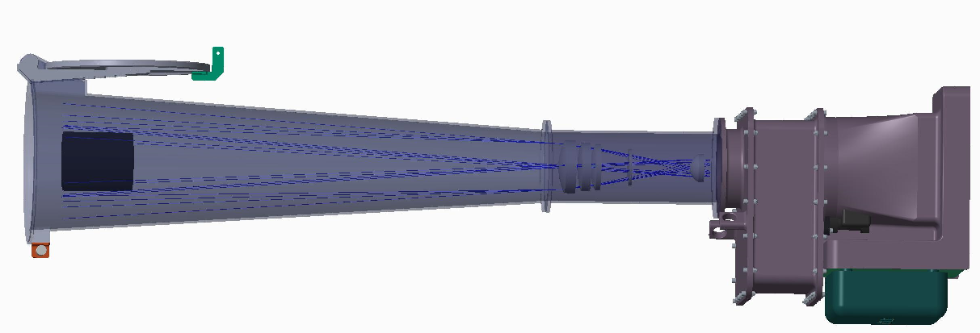
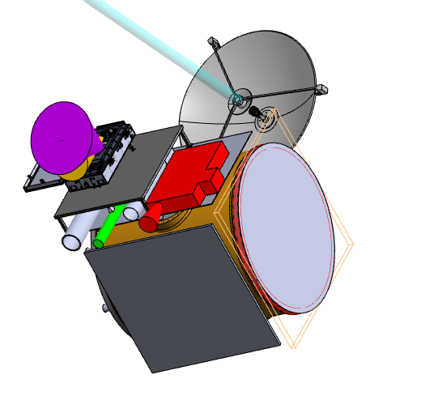
Future
GMC LEO
ISS – Cyclops
Polar orbit
Polcam will be used in BITSE Launch: Sep 2019
CODEX on ISS
SELEX
Sun-Earth Lagrange Explorer

Slide 16
Summary
The GSFC eclipse expedition demonstrated that the polarization camera can be used to obtain total and polarized brightness without the need for a polarization wheel
The degree of polarization obtained is consistent with that from previous eclipse observations (with polarization wheel)
The pB image ratio at 410 and 385 nm shows the temperature distribution in the corona (hot streamers and cool coronal holes)
The pB image ratio at 423 and 397 nm is uniform throughout the image indicating temperature insensitivity (needed for flow determination)
The polarization camera can be used in space coronagraphs, because it eliminates the need for a polarization mechanism (and hence the associated risk)

Slide 17
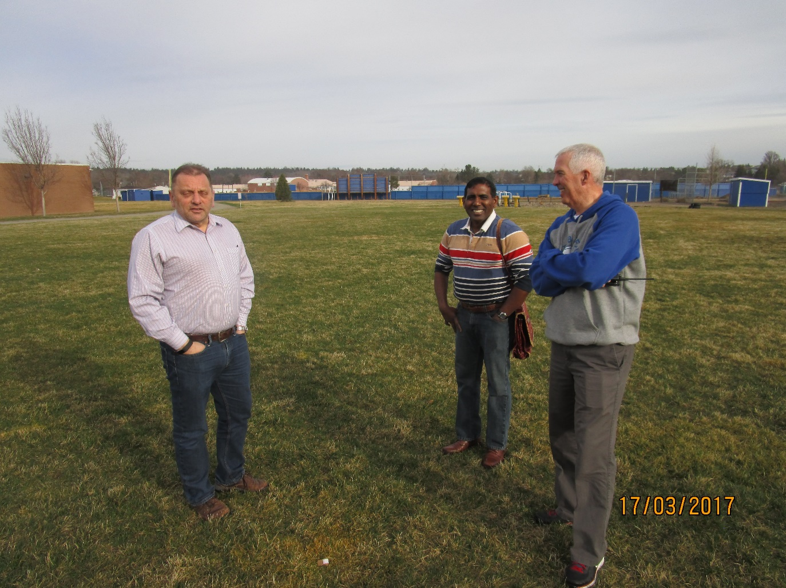
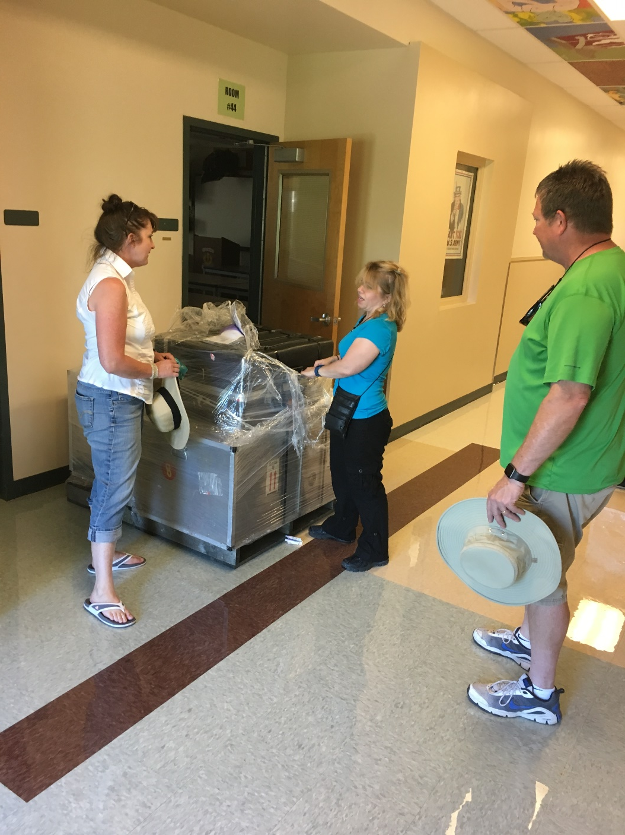
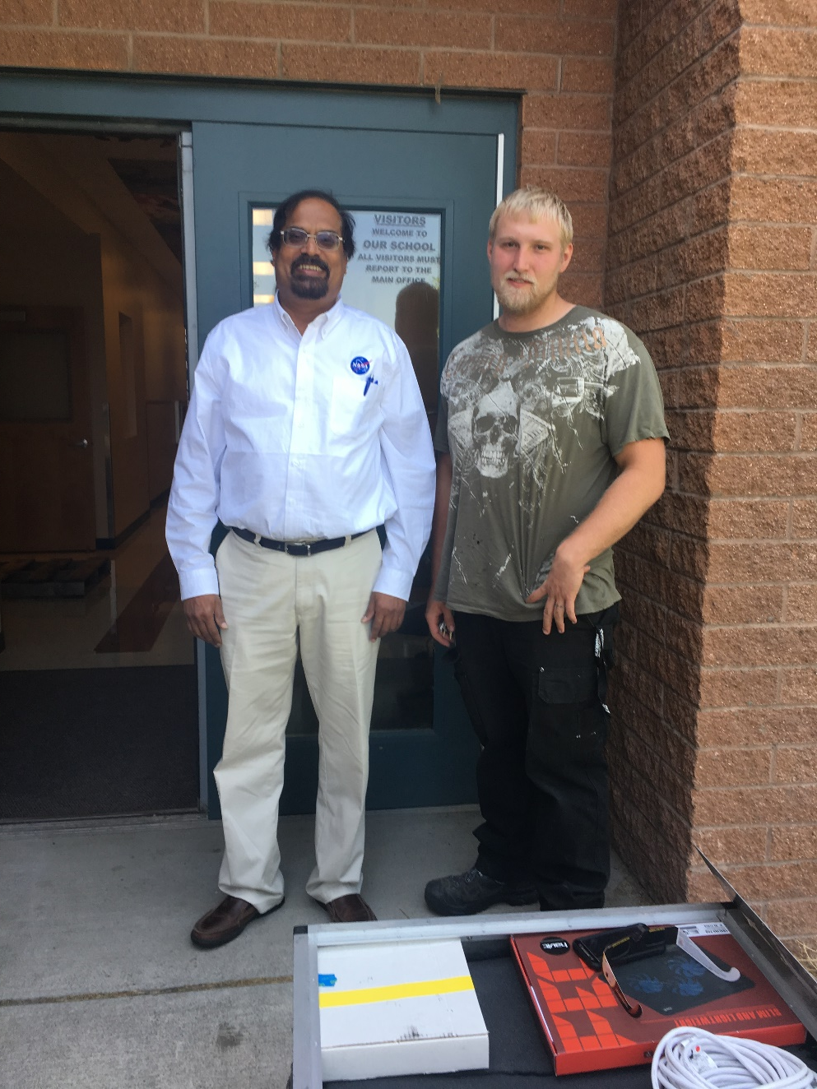
Sharon
Director of Performing Arts Center
Evan
Athletic Director
Justin
Custodian
Neffendorf
Principal
Thanks Madras High School!
Acknowledgments

