Slide 1
STEREO & SMEI Observations Pertinent
to LWS MC CDAW
Dave Webb
Contributions by Yan Li, John Clover, Bernie Jackson,
Nariaki Nitta, Maru, Daniel Berdichevsky

Slide 2
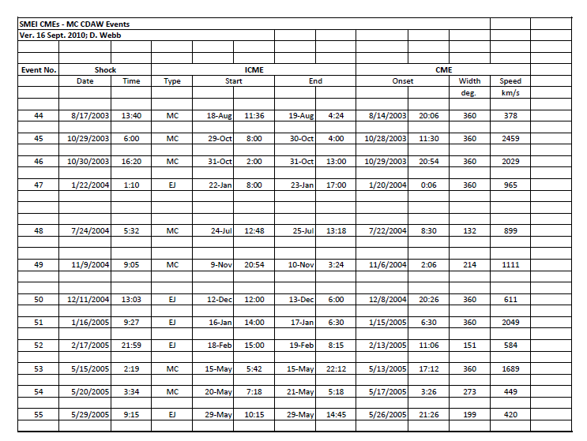
SMEI CME Data for MC CDAW Events

Slide 3
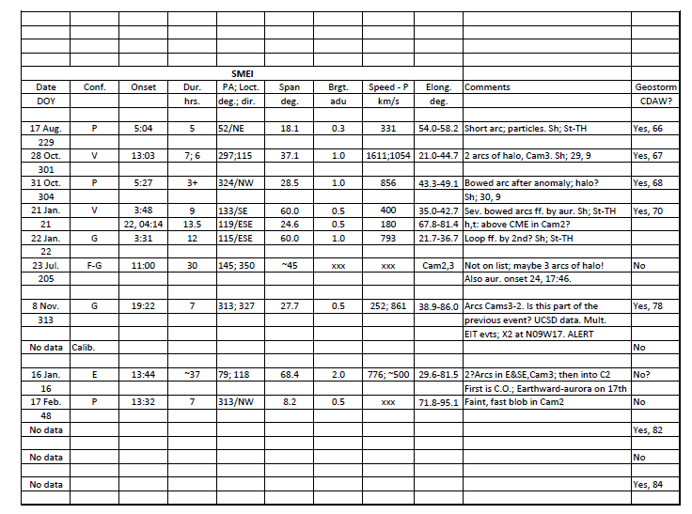

Slide 4
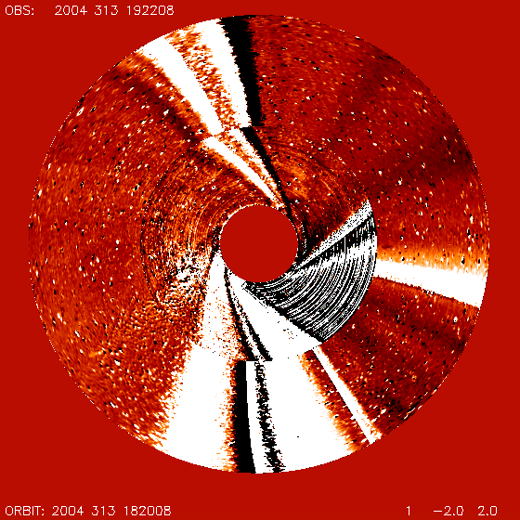
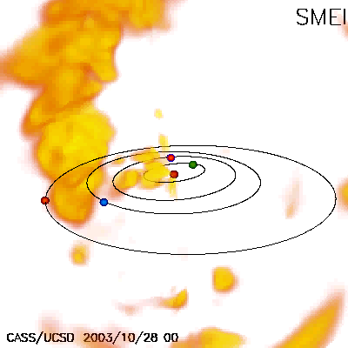
Solar Mass Ejection Imager Data & CDAW Events
SMEI archived and near-real time images/movies at:
AFRL SMEI site: http://smei.nso.edu/
UCSD SMEI site: http://smei.ucsd.edu/smeidata.html

Slide 5
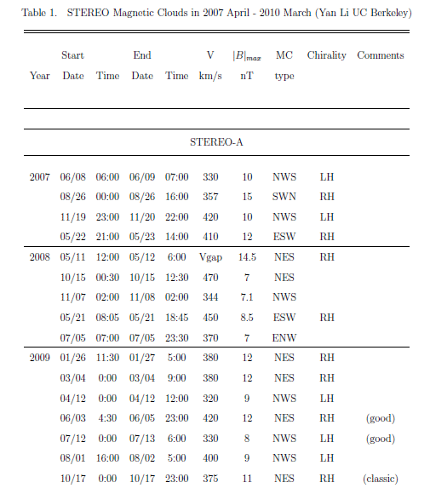

Slide 6
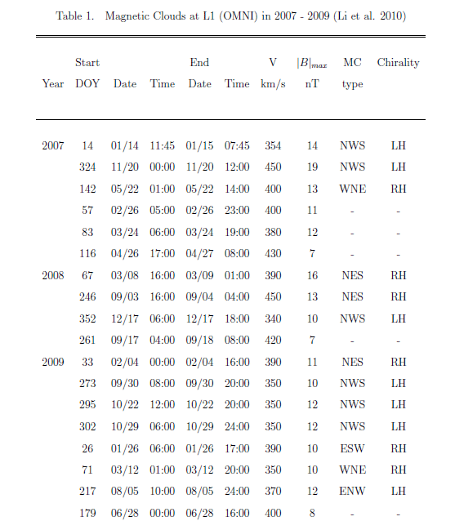

Slide 7
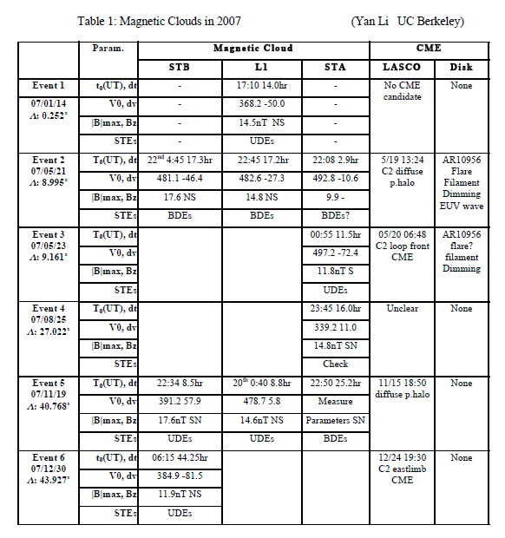

Slide 8
Additional (STEREO) Events for LWS CDAW2010 Workshop
  STEREO + L1 in-situ obs. Provide 2-3 separated locations at 1 AU to detect/measure same ICME.
  Detect MC at one location and a MC or ICME at another; study geometry, extent
  CORs & LASCO: Orthogonal views; address Jie’s question
  HI & SMEI: Allow tracking CME/ICME from Sun to 1 AU.
  Yan Li’s Merged STEREO IMF + plasma plots:
  http://sprg.ssl.berkeley.edu/~yanli/wind/stereo_plasma_imf.html
  See my STEREO SWx site for some of the events:
  http://secchi.nrl.navy.mil/spwx/index.php?p=sun_stereo_events
  ~25 MC events at STEREO or L1 or both
  2 events at all 3 locations: May 21-22, 2007 & Nov. 19, 2007
  June 6, 2008: last STEREO-L1 event; 55° separation.
  Nariaki Nitta’s STEREO EUVI Eruptive Flare list
  http://www.lmsal.com/nitta/movies/flares_euvi/index.html

Slide 9
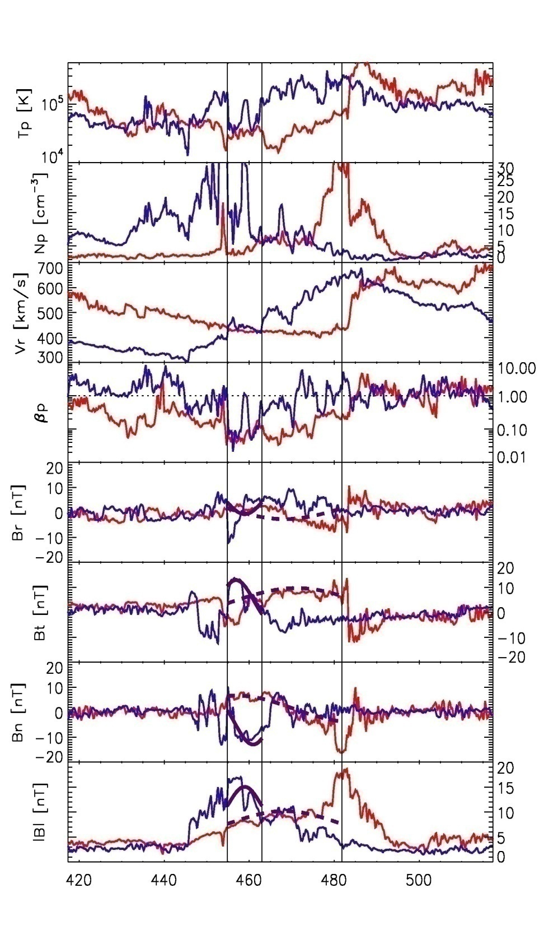
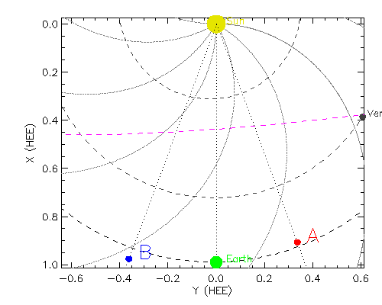
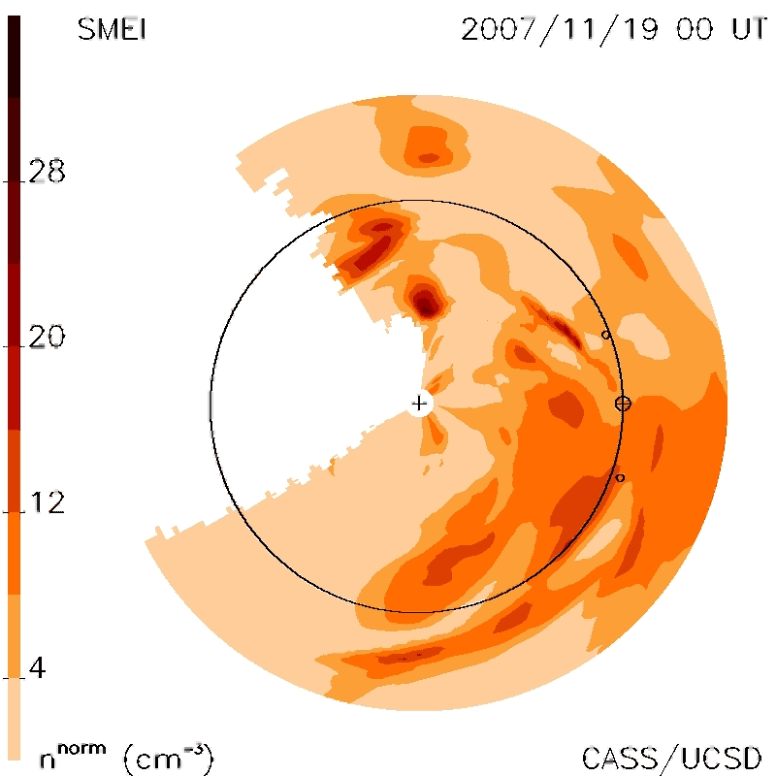
19 November 2007 ICME
Shk STB STA
41˚
SMEI density
Density flows –
ST-B & Earth
Note linear structure -
ST-A
B. Jackson,
UCSD
22:30
22:50

Slide 10
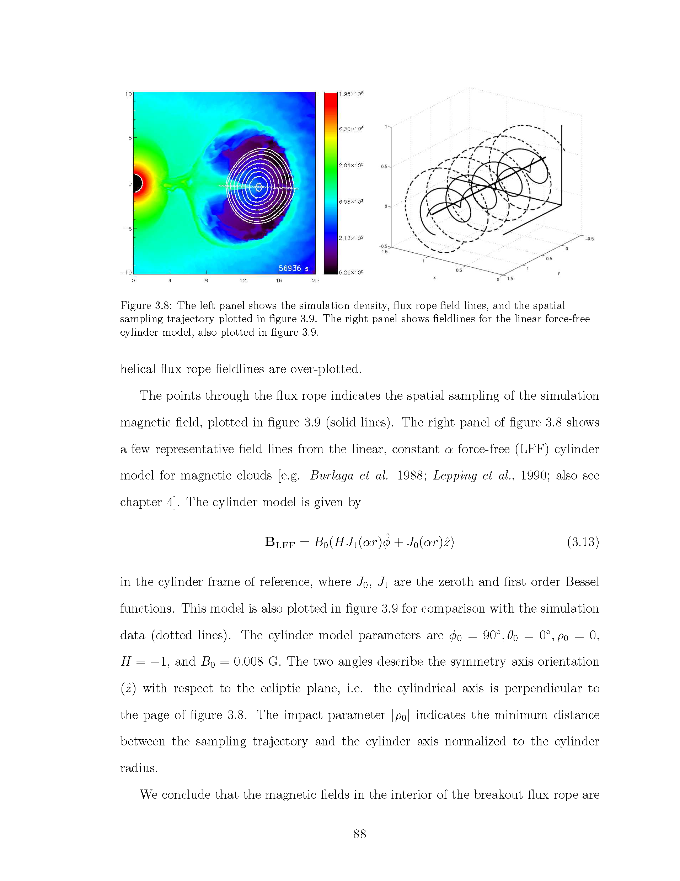
19 November
Force-free Flux Rope Fit
SUN
Y
X
STB
Two views show the
approximate orientations
of the force-free flux rope
(Lynch et al., 2003)
Magnetic Cloud (MC)
at ST-B, ACE, and ST-A.
The flux rope (all left-handed)
is consistent with a CME/flux rope having the axis parallel with the ecliptic plane with a
longitudinal extent at
the same scale with the
STEREO separation ~41˚.
?
STA
ACE
Z
STB
Y
ACE
STA
Lat.: 156.0 81.1 162.4
Lon.: -22.2 -4.7 4.9
Rho -0.70 0.39 -0.72
left-handed left-handed left-handed

Slide 11
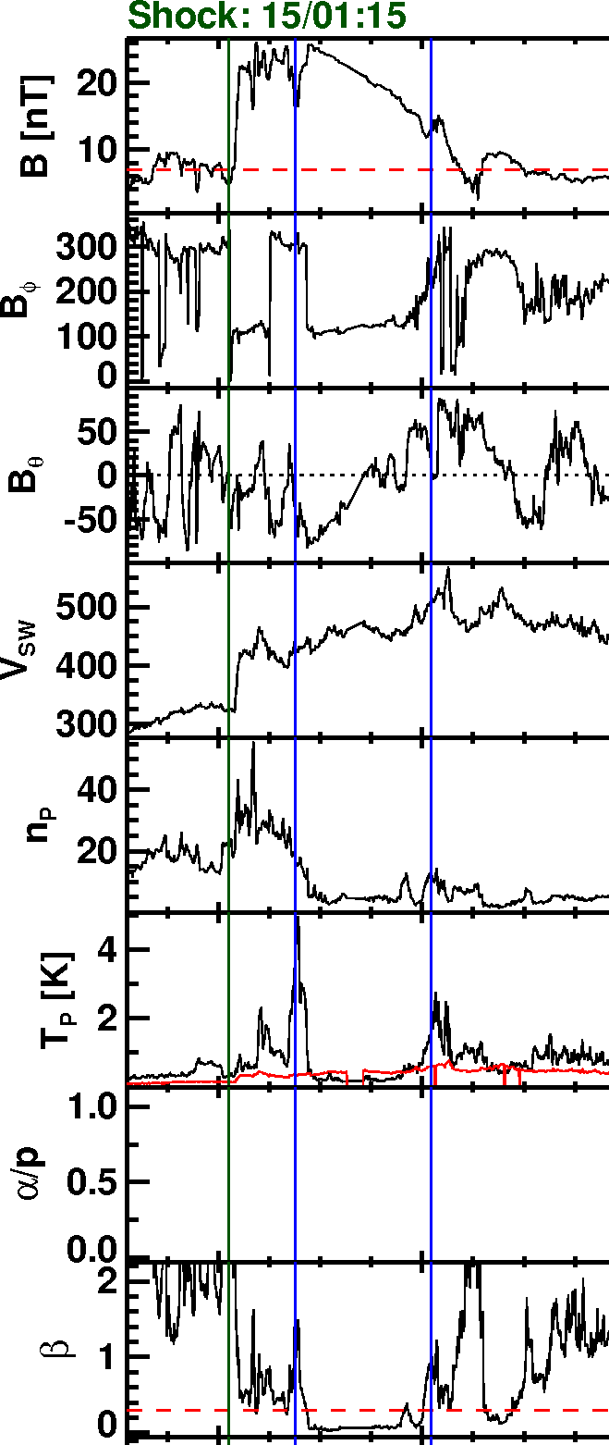
Two More Subjects of Interest
Twin MCs (w/ D. Berdichevsky)
- Qiang Hu & Maru showed CDAW events
with multiple MCs.
- We studied older events that had twin
MCs; both same and opposite
helicity.
- May 1997 & January 1998 events
- Possibilities:
* Each CME has 2 MCs- one is
“main” cavity FR & another is
prominence FR (follows main MC)
*”Single” events might consist of
multiple eruptions.

Slide 12
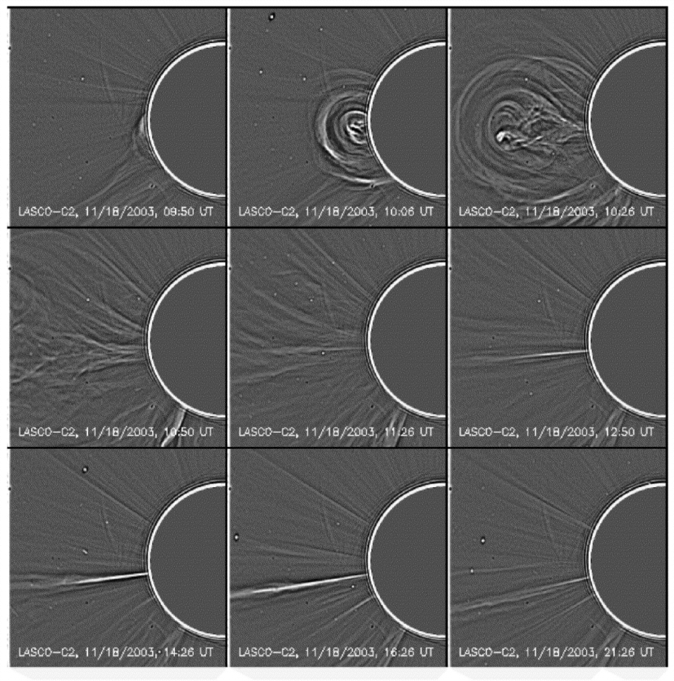
Rays/current sheets trailing CMEs
  - Survey of LASCO CMEs at solar
  min. & max.
  ~10 of all CMEs have obs. CSs
  Widths and evolution have been
  modeled
18-20 Nov 2003 Event; (Lin et al., 2005) & PSI simulation (Riley et al., 2006)
Lin and Forbes, JGR, 2000

