Slide 1
The effect of direction parameter on the classification of MC and EJ
Rok-Soon Kim, Yong-Jae Moon,
N. Gopalswamy, K.-S. Cho
NASA/GSFC, CAU, KASI

Slide 2
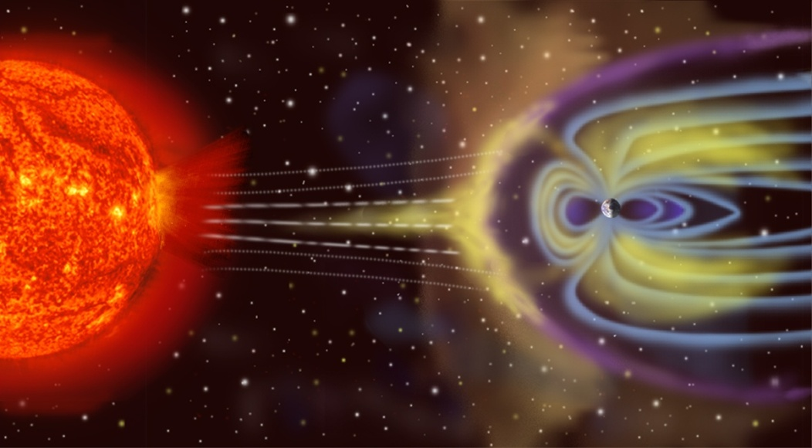
Classification of ICME Type
Magnetic cloud and Ejecta
  We examined the direction parameter of CME.
  Direction parameter is related with the direction of ICME to the space observation.
CME
- Angular Width
- Location
- Speed
- Direction parameter
ICME
- MC
- EJ

Slide 3
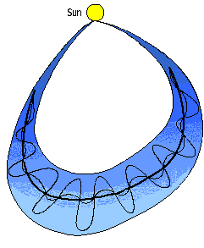
The geometry of ICME
Can the observing position control the ICME type?

Slide 4
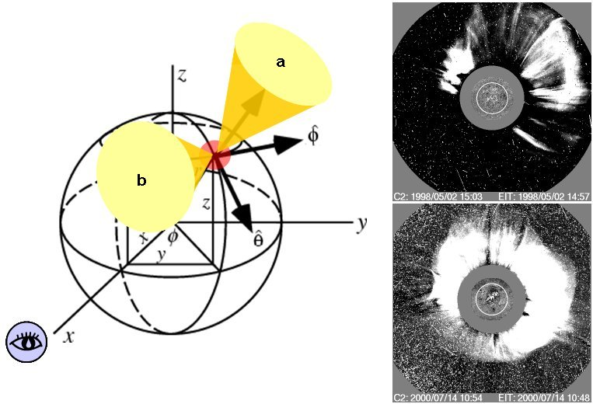
Direction Parameter (D)
CME’s direction of propagation
  Two CMEs ejected at the same region might be propagated to different directions according to the their ambience configurations.
  The shape of CME's front edge could be used to trace CME propagating direction.

Slide 5
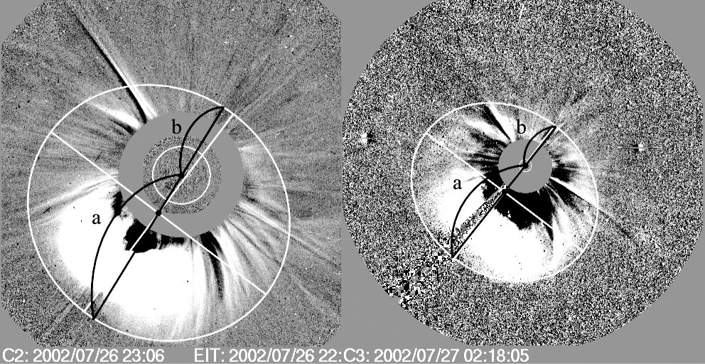
Direction Parameter (D)
Definition and Measurement
  The ratio of the distance between the shorter CME front and the solar center (b) to that of the longer one (a).
  An ellipse is plotted to follow the CME front in the SOHO/LASCO running difference image.
  a and b are measured along a line passing through centers of the Sun and the ellipse.
  D=b/a (0 ≤ D ≤ 1)

Slide 6
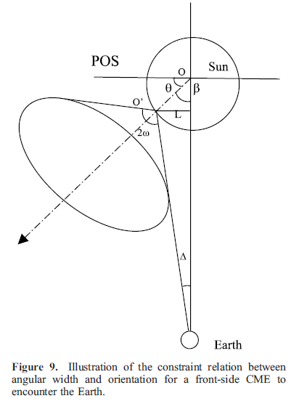
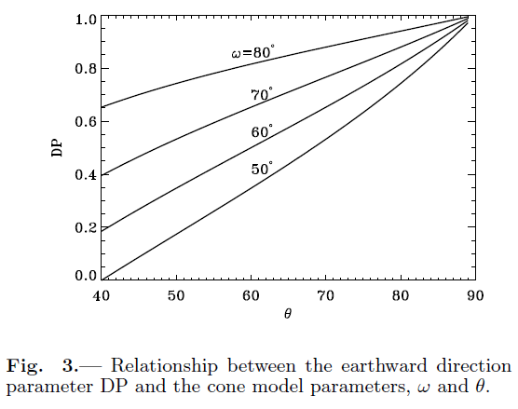
Direction Parameter (D)
Advantages
  The direction parameter can be directly estimated from the coronagraph images.
  It includes both the CME propagation direction and angular effect of the cone model (Xie et al. 2004, Moon et al. 2009).

Slide 7
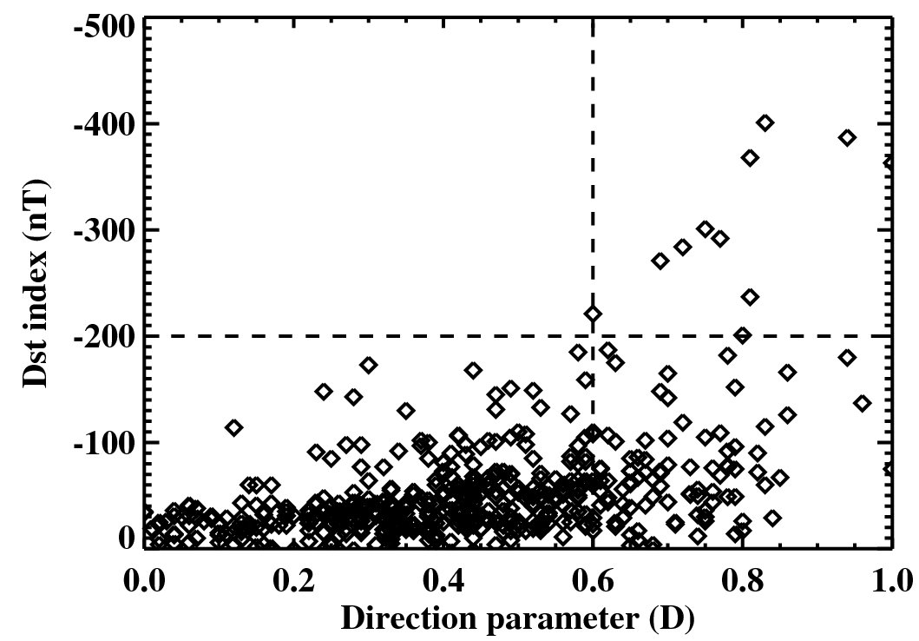
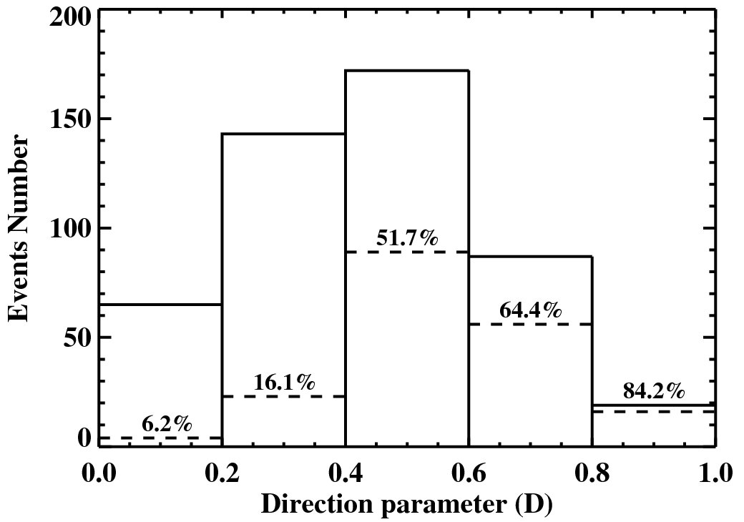
Geoeffectiveness of Direction Parameter
Distribution and probability
  Direction parameter has a good correlation with storm strength.
  All CMEs associated with strong geomagnetic storms (Dst ≤ -200 nT) have large direction parameters (D ≥ 0.6).
  Probability of geoeffective CME rises from 52% to 84% as the direction parameter increases from 0.4 to 1.0.

Slide 8
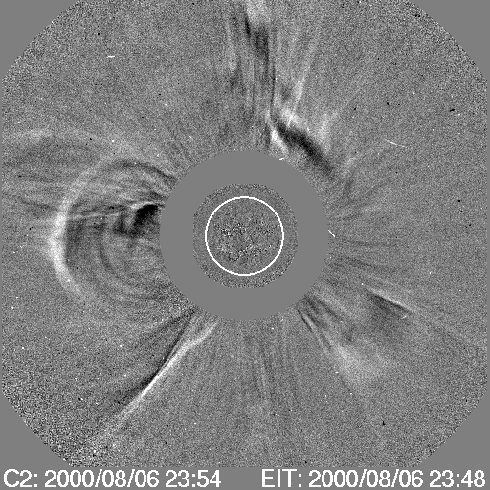
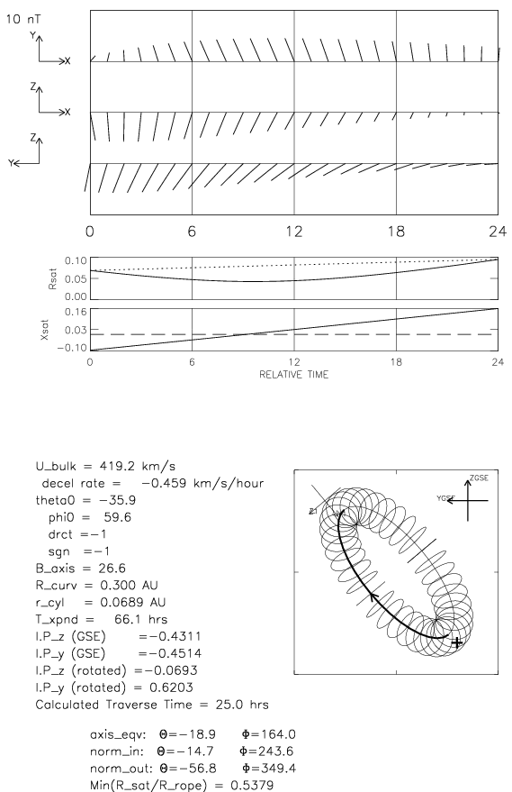
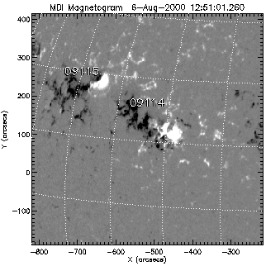
CME and ICME pair identification
Magnetic flux rope and CME direction parameter
  Event #: 22 (EJ)
  D=0.44

Slide 9
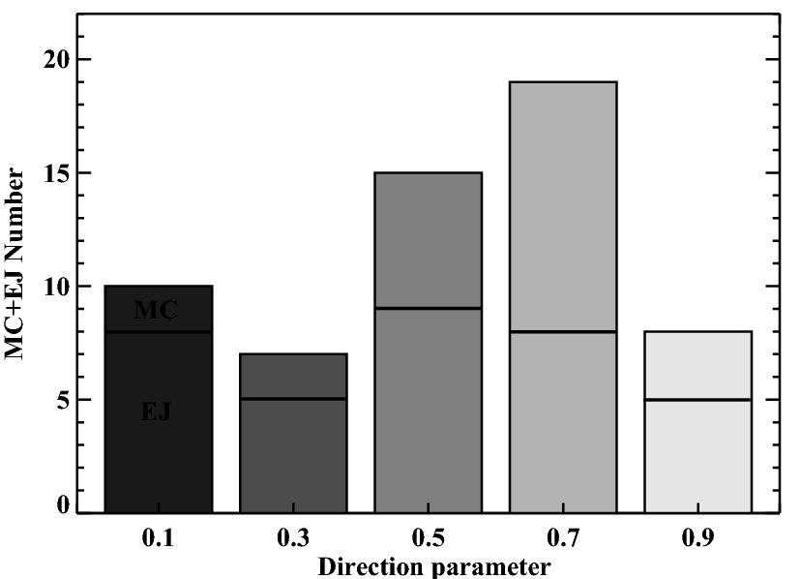
Direction parameter of MC and EJ
Statistical result for 59 CDAW events
  D ≥ 0.4
    MC: 48%, EJ: 52%
  D < 0.4
    MC: 24%, EJ: 76%

Slide 10
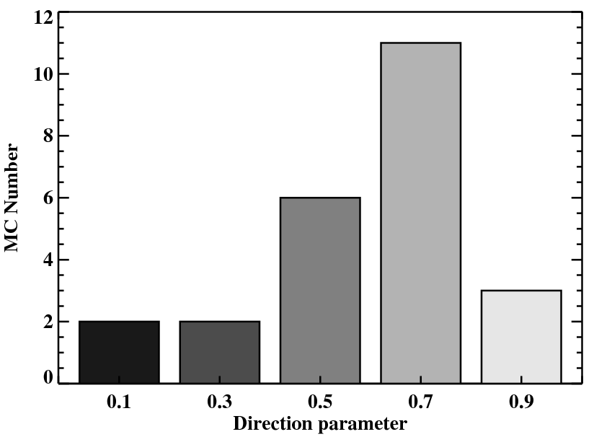
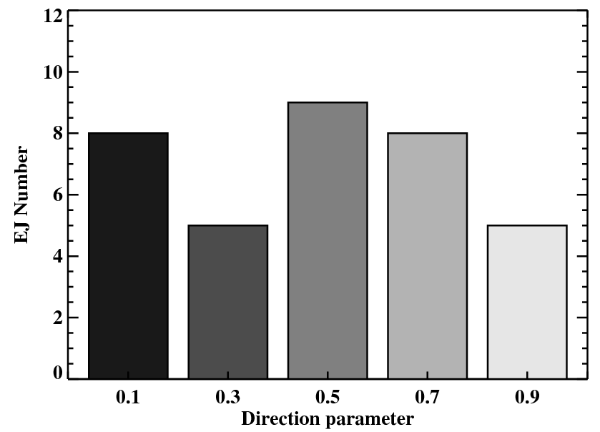
Direction parameter of MC and EJ
Statistical result for 59 CDAW list events
  MC tends to have larger direction parameter than EJ.
    Mean D for MC: 0.60
    EJ : 0.49

Slide 11
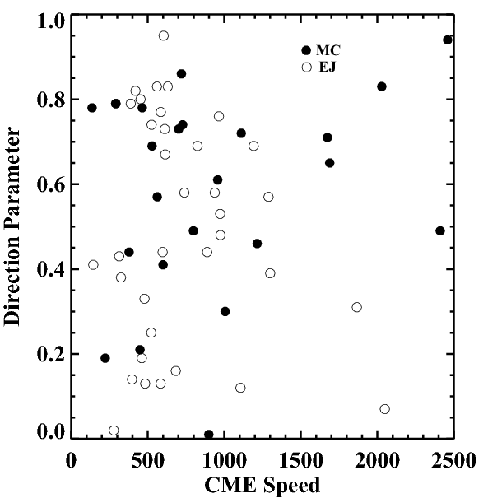
The combination effect of D and Speed
For very fast CMEs (V ≥ 1500 km/s)
  If the CME has large D,
  → MC
  If the CME has small D,
  → EJ

Slide 12
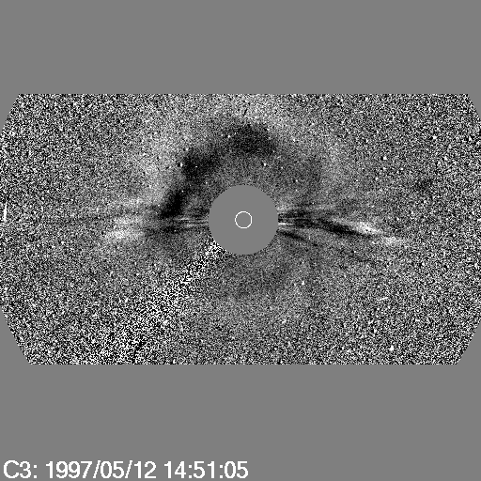
Case Study
MC (#2)
  CME speed: 464 km/s
  Flare class: C1.3
  Flare location: N21W08
  D: 0.83

Slide 13
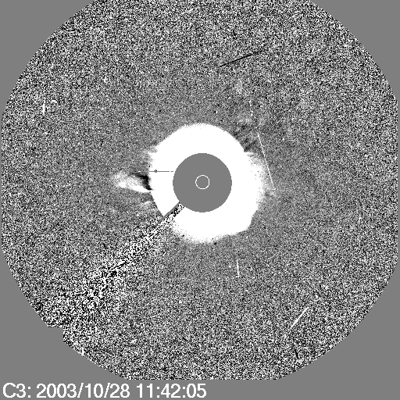
Case Study
MC (#45)
  CME speed: 2459 km/s
  Flare class: X17.2
  Location: S16E08
  D: 0.94

Slide 14
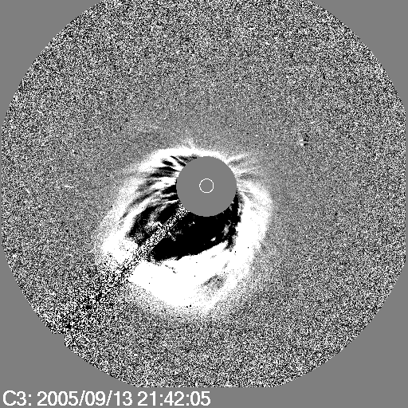
Case Study
EJ (#58)
  CME speed: 1866 km/s
  Flare class: X1.5
  Flare location: S09E10
  D: 0.31

Slide 15
Conclusions
If the direction parameter is
  Larger than 0.4: MC: 48%, EJ: 52%
  Small than 0.4: MC: 24%, EJ: 76%
  MC tends to have larger direction parameter than EJ
      Small D
      Large D

Slide 16
Conclusions
Combination effect with CME speed
  For fast CMEs (V ≥ 1500 km/s) ,
    If the D ≥ 0.4 → MC
    If the D < 0.4 → EJ
  For slow CME,
    We have to examine the combination effect with other CME parameters or other process.

