Slide 1
Tutorial for UVCS CME Observations
This file gives a brief overview of the UVCS instrument and the diagnostics available for CMEs. More details about the instrument are available in Kohl et al. (1997, Sol. Phys. 175, 613) and Gardner et al. (in The Radiometric Calibration of SOHO, A. Pauluhn, M.C.E. Huber and R. von Steiger, eds. (ISSI: Bern), p.161)
An overview of UVCS CME observations is included in the review of UV observations of the corona by Kohl et al. (2006, A&A Rev., 13, 31)

Slide 2
CONTENTS
UltraViolet Coronagraph Spectrometer 3
Observing CMEs with UVCS 4
UV Spectra of CMEs 5
Examples of CME Spectra 6
Making CME Images using UVCS Spectra 7
Comparing WL and UV Images 8
Diagnostics
I. Doppler Shift 9
II. Line Width 11
III. Doppler Dimming (outflow speed ) 12
IV. Density 13
V. Temperature 14
Caveats
I. Saturation 15
II. Grating Ghosts 16
III. Grating Scatter
IV. Wires 17
V. Wavelength Scale
VI. Radiometric calibration in second order
VII. Low sensitivity regions on the detectors 18
9. Interpretation 19

Slide 3
1. UltraViolet Coronagraph Spectrometer
The UVCS was designed for spectroscopic diagnostics of temperatures, densities, and flow velocities in the extended solar.
The instrument images the corona through an entrance slit 42’ long and up to 84” wide, which can be pointed at any polar angle and heliocentric distance from 1.5 to 10 R
42’
1.5 R 10 R
It contains two UV spectrometers (LYA and OVI channels) detecting emission lines in the 950–1350 Å wavelength range. The Table below gives an overview of the UVCS characteristics, for more details see Kohl et al. 1995 and Kohl et al 2006.
Spatial : pixel size 7” (~ 0.01 R)
Spectral LYA OVI OVI Redundant
1° order 1150 – 1350Å 940 – 1120 Å 1160 - 1270
2° order 470 – 560 Å 580 - 635
pixel 0.14 Å 0.1 Å 0.09 Å

Slide 4
2. Observing CMEs with UVCS
arcsec
λ
Observation of a CME requires placing the entrance slit at the right time and location in the corona to get spectra of the event as it crosses the FOV of the slit. The spectra are two-dimensional images where the vertical axis is the coordinate along the entrance slit (arcsec or PA) and the horizontal axis is the wavelength dispersion direction.
Spectral resolution ranges from 0.18 to 0.6 Å. The highest resolution is used in the CME watch observations, while the lowest are often obtained during synoptic scans.
A CME can, in principle, be detected at more the one heliocentric distance.
A summary of the characteristics of most CME observations is:
Exp. Time: CME watch 100 – 200 sec; Synoptic 100 – 600 sec
Heights : 1.5 up to 6 R
Spatial Binning : 21” up to 70” (full detector)
Spectral Lines : H I Lyman lines ( Lyα, Lyβ, Lyδ, Lyγ ), C III 977
N III, O V, OVI(1032,1037 ), Si XII, Fe XVIII

Slide 5
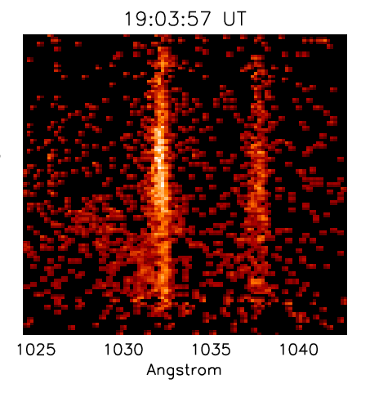
3. UV Spectra of CMEs
As a CME enters the slit, line intensity changes are detected in the spatial and spectral directions.
In general, the spectra emitted by different parts of the CME are different.
In the context of a three part CME with a front, a void and a bright cavity,
UVCS more often observes the core material and void than the front.
The core (see Fig 1) is highly structured material in terms
of knots/threads and Doppler shifts, and it is typically seen in
cold lines such as C III 977Å, Si III 1206 Å, Lyman lines etc.
However the are a few events in which the core material has
been detected in hotter lines.
The void is a dimming in the pre-CME coronal emission.
The front (see Fig. 2) is detected as faint and broad emission
often in O VI and Si XII lines.
O VI 1037
O VI 1032
H I Lyβ
H I Lyα
Fig. 1 – The CME core material
O VI 1037
O VI 1032
Fig. 2 – The CME front.
(Ciaravella et al 2005,ApJ,621)

Slide 6
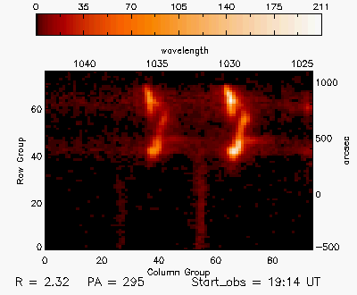
4. Examples of CME Spectra
As with white light images, CME spectra can look very different one from another dependingon the morphological and physical characteristics of the CME.
Thus fast, halo CMEs have different spectra from slow ones. Here a streamer blowout spectral sequence is shown on the left and a movie of a halo CME on the right.
Click on the image to see the
evolution of the O VI lines as a
CME goes through the UVCS slit
Pre-CME corona
Initial streamer blowout
Red & Blue Doppler shift
(Ciaravella et al 2005,ApJ,621)
(Raymond et al 2003,ApJ,597)

Slide 7
5. Making CME Images using UVCS Spectra
arcsec
1) As the CME passes though the slit,
UVCS collects spectra with a selected
spectral range and exposure time
}
λ
2) Select the spectral line in which CME
material is detected and integrate the
line profile for each exposure and for
each spatial bin to obtain one
dimensional images giving the spatial
distribution of the line intensity along
the entrance slit
t₀
∫ I_{λ}dλ
arcsec
λ
t_{n}
3) By placing the one-dimensional images
from consecutive exposures along a
time-reversed axis, we obtain an
image. The image is then a temporal
scan of the event at a fixed position
t₂
t₀
t_{n}
t₀
…….
arcsec

Slide 8
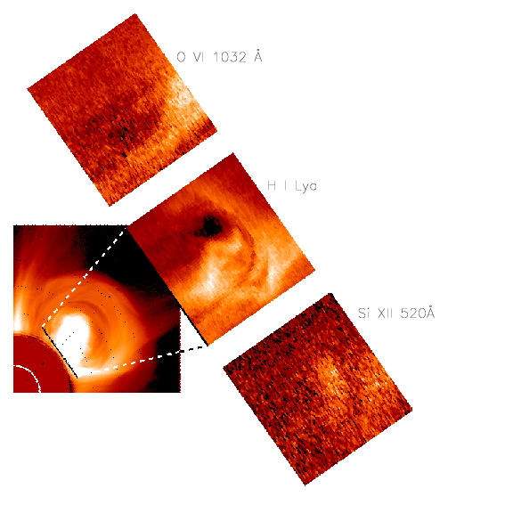
6. Comparing WL and UV Images
Images of the CME in different spectral lines show that
morphology depends on the physical characteristics of the ejecta.
t_{i}
O VI 1032 Å
t_{f}
Temperature, density, outflow speed
and abundances of the ejected plasma
determine the morphology in the
three selected spectral lines.
H I Lyα
Si XII 520 Å
t_{i} = beginning of the observation
t_{f} = end of the observation
(Ciaravella et al 2003,ApJ, 597)

Slide 9
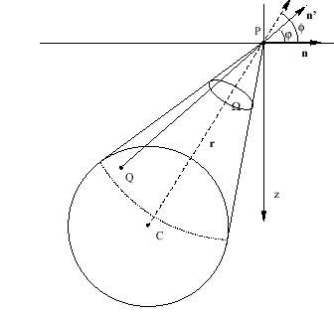
Diagnostics: I. Doppler Shift
Coronal material
Doppler shift of the spectral lines provides the line of sight speed of the emitting material.
In the spectrum on the left the CME material on the right of the background coronal emission is blue shifted.
In particular for :
Collisional lines
Radiatively Excited Lines
CME material
( Noci & Maccari, 1999, A&A, 341)

Slide 10
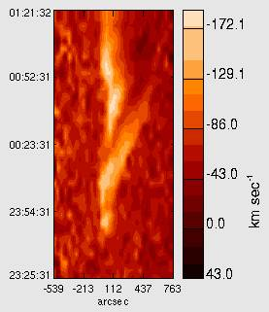
7. Diagnostics I. Doppler Shift cont
1997 Dec 11
The Doppler shift evolution suggests a helical motion of the ejecta.
Spatial structure and the LOS velocity evolution were interpreted as a
Left-Handed helix untwisting at ~ 9 × 10⁻⁴ rad /sec
(Ciaravella et al 2000,ApJ,529)
2000 Feb 12
The front was moving toward the Earth at
speed varying from 10 km/sec in the southern leg
to 60 km/sec in the northern leg.
The core shows along its S shape a smooth change
from blue (-30 km /sec) to red shift (+25 km /sec)
(Ciaravella et al 2003,ApJ, 597)

Slide 11
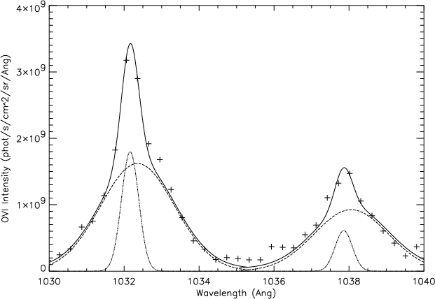
Diagnostics II. Line Width
The analysis of line profiles provides diagnostics of ion temperature (see pag . 13) as well as bulk
speed of the emitting plasma. Both increasing temperature and expansion of the emitting material
contribute to broadening the line profiles. The comparison of different spectral lines and the estimate of
the expansion speed are required to disentangle the two effects (Ciaravella et al. 2005, ApJ, 621; Raymond
et al. 2000, GeoRL, 27 ).
The passage of a shock heats the emitting material and is detected as broad wings mainly in the
non neutral ions. The mechanisms responsible for heating the neutral atoms , such as ionizing collisions
with the hot electrons of the plasma or resonant charge transfer with fast shocked protons, require
long time scales. Thus, in the UVCS spectra the presence
of a shock front is more likely to be detected in the
spectral lines of the brightest ions such as the O VI doublet,
but broadening of the H I Lyα line, if present, provides a
direct diagnostic of the proton temperature behind the shock.
Detections of shocks in UV spectra have already been reported
for four CMEs (Raymond et al. 2000 ,GeoRL, 27 ; Mancuso et al. 2002, A&A, 383; Raouafi et al. 2004,
A&A, 424 ; Ciaravella et al. 2005, ApJ, 621; Mancuso & Avetta 2008, ApJ, 677, 683 ).
Broad wings in the O VI doublet as results of
a shock passage ( from Mancuso et al. 2000, A&A ).

Slide 12
Diagnostics III. Doppler Dimming (outflow speed )
v_{ion}
UV spectra provide a method to estimate the outflow speed by using the
spectral lines with radiative components, such as the O VI 1032, 1037 Å doublet.
The collisional components of the O VI lines have an intensity ratio of 0.5,
while the ratio of the radiative components is 0.25 for emitting plasma at rest.
The radiative component originates from the resonant scattering of the chromospheric line by the O VI
ions of the corona. The intensity of the radiative component depends on the speed of the scattering ion .
As the ions move outward in the corona, the radiative
component dims because the solar emission and
coronal absorption profiles are Doppler shifted apart.
Thus, the line ratio increases and eventually becomes collisional when the outflow speed is such that the absorbing and emitting profiles no longer overlap.
However, at higher speeds the nearby lines of C II 1036.34, 1037.02 Å can pump the radiative component of the 1037 Å line at outflow speeds of 170 and 370 km/sec, respectively.
In very fast CMEs pumping of the 1037 Å line by 1032 Å (v = 1650 km/sec) and the 1032 Å line by Lyβ (v =1810 km/sec) can occur, as for the 2000 June 28 event (Raymond & Ciaravella 2004, ApJ, 606).
v_{ion}= 0
v_{ion}> 0
Absorbing Profile
Incoming Profile
₀
₀ -Δλ

Slide 13
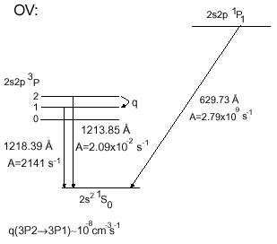
Diagnostics IV. Density
Diagnostics of density can be obtained from different spectral lines.
The O VI doublet provides diagnostics of density (Mariska 1977 , Ph. D Thesis; Noci et al. 1987, ApJ , 315;
Raymond & Ciaravella 2004, ApJ, 597). Since the illuminating flux from the disk is known, the intensity
of the radiative component fixes the number of O VI ions in the corona. The intensity of the collisional
component, combined with the O VI column density and excitation rate, determines the electron
density. This is most easily applied to pre-CME coronal densities, but it can sometimes be used for
CME ejecta.
The ratio of the intensities of the [O V] forbidden line at 1213.85 Å
and the O V] intercombination line at 1218.39 Å provides a reliable
density diagnostic. The forbidden line is generally difficult to detect
in solar spectra, since it occurs within the wing of the bright Lyα line.
This ratio has successfully been used to determine the electron density
of the 1999 April 23 CME at heliocentric height of 3.5 R (Akmal et al.
2001, ApJ, 553). The density determination is based on transitions between
the triplet P excited state and the singlet S ground state. Near the critical density n_{c} the P₂ state is
depopulated via collision in favor of the P₁ state. The critical density is:
A = radiative decay rate q = collisional rate coefficient

Slide 14
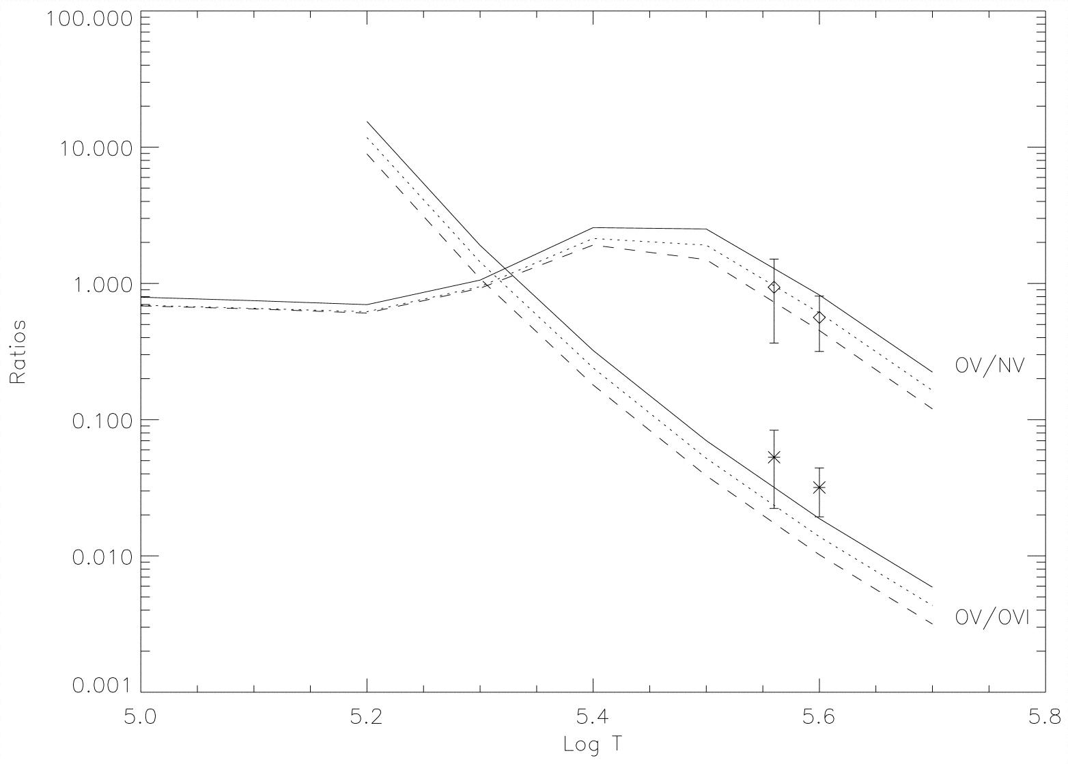
Diagnostics V. Temperature
The lines in the observed spectra indicate the ionization stage and the range of temperatures of the emitting material. The table lists the maximum temperature of formation of the some of the most common lines in UVCS spectra in
ionization equilibrium. At the larger
heights and in faster CMEs,
ionization equilibrium may not hold.
Spectral Lines T_{Max}
Lyα, Lyβ, Lyδ, Lyγ 1.3 ×10⁴
C III, Si III, N III 4 – 8 ×10⁴
S V], N V, O VI 1.6 – 3 ×10⁵
[S X], Si XII, [Fe XVIII] 1.3 – 6.8 ×10⁶
The ion temperature can be obtained from the line width:
Comparison of observed and predicted line ratios provide diagnostics of the electron temperature:
Predicted O V]/O VI and O V]/N V line ratios as a function of the temperature,
and density of 10⁶ cm⁻³ (solid line),10⁷ cm⁻³ (dotted line), and 10⁸ cm⁻³ (dashed line). The diamonds and asterisks are the observed values with their error bars .
From Ciaravella et al., 1999, ApJ, 510 .

Slide 15
8. Caveats
I. Saturation
CMEs can be far brighter than the quiet corona that UVCS was meant to observe, and the brightest lines can become saturated. The most critical problem generally occurs for HI Lyα and Lyβ, C III 977 Å, and one or two other bright lines. This saturation has not been calibrated for UVCS. To give an idea of the magnitude of the effect, we show the loss of sensitivity as a function of count rate for the nearly identical detectors of SUMER (from the SUMER ssw package idl/contrib/wilhelm/corr/local_gain_corr.pro)
Rate Sensitivity
0.0 1.0
0.1 1.0
0.3 0.99
1.0 0.986
3.0 0.928
10. 0.866
30. 0.765
100. 0.500
300 0.123
Note that these are counts per pixel per second.
UVCS data are usually binned by 3, 6 or more pixels.

Slide 16
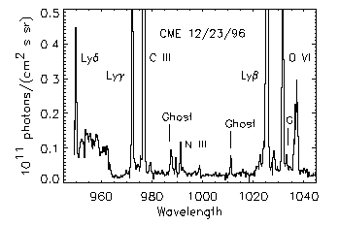
Caveats Cont.
II. Grating Ghosts
Imperfections in the diffraction grating can cause spurious images of a bright line at other wavelengths, particularly in the O VI channel. Pre-flight laboratory measurements showed ghosts at ±28.5Å from a strong line in the LYA channel. The most troublesome ghosts in the OVI channel arise from Lyα even when that line is not on the detector:
λ I/I_{Lyα}
987.85 1.3x10⁻⁴
1011.08 1.0x10⁻⁴
1033.03 1.1x10⁻⁴
1052.96 8.5x10⁻⁵
1079.35 4.0x10⁻⁴
1170.00 ~1.0x10⁻³
1261.33 ~1.0x10⁻³

Slide 17
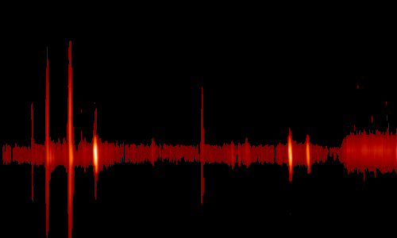
Caveats Cont.
O VI Lyβ C III Lyγ
III. Grating Scatter (false continuum)
Roughness in the conventionally ruled grating in the OVI channel scatters photons along the dispersion direction. The example shown is from the 1996 Dec 23 CME (Ciaravella et al. 1997, ApJ, 491). Note that the pseudo-continuum is twice as bright at the right hand end, where light from the redundant mirror is added to the direct illumination.
IV. X-ray artifacts
……
……
V. Particles background
……
……

Slide 18
9. Interpretation
The catalog includes a set of subjective assessments of the likelihood that a given event shows indications of a shock wave, a current sheet, or other interesting phenomenon based on a quick look at the data.
The criteria used are:
Front
The UVCS slit has the position and temporal coverage to catch the CME Front, and some change in the line profile or intensity is seen.
Void
The CME Void generally appears as just a lack of emission, and it is hard to discriminate between emission from the void and emission from the front and back of the bubble. In general, Void is indicated if some change in the ionization state or line profile suggested emission from the interior of the CME.
Shock
A shock is indicated by very broad O VI line profiles when the Leading Edge crosses the slit.

Slide 19
Interpretation Cont.
Current Sheet
Emission in [Fe XVIII] λ974 after the CME onset is taken as an indication of a current sheet, especially if it is seen in a narrow region along the slit and if it lasts for a long time.
Prominence
Bright emission in low stages of ionization such as C III and N III is taken to how ejected prominence material, particularly when these lines occur in small spatial regions.
Flare OVI
O VI emission all along the slit before the CME material arrives at the slit indicates flare O VI photons scattered by O VI ions in the corona.
Leg
Fairly bright emission in low ionization lines (e.g., C III) that lasts for a long time and has little Doppler shift is interpreted as a flux filament connecting the CME back to the Sun.
Helix
A filament or strand that moves along the UVCS slit and also moves in Doppler shift may indicate a helical motion, but detailed models are needed to verify this interpretation.

