Slide 1
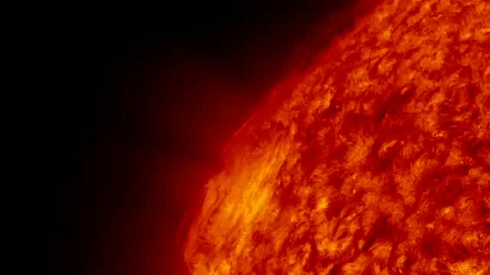



Neel P Savani^{1,2},
¹UCAR,
²Naval Research Lab
CDAW, Sept 2011
In situ Force-Free Flux rope fittings
Notes:
Good afternoon. Today I will be talking about the morphology of coronal mass ejections between the Sun and 1AU.

Slide 2
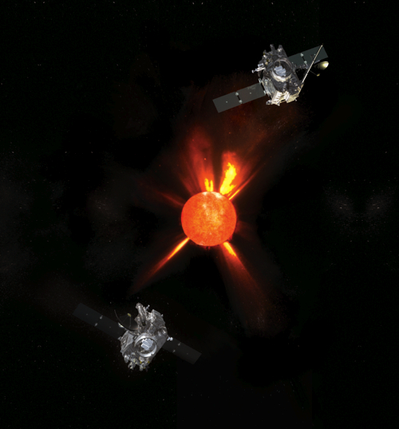
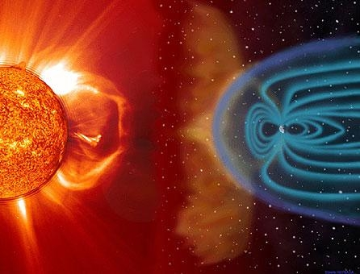
INTRODUCTION
Introduction to the GUI in Matlab
Basic understanding of FR theory
Geometrical investigation of FR cross-section
More advances models:
  Self expanding Flux rope
  Kinematically expanding Flux rope
Revisit Flux rope GUI and test events
Notes:
The observational work that I will talk about concentrates on tracking the 2dimensional shape of 4 case study events from STEREO. They were identified by the general public under the solarstormwatch project. This project was set up by the rutherford appleton lab and the royal observatory, Greenwich . What I will show is that the radial width of a CME can be continually tracked by measuring the front and rear edge within a J-map. I will then expand this technique to estimate the 2D aspect ratio of the CME and ascertain the pancaking nature of the object. So, I am defining the aspect ratio as the vertical extent of a CME divided by the radial width. And then I will make an estimate of the expansion rate.

Slide 3
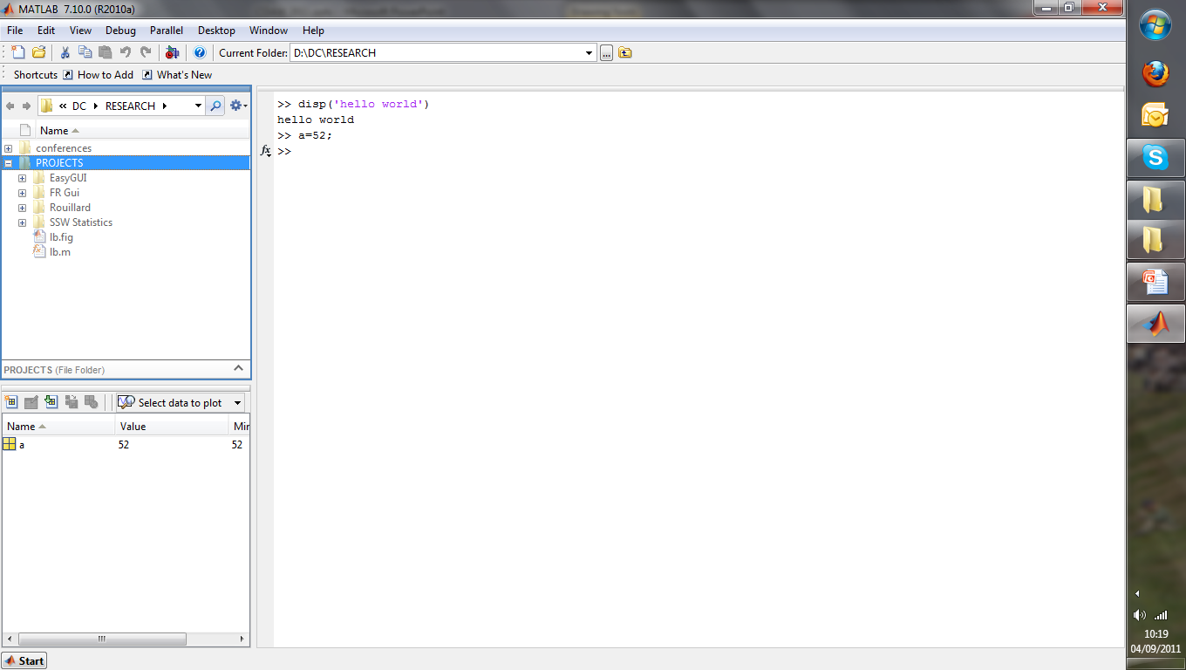
Introduction to GUI
Current directory/ folder
Cmd window
Workspace variables
Notes:
This is an example of one of the 4 events. It is on STEREO-B in May 2009. What is shown in this movie is that the cross section of the CME is clearly visible. What you should concentrate on is that the overall shape is clearly being seen to become more elliptical as it propagates further into the heliosphere. This is sometimes referred to as ‘pancaking’.
What you may see is that the CME begins relatively circular within COR and then can be seen to become very elliptical in HI 1 and 2

Slide 4
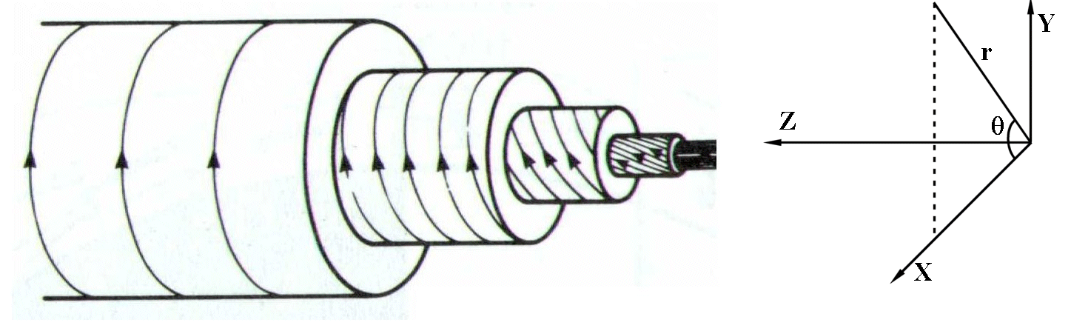
Flux Rope Theory
Burlaga et al in 1981 defined a subset as magnetic clouds, with properties:
  Enhanced magnetic Field
  Slow rotation in Magnetic Field
  Reduced Proton Temperature
Magnetic clouds have helical magnetic field structure
magnetic cloud = flux rope
Structure of a magnetic cloud
Notes:
Out of the various properties Burlaga noted that a particular subset of Interplanetary CME have the same 3 properties: enhanced magnetic field, slow rotation in magnetic field, reduced proton temperature. Using these properties the global structure of the field is somewhat helical in shape producing the picture on the right
An example of this can be seen with in-situ data as…..

Slide 5
Flux Rope Theory
Constant α, force-free flux rope
  Assume force-free,
  α is an arbitrary constant ⇒
  Assume α is constant,
  Helmoltz equation ⇒
  Assume B is a function
  of only radius,
  Solution: Bessel function :
α = 2.4 ⇒ the B field on the outer shell of the flux rope is completely poloidal (i.e. no axial component)
Notes:
….. One possibility is the constant alpha force-free flux rope model. Before we delve into the maths I would like you to have a look at the end result. The main features of the picture shows a cylindrical tube. At the centre, the field lines travel along the axis of the rope. But as we jump progressively out into the outer shells, the field lines begin to wrap around the cylinder more.
So how do to come to this result: if we look at the force on a plasma. force is equal to current density, j, cross product with B field. If we then assume that the plasma is force balanced then j is parallel to B field.
If we then assume that the arbitrary alpha is constant, we can generate the helmoltz equation.
And from there we can state that B field is a function of only radius- using this fact we can generate a solution satisfying the Bessel Function. This creates our cylindrical rope structure.
We can then optimise this solution to satisfy our data.

Slide 6
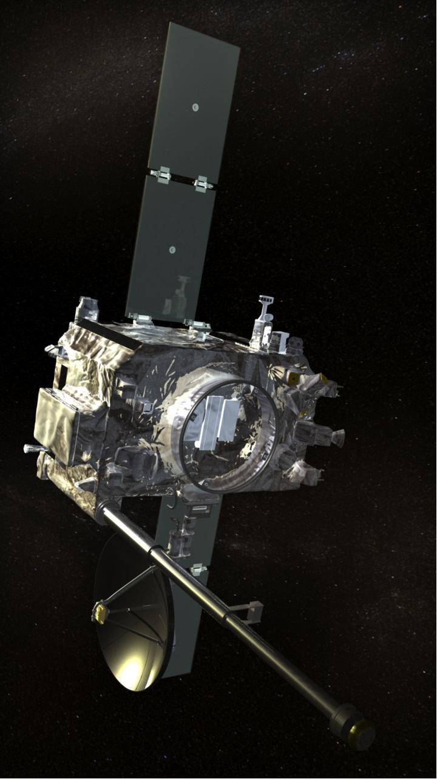
Flux Rope Theory
Y
Bx
MVA
X
+
+
+
+
+
min
Z
By
+
+
+
max
+
+
+
Spacecraft path
Bz
+
+
+
+
int
+
|B|
+
+
+
+
Notes:
The question is what does the spacecraft observe as it travels through a flux rope? If we imagine the blue circle as a flux rope. With the B field moving clockwise and out of the page. Then as spacecraft enters from the left in this idealised case, the magnetic field in the x and z will be 0; with the y at maximum.
Then as the crafts enters the centre of the rope; the Z direction will be at maximum and the y at 0.
It is useful to point out here that the x,y,z directions here are abitrary, and linked to the rope axis. But the rope may not always be orientated in this fashion. In this case, its orientation needs to be determined and path calculated before plotting onto a data set in rtn coordinates. this is done by something called MVA minimum varariance analysis. This method calculates the axes with min max and interdiate variance directions. What you observe on the right is the x direction remaining at zero and not having any variation producing our minimum variance. The y having maximum variation going from +ve max to –ve max. and the z showing an intermediate direction by changing from +ve to +ve max. For our purposes the intermediate direction or z direction is the most important as it provides the axis of our rope.

Slide 7
Flux Rope Theory
Chirality= -1
3 Free parameters:
  Magnetic field magnitude along axial direction
  Chirality
  Impact Parameter, Y₀
Spacecraft path
R
d
Chirality= 1
Notes:
When optimising our model to the data, we have 3 free parameters: the magnetic field in the axial direction.
The chirality, which shows the spin of the b field; if it spins clockwise or anticlockwise. And something we called the
Impact parameter. It is a definition of closest approach of the craft the to axis. Defined here as d divided by R.
Once the model has been optimised……

Slide 8
Magnetic Cloud Model
Variance Analysis:
  Developed by Sonnerup and Cahill in 1965
  Deduces MC direction without being computationally intensive
  Ratio of e-values: int/min & max/int should both be larger than ~4
  High frequency noise is a source of error
  Error in MVA increases with impact parameter
  Error is minimised by using low resolution data- ~10-15min res.
Graph showing the inaccuracy of MVA for flux rope fittings as the impact parameter increases. (Rees, 2003)
Notes:
….. One possibility is the constant alpha force-free flux rope model. Before we delve into the maths I would like you to have a look at the end result. The main features of the picture shows a cylindrical tube. At the centre, the field lines travel along the axis of the rope. But as we jump progressively out into the outer shells, the field lines begin to wrap around the cylinder more.
So how do to come to this result: if we look at the force on a plasma. force is equal to current density, j, cross product with B field. If we then assume that the plasma is force balanced then j is parallel to B field.
If we then assume that the arbitrary alpha is constant, we can generate the helmoltz equation.
And from there we can state that B field is a function of only radius- using this fact we can generate a solution satisfying the Bessel Function. This creates our cylindrical rope structure.
We can then optimise this solution to satisfy our data.

Slide 9
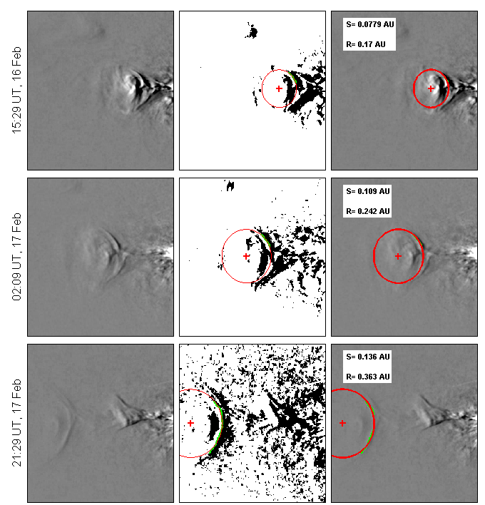
Geometrical investigation: Circular
Measure the radius of curvature of the rear edge
This can then be used to determine the cross-sectional size.
This analysis was carried out over 9 frames
But this is limited to manual identifications on a frame-by-frame basis

Slide 10
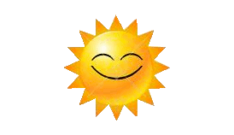
Extra time - Geometrical estimates
t₀ = 0
Time, t
θ= constant through CME evolution
tan(θ)= (r₀/L₀)
½ height = R tan(θ)
H
r₀
θ
W
L₀
H= 2R (r₀/L₀)
W = 2r₀ + 2A (R - L₀)
R
Notes:
So to begin our geometrical analysis. If a CME starts as a circular FR close to the Sun and then moves radially away, it will quickly become elliptical.

Slide 11
Geometrical investigation
t₀ = 0
Time, t
θ= constant through CME evolution
tan(θ)= (r₀/L₀)
tan(θ)= (r₀/L₀)
½ height = R tan(θ)
H
r₀
θ
H= 2R (r₀/L₀)
(A= Vex/Vbulk)
W = 2r₀ + 2A (R - L₀)
⇒ A(R) = ½ W - r₀ _
R - L₀
W
L₀
R
Notes:
So if we briefly take a step back and look at the geometrical estimates of the CME shape, we see that the height of a CME ( or its vertical extent) can be estimated by simply measuring the PA angular width.
Although we are measuring the radial width from the J-maps, we can also make an estimate for it if we assume that it begins with an initial size and then and a growth term. Here, the parameter, A refers to a ratio of expansion velocity to bulk flow. What you will note is that if we made A, the subject of the formula, all the other parameters are measurable from the J-maps.

Slide 12
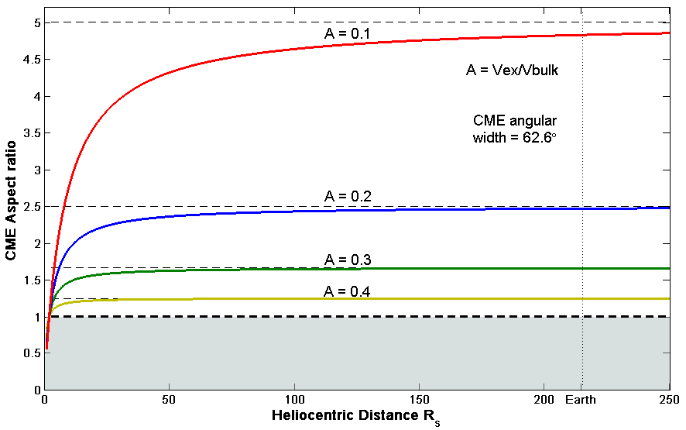
Geometrical investigation: Aspect ratio, χ
Aspect ratio, χ
χ = Height/ Width
χ = R (r₀/L₀) _
r₀ + A(R- L₀)
Notes:
As an aside it is interesting to notice that if the expansion paramater is assumed to be constant, then the aspect ratio of a CME converges to a fixed number. Therefore the aspect ratio becomes scale invariant and no longer undergoes further pancaking. …. On this figure the value of 1 represents a circular cross section and numbers larger than 1 indicate pancaking into an elliptical shape.

Slide 13
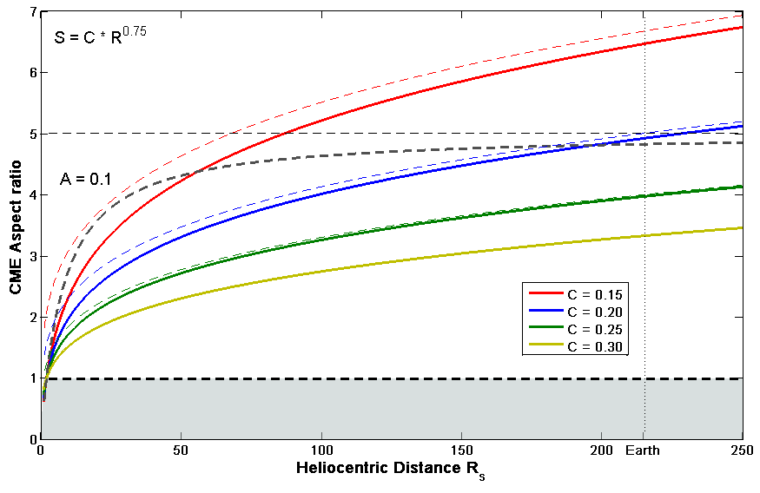
Geometrical investigation: Aspect ratio, χ
Improve the A= Constant
Use Bothmer’s power law
to determine radial width of
CME:
S= 0.24*R^{0.78}
Width = S
Width= C *R^{n}
Aspect ratio, χ
χ = Height/ Width
χ = R (r₀/L₀) _
C *R^{n}
Notes:
This work of course assumes that the ratio between expansion to bulk flow remains constant. This is not entirely accurate, and can be improved.

Slide 14
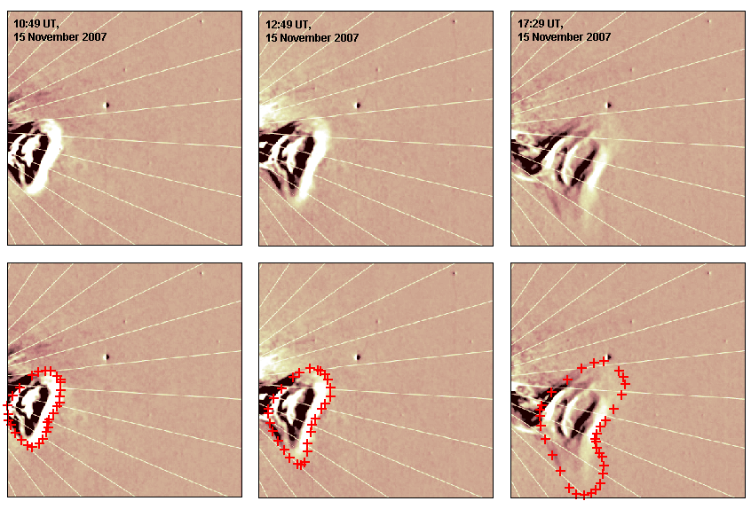
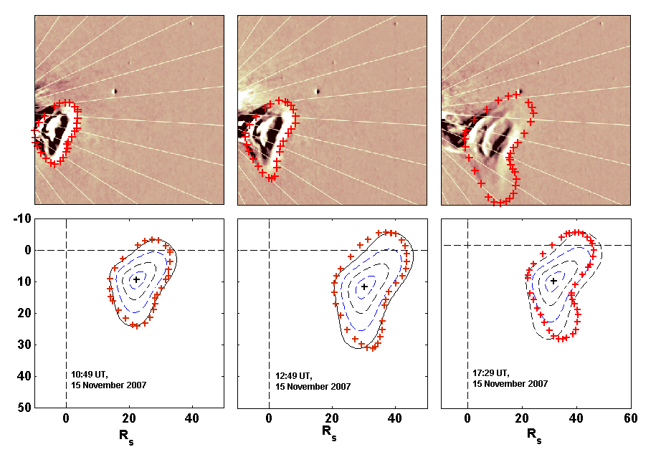
Geometrical investigation: Distortions

Slide 15
Advanced models: Expanding model
Many observations of MCs at 1 AU show a gradually declining velocity profile
Often they also show an asymmetric profile of the magnetic field magnitude
Assuming Magnetic Pressure acts symmetrically from the central axis
Marubashi (1997) developed a self similar expanding model to answer these observations
Notes:
The vicinity of other spacecrafts during the may 2007 event may provide better understanding.
Its an interesting case that when STEREO B observed this Interplanetary CME, Venus was also relatively close at about 50 degrees a way. This suggests there may be a possibility of observing the same event, inorder to calculate further studies.

Slide 16
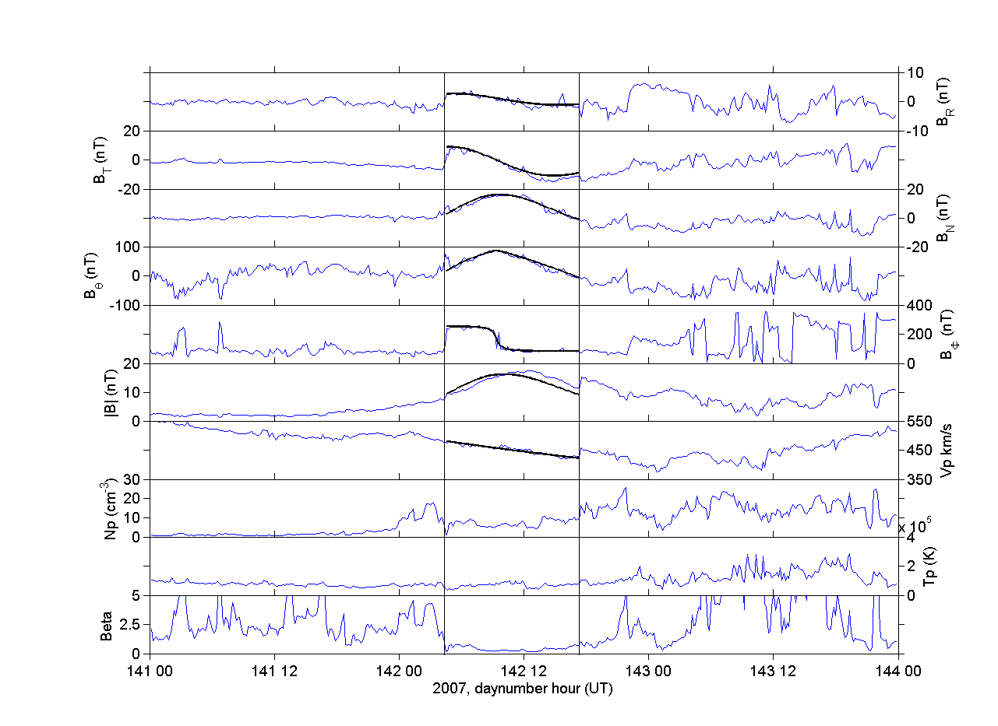
Advanced models: Expanding model
Velocity and Magnetic field distribution described by Marubashi (1997)
Notes:
The vicinity of other spacecrafts during the may 2007 event may provide better understanding.
Its an interesting case that when STEREO B observed this Interplanetary CME, Venus was also relatively close at about 50 degrees a way. This suggests there may be a possibility of observing the same event, inorder to calculate further studies.

Slide 17
Advanced models: Kinematic model
Detailed MHD simulations show MCs have highly oblate cross sections at 1AU
The angle of the deflected solar wind in the sheath region ahead of MCs also suggest non circular-cross sections
Owens et al (2006) developed a model to respond to these results
The model uses the constant alpha force free flux rope as its initial conditions close to the sun. Then kinematically distorts the shape as it propagates out into the heliosphere
Consistent with observations on coronagraphs the model is limited to retain a constant angular width
Owens et al, 2006
Notes:
The vicinity of other spacecrafts during the may 2007 event may provide better understanding.
Its an interesting case that when STEREO B observed this Interplanetary CME, Venus was also relatively close at about 50 degrees a way. This suggests there may be a possibility of observing the same event, inorder to calculate further studies.

Slide 18
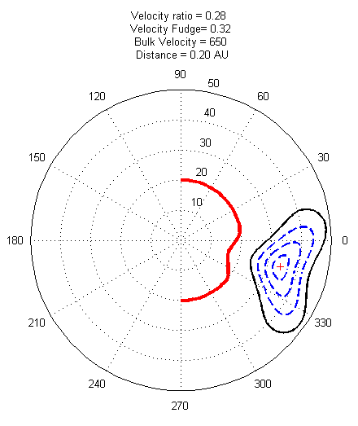
Advanced models: Kinematic model
Kinematically distorted model developed by Owens et al. [2006]
Considers a cylindrical structure close to the Sun (~2R_{S}) and propagates the CME radially away from the Sun
Expansion of CME assumed to be a constant fraction of the bulk flow
Structured solar wind used to propagate different sections of the CME at different rates
Owens et al. ,2006

Slide 19
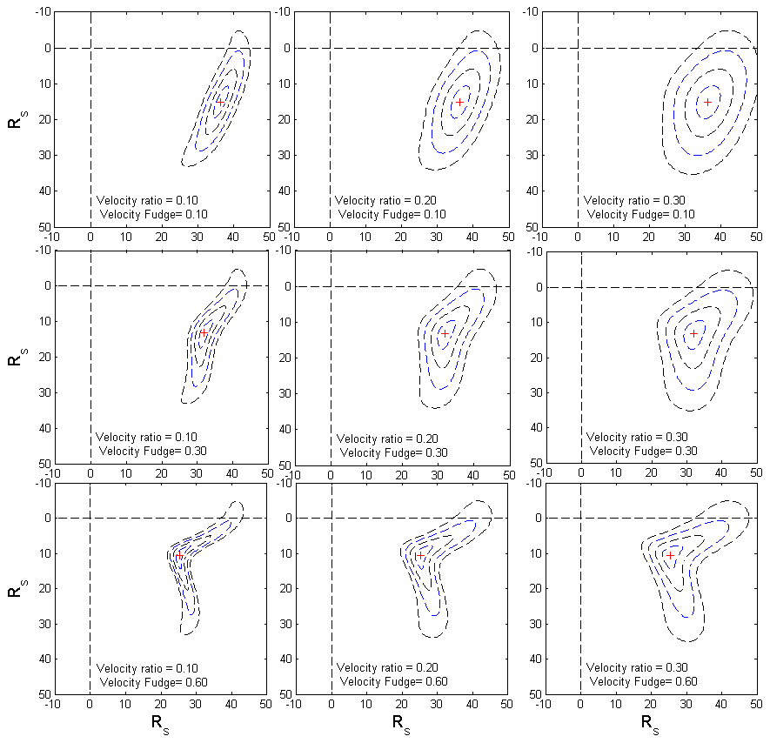
Advanced models: Kinematic distortions
Importing structure solar wind onto a CME model object.
2 Free parameters used to model the images:
  Velocity ratio, A= ratio between expansion and bulk velocity
  Reduction Factor, F= fraction of velocity magnitude between slow/fast wind used in the model
A
F

Slide 20
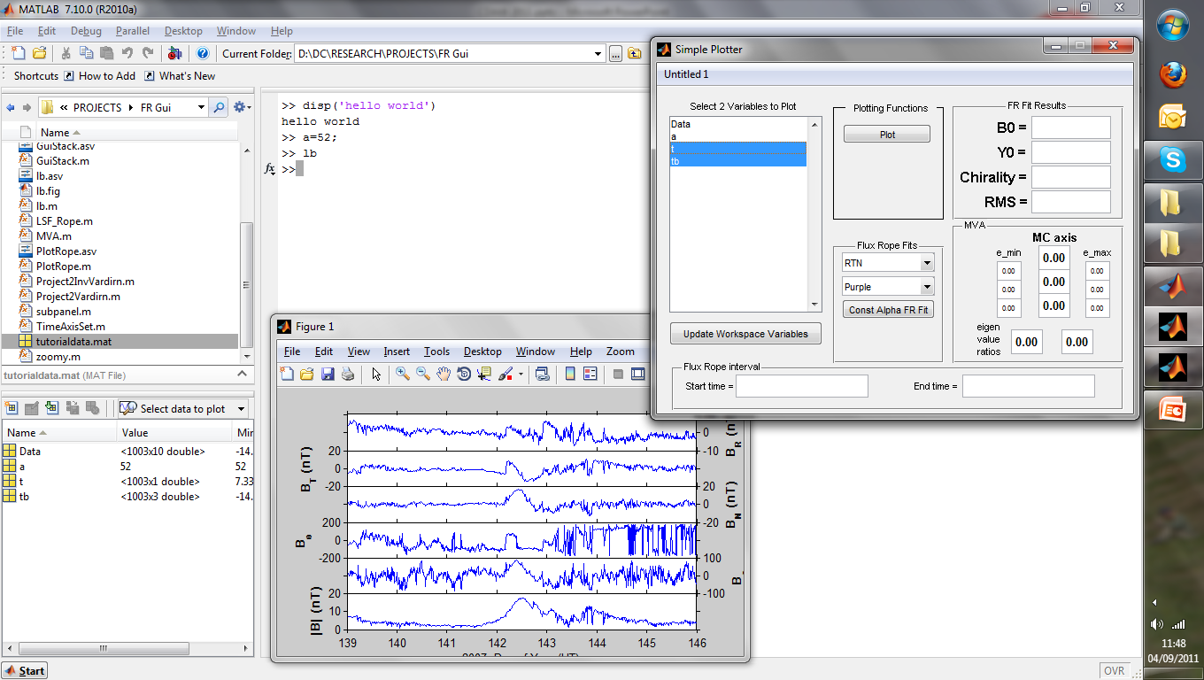
Revisit GUI
Notes:
This is an example of one of the 4 events. It is on STEREO-B in May 2009. What is shown in this movie is that the cross section of the CME is clearly visible. What you should concentrate on is that the overall shape is clearly being seen to become more elliptical as it propagates further into the heliosphere. This is sometimes referred to as ‘pancaking’.
What you may see is that the CME begins relatively circular within COR and then can be seen to become very elliptical in HI 1 and 2

Slide 21
Main Results
Aspect ratio, χ
H
r₀
W
L₀
R
⇒ A(R) = ½ W - r₀ _
R - L₀
Notes:
We can average the individual results to produce a linear best fit for the radial width and aspect ratio of all 4 events. Also by using the radial width values and heliocentric distances we make an estimate for the expansion rate which follows the formula given earlier. What is surprising about this is that the expansion rate fits a power law very well. Such that the expansion is estimated to be about 40% at 20Solar Radii away for the Sun, and then decreases to about 5% at 1AU. The power law now gives us a mathematical formula from which we can estimate the expansion of a CME at any given distance away for the Sun.

Slide 22
Notes:
I put this figure together in order to make sure the power law was not being dominated by the result of a single CME. So here, each panel displays the expansion rate of each CME in red. … while the power law for the 4 averaged together is displayed again in black. This shows that each CME is on the whole predominately following a power law behaviour.

Slide 23
Summary
SOLARSTORMWATCH.com - project is beginning to statistically estimate the shape and sizes of CMEs as they move between the Sun and 1AU.
Direct observations of the 2D structure of CMEs can be measured between the Sun and 1AU.
Generate a Power law fit for the typical expansion rate of a CME at any position in the inner heliosphere
A = 0.05*R ^{-0.8}

Slide 24
in situ estimates
Spreiter et al. (1966)
Planet. Space Sci.
Effective Magnetic bubble of CME
Mach Number
Shock normal
Sheath
Distance, Δ
Inferred Height of CME from shock, R_{c}
+
=
R_{c} = ½ ×Height (H)
Width = W
Measured Width of CME by travelling through
Notes:
So those are the expected results when considering the geometry. The question we have is can we measure this? We follw an aprroach started by Russell and start by comparing the Earths magnetosphere with the magnetic bubble of the CME.

Slide 25
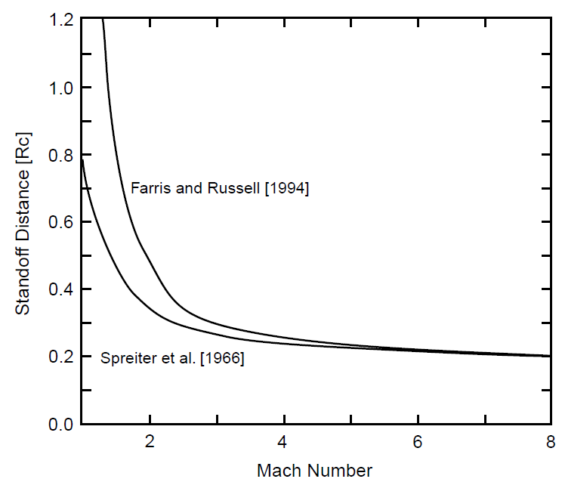


in situ estimates
Empirical formula to determine the standoff
distance, Δ, normalised by the distance, D_{OB},
from the centre of the Earth to the nose of the
magnetosphere
The radius of curvature can be rewritten for
ICMEs
For γ= 5/3 with high Mach number, Spreiter et
al. (1966) approximate relationship as:
While an approximation to satisfy low Mach
numbers developed by Farris and Rusell
(1994)
Formulism developed by Russell and
Mulligan (2002) Planet. Space Sci.

Slide 26
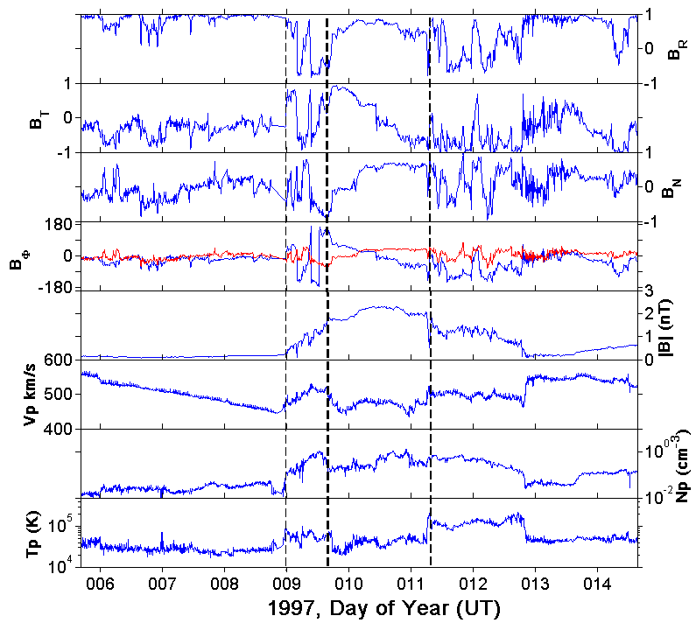
in situ estimates

Slide 27
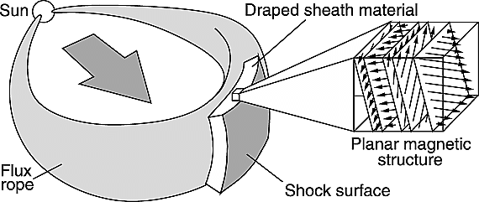
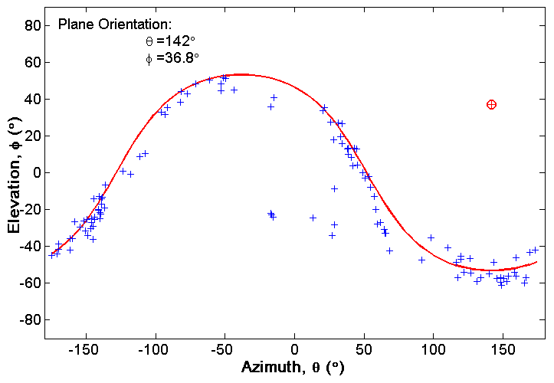
in situ estimates
Jones et al. (2002) GRL
Normal to shock front calculated
using Planar magnetic structures
MVA analysis studied over
sheath region
Eigen value ratios studied
MVA over shock front was used
for events where PMS were not
exhibited

Slide 28
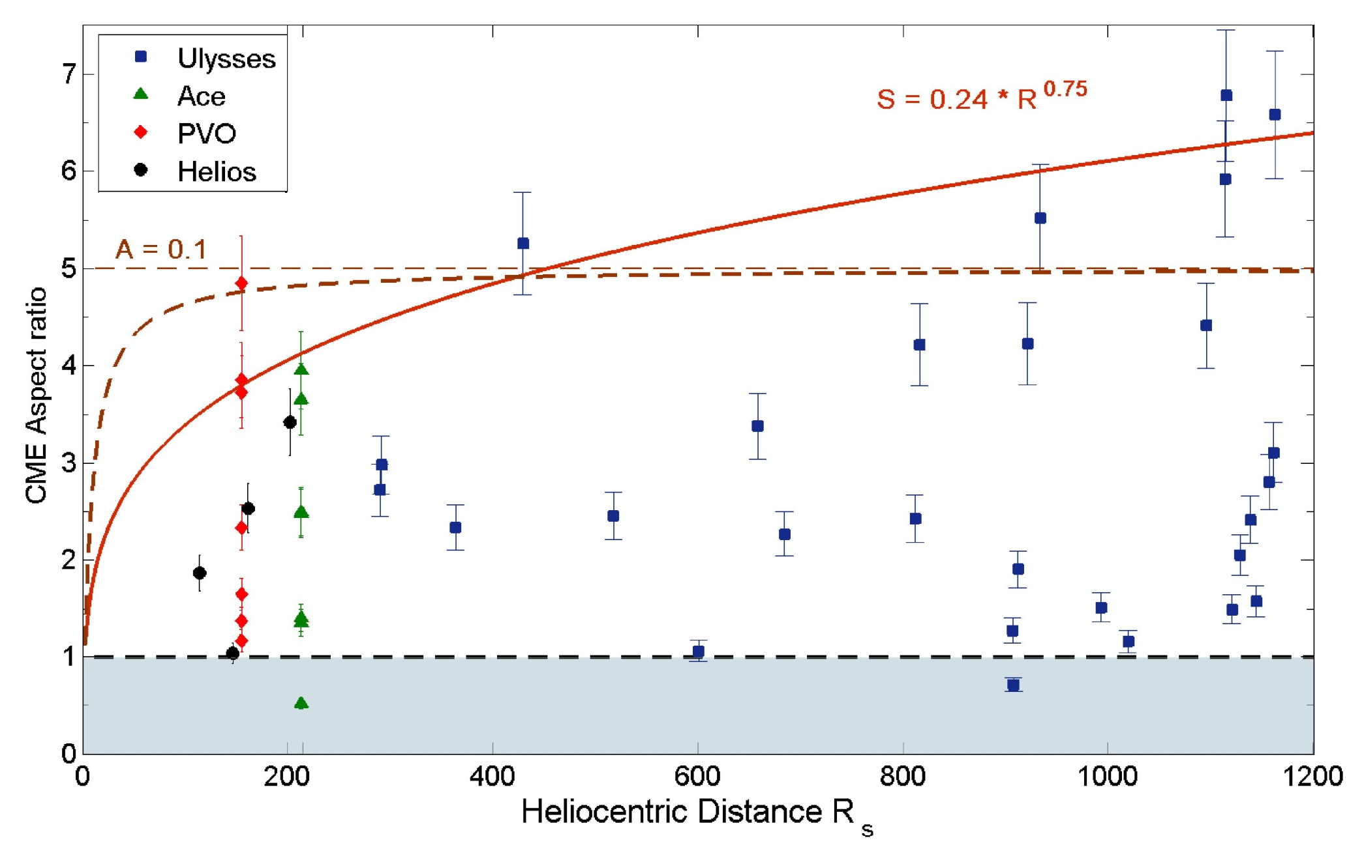
in situ estimates

Slide 29
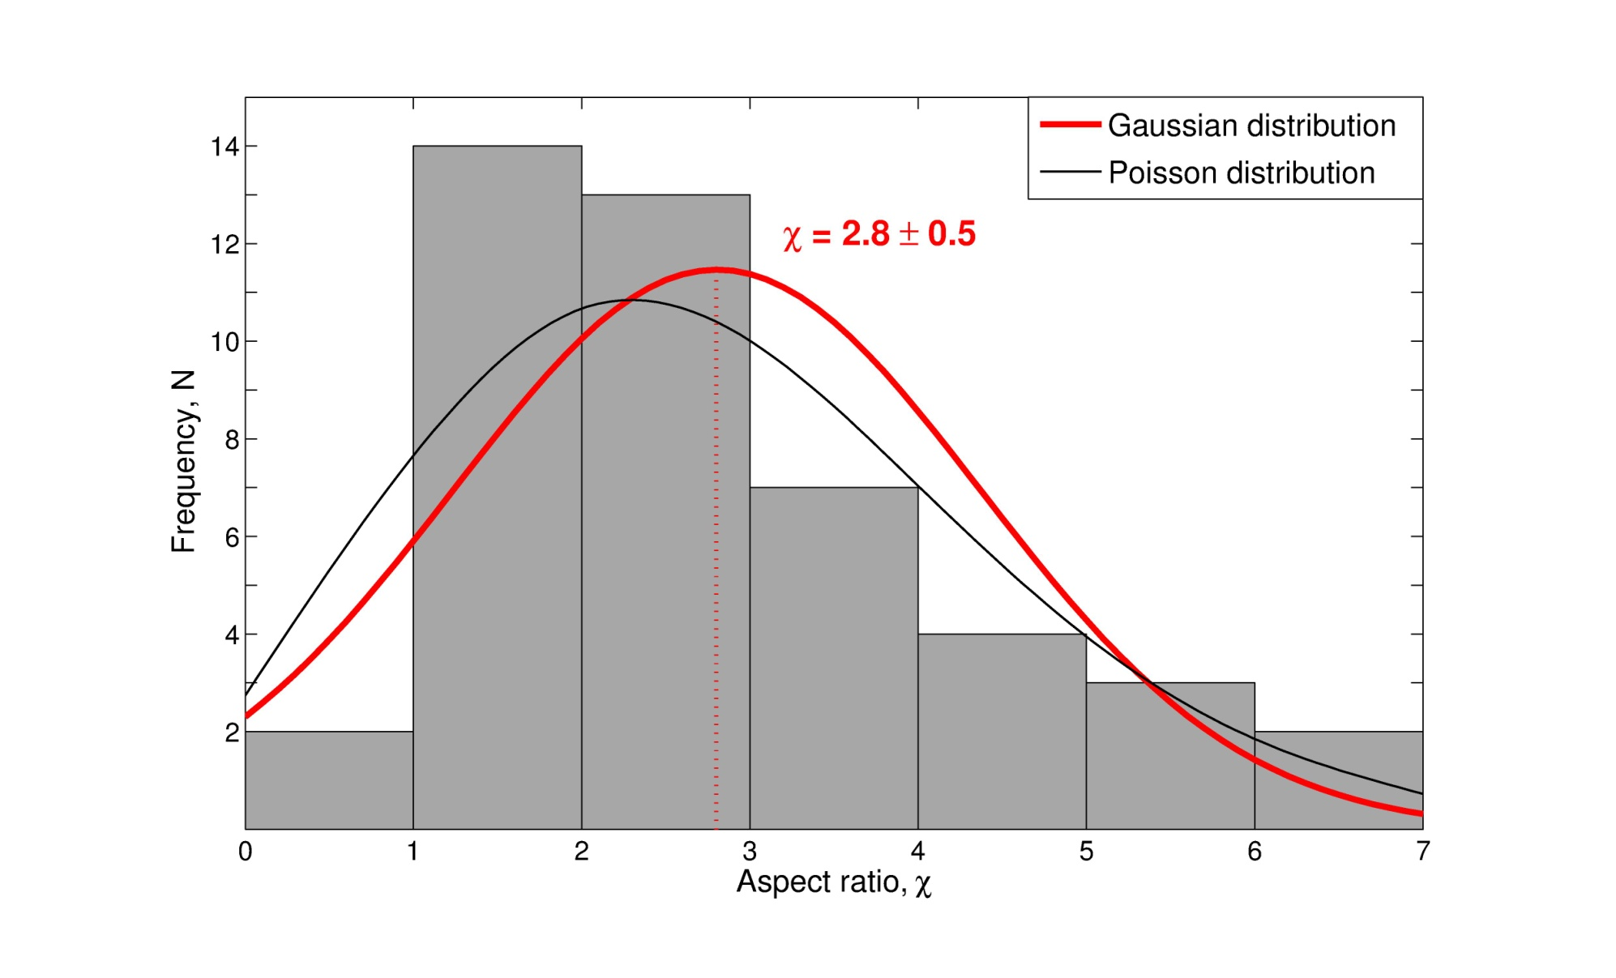
in situ estimates

