Slide 1
I. Predictions of
Reconnected Flux, Energy and Helicity in Four Eruptive Solar Flares
II. Active-Region Helicities Associated with Events from the CDAW List.
M. Kazachenko, R. Canfield, D. Longcope, J. Qiu
UC Berkeley – MSU, Bozeman, USA
CDAW 2011, Spain
Notes:
original work of the thesis, tool development; sunspot rotation.
Devote a slide to incorporating rotation; spin, braiding;
Maybe do MCC for dummies.

Slide 2
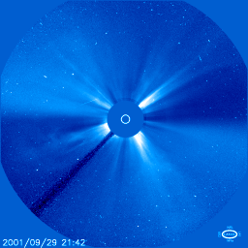
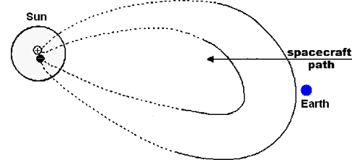
Coronal Mass Ejections
Notes:
Coronal mass ejections (CMEs) expel plasma and magnetic flux from the Sun into the interplanetary medium where they frequently interact with the earth atmosphere and cause major geomagnetic disturbances.

Slide 3
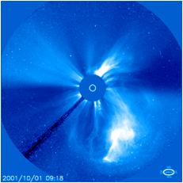
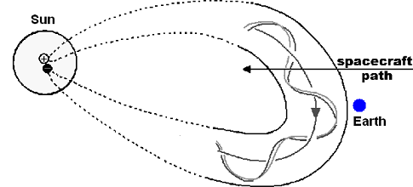
CMEs
Coronal Mass Ejections
ICMEs
>1/3
Non-Cylindrical structures
Magnetic clouds (MC)
Magnetic clouds (MC)
Quiet Sun structures
Active regions
(flares)
Magnetic clouds (MC)
Active regions
Notes:
They originate from structures in the quite sun filaments, coronal holes, dimmings and solar active regions. The 3D magnetic models and geomagnetic relationships are better understood for filament eruptions than for active region phenomena. However the most geoeffective CMEs have been found to originate from the ARs (see Gopalswamy 2010).
At 1 AU CMEs are observed in situ by satellites as interplanetary coronal mass ejections (ICMEs). At least one third or perhaps a larger fraction of the ICMEs observed in situ have cylindrical flux rope structures and are called magnetic clouds. In my study I focus on the magnetic clouds originating from the active regions only.

Slide 4
Flares
How are Magnetic Clouds related to flares?
MCs
axis orientation
magnetic flux
helicity
Compare!
axis orientation
magnetic flux
helicity
energy
energy
Notes:
Because flares are so energetic and geo-effective they have been always of large interest to solar physicists. Many studies have been done trying to compare and thus put into one picture the flux rope characteristics ejected at the solar surface (click) and near the earth (click).
From the observations of solar magnetic fields axis orientation, magnetic flux and helicity have been inferred and compared (click) with inferred MC global properties such as MC axis orientation, net magnetic flux, and magnetic helicity. In my dissertation I quantify magnetic flux (click), helicity (click) in both domains. And also find the lower limit for the magnetic energy released during the flare and compare it with energy losses.
Most of the quantities discussed here at the solar surface, such as magnetic flux reconnected in the flare, helicity of the ejected flux rope and magnetic energy cannot be inferred directly from the observations. However understanding and proper modeling of the FR formation process is required. click

Slide 5
Flux rope formation
To model CME flux rope properties we need to understand
How and When are the flux ropes formed?
Before flare Pre-existing
During flare
Formed in-situ
Emerge twisted
Formed by slow pre-flare magnetic reconnection
Fast magnetic reconnection during flare
Notes:
The are two groups of flux rope theories concerning the time when the flux ropes are formed, before the flares or during the flares. The first one, called preexisting fr model states that FR either emerge already twisted into the photosphere, or are formed in the low corona by a gradual physical process, such as slow magnetic reconnection and flux transport .
In the second model, the flux rope is formed {\it in situ} by magnetic reconnection. The magnetic reconnection violently re-organizes the field configuration in favor of expulsion of the ``in situ'' formed magnetic flux rope out of the solar atmosphere.

Slide 6

One slide summary
Hypothesis
MCs originate from the ejection of locally formed flux ropes.
Tools
Minimum Current Corona Model; magnetic cloud, ribbon, magnetic field and X-ray observations for four eruptive solar flares.
    Analysis
Compare!
Model predictions
Observations
magnetic flux
helicity
energy
Result:
Model works
magnetic flux
helicity
energy
Notes:
The working hypothesis in my thesis is that MCs originate from the ejection of locally in-situ formed flux ropes.
To test this hypothesis I first apply a unique of its kind quantitative non-potential self-consistent analytical \emph{Minimum Current Corona} model, which allows to find the properties the in-situ formed flux rope and then compare those with the properties from the observations.
Using MCC model with the SOHO/MDI data I construct a three-dimensional model of the pre-flare magnetic field and make quantitative predictions of the magnetic flux that reconnects in the flare, the magnetic helicity of the flux rope ejected in the two-ribbon flare and the energy the flare would produce. I then compare predicted energy and helicity to helicity and radiated energy loss, inferred from fitting the magnetic cloud (Wind/ACE) and GOES observations correspondingly. I compare the model reconnected flux to the amount of photospheric flux swept up by the flare ribbons using TRACE 1600\AA{} data and the poloidal MC flux inferred from fitting the magnetic cloud observations.
I find that results comply with the scenario in which the helical flux rope is largely in situ formed by magnetic reconnection in low-corona immediately before its expulsion into interplanetary space and describe the major sources of uncertainties in the methods/observations we use.
-cut: . In this case shearing and rotation of the photosphere magnetic flux concentrations before the flare lead to the buildup of magnetic stress which is removed during the flare by reconnection. As a result a magnetic flux rope is formed.

Slide 7
Presentation Outline
Introduction: Standard flare model: in 2D and 3D;
Flare energy storage and release.
Methods: Minimum Current Corona Model
Ribbon’s reconnection flux, Magnetic Cloud’s helicity, Energy losses from X-ray observations.
Results:
Comparison of predicted and observed flare properties.
Introduction Methods: MCC , Observations Data Results I Results II
Notes:
The outline of my presentation is the following: first I will introduce the standard model for the flare phenomenon, first in 2D and then in 3D. I will then talk about the energy stored before the flare and released in the flare. Afterwards I will talk about the methods I use to predict flare properties – the model and observations. And then results – first. the result of the application of the my improved method for taking into account sunspot rotation in the flare energy storage for two flares. And then the comparison of predicted and observed flare properties for four flares.

Slide 8
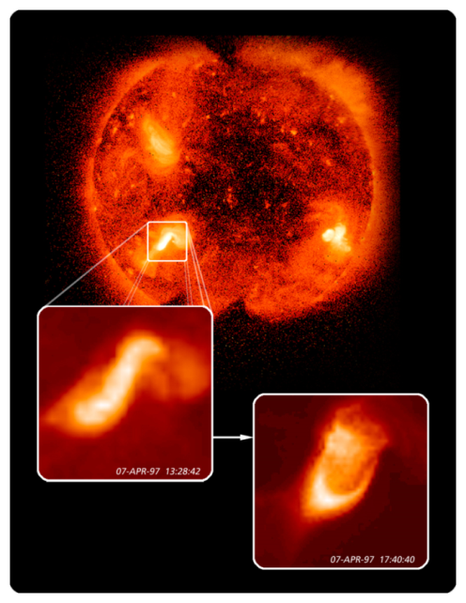
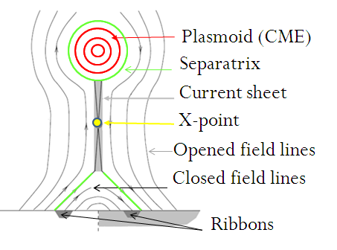
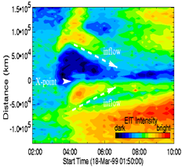
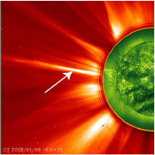
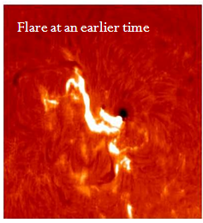
Standard 2D Flare Model
CSHKP (Carmichael, Sturrock, Hirayama, Kopp, Pneumann)
X-ray
Horizontal
inflows
2D Model cannot explain:
Ribbon propagation parallel to PIL.
Disconnected flux ropes.
before
Cusps
after
Current
sheet
Phenomenological
two-ribbon flare model.
LASCO
Hα
Ribbons
Quantitative evidence: Ribbon’s magnetic flux.
Ribbons
Introduction Methods: MCC , Observations Data Results I Results II
Notes:
Because of their relevance to space weather, the most energetic two-ribbon eruptive solar flares are among the most thoroughly studied cases of magnetic reconnection. The classic phenomenological 2D model of the two-ribbon flare/CME relationship is called the CSHKP model, since it builds on works by \cite{carmichael1964}, \cite{Sturrock1968}, \cite{Hirayama1974} and \cite{Kopp1976}. In this model, shown in Figure~\ref{fig:CSHKP} (left), oppositely directed field lines which form a loop (A) are separated by a current sheet (CS). The two field lines reconnect at a magnetic X-point (X) to create closed field lines (C) and a plasmoid (P) (flux rope ejected by a coronal mass ejection). The energy released by reconnection creates chromospheric flare ribbons (R) on either side of the polarity inversion line. As the volume of closed field lines increases, the reconnection point (X) moves upward and the flare ribbons move outward.
Since CSHKP appeared as a phenomenological qualitative model, it is not surprising that there is an overwhelming collection of flare observations that are consistent with it. The best evidence for the CSHKP-geometry is vertical cusp-shaped structure seen in soft X-rays after the flare. The cusp grows with time, and higher loops have a higher temperature, as predicted by continuous reconnection. The observational evidence also current sheet observations shown here and also discussed in Sabrina’s defense talk couple of weeks ago. There is also evidence for horizontal inflows of cold material from the side and two sources of hot plasma that move away from the X-point upward and downward \citep{Yokoyama2001,Chen2004}. Finally, the existence of two ribbons marking the footpoints of an arcade of loops in $H_{\alpha}$, EUV, and X-ray emissions is evidence for the loop structure, stretched into a third dimension.
Inspite, of this qualitative support of the CSHKP model, it has only recently found wide use in quantitative measurements. \cite{Forbes1984} proposed a general method for inferring the flux reconnected across the current sheet by measuring vertical magnetic flux swept up by $H_{\alpha}$ flare ribbons . One of the serious difficulties presented by the application of the CSHKP model to a broader range of quantitative measurements is the lack of an accepted three-dimensional quantitative generalization. In the 2D CSHKP cartoon reconnection is assumed to occur simultaneously along a line of X-points. However recent observations contradict the 2D model. Firstly, the flare ribbons propagate both perpendicular and parallel to the polarity inversion line. Secondly, hard X-ray sources which are assumed to be produced by electron precipitation from the reconnection site, generally do occur within the ribbon, but at a single point, which also tends to move along the ribbon rather than perpendicular to it. Finally, in situ observations of CME ejecta, particularly high-energy electrons which allow to infer the actual connectivity of the heliospheric field lines \citep{Feldman1975,Gosling1987} show that, rather than disconnected plasmoids, a CME produces a flux rope with two feet anchored back at the Sun even as its apex passes 1 AU.
Explaining those observations, especially the flux ropes, has led to a more faithfully three-dimensional picture.

Slide 9
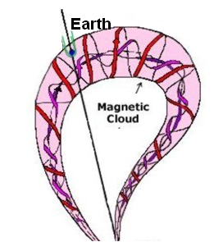
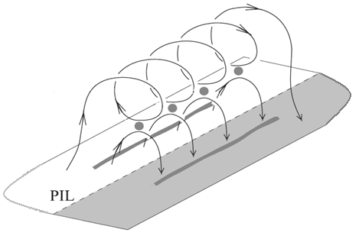

Standard 3D Flare Model
Poloidal flux, Φ_{P}
Flux rope
Reconnection flux, Φ_{rec}
If CSHKP model is true, then Φ_{P} ~ Φ_{rec}
Introduction Methods: MCC , Observations Data Results I Results II
Notes:
Similarly to 2D in 3D an active region is sheared along its PIL to build up stress. After this pre-flare buildup, magnetic reconnection occurs at several sites, called null points (X), eliminating some or all of the stress and creating 3D coronal loops (C) and a twisted flux rope (FR), the 3D analogue of the 2D plasmoid. Created FR escapes with a CME. % (e.g. \cite{vanBallegooijen1989}).
This model implies that a relation should exist between the flux reconnected in the flare that is swept by the flare ribbons (R) and the flux of the twisted flux rope carried away with a CME.
The problem is that only indirect information of the coronal magnetic field in the CME is available, mainly from magnetic extrapolations of photospheric magnetograms and from coronal loop observations. Direct magnetic field measurements in the CME are available only near the Earth, where they are observed in situ as ICMEs
Several authors have succeeded in matching the observations of the solar flares to different MC properties such as axis orientation, net flux, and helicity (see details in Chapter 4). However most of the works considered the properties of the whole active region rather than part of the active region which flares and contributes to interplanetary flux rope. Our contribution to this work is a quantitative model which distinguishes the flare's properties from the AR's properties.

Slide 10
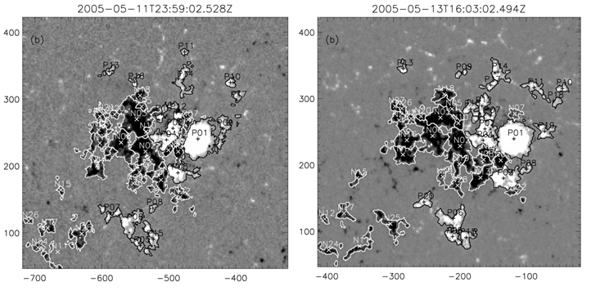
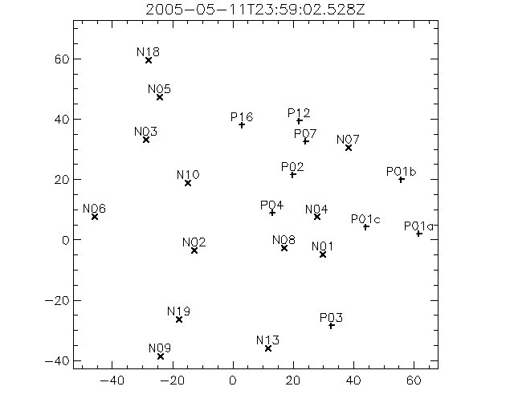
Following magnetic field evolution
Magnetic field evolution in 40 hr.
T0
T0+40 hr
Set of
magnetograms
LCT
Set of magnetic regions
Set of magnetic point charges
Magnetic point charge motions before May 13 2005 flare
Notes:
To track the evolution of magnetic fields prior to the flare we use a sequence of magnetograms. Using local correlation tracking technique we first derive the horizontal velocity field for all successive pairs of magnetograms and find a set of persistent in time magnetic regions. The example of partitioned magnetogram at T0 and T0+40 hours is shown on the Figure on the right. Then, we represent each partition at each time by a magnetic point charge, a unipolar point magnetic source surrounded by a field-free “sea”. The resulting sequence of the point charges is shown on the movie on the right (click movie).
November and Simon
Skeleton

Slide 11
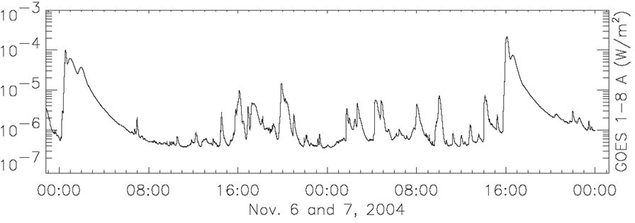
MCC: Magnetic stress buildup
T0
T_{flare}
Release
Stress builds up
Release
1
2
Reconnection relaxes field to potential.
No reconnection Constant Domain fluxes Non-potentiality builds
To preserve topology currents flow along separators
Reconnection
relaxes field to potential.
Notes:
Now when I introduced the idea of domains, separators, point charges, I could proceed to describing what is the main idea behind the MCC model. Consider a frequently observed case, where one active region has two consequent flares, like the one with a November 7 2004 X2 flare. The first flare would release the stress by magnetic field reconnection and relax the field to the potential field. After the second flare similar thing would happen.
Between the two flare the stress build-ups. Under the assumption that no reconnection, flux emergence or cancellation occur during that time, the domain fluxes could not have changed and the field could not have remained in a potential state. In this way the lack of reconnection leads to current flow along the separators and hence a storage of free magnetic energy, energy above that of the potential field, which could then be released by reconnection in the flare. To achieve the maximum energy release, the field inside the magnetic domains associated with the flare would need to relax to its potential state. Thus the Reconnected magnetic flux would then be the change of domain flux b/w two potential fields:

Slide 12
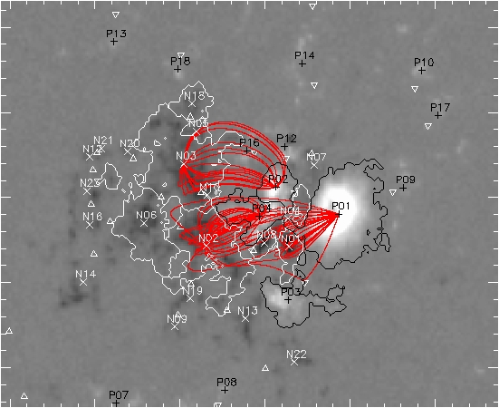
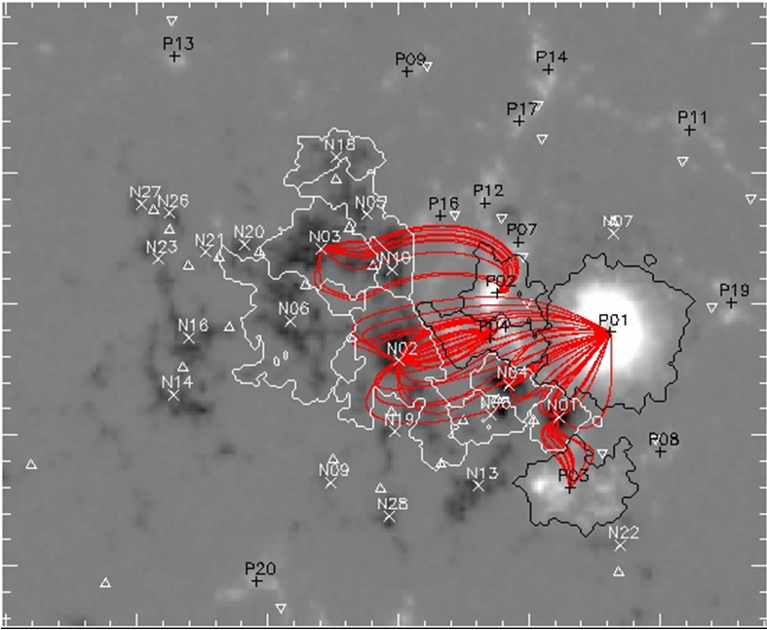
MCC: Magnetic stress buildup
T0
T_{flare}
Release
Stress builds up
Release
No reconnection
1
2
T0
T_{flare}
Φ_{r,MCC}
Notes:
…. at T0 and Tflare.
By summing all the positive and negative domain flux changes in the domains associated with the flare
we would then find the model (MCC) reconnection flux, that is the net flux transfer which must occur in the two-ribbon flare. We think that the transfer of this flux through reconnection is responsible for the flare.

Slide 13
Minimum Current Corona Model
(Longcope 1996)
Topology changes
Topology does not change
Topology changes
Charge motion. No emergence.
Currents build along separators
1
2
Field becomes
potential
Field becomes
potential
MDI,
TRACE
data
Reconnection flux, Φ_{r,MCC}
Flare magnetic energy, E_{MCC}
Flare Helicity, H_{MCC}
+
MCC
Notes:
Summarizing the MCC model idea: we track the motion of the magnetic regions between two flare which motions build-up stress. Since there is no reconnection happening b/w the flares and no emergence, current builds on the separators. By taking the difference b/w two potential magnetic fields we find the amount of flux which reconnected in the active region. From the set of point charges associated with the flare we find a set of flaring separators, i.e. separators connecting the nulls which lie on the flare ribbons. Provided that observed photospheric field may be approximated as discrete sources, the MCC permits ready calculation of a lower bound on the energy and helicity liberated by reconnection at the separators. The total helicity and energy over all flaring separators yields the total amount of energy and helicity released during the flare.

Slide 14
Predicted MC/flare properties
MDI, TRACE 1600 A
Reconnection flux, Φ_{r,MCC}
Magnetic energy, E_{MCC}
Helicity, H_{MCC}
+
MCC
Observed MC/flare properties
TRACE 1600 A
+
Ribbon motion
Reconnection flux, Φ_{r,ribbon}
Notes:
We compare model values derived from MCC, MCC reconnection flux, energy and helicity to observations.
For the observed reconnection flux ($\Phi_{r,obs}$) we use ribbon motions observations by TRACE in 1600\AA.

Slide 15
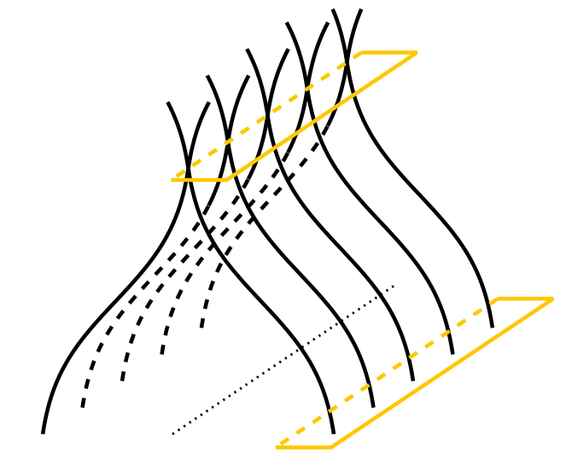
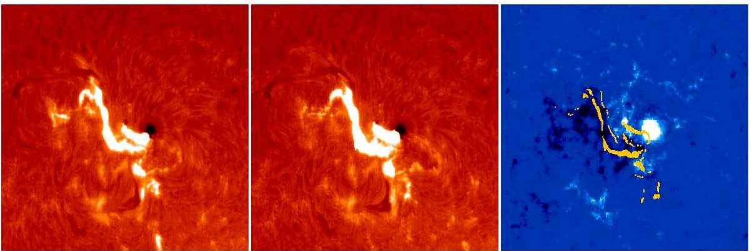
Observed reconnection flux
B_{C}
dA_{C}
B_{R}
Uncertainty: TRACE ribbon edge
Input: magnetogram + ribbon observations
dA_{R}
Flare at an earlier time
Flare at a later time
MDI magnetogram
dA_{R}
Notes:
To find the total magnetic flux that reconnected we need to know the magnetic flux in the reconnection site high in the corona. Impossible. However from the conservation of flux we can just use magnetic field swept out by moving ribbon to find the reconnection rate. To do that we count all pixels that brightened during any period of the flare and then integrate the unsigned magnetic flux encompassed by the entire area taking into account the height of the ribbon's formation, a $20\%$ correction (Qiu et al. 2007).
model: Forbes & Priest 1984

Slide 16
Predicted MC/flare properties
MDI, TRACE 1600 A
Reconnection flux, Φ_{r,MCC}
Magnetic energy, E_{MCC}
Helicity, H_{MCC}
+
MCC
Observed MC/flare properties
+
Reconnection flux, Φ_{r,ribbon}
TRACE 1600 A
Ribbon motions
GOES 1-8 A
+
Mewe radiative
loss function
Energy losses,
E_{GOES}
Notes:
For the observed energy value we take the total radiative energy loss of the flare using the observed fluxes in the two channels of the GOES instrument and temperature dependent Mewe radiative loss function.

Slide 17
Observed Energy losses
EM,
T,
E_{r}
Radiative energy losses: 1-8 Å and 0.5-4 Å + Mewe et al. 1985
Conductive energy losses:
Plasma thermal energy
Conductive timescale
L - separator length, V-volume
Enthalpy:
Bradshaw, Cargill, 2009
Input: magnetogram + 1-8 Å and 0.5-4 Å GOES measurements
Notes:
I calculate the observed energy as the sum of
given by the ratio between radiative and enthalpy cooling timescales

Slide 18
Predicted MC/flare properties
MDI, TRACE 1600 A
Reconnection flux, Φ_{r,MCC}
Magnetic energy, E_{MCC}
Helicity, H_{MCC}
+
MCC
Observed MC/flare properties
TRACE 1600 A
+
Ribbon motion
Reconnection flux, Φ_{r,ribbon}
Energy losses,
E_{GOES}
GOES 1-8 A
+
Mewe loss function
L=1 AU
MC poloidal flux Φ_{p,MC},
Helicity H_{MC}
Wind/ACE MC in situ data
+
Grad-Shafranov
method
Notes:
We also compare the MCC reconnection flux to the poloidal MC flux $\Phi_{p}$ derived from the fit to the MC ACE/Wind observations with the Grad-Shafranov reconstruction method. Qiu (2007) showed quantitatively that the reconnection flux from TRACE is very close to the poloidal flux of the MCs measure in situ. They interpreted this result in the framework of CSHKP-model as evidence of formation of the helical structure of magnetic flux ropes by reconnection, in the course of which magnetic flux, as well as helicity, are transported into the flux rope. We use this comparison as an additional test of the MCC method and the uncertainties in the MC fits (i.e. MC length).
Finally, we compare our the model MCC flux rope helicity with the helicity of the magnetic cloud associated with the flare using the Grad-Shafranov method (for all events) and the Lundquist together with the ACE/Wind observations.

Slide 19
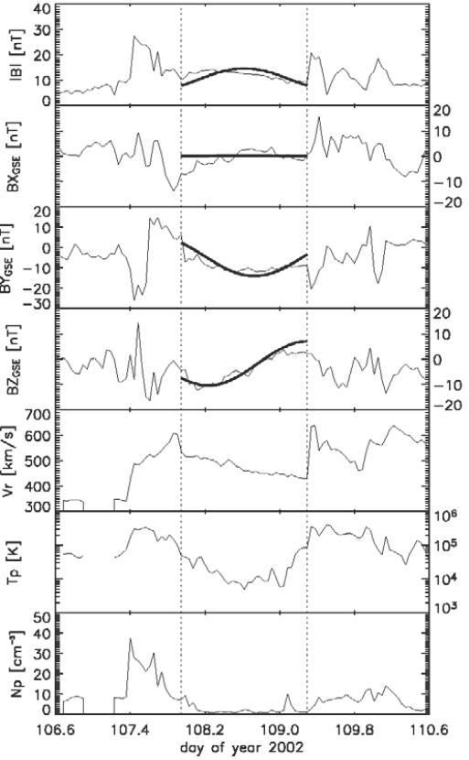
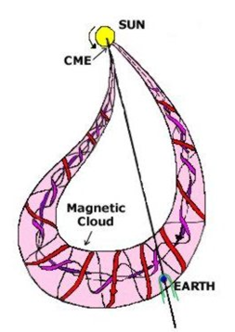
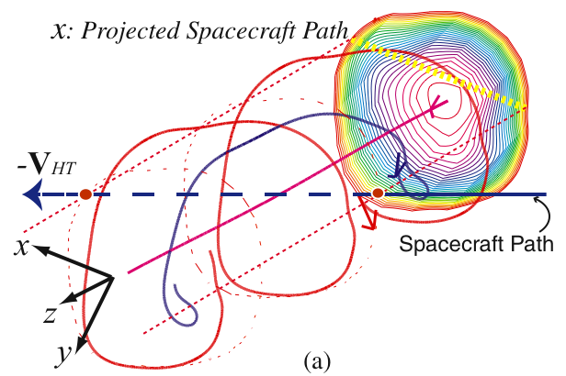
Observed poloidal flux and helicity.
Magnetic cloud:
Smooth field rotation
Enhanced B
Low proton T
Reconstructed flux rope
Uncertainty: Length
Notes:
To infer the MC helicity I use in situ observations of the MC shown on the right. The boundaries of the MC are defined from the definition of MC:
Slide of observations.
Burlaga (1981) found a MF structure in the solar wind and named it a "magnetic cloud". MC - solar ejecta where
1. B is higher, 2. proton T is low 3. MF vectors smoothly rotate. Goldstein (1983) - cyl FF flux rope model.
Marubashi (1986) - relationship bw cyl str and eruptive sol filament. Burlaga (1988) - const alpha FF field 4 internal
magnetic field config of flux ropes. Lepping (1990) - non-linear LSM to fit Bz variations to cons alpha FF field model.
Are FR connected or disconnected from the sun

Slide 20
Predicted MC/flare properties
MDI, TRACE 1600 A
Reconnection flux, Φ_{r,MCC}
Magnetic energy, E_{MCC}
Helicity, H_{MCC}
+
MCC
Observed MC/flare properties
TRACE 1600 A
+
Ribbon motion
Reconnection flux, Φ_{r,ribbon}
Energy losses,
E_{GOES}
GOES 1-8 A
+
Mewe loss function
L=1 AU
Wind/ACE MC in situ data
+
Grad-Shafranov and
Lundquist fit
MC poloidal flux Φ_{p,MC},
Helicity H_{MC}

Slide 21

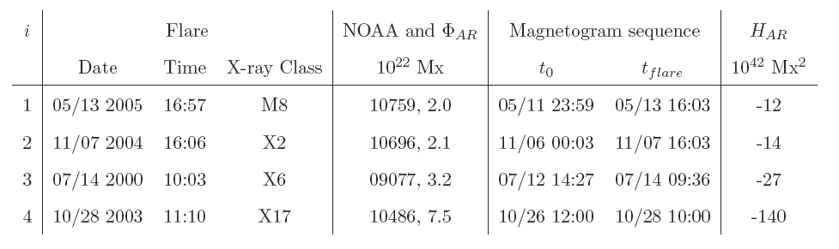
Data: Flares studied
Selection criteria
observations of both flare and MC
two successive flares (>M) in one AR
both close to the disk center
no significant flux emergence/cancellation
N_{cdaw}
53
-
19
45
Notes:
We apply the methods described in previous section to four eruptive flares. Limited number of events is governed by several flare selection criteria that we had to comply. Firstly, we selected only events which have good observations both of the flare and MC. Secondly, the AR associated with the flare of study needs to have one more flare in the beginning of the sequence in order to relax the AR's magnetic field to potential state. Third, the flare of study should happen close to the central meridian and the zero-flare should happen not further than 40 deg far from the central meridian. Finally, we select only flares associated with the AR with no flux emergence/cancellation.
In the table below we list date, time, X-ray class, AR number, AR magnetic flux, AR helicity flux, magnetogram sequence start and end times associated with each flare.

Slide 22
Results: I. Reconnected flux, energy and helicity in four flares.
Introduction Methods: MCC , Observations Data Results I Results II

Slide 23
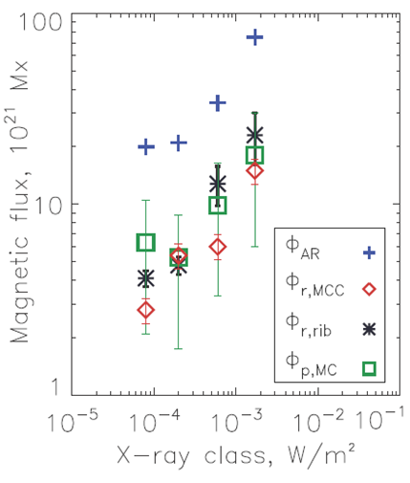
Results: Magnetic Flux
1. Φ_{r} ≈ [0.18, 0.49] * Φ_{AR}
2. Φ_{r,MCC} ≈ Φ_{r,rib} (for 2 and 4)
lower by 13% and 29% (for 1 and 3)
3. Φ_{p, MC} ~ Φ_{r}
  Results:
  MCC captures the lower limit of the reconnection flux.
Supports CSHKP model.
Predicted (Φ_{r,MCC}) and observed (Φ_{r,rib}) reconnection flux, magnetic cloud poloidal flux (Φ_{p,MC}), total AR flux (Φ_{AR} ).
Notes:
The main global property that describes the flare's reconnection is the amount of field lines which participate in the reconnection or the magnetic reconnection flux. The Figure on the left shows MCC and observed reconnection fluxes for each event, the AR average unsigned magnetic flux and the poloidal MC flux.
Firstly, the total AR flux gives an idea of the fraction of the magnetic flux that gets reconnected during the flare. It ranges in different flares from $15\%$ to $40\%$ of the total AR flux.
Secondly, In all four cases the MCC reconnection flux is lower or comparable to the observed reconnection flux. This gives some confidence that MCC correctly captures at least the lower limit of the amount of magnetic flux that got reconnected during the flare and hence the lower limit on the amount of energy released in the flare.
As for the poloidal MC flux, in all four cases it is similar or lower that the observed reconnection flux. According to the CSHKP model, on which the MCC model builds, reconnection contributes solely to the incremental poloidal component of the flux-rope model. Therefore, if the flux rope is formed in situ the poloidal MC flux should be comparable to the reconnection flux.
The uncertainties in the observed reconnection flux come from estimates of the misalignment between the MDI and TRACE data, ribbon edge identification and inclusion of transient non-ribbon features with the ribbon areas, MC fitting (MC length, boundaries)
To quantify misalignment contribution we perform a set of trials whereby magnetogram and 1600\AA{} images are offset by up to 2 MDI pixels. To find uncertainty due to the ribbon edge identification we perform the calculation for different ribbon-edge cutoff ranging from 6 to 10 times the background intensity.

Slide 24
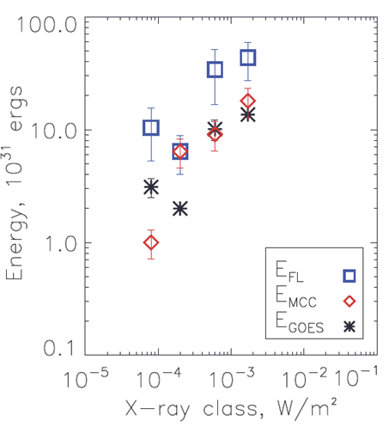
Results: Energy
1. E_{GOES}< E_{MCC} (2, 3, 4)
E_{GOES} > E_{MCC} (1, no zero-flare)
2. E_{GOES,}E_{MCC} ≤ E_{FL}
Results:
Shearing/rotation provide enough energy to account for conductive, radiative, enthalpy energy losses.
Predicted (E_{MCC}) and observed energy losses (E_{GOES}), flare luminosity (E_{FL}).
Notes:
Finding the lower limit of the magnetic energy released in the flare forms the basis of the MCC model. On the left figure we compare model energy from the MCC model with the observed time-integrated sum of radiative and conductive energy losses and the entalpy fluxes; I also show the estimated flare luminosity energy loss from GOES. In all four cases the MCC energy is comparable or larger than the observed GOES energy.
Since there is consistency between the MCC model and observed reconnection fluxes, we think that MCC reproduces the lower limit for the magnetic energy.
That means that MCC implies shearing/rotation provide enough energy to account for radiated energy loss.
One must keep in mind that there are several limits in the observed GOES and model MCC energy calculations. Firstly, the radiative energy loss from GOES observations is a fraction of the thermal energy; we neglect the other fraction of the thermal energy due to thermal conduction. In fact, the energy losses due to thermal conduction can be significant. In two case studies the conductive losses have been found to dominate the radiative losses by up to an order of magnitude (Raftery (2009), Longcope (2010)). Secondly, there is also non-thermal energy component which the GOES estimate does not take into account. Hence the observed energy that we use ($\mathcal{E}_{obs}$) is the lower estimate of the energy of the flare. The model energy estimate from the MCC model is a lower bound on the energy stored by ideal quasi-static line-tied evolution since it uses the point charge representation and hence applies a smaller number of constraints than the point-for-point line-tying. It can be shown that the energy stored by ideal, line-tied, quasi-static evolution will always exceed the energy of the corresponding flux constrained equilibria (Longcope 2001). Since the MCC is inconsistent with the assumption of photospheric line tying, this means that the MCC may be used to provide only a lower bound on the free magnetic energy.
Since we lack a detailed model of how energy stored as current on separators is converted to other forms (thermal, mass motions, accelerated particles) and there are only few studies quantifying the energy budget, it is hard to come to strong conclusions

Slide 25
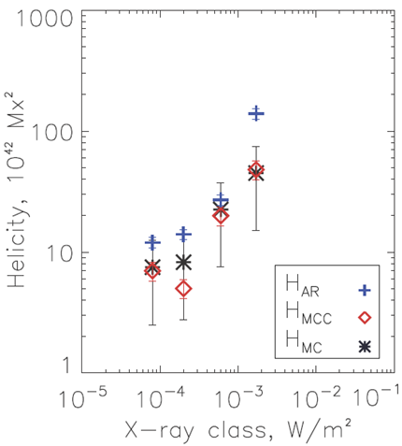
Results: Magnetic Helicity
H_{MCC,} H_{MC} < H_{AR}
H_{MCC} ≈ H_{MC}
Results:
No preexisting twist required in these events
Predicted (H_{MCC}) and observed helicity (H_{MC}), total AR helicity (H_{AR}).
Notes:
Because magnetic helicity is conserved in the corona, even in the presence of reconnection, it is instructive to compare $H_{MCC}$ to $H_{MC}$. Figure on the left shows the
relationship between the predicted ($H_{MCC}$, diamonds) and observed ($H_{MC}$, stars) values of helicity. The blue $+$s show the amount of the helicity for the whole AR
In all four cases we get MCC model helicities
that are of comparable magnitude and same sign as the observed MC values and are smaller than the helicity of the whole AR. Our analysis shows that preflare motions contribute enough stress to account for observed helicity values, however more accurate estimate of the MC length is required in order to lower the error bars in the MC helicities and improve our understanding of MC/flare relationship.
The properties of the magnetic field in a MC are determined by the initial conditions of the eruption which we derive with the MCC model as well as by how the MC interacts
with the interplanetary medium during its travel toward the Earth. Above we found a consistency between the MC flux and predicted model and observed flare reconnection fluxes,
the MC and predicted flare flux rope helicities, observed and predicted flare energy releases. The agreement between those supports our local in-situ formed flux rope
hypothesis.

Slide 26
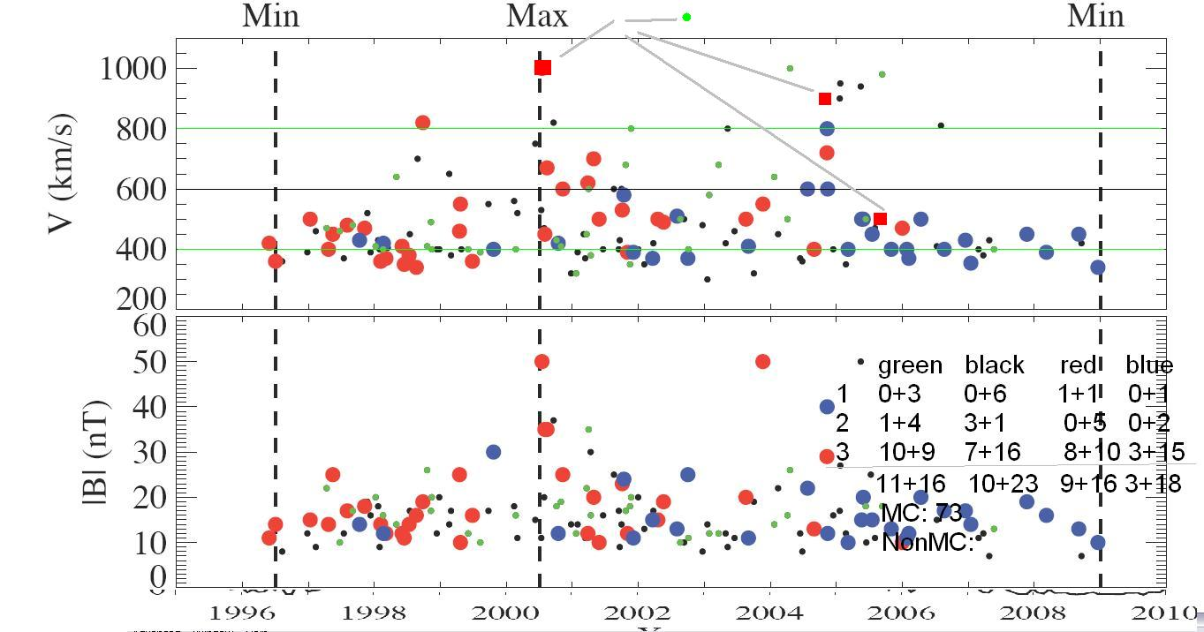
MC and Flux rope orientations
Blue circles – NS magnetic clouds, red circles – SN magnetic clouds
Yan Li et al. 2011

Slide 27
Summary
Main purpose of the study:
Understand the FR formation and its relationship with the MC
    Tool, Data
    MCC model + observations for four eruptive solar flares with MCs
    Results:
    In these four events, the MCC model is able to account for the observed reconnection flux, FR helicity and flare energy.
    It suggests that:
    FRs are formed in situ within the AR,
    No preexisting twist required.
Introduction Methods: MCC , Observations Data Results I Results II
Notes:
The main purpose of this study is to understand the mechanism of the CME flux rope formation and its relationship with the MC. The key of this study is a Minimum Current Corona model (Longcope 1996) which, using the pre-flare photospheric motions and flare ribbon observations quantifies reconnection flux, energy and helicity budget of the flare. In spite of its complexity, the model contains all the basic elements of the CSHKP flare scenario.
We apply this model to 4 eruptive solar flares that produced MCs and compare the model flux rope properties to the observations. We compare the MCC energy with the radiative energy loss from GOES observations and the model MCC helicity with the magnetic cloud helicity. As an additional test we compare the model reconnected flux from the MCC model with the observed reconnected flux from the TRACE 1600\AA{} observations and poloidal MC flux.
In these four events, the MCC model is able to account for the observed reconnection flux, FR helicity and flare energy. It suggests that:
FRs are formed in situ within the AR,
Flux emergence is relatively unimportant,
No preexisting twist is required.
To summarize, as a result of our study, we conclude that the modeling effort demonstrates that the simple two-dimensional model of CSHKP applies in detail to actual solar flares.
We would like to note that all 4 analyzed flares happened in AR's without flux cancellation/emergence during the stress buildup period. That means that all energy and helicity that we find is accumulated by shearing and rotating motions, i.e. photospheric evolution induces currents in already-emerged coronal magnetic fields that are sufficient to account for the observed flare energy and helicity.
We understand that 4 events is not enough for more confident conclusions and more cases should be studied. However even such a small study is valuable. The unique feature of our analysis is that we study not only the preflare magnetic field evolution (Chae 2010, Nindos 2003), but also consider the location of those photospheric motions in the topology of the flaring active region. As was shown by Kazachenko 2010, flares are not necessarily associated with the parts of the AR where most of helicity is injected; it is necessary to look at the helicity content of the flaring part of the AR to understand what role do preflare motions play in the helicity budget of the formed flux rope. To expand the current study we need systematic observations of both MCs and the flares (magnetograms, 1600\AA{}). We hope that with SDO observations and the feature recognizing tools this selection process would be easier. The study of the small flares with good MC's observations would be also very useful to estimate the errors and sensitivity of the MCC model.

Slide 28
II. Active-Region Helicities Associated with Events from the CDAW List.
Notes:
original work of the thesis, tool development; sunspot rotation.
Devote a slide to incorporating rotation; spin, braiding;
Maybe do MCC for dummies.

Slide 29
Data available
For each event in the list that is associated with a flare (49 out of 59) we have the following active region (AR) properties:
A sequence of pre-flare MDI (96-min) magnetograms, B(x,y);
A sequence of pre-flare velocities of the magnetic elements; V(x,y)
Evolution of the active region magnetic fluxes; Φ_{AR}
Evolution of the active region helicity fluxes. H_{AR}
Future: Application of the MCC model => flare helicity
All those data is stored in IDL as *sav files + plots are saved as *fits files.

Slide 30
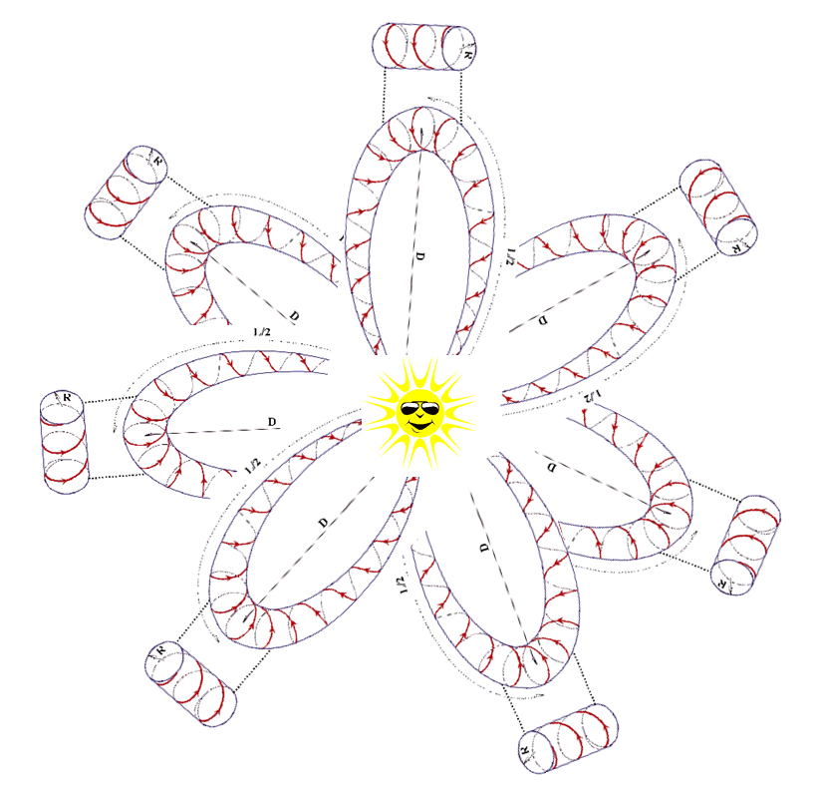
Questions?

