Slide 1
Flux-Rope CDAW: Overview
N. Gopalswamy

Slide 2
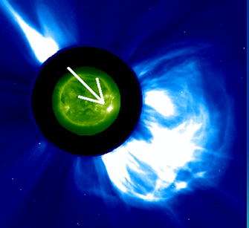
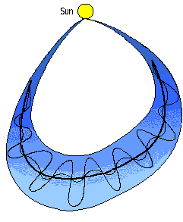
CME
Flare
Shock
MC
Sheath
Hypothesis: All ICMEs have
Flux rope structure
The observed difference
Between flux ropes and
non-flux ropes is due to
Different Sun-observer angles
Arguments in support
Deviations from this picture

Slide 3
ICMEs: Variation due to Geometry
Gopalswamy, 2006 SSRv

Slide 4
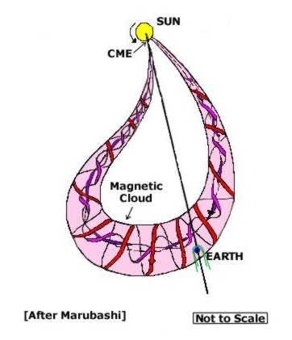
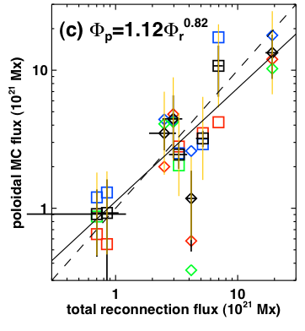
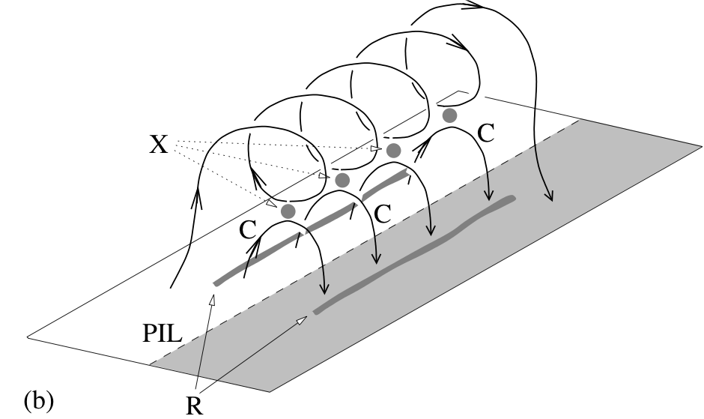
MC
CME
Earth
Φ_{P}
Marubashi, 1997
Hu et al. 02
Leamon et al. 04
Lynch et al. 05
Φ_{P}
Qiu et al. 2007
Post-eruption arcade with every ICME
Reconnection creates flux ropes and flare
arcades
No difference between MCs and EJ expected
Φ_{r}
ribbons
Longcope et al. (2007)
Yashiro, Hong

Slide 5
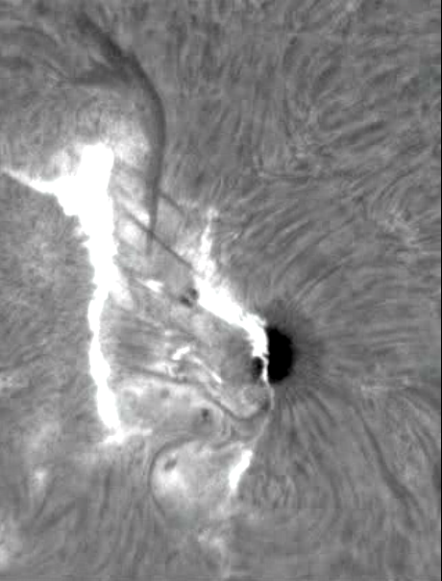
Chromospheric Change
15:43:10
18:01:31
F
R2
R1
Courtesy:. YurchyShyn

Slide 6
Eruption Geometry is also common to all ICME sources
PIL
D2
-
+
HXR, μ
HXR, μ
R2
R1
PEL
FR
D1

Slide 7
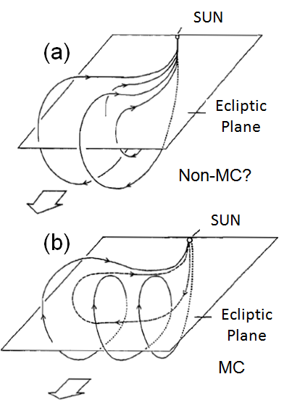
Flux-rope & Non-flux-rope Structures
The flux rope structure is formed by the reconnection of sheared loops at the Sun during the eruption.
How are the non-flux-rope structures formed? Do they have different flare geometry? By = 0?
Gosling 1990

Slide 8
If all ICMEs are Flux Ropes…
Geometry is key
MCs must be coming from the disk center
Non-MCs at intermediate angles
“Driverless” shocks at large angles from the Sun-Earth line – due to limb CMEs (Gopalswamy et al., 2001, 2009 JGR)

Slide 9
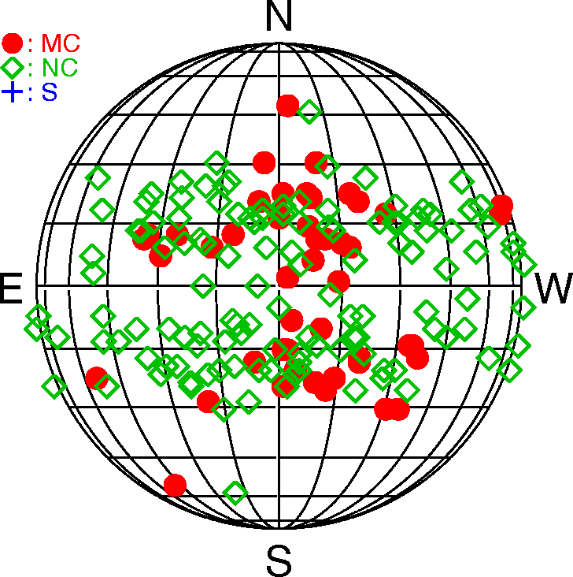
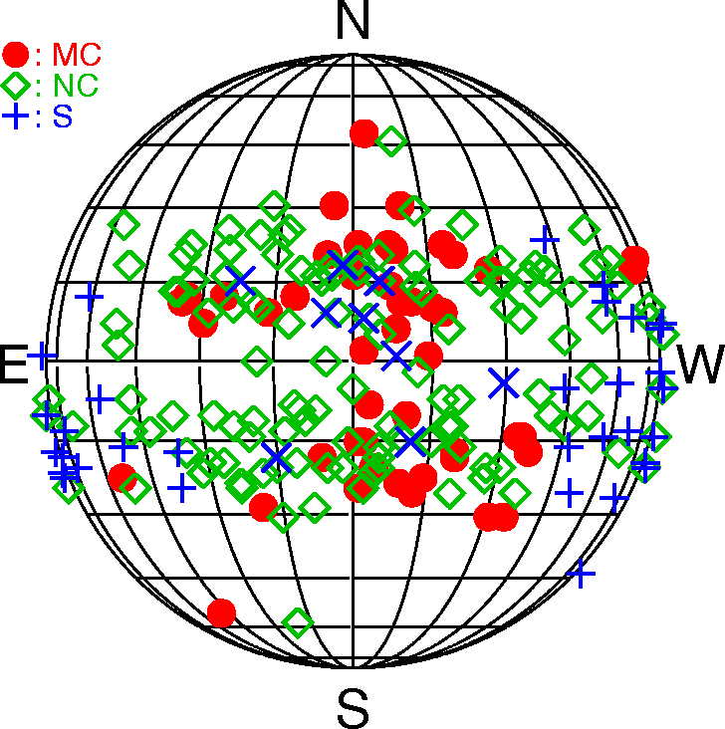
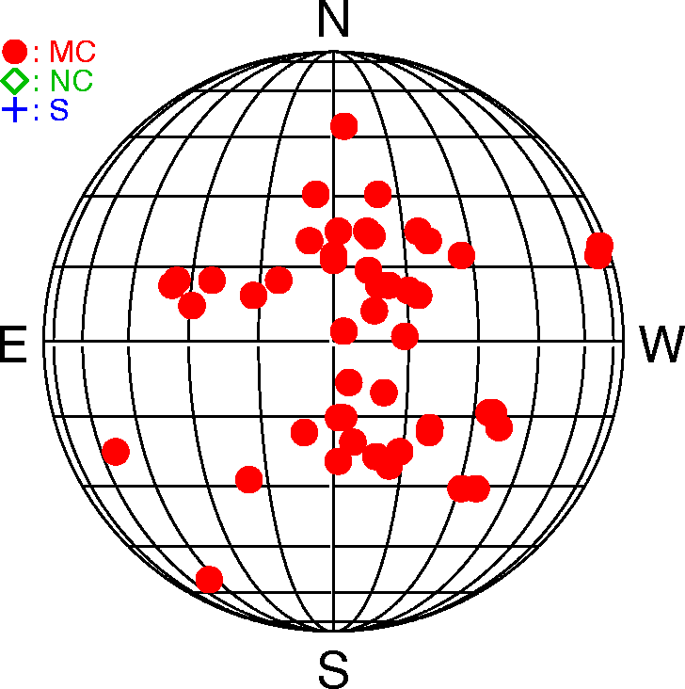
Solar Sources
MCs
Only a few sources outside
CMD ≤ 30º
Non-MCs (NCs)
Solar sources widely distributed. Most sources at CMD > 15º. Many exceptions
“Driverless Shocks”
Shocks without an ICME behind them. All we see is a shock and some sheath. Solar sources generally have CMD > 30º (+) except for a few central events (X).
Gopalswamy, 2006 SSRv

Slide 10
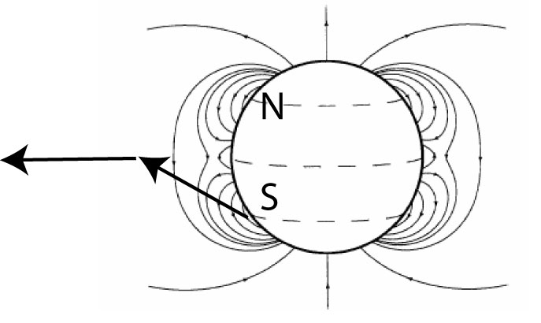
Higher MC Lat. in the Rise Phase
Gopalswamy et al., 2008
More MCs during the
Rise phase (Riley et al. 2006)
The global dipolar field guides
CMEs towards equator, so they
end up as MCs (geometrical)
Gopalswamy & Thompson 2000
Filippov et al., 2001
Butterfly diagram of CME source regions

Slide 11
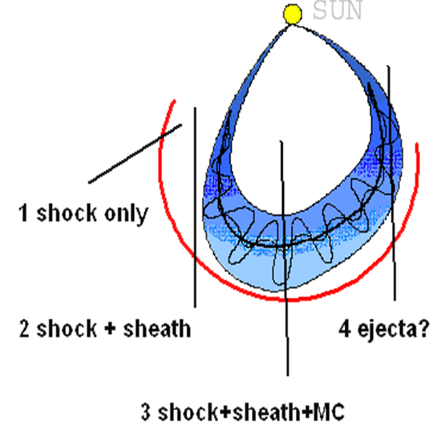
Solar Sources of “driverless” IP shocks (ICME not intercepted at Earth)
Max
Decl
Gopalswamy et al., 2001; 2009 JGR

Slide 12
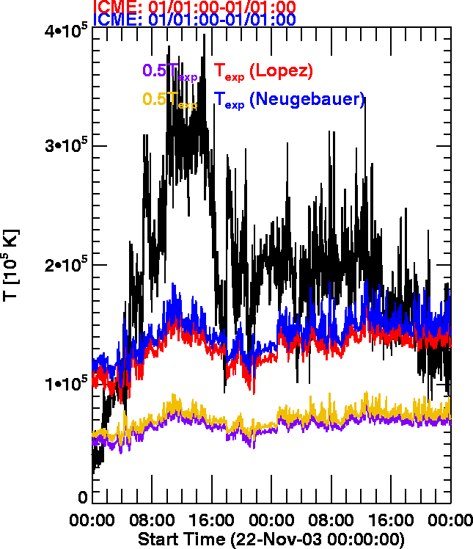
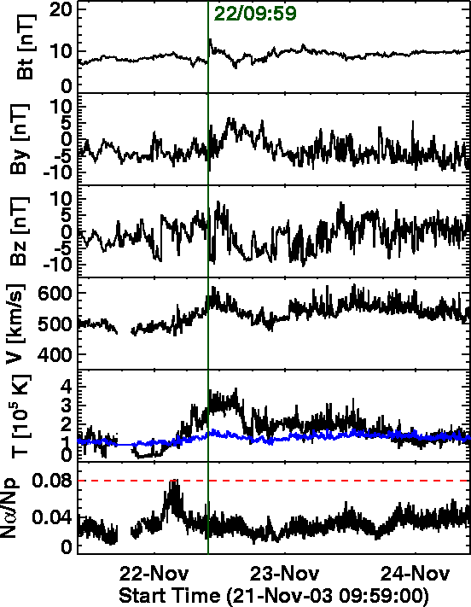
At 1 AU: Just the Shock & Sheath
+
Texp

Slide 13
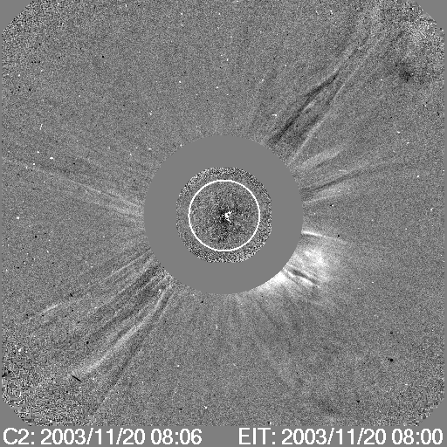
Some CMEs from Disk Center do not Reach Earth
F = CH area <B> r⁻²
N01W08
F
Mäkelä presentation: Coronal hole influence on MCs and EJ

Slide 14
Possible Deviations
Rise Phase: Global dipolar field is strong → Higher lat. CMEs may become MCs
Max Phase: more CME collisions → deflections & merger are common (complex ejecta) – needs systematic study
Declining Phase: More equatorial coronal holes → CMEs are deflected
Moon, Mäkelä

Slide 15
Flux Rope Deflection vs CHIP
Mäkelä et al.
CME deflection away from Sun-Earth line
CME deflection towards Sun-Earth line

Slide 16
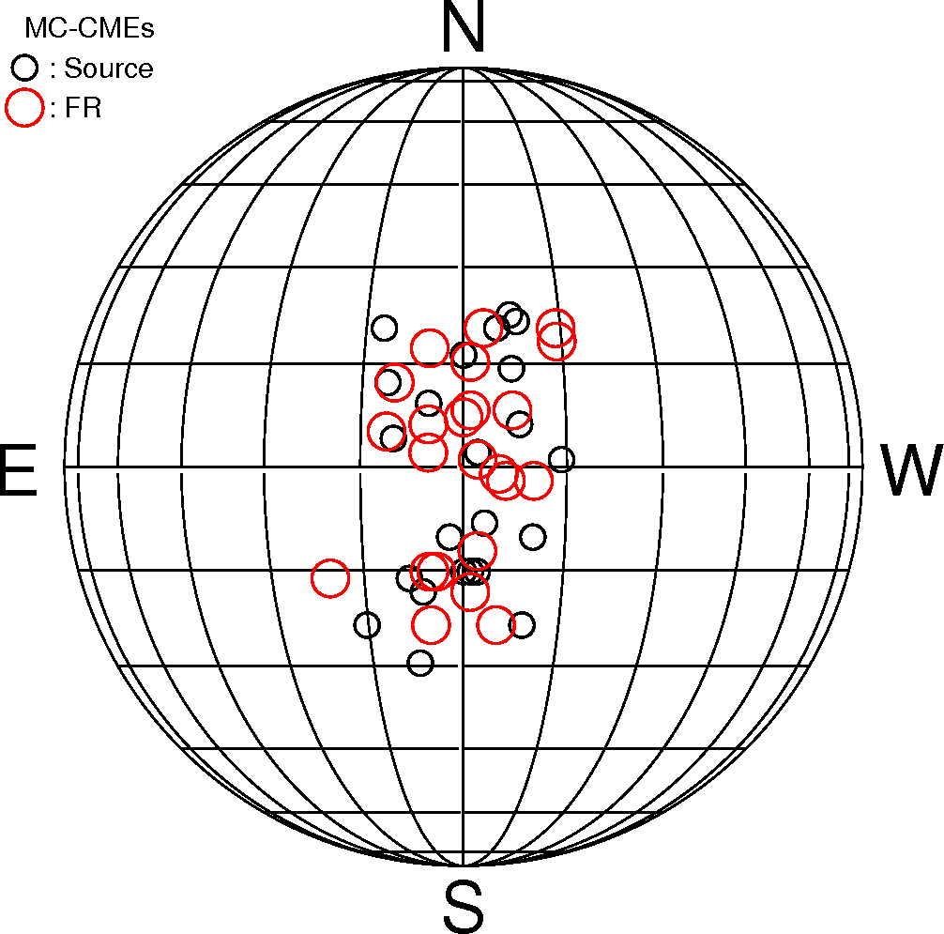
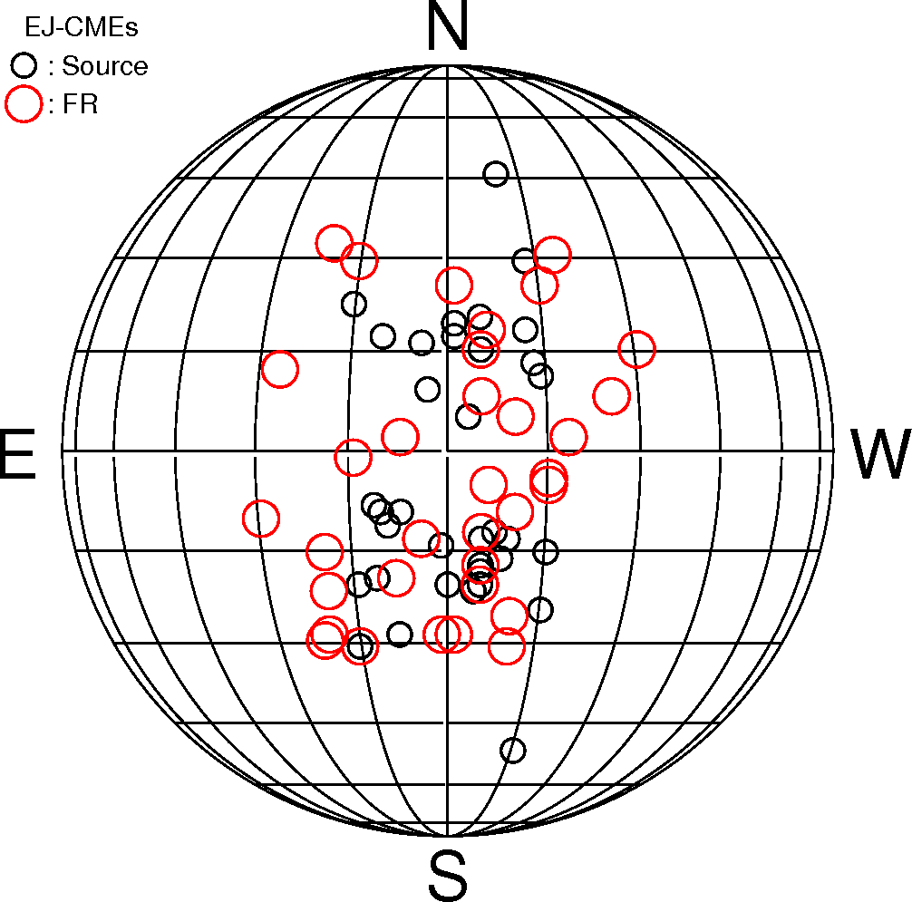
Flux Rope Fitting Near the Sun
MC
EJ
23 MC-CMEs
Fitted sources close to AR
35 EJ-CMEs
Fitted sources deviate from AR
Hong et al.

Slide 17
How to make Progress?
Consider Central Sources (CMD ≤ 15º)
All types are present in this zone: 24 MCs, 35 non-MCs and 5 driverless shocks
Driverless shocks explained as due to coronal hole deflection
This CDAW is to understand why so many central ICMEs are not MCs

Slide 18
What can we compare?
Solar sources: Active region properties, flare properties, neutral line orientation, filaments, …
CME properties: Kinematics, angular width, non-radial ejection, non-radial propagation due to deflection, CME interaction, …
ICME properties: magnetic (B, By, Bz), Plasma (V, Tp, Np), charge state (O7+/O6+ & <QFe>)
Modeling (flux-rope fitting to MC and non-MC events)
MHD simulation
Comparison with STEREO events
Others

Slide 19
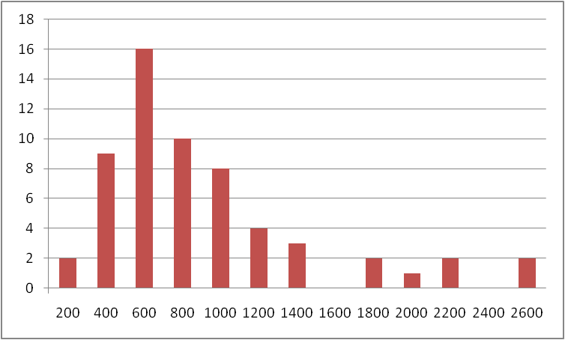
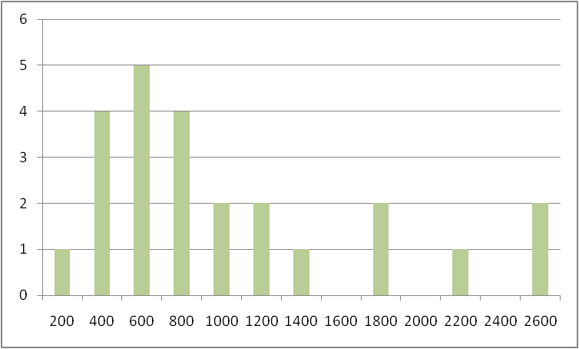
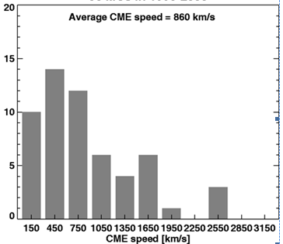
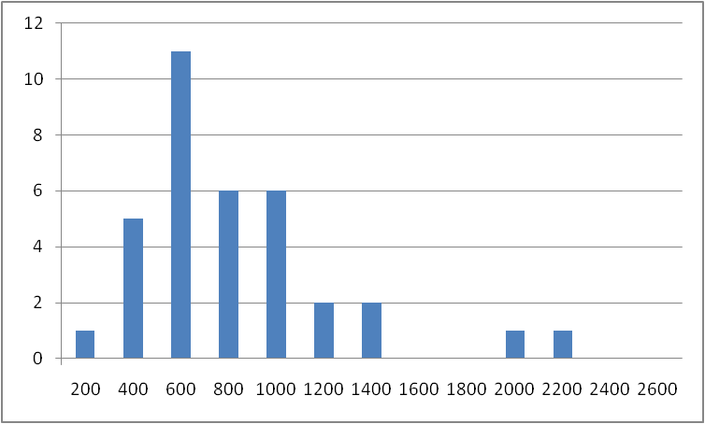
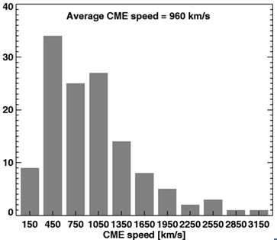
MCs and non-MCs have similar speeds
Central (CMD <15º)
ALL: <V> 815 km/s
General population (no long. Restriction)
MC: <V> 930 km/s
56 MCs
<V> 860 km/s
EJ: <V> 736 km/s
129 non-MCs
<V> 960 km/s

Slide 20
Angular Width
Fraction of Halos is a good indicator of the width of a CME population
75% of MCs (18/24) are full halos (W = 360º)
60% of EJ (21/35) are full halos
17 partial halos (6 MC; 14 EJ)
3 narrow (W < 60º) (MC – 59º; EJ – 40º; EJ – 45º) – incorrect identification?

Slide 21
Charge States
17 EJ: 2000 July 10
4.2
shock
SW
0.8
14
12
SW
EJ

Slide 22
Solar Wind Signatures: 2000 July 10 EJ
Magnetic signatures – not MC-like
SW Speed – not MC-like
Temperature – MC like
α/p : Good signature
β : not MC-like
<QFe> enhanced
Oxygen ratio: one of the highest

Slide 23
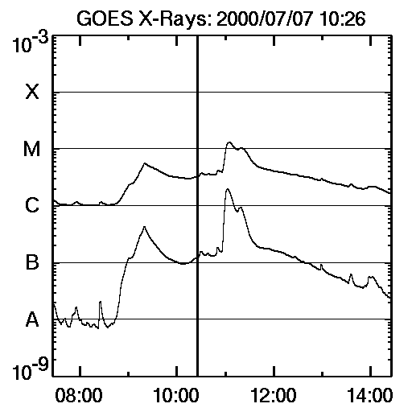
17 EJ: Solar Source
C5.6
N17E10
Halo CME
453 km/s

Slide 24
39 MC: 2002 May 18
SW
SW
The only MC event with no charge state signatures

Slide 25
2002 May 18 MC: No O, QFe Signature
Magnetic signatures – MC-like
SW Speed – MC-like
Temperature –Not MC like
α/p : Not a good signature
β : MC-like
<QFe> No Signature
Oxygen ratio: No Signature

Slide 26
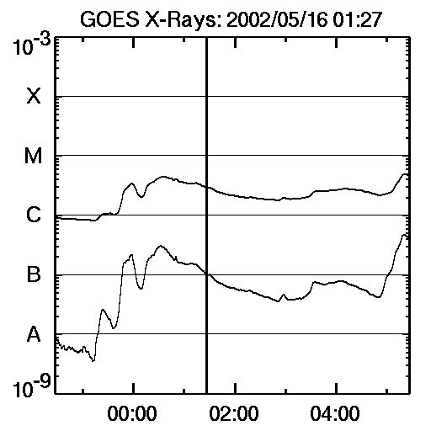
30 MC: Solar Source
S23E15
C4.5
Halo CME
600 km/s

Slide 27
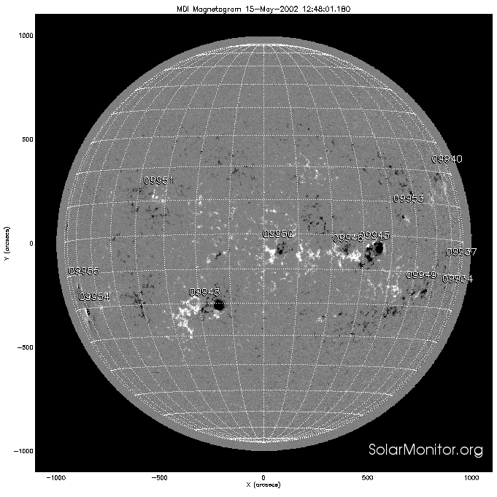
Solar Source: magnetic Field
2000 July 10 EJ
2002 May 18 MC

Slide 28
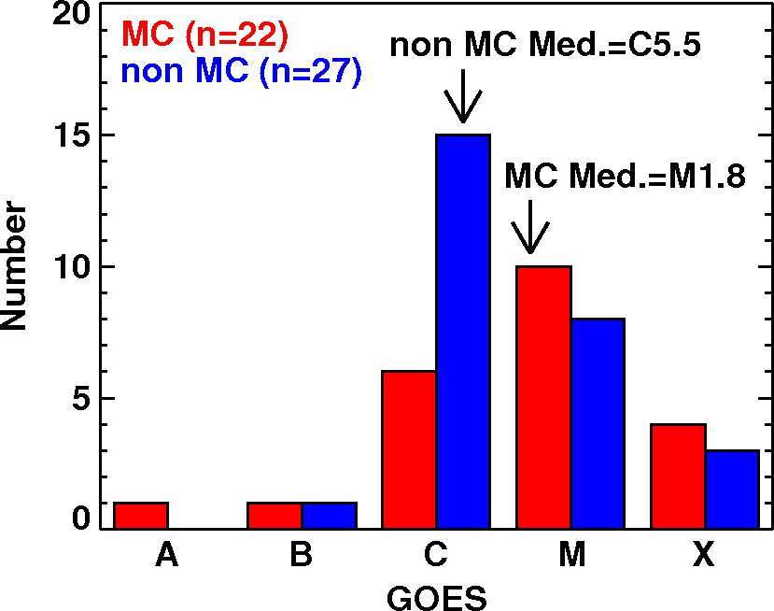
Flare size
EJ flares slightly weaker

Slide 29
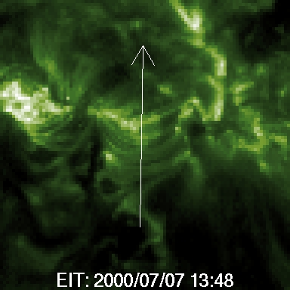
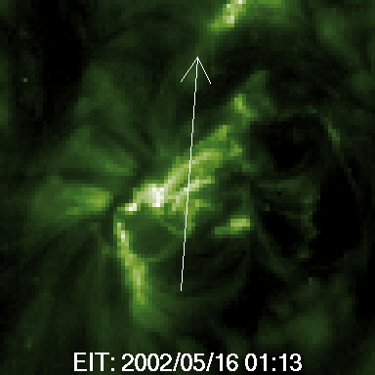
Post-eruption arcades
MC
EJ
less number of loops?
less number of turns in the flux rope?
Yashiro et al.

Slide 30
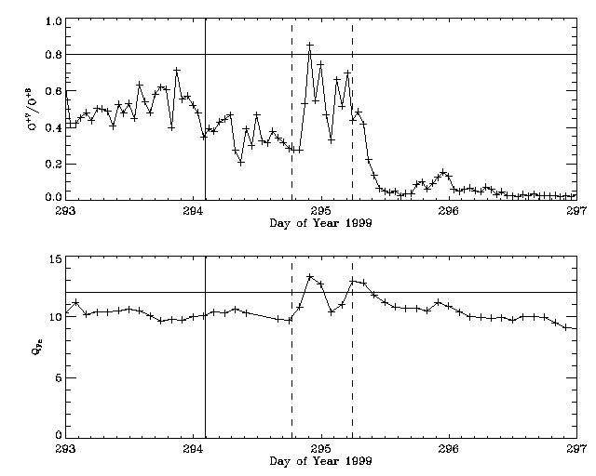
EJ: O7/O6 & QFe
1999 09 22
1999 10 21

Slide 32
Almost all of the MCs had enhanced O7+/O6+ and <QFe>
ICME Type | O7/O6 Enhancement |  | QFe Enhancement
 | Y | N | Y | N
MC | 21/22 (95%) | 1/22 (5%) | 20/22 (91%) | 2/22 (9%)
EJ | 18 /33 (55%) | 15/33 (45%) | 16/33 (48%) | 17/33 (52%)
ICME Type | Average O7/O6 Enhancement | Average QFe Enhancement
MC | 2.7 | 15.4
EJ | 1.7 | 14.4

Slide 33
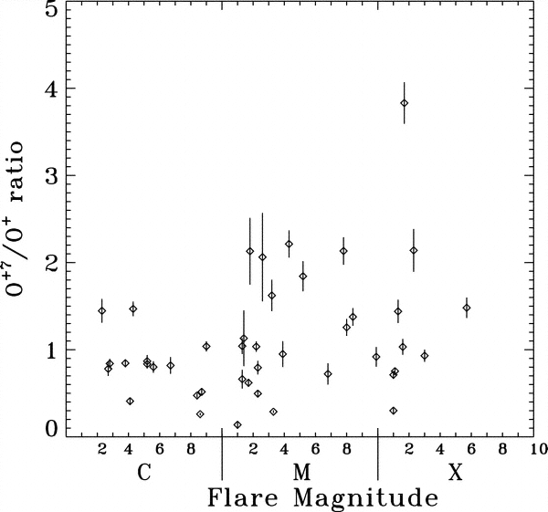
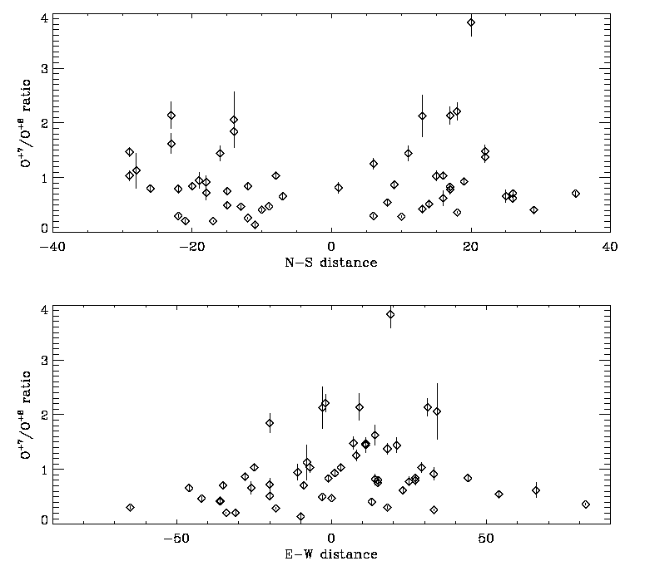
O7+/O6+
Reinard 2005
High charge states
for disk-center events
Disk Center events
become MCs
Temperature increase in the source: RC
Henke et al. 2001
Notes:
Charge state enhancement is an important indicator of ejecta. The high charge state is a result of injection of high charge state into the flux rope from the flare site. The observing spacecraft need to pass thru the flux rope to observe the high charge state. Bigger flares are hotter, and more likely to produce higher charge state. Also higher charge state in disk center events.

Slide 34
Central O⁷⁺/O⁶⁺ compared with all events
The Oxygen ratio is
higher by ~60% for MCs
compared to Ejecta
The ratio for CDAW events is higher than that for the general population
(CDAW events are from disk center)
MC
2.7
EJ
1.7

Slide 35
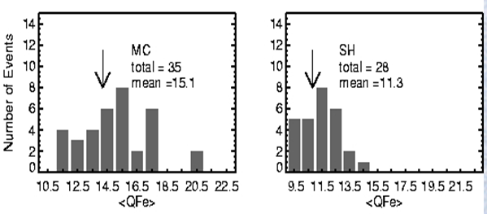
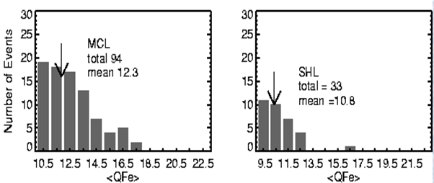
Central QFe Compared with all Events
CDAW: 15.4
Magnetic Cloud
MC Sheath
MC values consistent with the
previous events
Ejecta values slightly higher probably
because we consider only disk-center events
Question: High QFe Ejecta magnetic clouds
classified mistakenly?
CDAW: 14.4
Cloud-like
CL Sheath
Gopalswamy 2006
Notes:
Main point of this slide: RC makes the flux rope. Reconnection also injects hot plasma into the flux rope. The hot plasma means higher charge state at 1 AU because the charge states are frozen as the flux rope starts expanding. When the eruption occurs near the disk center, the observing spacecraft is likely to intercept the flux rope with high charge state

Slide 36
Charge State Analysis
Nearly all MCs have high O7+/O6+ ratio (> 0.8) and average Fe charge state (<QFe> > 12)
Only ~half of non-MCs have high O7+/O6+ and QFe
<QFe> _{MC} ~ 1.07 <QFe>_{EJ}
< O7+/O6+>_{MC} ~ 1.6 < O7+/O6+> _{EJ}
Comparison with the general population (including non-DC events)

Slide 37
Are all CMEs are Flux ropes?
Consider Central Sources (CMD ≤ 15º) 24 MCs, 35 non-MCs. Why so many central ICMEs are not MCs?
Flux ropes can be fit for 31/35 non-MC events if different boundaries and multiple flux ropes are used
The four events without flux rope structure seem to be poor events (short duration, poor magnetic and plasma signatures)
Coronal flux rope fitting suggests (at least for a subset) non-MC events become non-central during propagation
All MCs have high charge states; half of non-MC events have high charge states
Direction parameter seems to be high for MCs. Need to be recomputed excluding the shock
There is increasing evidence that all ICMEs may be flux ropes
(Based on Flux Rope CDAW, Sep 21 -25, San Diego, 2010)

